Slide 1
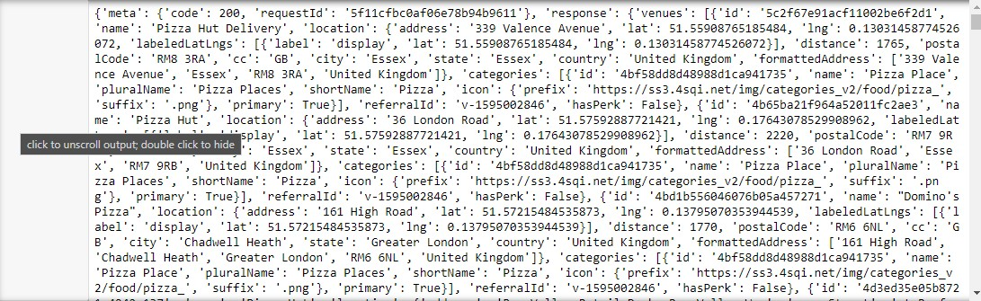
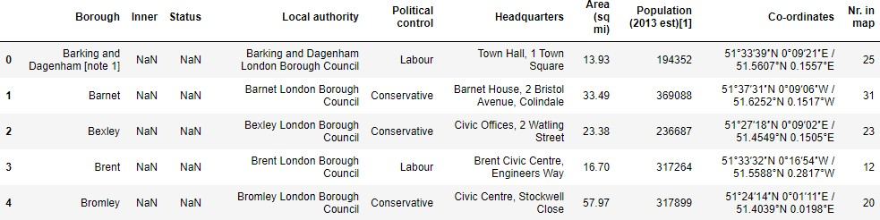
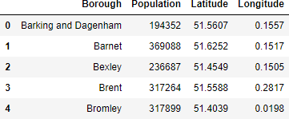
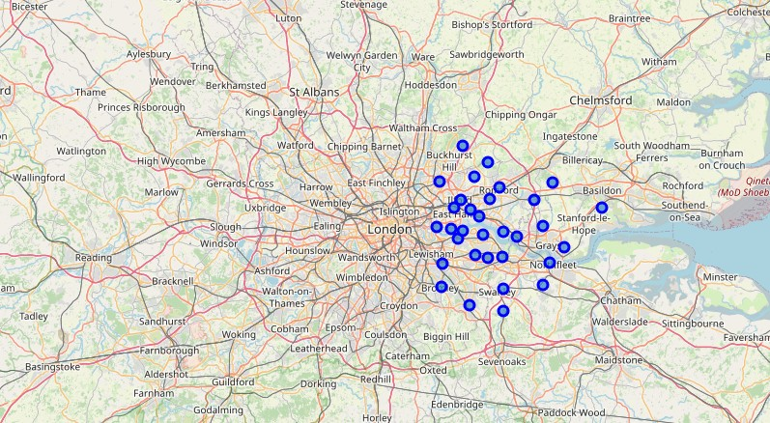
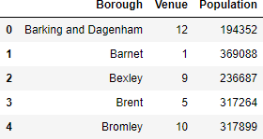
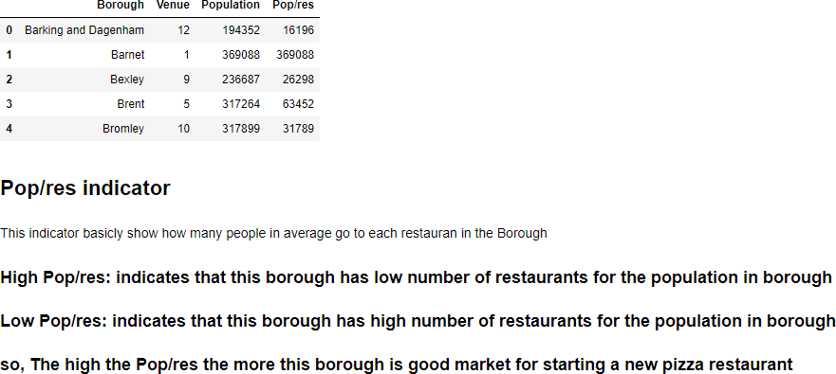
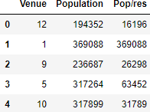
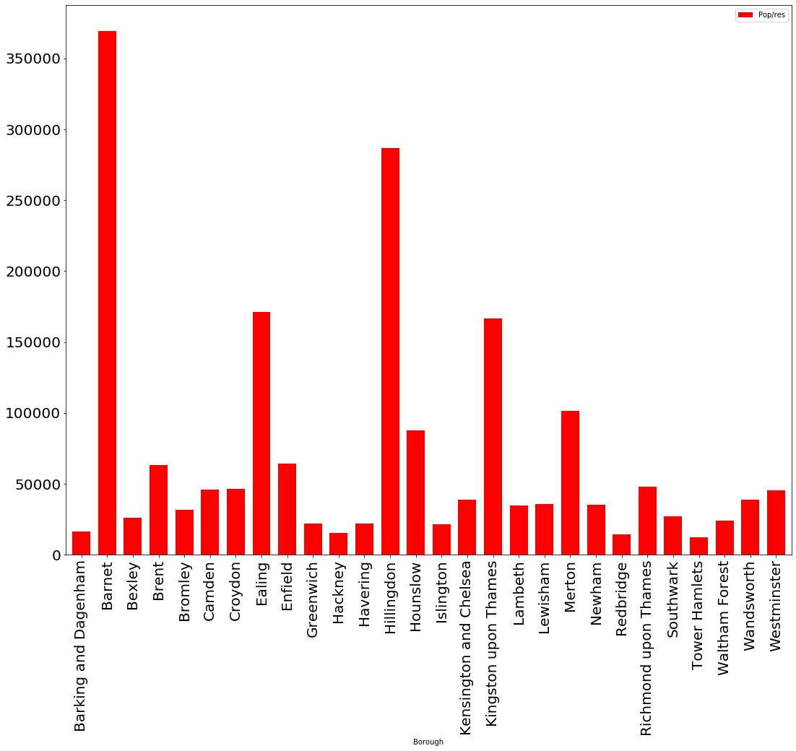
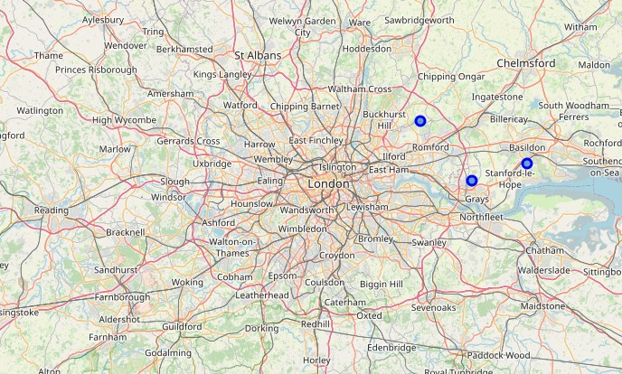
Report
Introduction & Business Problem :
Problem Background:
The restaurant industry in London is growing exponentially, every street is filled with every variety of restaurant, fast food place and pub; every type of food is available from classic European cuisines, primarily Italian, Spanish and French, to more exotic foods originating from Asia or South America. Demand, in the culinary industry, has become extremely high and as a result so has extent of competition to open a restaurant or cafeteria in a supposedly ‘cool’ area of the city.
So it become harder to choose location of new restaurn today espashily in big city like London
Problem
Pizza industry has grown up a lot in the last few years because the love of this dish along different people, so this industry is not only about food but also about the place of restauran because if you failed at your first branch you probably not going to success in the industry
So, the main purpose of the problem is to suggest a borough for a customer who want to open a pizza restaurant in london and suggest places for the new branches in the future
Target Audience
As the pizza industry is very big and has a lot of aspects to make successful name in this fiels all customers aim to open a restaurant where big number as possible can see in their street and at the same time this place has a weak competation as the restaurant will have hards at first to establish his name among people so my target audience will have a lot of interest in this problem because no one want to start his new industry badly because it will make him regret a lot in the future so the audience will need to have a solve to this problem here where my project come
Another point important for target audience is that my project also suggests the best places to open new restaurants in the future which is may be very considering for the customer
Success Criteria:
The success criteria of the project will be a good recommendation of borough/Neighborhood choice to The customer Ltd based on Lack of such restaurants in that location and recommend good places for the future branches
Data:
City will be analysed for the project is: Londaon
We will be using the below datasets for analysing London:
Data 1:
Neighborhood has a total of 32 boroughs. In order to segement the boroughs and explore them, we will essentially need a dataset that contains the 32 boroughs and the latitude and logitude coordinates of each borough.
The dataset also have population data about each borough so it will help in solving this problem example for data before cleaning it:
This dataset exists for free on the web. Link to the dataset is : https://en.wikipedia.org/wiki/List_of_London_boroughs
Data 2:
London geographical coordinates data will be utilized as input for the Foursquare API, that will be leveraged to provision venues information for each borough. We will use the Foursquare API to search pizza restaurants in each London borough.
example of data:
Mathedology
1. We begin by collecting data about London Boroughs from this link 'https://en.wikipedia.org/wiki/List_of_London_boroughs'
1. We cleaned Data and Remved unwanted Columns
1. Use geopy to get coordinates of London "The geograpical coordinate of London are 51.5073219, -0.1276474."
1. Create a map of London with Populataion superimposed on top
1. Get the pizza restaurants in each borough from Foursquare API
1. Make new Dataframe contain info about pizza res in Boroughs
1. Analyze each Borough By Pop/res
1. Pre-processing for ML k-means Algorithm
1. Modeling using scikit learn and got this labels [0 1 0 0 0 0 0 1 0 0 0 0 1 0 0 0 0 0 0 0 0 0 0 0 0 0 0 0]
Results
So we can know which borough is recommended to open pizza restaurant and where to open new branches
First the following graph indicates that the best place is 'Berent'
Seconed the following map indicates where to open new branches
Conclusion:
There is always room for improvement and hence the above solution I have provided can also be improved for best results depending upon the data we have.
In [ ]:

