Slide 1
Patient monitoring IoT device
Atanas Atanasov 12V

Slide 2
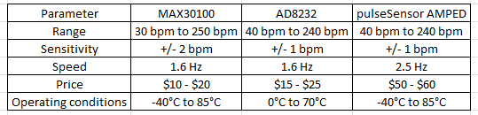
Sensors and actuators
Heart rate sensors:
MAX30100 Heart Rate and Pulse Oximeter Sensor Module (MAXIM Integrated) (Selected)
AD8232 ECG Sensor Module (Analog Devices)
pulseSensor AMPED (PulseSensor)
Pulse oximeter sensors:
MAX30101 Pulse Oximeter and Heart-Rate Sensor Module (MAXIM Integrated)
MAXREFDES117# Pulse Oximeter and Heart-Rate Monitor (MAXIM Integrated)
MAXREFDES131# Pulse Oximeter and Heart-Rate Monitor (MAXIM Integrated)

Slide 3
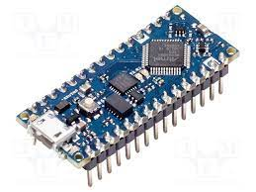
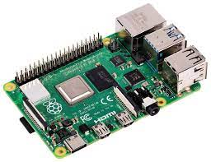
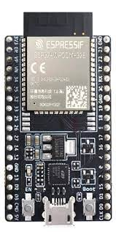
MCU
Arduino Nano
Raspberry Pi 3 Model B+ / Raspberry Pi 4 Model B (selected)
ESP32

Slide 4
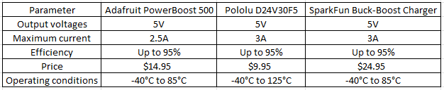
PSU
Adafruit PowerBoost 500 Charger
Pololu 5V, 3A Step-Down Voltage Regulator D24V30F5 (Selected)
SparkFun 5V/3A Buck-Boost LiPo Charger/Power Supply

Slide 5
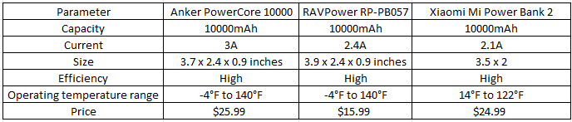
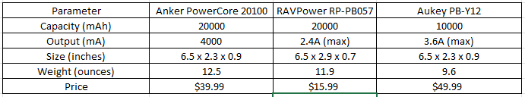
Power source
5 hours battery life
Anker PowerCore 10000
RAVPower RP-PB057 (Selected)
Xiaomi Mi Power Bank 2
10 hours battery life
Anker PowerCore 20100 (Selected)
RAVPower RP-PB057
Aukey PB-Y12

Slide 6
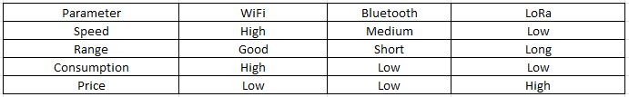
Communication
WiFi
Fast
Reliable
Short to medium ranges
ESP8266 WiFi Module
Low power consumption
Temperature range: -40°C to 125°C
Easy to use

Slide 7
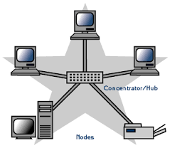
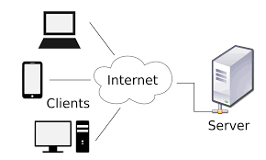
Topology and communication model
In terms of the communication between the IoT device and the internet, a topology of "star" can be used, with the device connecting to the cloud server trough the WiFi network. The communication model can be "client-server", with the device acting as the client and the cloud server acting as the server.

Slide 8
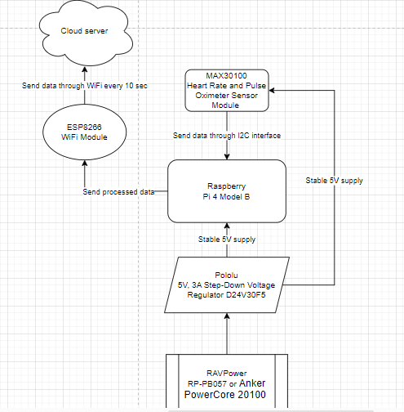
Block diagram

Slide 9
Cost estimation
Raspberry Pi 4 Model B with 4GB of RAM: $55
Pololu 5V, 3A Step-Down Voltage Regulator D24V30F5: $12.95
MAX30100 Heart Rate and Pulse Oximeter Sensor Module: $9.99
ESP8266 WiFi Module: $4.99
Battery or power bank: $15.99 (RAVPower RP-PB057) / $39.99 (Anker PowerCore 20100)
Total cost for a single IoT device: $98.92 / $122.92
Data consumption: $10/month (estimated at 672,000 bytes/month)
Electricity consumption: $2/month (estimated at 2 watts of power at $0.10/kWh)
A month: $12

Slide 10
Thank you for your attention

