Slide 1
3rd Data Set (“walk 2D - straight”)
Classification | Walking / 2D
Date & Time & Place | 02.08.2010 16:41h TE01/Holodeck
Pattern | Straight up and down
Surface | Normal floor
Subject | Thomas Kemptner
Synchronisation Move | Stamp on the floor (pause before and after stamp)
Shoe | #1 : Modified right shoe with 7 markers (3 outside, 1 back, 1 inside, 2 on top, 1 front); xSENS#1@100Hz
Duration | 60 seconds
Timestamp in IMU file at stamp | 513.330
Timestamp in reference system file at stamp | 1280760037.879
Additional information

Slide 2
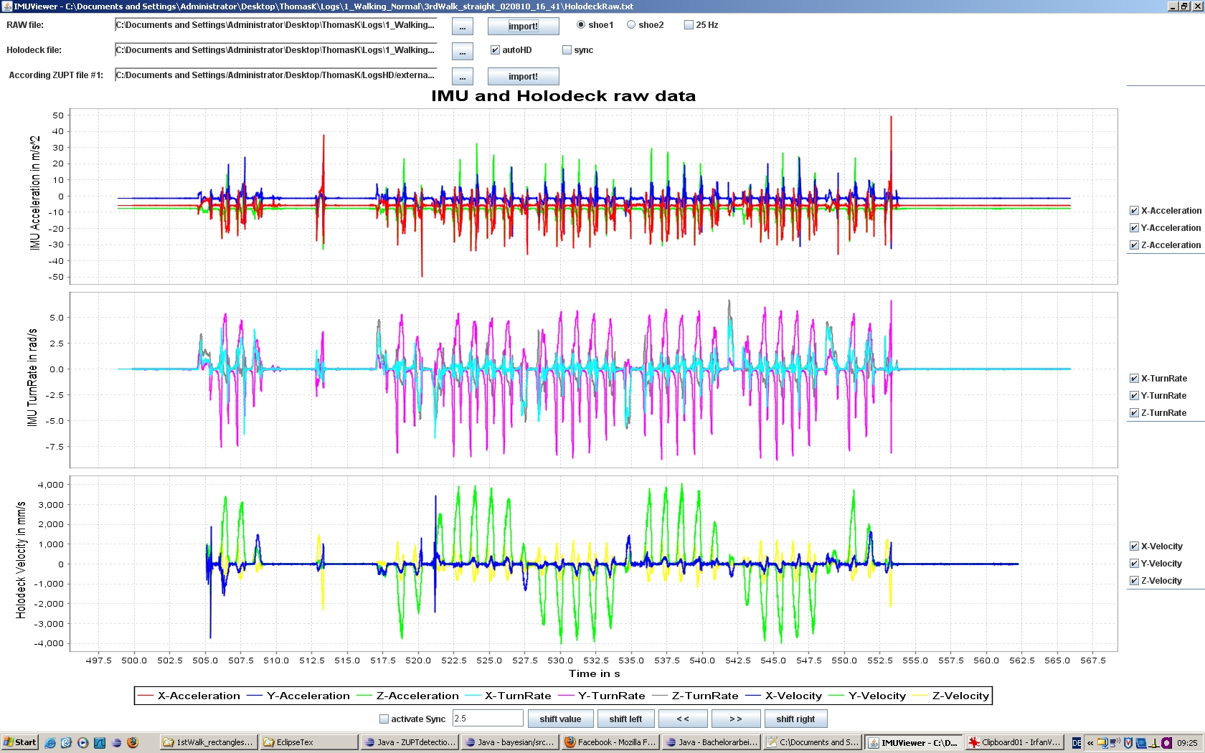
IMU Raw & Reference System Velocity

Slide 3
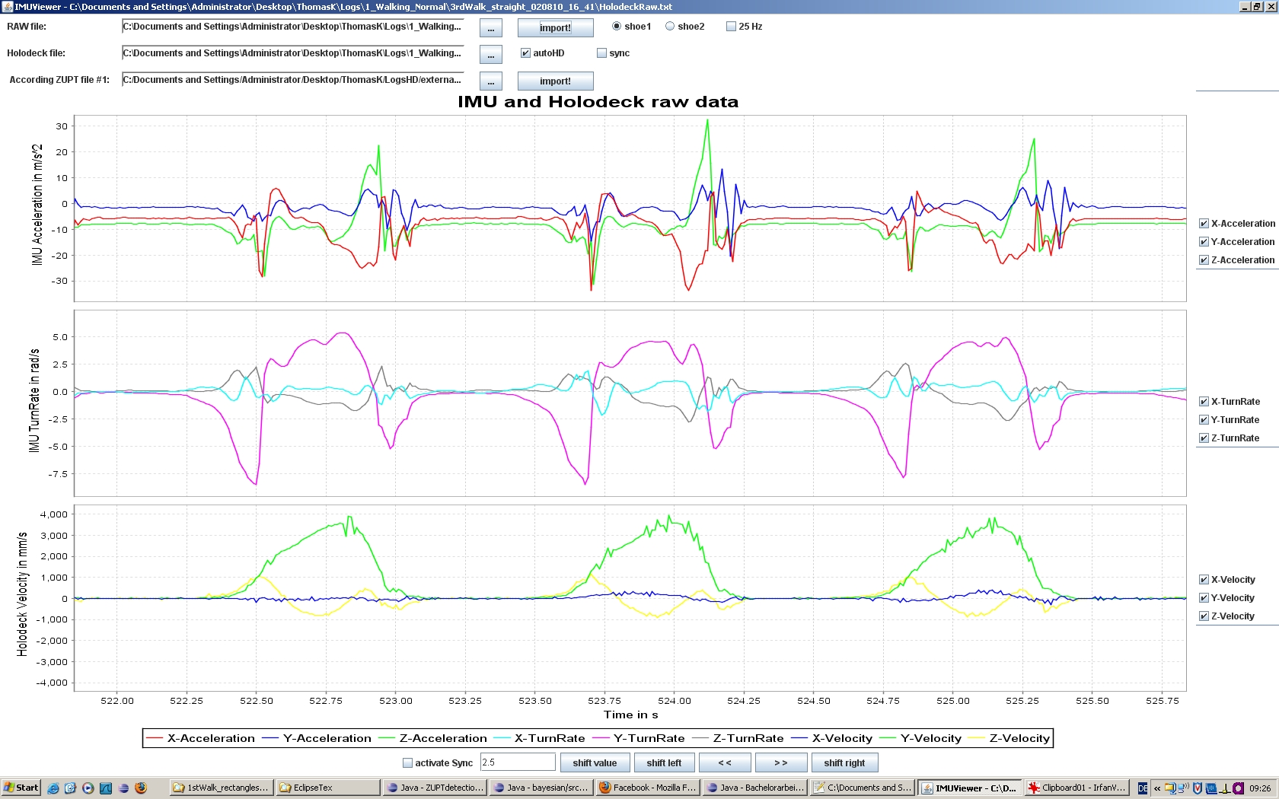
IMU Raw & Reference System Velocity (zoomed in)

Slide 4
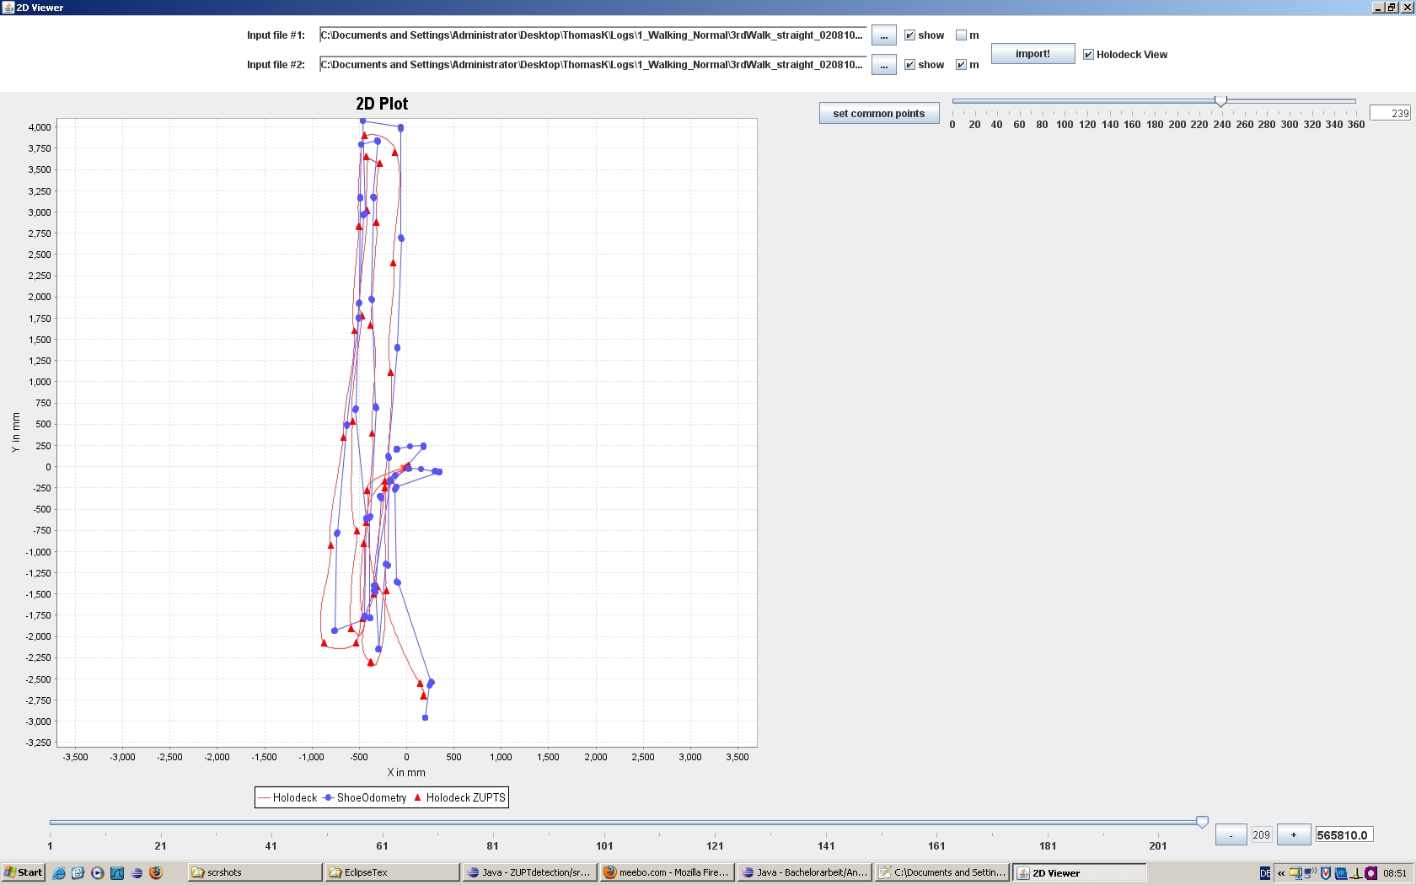
Reference System 2D Position

