Slide 1
4th Data Set (“walk 2D - 8”)
Classification | Walking / 2D
Date & Time & Place | 02.08.2010 16:46h TE01/Holodeck
Pattern | 8-pattern
Surface | Normal floor
Subject | Thomas Kemptner
Synchronisation Move | Stamp on the floor (pause before and after stamp)
Shoe | #1 : Modified right shoe with 7 markers (3 outside, 1 back, 1 inside, 2 on top, 1 front); xSENS#1@100Hz
Duration | 60 seconds
Timestamp in IMU file at stamp | 818.920
Timestamp in reference system file at stamp | 1280760343.466
Additional information

Slide 2
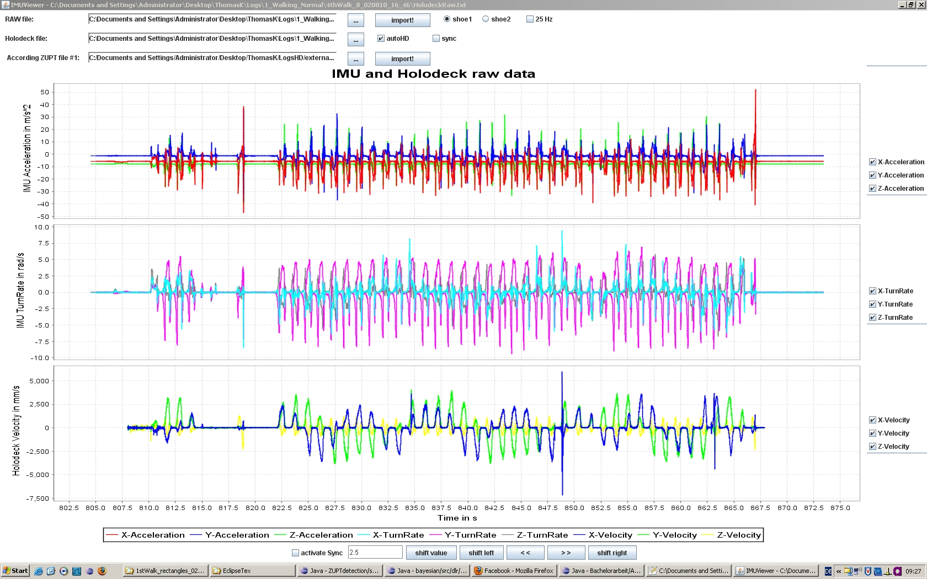
IMU Raw & Reference System Velocity

Slide 3
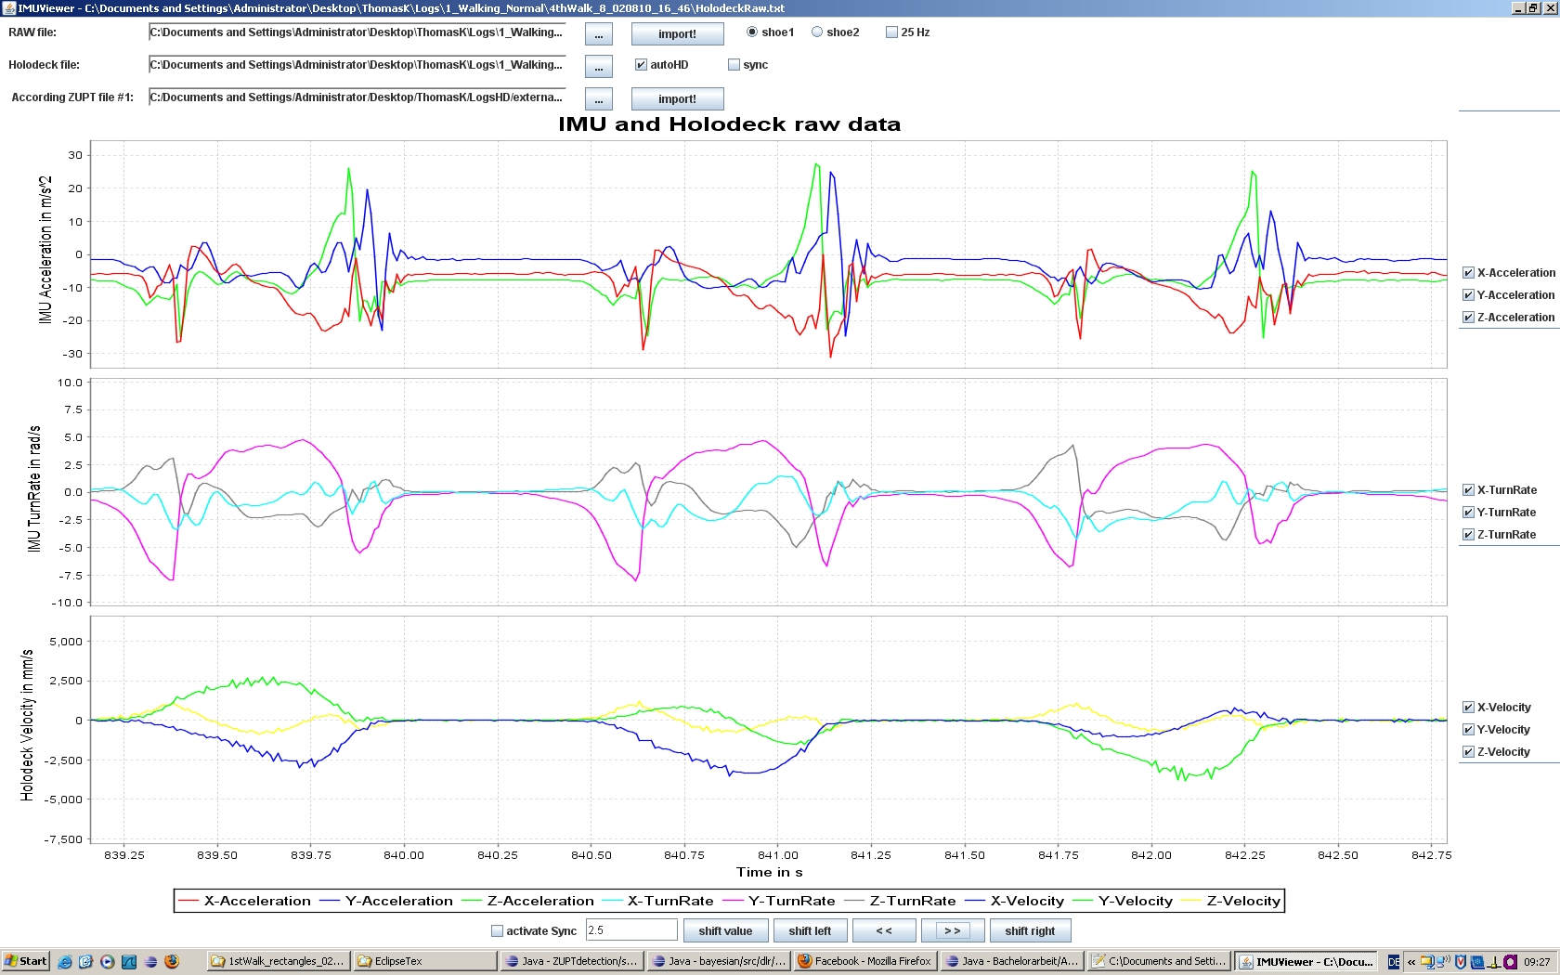
IMU Raw & Reference System Velocity (zoomed in)

Slide 4
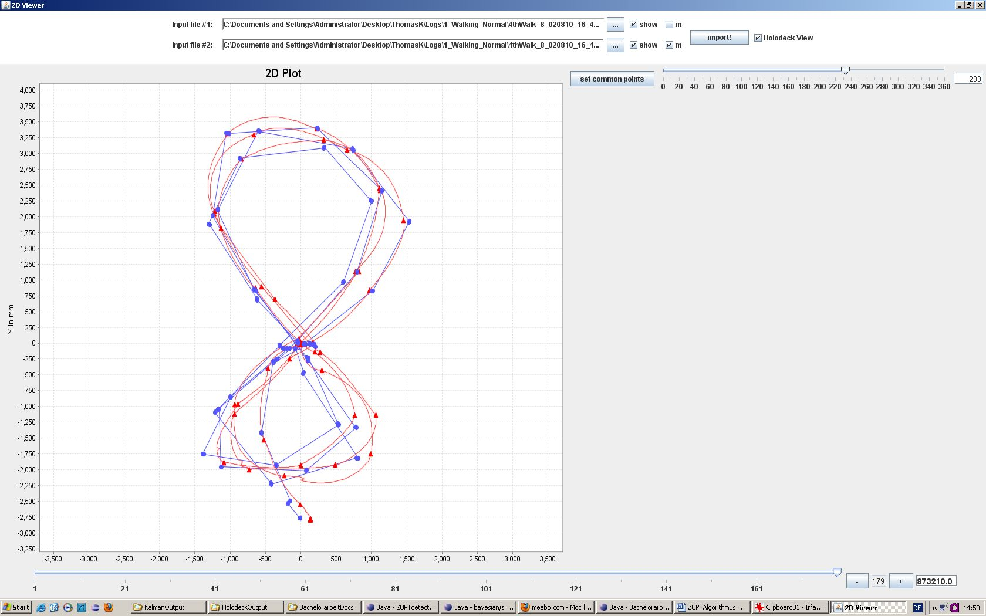
Reference System 2D Position

