Slide 1
6th Data Set (“walk 2D – on table”)
Classification | Walking / 2D
Date & Time & Place | 03.08.2010 15:14h TE01/Holodeck
Pattern | Half circle
Surface | Table on the floor
Subject | Thomas Kemptner
Synchronisation Move | Stamp on the floor (pause before and after stamp)
Shoe | #1 : Modified right shoe with 7 markers (3 outside, 1 back, 1 inside, 2 on top, 1 front); xSENS#1@100Hz
Duration | 60 seconds
Timestamp in IMU file at stamp | 308.130
Timestamp in reference system file at stamp | 1280841290.530
Additional information

Slide 2
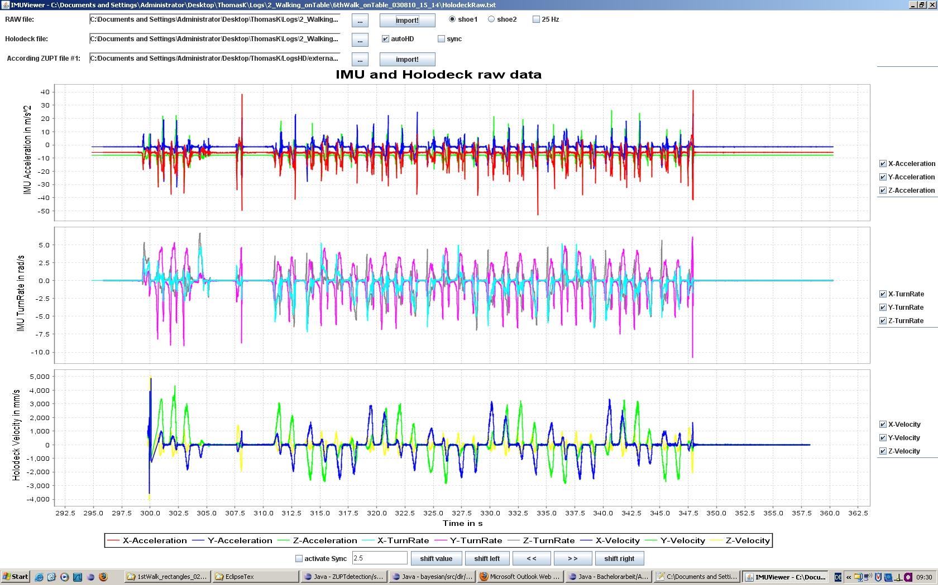
IMU Raw & Reference System Velocity

Slide 3
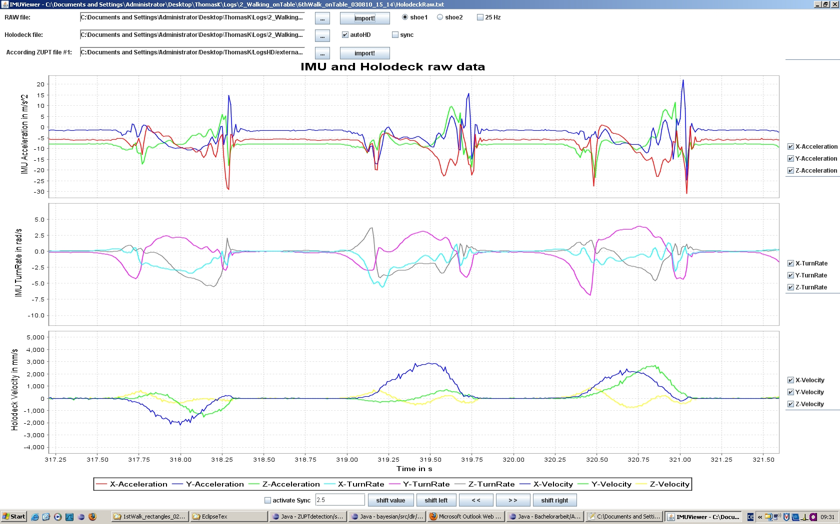
IMU Raw & Reference System Velocity (zoomed in)

Slide 4
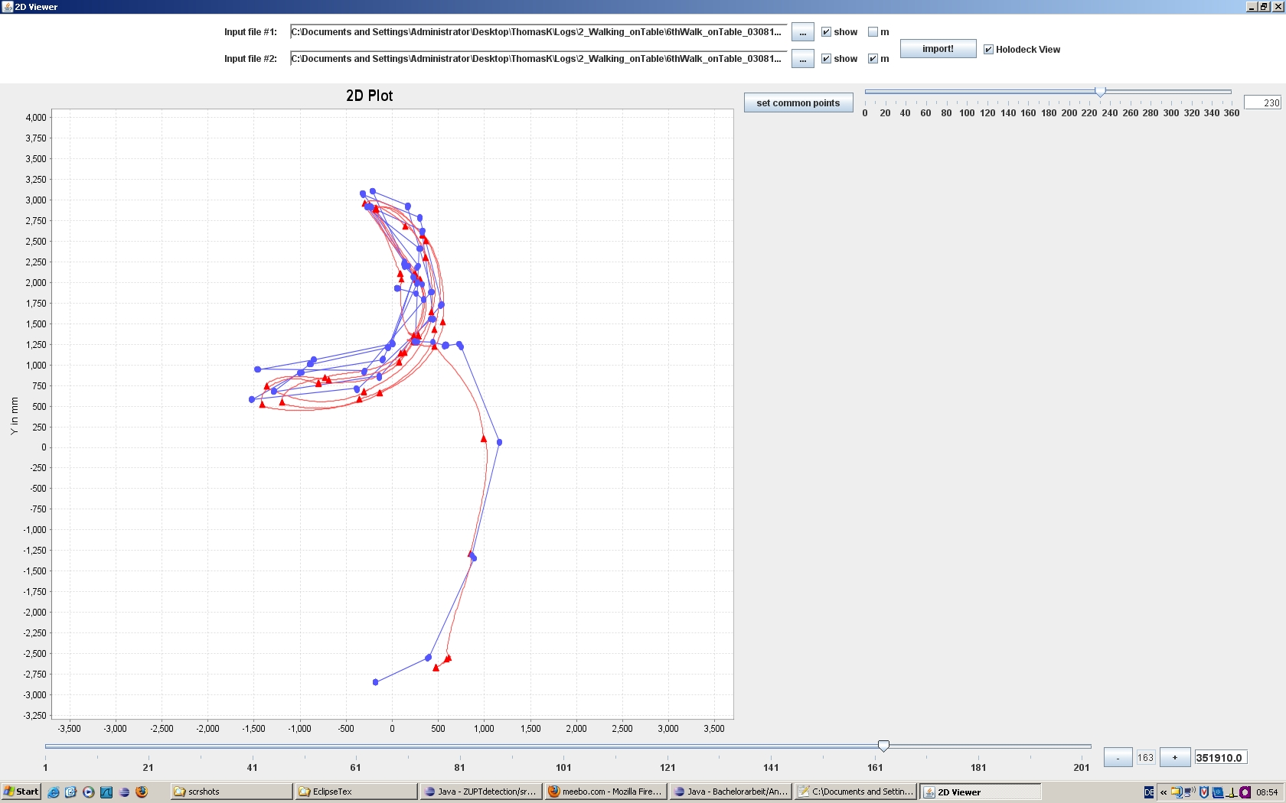
Reference System 2D Position

