Slide 1

Machine Learning in Finance Group Project - Spring Semester 2021
Aaron Hauser Lorena Tassone Lukas Dekker Nick Vogel

Slide 2
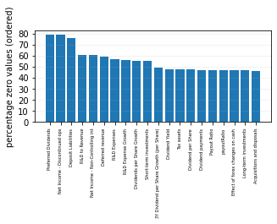
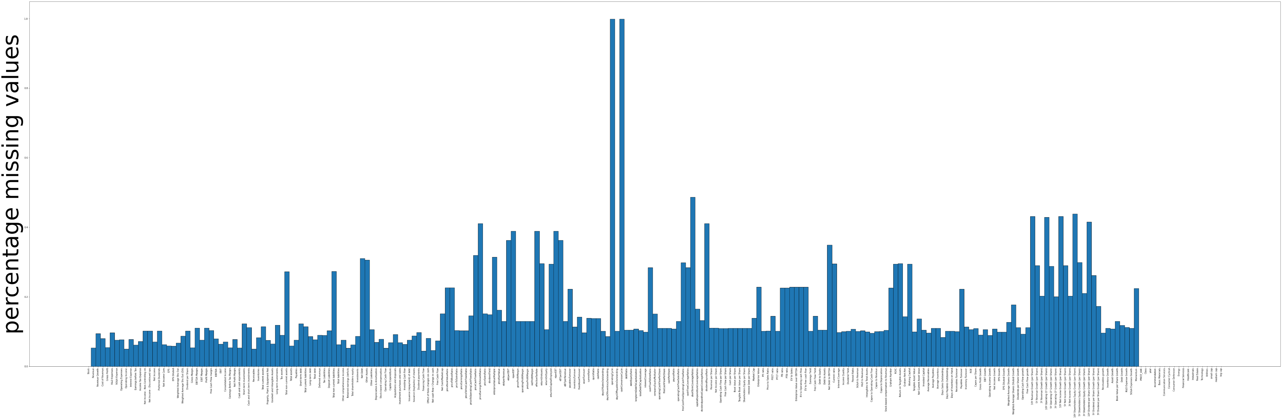
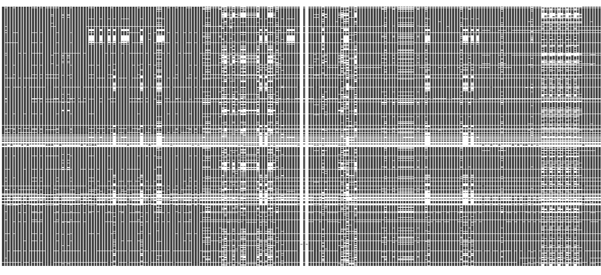
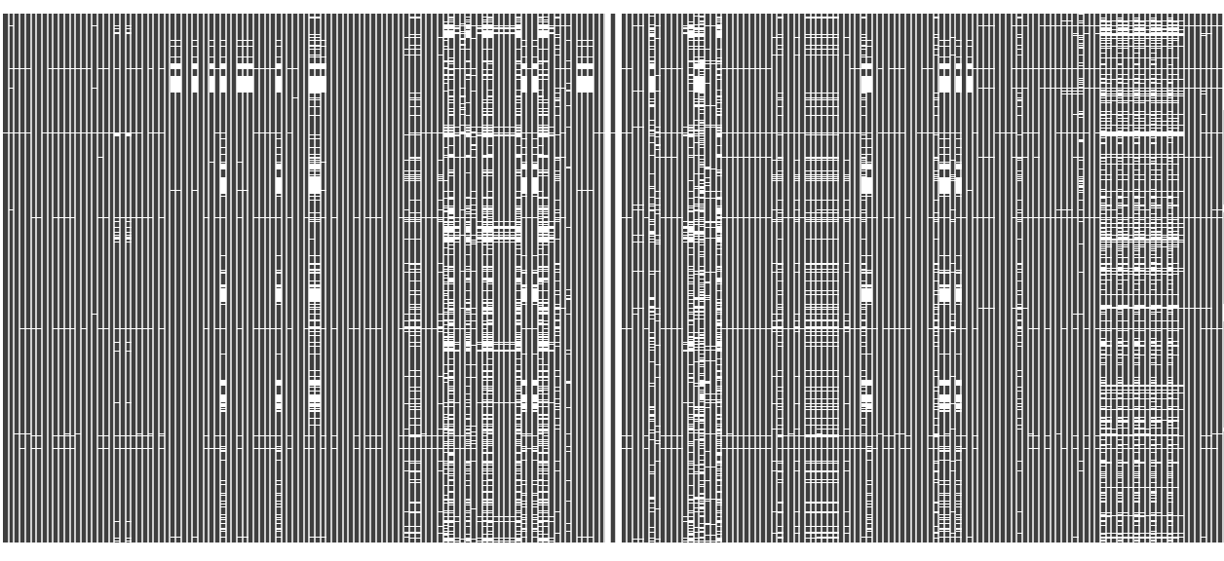
Data Cleaning
Outliers
IQR Method / Winsorization Method
Missing Values
Eliminate high-NA Columns and Rows
KNN Imputer / Iterative Imputer / MissForest Imputer
Zero Values
Analysing Columns with high Zero Value Count

Slide 3

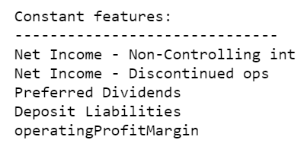
Feature Engineering (tbd)
Dummy variables for ‘Sector’ and ‘Market Cap’:
Addition of new features:
Momentum Factor
Macroeconomic Factor / Inflation Interaction Term
Elimination of Constant Features:
Elimination of Highly Correlated Features:

Slide 4
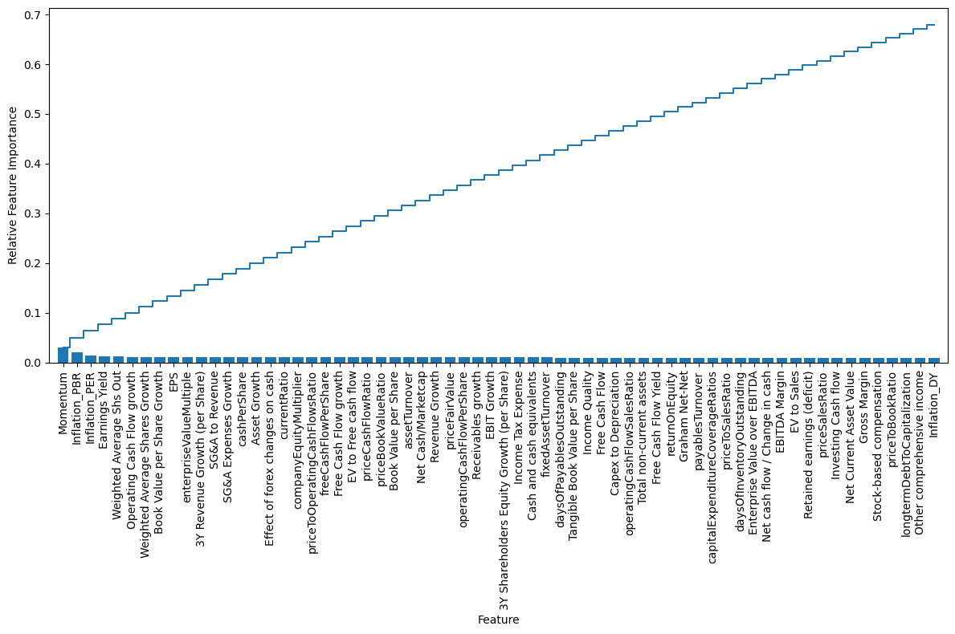
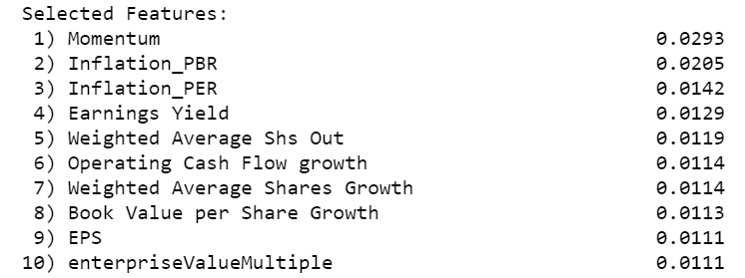
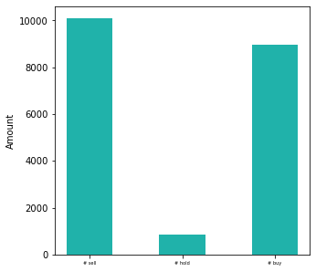
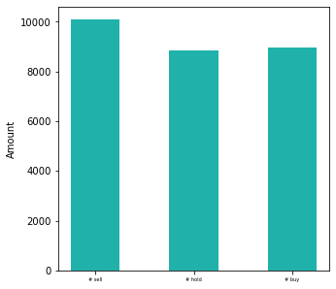
Feature Engineering
Feature Selection with Random Forest Classifier:
Dealing with Class Imbalance: → up sampling class “hold” 8000x
…
____
67.7%

Slide 5
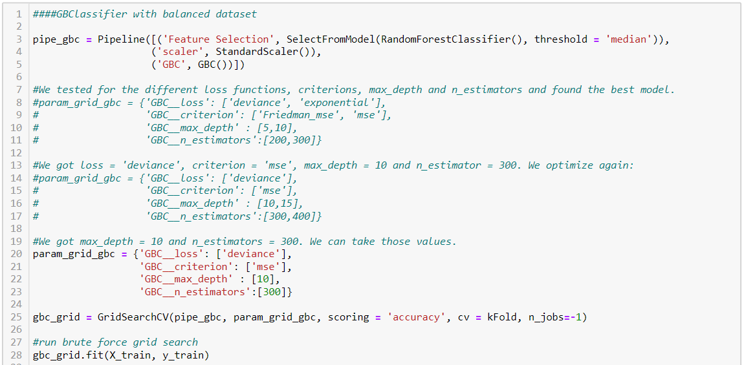
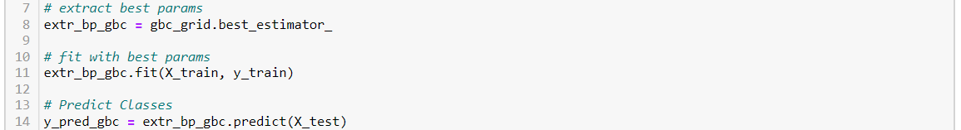
Training & Testing of Model (tbd)
Hyperparameter tuning
Reducing overfitting by in-/decreasing parameters manually
Bagging method
Balanced/Unbalanced data set
Train/Test Score
Confusion Matrix

Slide 6
Trained and Tested Classifiers (tbd)

Slide 7
Results (tbd)
**Overall Results plot**

Slide 8
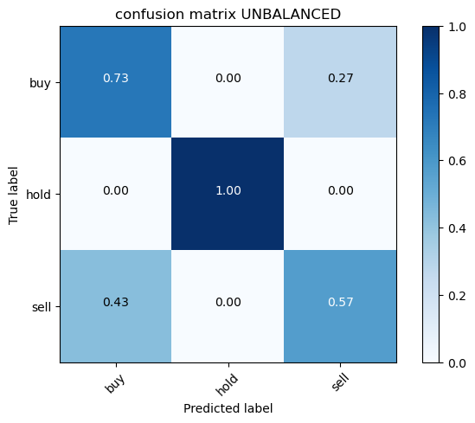



Best Classifier (tbd)
Gradient Boosting

Slide 9
Further Actions
Difficulties (tbd)
Lack of Processing Power
Overfitting
Finding optimal parameters
Apply more Imputing Methods
Create new features , complementing our inflation and momentum terms
Causality-based feature selection
Hyperparameter tuning including more values at once
Check the validity of the models with more/different performance metrics
Try to reduce the overfitting of our best model and improve performance further

