Slide 1

Machine Learning in Finance Group Project - Spring Semester 2021
Aaron Hauser Lorena Tassone Lukas Dekker Nick Vogel

Slide 2
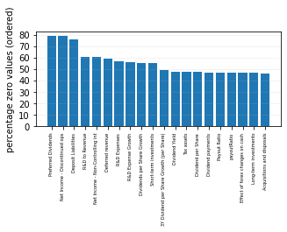
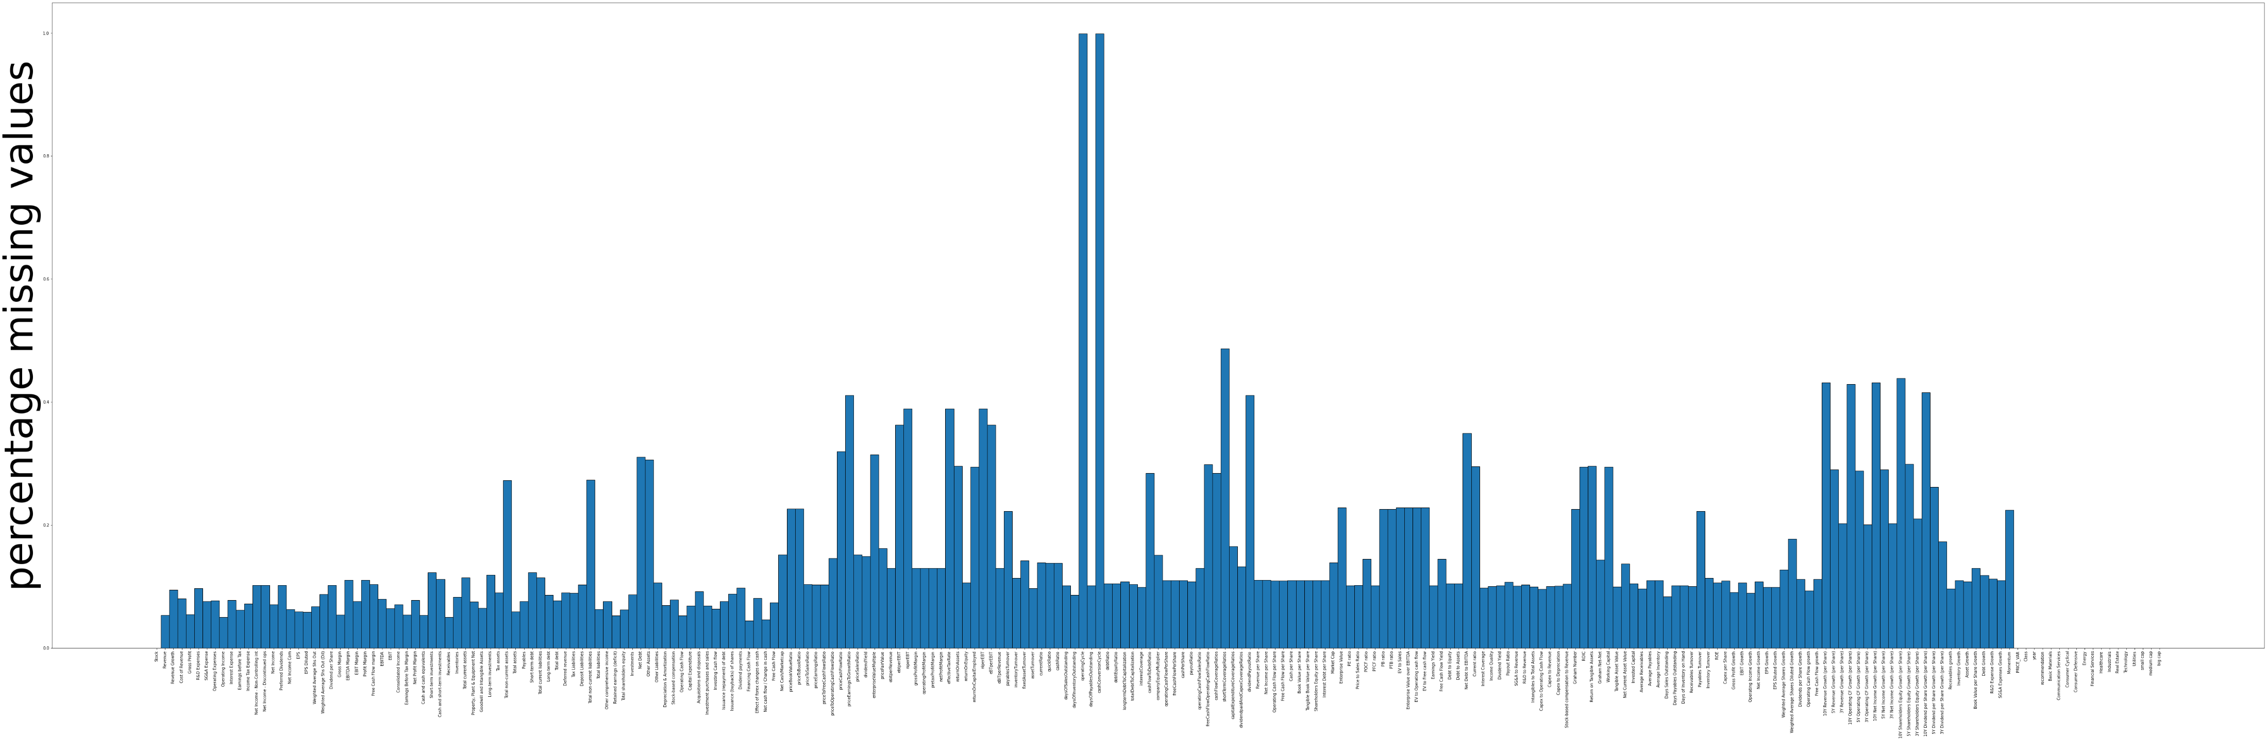
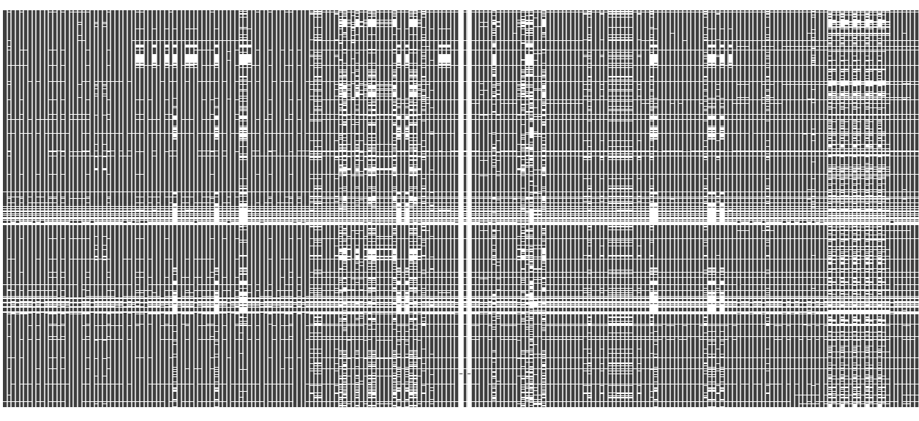
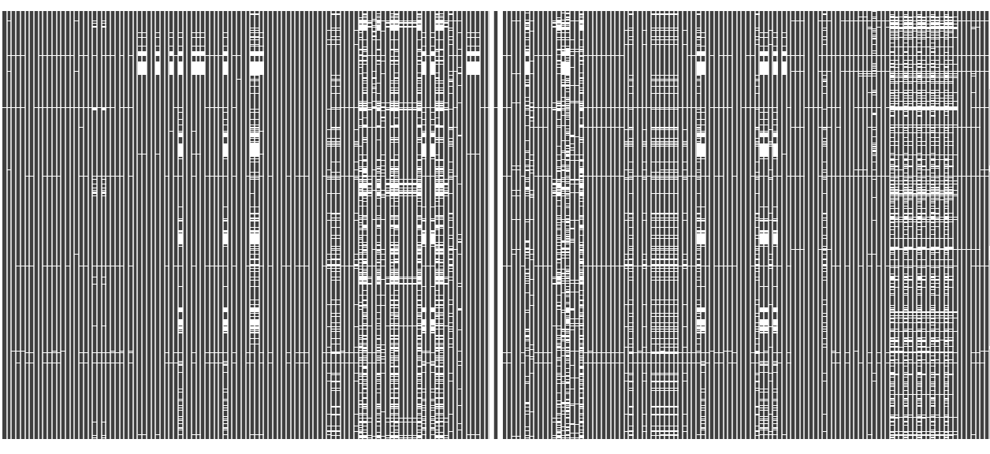
Data Cleaning
Outliers
IQR Method / Winsorization Method
Missing Values
Eliminate high-NA Columns and Rows
KNN Imputer / Iterative Imputer / MissForest Imputer
Zero Values
Analysing Columns with high Zero Value Count

Slide 3

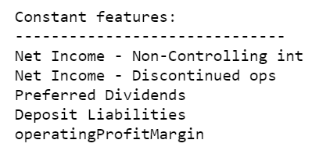
Feature Engineering
Dummy Variables for ‘Sector’ and ‘Market Cap’:
Addition of new Features:
Momentum Factor
Macroeconomic Factor / Inflation Interaction Term
Elimination of Constant Features:
Elimination of Highly Correlated Features:

Slide 4
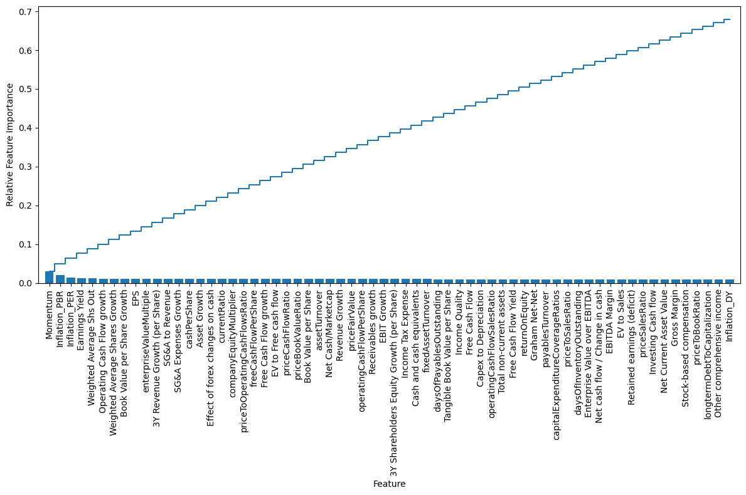
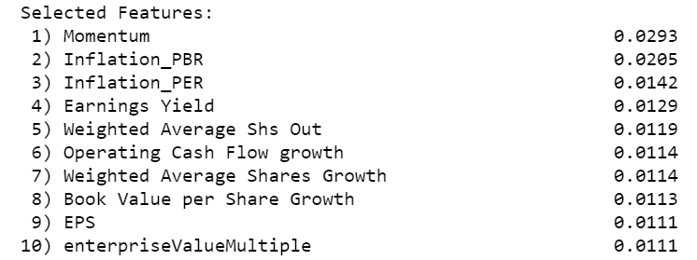
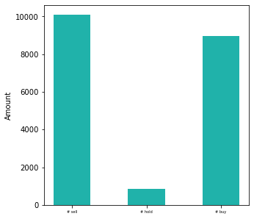
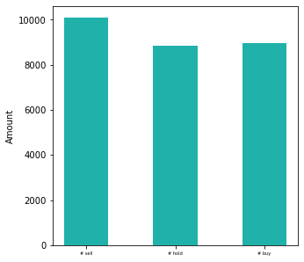
Feature Engineering
Feature Selection with Random Forest Classifier:
Dealing with Class Imbalance: → up sampling class “hold” 8000x
…
____
67.7%

Slide 5
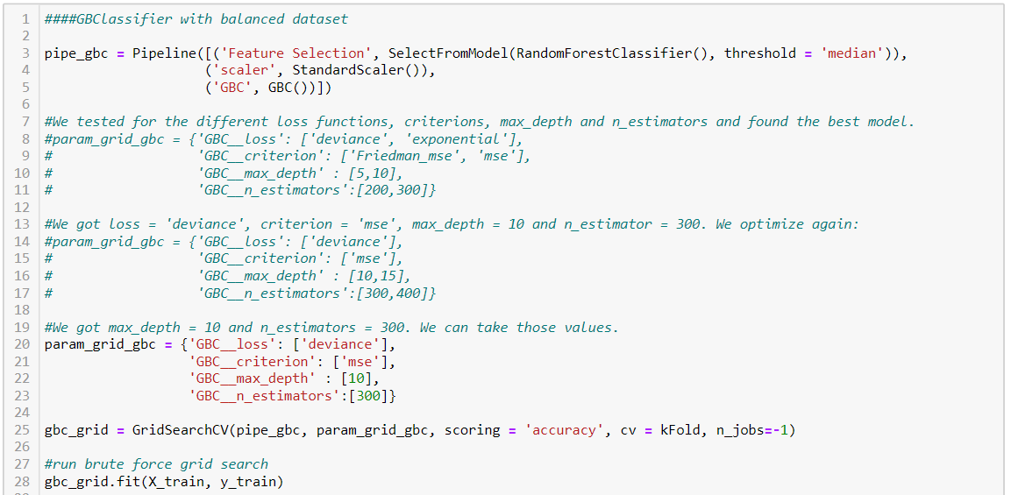
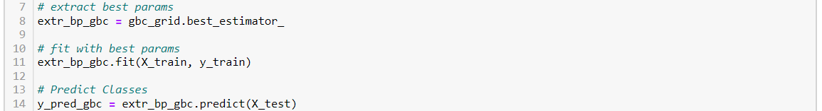
Training & Testing of Model
Hyperparameter Tuning
Reducing Overfitting by in-/decreasing Parameters manually
Bagging Method
Balanced/Unbalanced Data Set
Train/Test Score
Confusion Matrix

Slide 6
Trained and Tested Classifiers

Slide 7
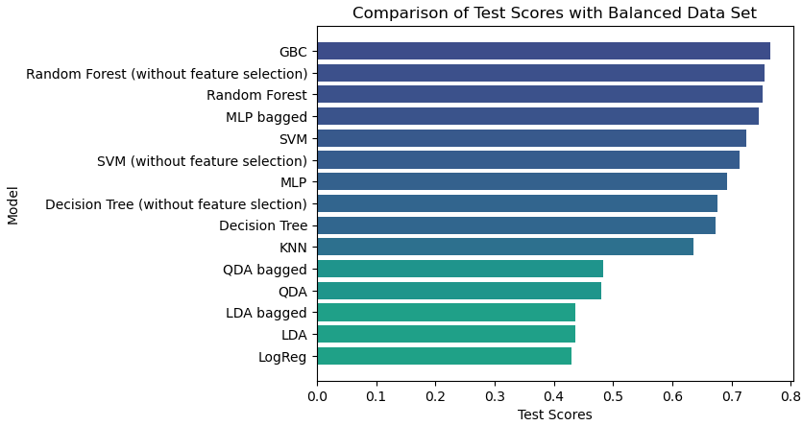
Results

Slide 8
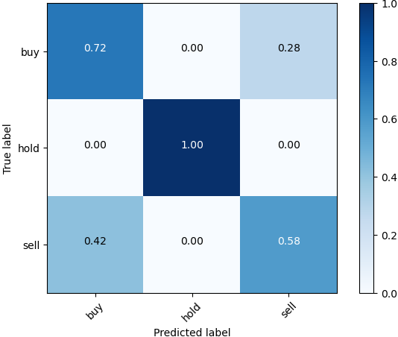
Best Classifier
Gradient Boosting Classifier

Slide 9
Further Actions
Difficulties
Lack of Processing Power
Overfitting
Finding optimal Parameters
Apply more Imputing Methods
Create new Features, Complementing our Inflation and Momentum Terms
Causality-based Feature Selection
Hyperparameter Tuning including more Values at once
Check the Validity of the Models with more/different Performance Metrics
Try to reduce the Overfitting of our best Model and improve Performance further

Slide 10

Time for Q&A

