Slide 1

Machine Learning in Finance Group Project - Spring Semester 2021
Aaron Hauser Lorena Tassone Lukas Dekker Nick Vogel

Slide 2
Data Cleaning
Missing Values
KNN Imputer / Iterative Imputing / MissForest Imputing / Eliminate high-NA Rows
Zero Values
Analysing Columns with high Zero Value count
Outliers
IQR Method / Winsorization Method

Slide 3
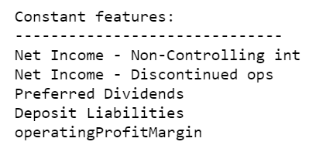
Feature Engineering
Addition of new features
Eliminate Constant Features:
Eliminate Highly Correlated Features:

Slide 4
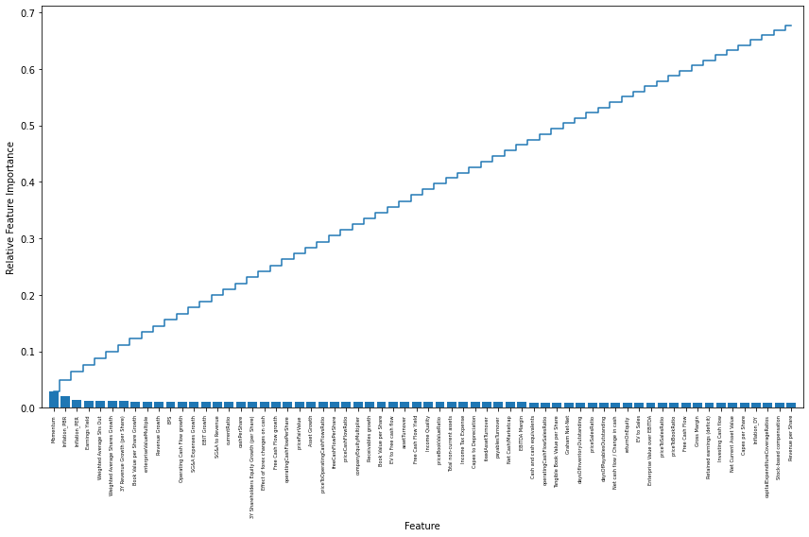
Feature Engineering
Feature Selection with Random Forest Classifier:

Slide 5
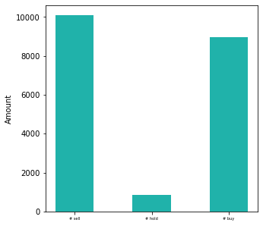
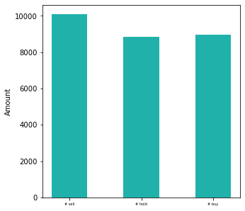
Feature Engineering
Dealing with Class Imbalance: → up sampling class “hold” 8000x

Slide 6
Trained and Tested Classifiers
 | Balanced | Unbalanced | With bagging | Overfitting?
Decision Tree
Random Forest
Gradient Boosting
Logistic Regression
Linear Discriminant Analysis
Quadratic Discriminant Analysis
Support Vector Machines
k-Nearest Neighbors
Simple Neural Network (Multi Layer Perceptron)

Slide 7
Training & Testing of Model

Slide 8
Results / Insights
Overall Results plot
Best Classifie insights

Slide 9
Difficulties
Lack of Processing Power
Overfitting

Slide 10
Further Actions
Apply more Imputing Methods
Causality-based feature selection
Hyperparameter tuning including all values at once

Slide 11
Time for Q&A

