Slide 1
Strategies for Effective Data Visualizations
November 9th, 2020
“Humans are pattern-seeking story-telling animals, and we are quite adept at telling stories about patterns, whether they exist or not.”
Michael Shermer

Slide 2
Plan of the Lecture
Human vision and visual attention
Advantages of visual representation of data
Doing it wrong: bad & misleading charts
Color
Plotting tutorial and exercises

Slide 3
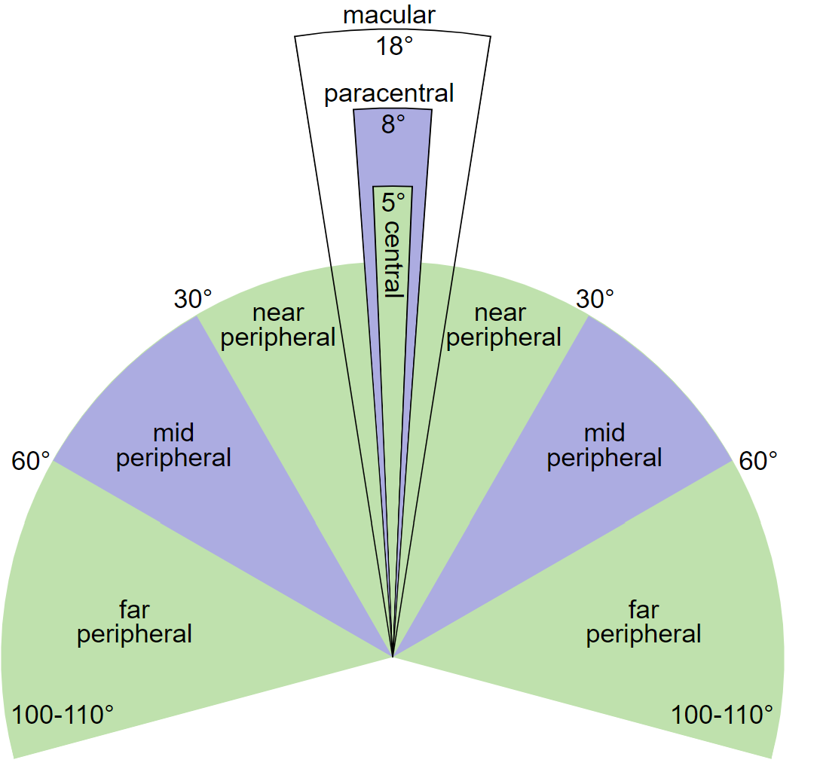
Basics of Human Vision
Central vision is narrow
Peripheral vision is low res
Our eyes jump all over an image and the brain creates an illusion of a broader visual field
Image credit: Zyxwv99, Wikipedia
Notes:
Although the field of vision of a single human eye is about 120 degrees, the peripheral vision takes up 115 degrees and the 5 degrees is the central vision
Try to focus on a single word in a text and check how quickly the resolution degrades with distance: only a couple words to the left and right on the current line and one-two lines above and below are clearly discernable
Our eyes rapidly jump from one part of a sizable object to another -- something known as saccade -- and the brain creates an illusion of a broader visual field from the parsed patches

Slide 4
Hierarchy of Visual Attention
Our eyes jump from one part of an image that stands out to another
Pre-attentive processing filters noise or irrelevant stimuli helping to maintain focus
We are hard-wired to look at what differs from the 'average':
Contrast
Color
Shape, size, orientation
Patterns and connections
Notes:
But our eyes do not jump all over an image randomly: they proceed from one part of the image that stands out to another.
Then pre-attentive processing kicks in filtering noise or irrelevant stimuli, helping to maintain focus
We are hard-wired to look at what differs from the ‘average’

Slide 5
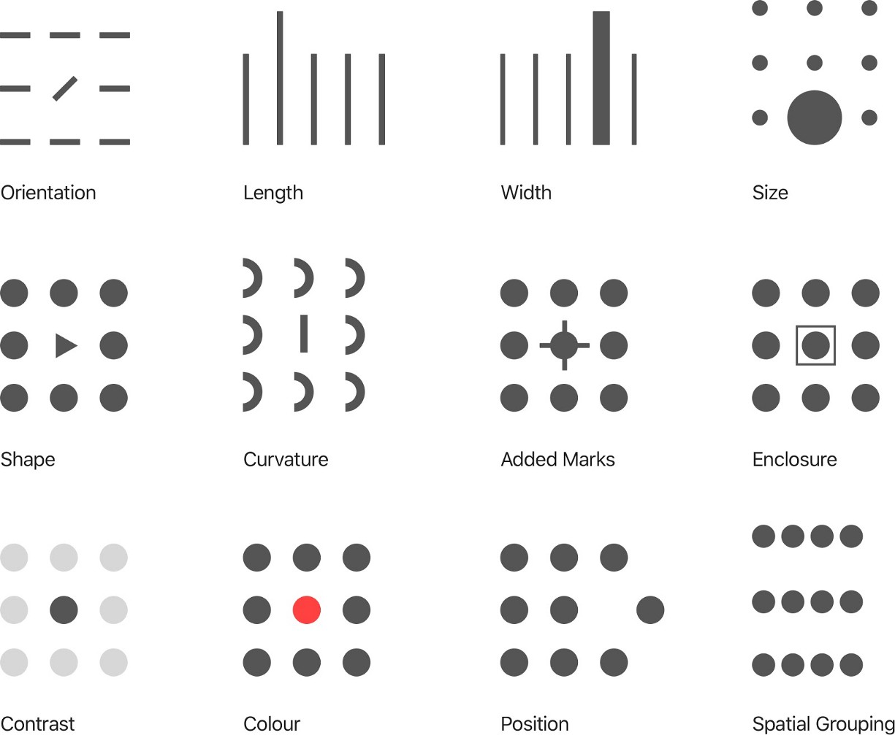
Pre-attentive Attributes
Image credit: Heldiney Pereira
Notes:
At every image the first thing we notice is the part that stands out: different orientation, position, and so on.

Slide 6
Hierarchy of Visual Attention (continued)
When more than a few distinct objects are present we view them as a single whole
Spatially grouped objects are easier to distinguish: 10000000 vs 10,000,000
We are pattern seekers, and our brain starts concocting a story even before we have a chance to process the whole picture
Evolutionary baggage: warmer colors are associated with higher values or 'good' -- helpful to discern ripe fruits from the surrounding foliage, preference for symmetry
Societal conventions: the time flows from left to right, text is read top-to-bottom, and left-to-right in European cultures
Notes:
However, if there are too many objects we start to look at them as a whole
For example: it is much easier to read 10,000,000 when thousands are separated by commas
We are pattern seekers and our brain starts making up a story even before we have a chance to process the whole picture. Suppose you are walking a park and spot something snake-like under your feet. Millions of years of evolution have resulted in innate fear of snakes in humans – you would first leap away and only then think, whether it is a snake or a stick.
Evolutionary baggage: warmer colors are associated with higher values or 'good' -- helpful to discern ripe fruits from the surrounding foliage, preference for symmetry
Societal conventions: the time flows from left to right, text is read top-to-bottom, and left-to-right in European cultures

Slide 7
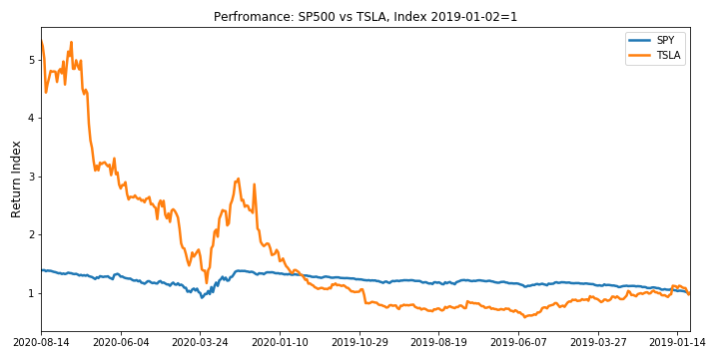
Example: Cultural Conventions
Let’s have a look at the performance of TSLA vs SP500 index, wait…
Notes:
As the brain of an audience member starts to make sense out of the slide, it (the brain) has to process the following:
the concept of a chart;
the concept of an index;
spatial representation of time flow;
colormap;
representation of dates;
...[a million other things]
...
the fact that Tesla has outperformed S&P500.
One immediate problem with the chart above is the unusual spatial representation of time: therein it flows right-to-left instead of left-to-right as the overwhelming majority of us are accustomed to. This custom is by no means instinct in all humans, but rather internalized in the first years of our life in a culture-specific way: indeed, certain peoples such as Aymara, when asked to point in the direction of time flow, would place past events in front of them and the future ones behind.
The majority of us is accustomed to the time flowing from left to right
Although rather artificial, the reverse time example highlights several things to keep in mind when visualizing research findings:
there is what can heuristically be called primary and secondary information on every slide or figure
the brain needs to process both while its resources are limited
It is the presenter's task to be informed of the wiring of the audience's brains to foster concentration on the primary information. Which would maybe imply drawing charts differently for Aymara speakers.
A more concrete example would be American vs European date conventions (month first vs day first)

Slide 8
Primary / Secondary Information
As we try to make sense out of the slide, our brain has to process the following:
the concept of a chart
the concept of an index
spatial representation of time flow
representation of dates
... a million other things...
the fact that Tesla has outperformed S&P500

Slide 9
Primary / Secondary Information
The majority of us is accustomed to the time flowing from left to right
But this is not a unique time convention – the Ayamara people refer to the past as being in front of them and the future as being behind them
Although rather artificial, the reverse time example highlights several things to keep in mind when visualizing research findings:
there is what can heuristically be called primary and secondary information on every slide
the brain needs to process both while its resources are limited
It is the presenter's task to be informed of the wiring of the audience's brains to foster concentration on the primary information. Which would maybe imply drawing charts differently for Aymara speakers.

Slide 10
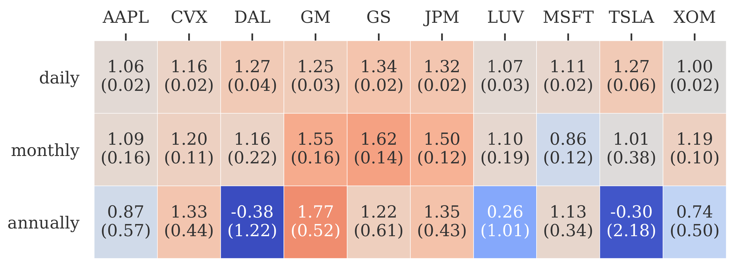
Example: Color and Contrast
The table shows market betas computed at different frequencies.
Our attention is immediately drawn to high-contrast cells, that contain more extreme values
We intuitively expect the cells with colder hues to contain lower values

Slide 11
Example: Visual Layouts
Emphasized
Neutral
Emphasized
Neutral
De-emphasized
Notes:
We tend to parse visuals from top left to bottom right: so the prime real estate is in the top left, or in the middle if there’s not much information on a slide

Slide 12
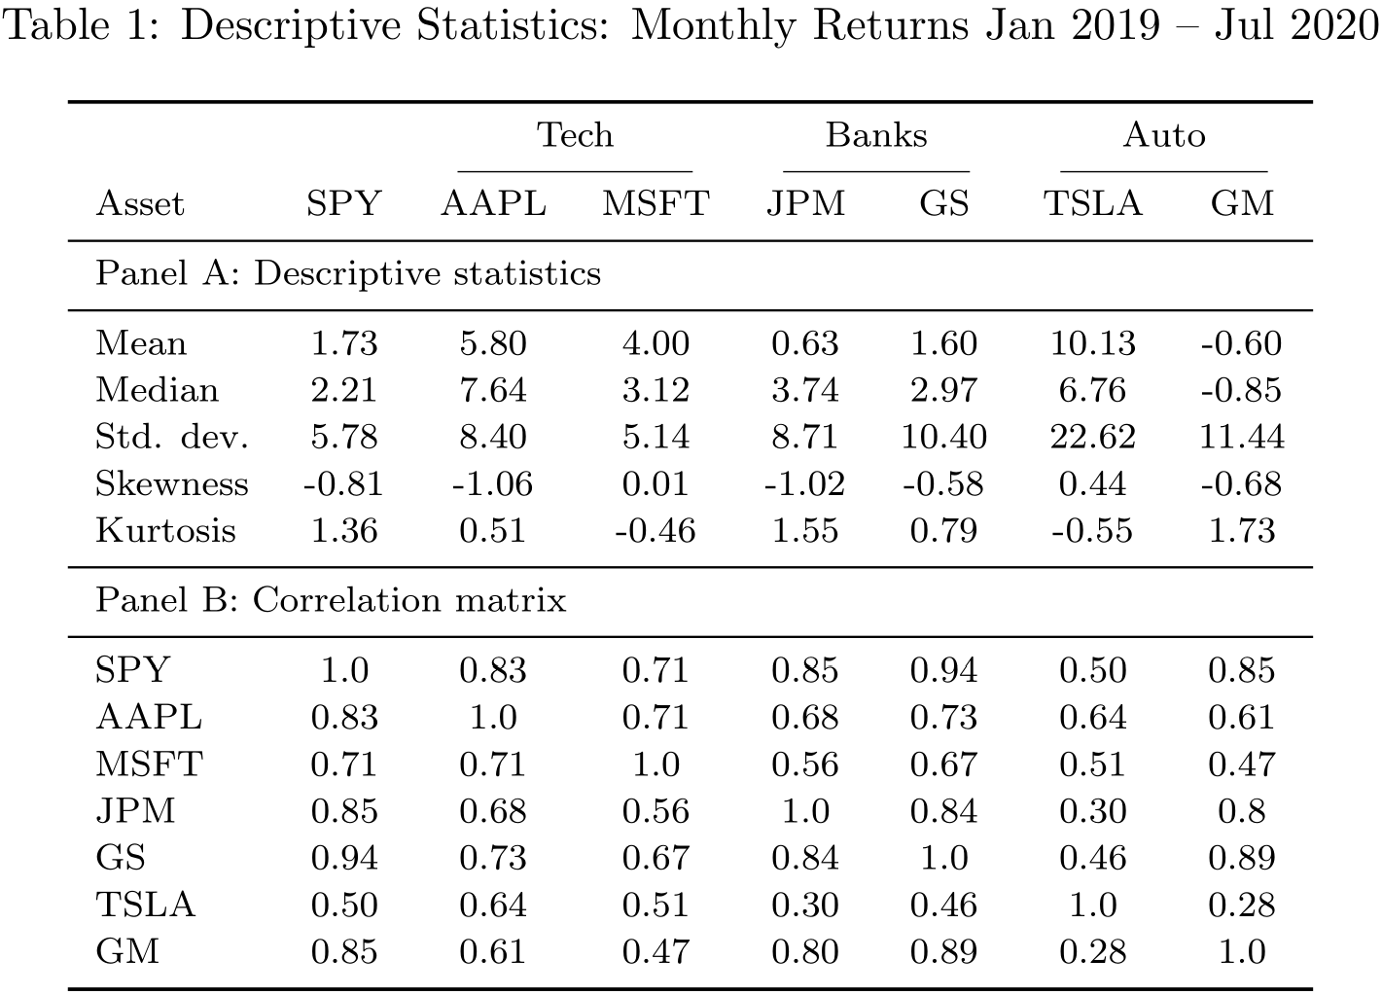
Example: Spatial Grouping and Symmetry
Notes:
A bit cluttered but passable, though misalignment of the decimals is a sore in the eye

Slide 13
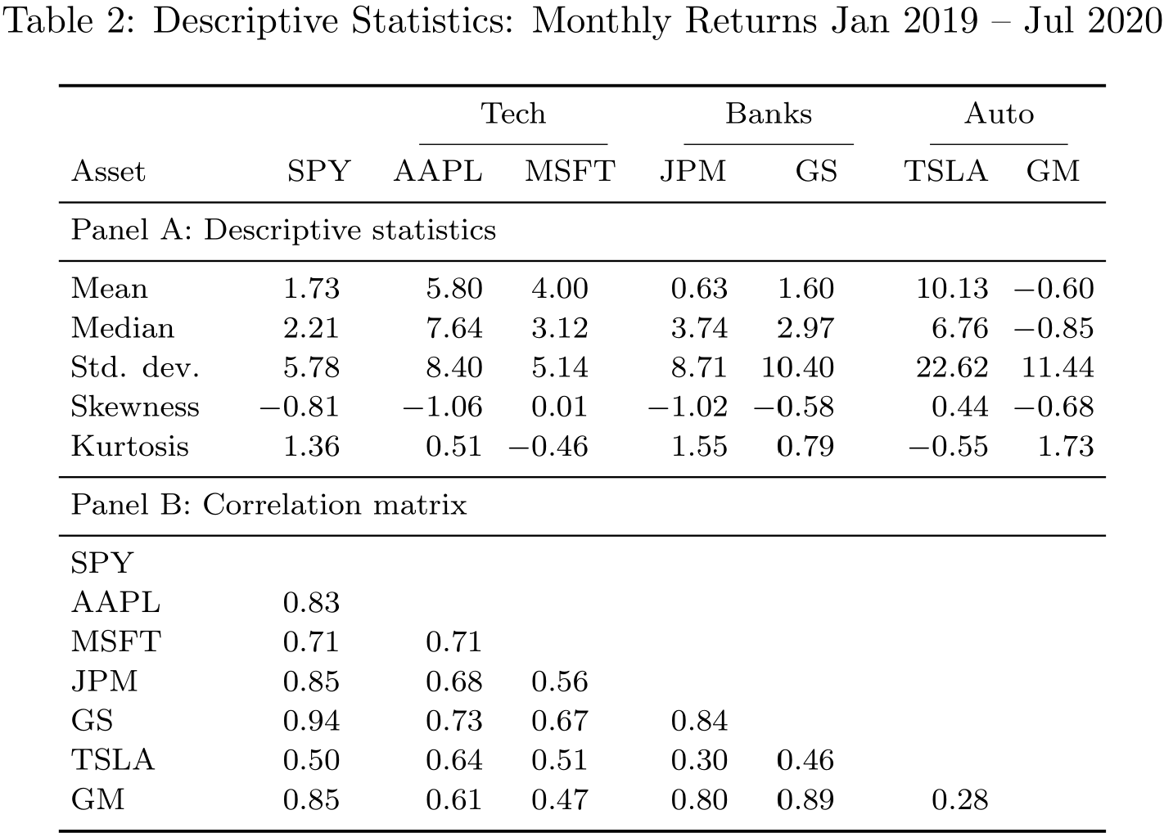
Example: Spatial Grouping and Symmetry
Notes:
Dcolumn package allows to align the decimals + the sectors are closer (the code for the tables is in the repository)
The lower right ‘de-emphasized’ corner is almost empty. The most interesting data – SPY and correlations are all to the left
We drop the main diagonal of the correlation matrix to further avoid unnecessary clutter: remember we are to make the primary information as accessible as possible

Slide 14

Type II errors (false negatives) are evolutionary costly
Thus it is advantageous to see something even if there is nothing
In fact we have limited control over what we are looking at
Notes:
Now to the pattern seeking. The first thing we notice on the picture is the eye, then our gaze jumps around tracing the head and snout.
Note that the eye is close to the center of the slide and image, and the most salient part of the image is situated in the top-left / middle
We decode the image in a rather predictable fashion, we can exploit it to craft impactful visuals

Slide 15
Why visualization is important
Humans receive disproportionally large share of information from vision in comparison to other senses
Visualization is information/knowledge compression, we are bad at comprehending large collections of objects like raw numbers
Other compression methods like descriptive statistics can miss important features of the dataset at hand, especially if the data is not iid.
It really helps you to tell your story, control the narrative and emphasize what you think is important
Notes:
Humans receive disproportionally large share of information from vision in comparison to other senses
Visualization is information/knowledge compression, we are bad at comprehending large collections of objects like raw numbers
Other compression methods like descriptive statistics can miss important features of the dataset at hand, especially if the data is not iid.
It really helps you to tell your story, control the narrative and emphasize what you think is important

Slide 16
Example: Sales Data
 | Region A |  | Region B |  | Region C |  | Region D
Store ID | Revenue | Profit | Revenue | Profit | Revenue | Profit | Revenue | Profit
1 | 10.0 | 8.04 | 10.0 | 9.14 | 10.0 | 7.46 | 8.0 | 6.58
2 | 8.0 | 6.95 | 8.0 | 8.14 | 8.0 | 6.77 | 8.0 | 5.76
2 | 13.0 | 7.58 | 13.0 | 8.74 | 13.0 | 12.74 | 8.0 | 7.71
4 | 9.0 | 8.81 | 9.0 | 8.77 | 9.0 | 7.11 | 8.0 | 8.84
5 | 11.0 | 8.33 | 11.0 | 9.26 | 11.0 | 7.81 | 8.0 | 8.47
6 | 14.0 | 9.96 | 14.0 | 8.10 | 14.0 | 8.84 | 8.0 | 7.04
7 | 6.0 | 7.24 | 6.0 | 6.13 | 6.0 | 6.08 | 8.0 | 5.25
8 | 4.0 | 4.26 | 4.0 | 3.10 | 4.0 | 5.39 | 19.0 | 12.50
9 | 12.0 | 10.84 | 12.0 | 9.13 | 12.0 | 8.15 | 8.0 | 5.56
10 | 7.0 | 4.82 | 7.0 | 7.26 | 7.0 | 6.42 | 8.0 | 7.91
11 | 5.0 | 5.68 | 5.0 | 4.74 | 5.0 | 5.73 | 8.0 | 6.89
Assume you are asked to evaluate profitability over four regions with 11 stores in each

Slide 17
Example: Sales Data
 | Region A |  | Region B |  | Region C |  | Region D
Store ID | Revenue | Profit | Revenue | Profit | Revenue | Profit | Revenue | Profit
Mean | 9 | 7.5 | 9 | 7.5 | 9 | 7.5 | 9 | 7.5
Variance | 11 | 4.125 | 11 | 4.125 | 11 | 4.125 | 11 | 4.125
Regression Line | P = 3 + 0.5R |  | P = 3 + 0.5R |  | P = 3 + 0.5R |  | P = 3 + 0.5R
Well, that wasn’t helpful
Correlations between revenue and profit are about 0.816 in all regions
Notes:
Assume you are asked to evaluate a dataset of profit

Slide 18
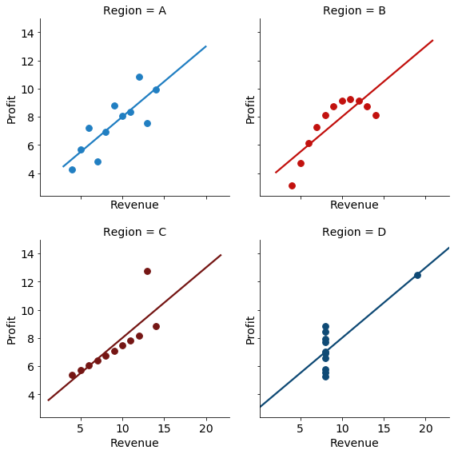
Example: Sales Data = Anscombe’s Quartet
Notes:
The first scatter plot (top left) appears to be a simple linear relationship, corresponding to two variables correlated where y could be modelled as gaussian with mean linearly dependent on x.
The second graph (top right) is not distributed normally; while a relationship between the two variables is obvious, it is not linear, and the Pearson correlation coefficient is not relevant. A more general regression and the corresponding coefficient of determination would be more appropriate.
In the third graph (bottom left), the distribution is linear, but should have a different regression line (a robust regression would have been called for). The calculated regression is offset by the one outlier which exerts enough influence to lower the correlation coefficient from 1 to 0.816.
Finally, the fourth graph (bottom right) shows an example when one high-leverage point is enough to produce a high correlation coefficient, even though the other data points do not indicate any relationship between the variables.

Slide 19
“The goal of a good data visualization is to help your reader in transition from 'WFT?' to 'Aha!'”
Karl Marx
Let’s start from ‘wtf’
Notes:
Here we have the mandatory quote

Slide 20
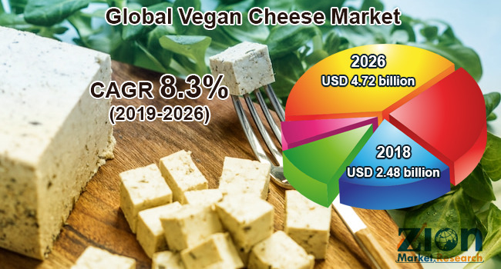
Abuse of Visualization: Pie Charts
Look at this utter nonsense (viz.wtf has plenty of those)
Notes:
Yes, it’s another mandatory pie chart example
What is the point of using a 3-D pie chart with five sections and two datapoints, except for its resemblance of a wheel of cheese?

Slide 21
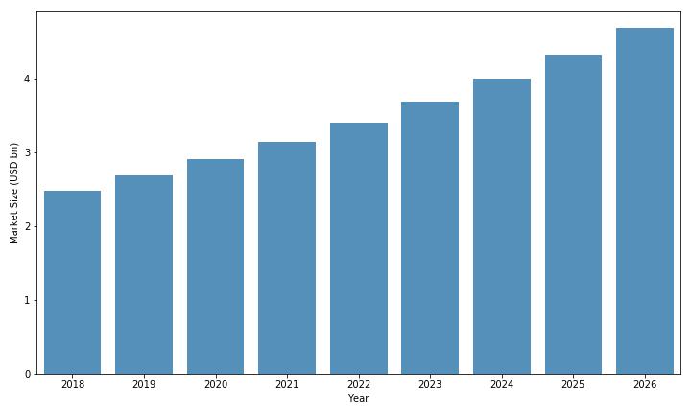
Abuse of Visualization: Bar Charts > Pie Charts
Notes:
A simple barchart can do the trick: and also depict dynamics.
We perceive height much better than volume or area on pie charts.
Can we do better though?

Slide 22
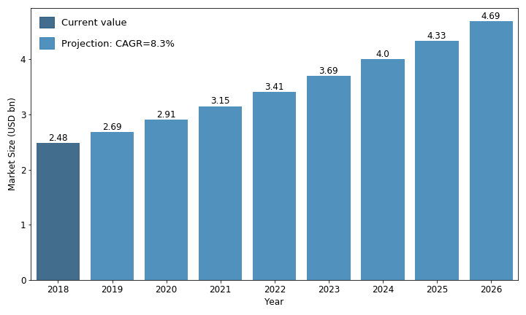
Abuse of Visualization: Bar Charts > Pie Charts
Notes:
Or an even better version which contains all the information needed. Add some cheese liberally if needed.
Note that all the important info is at the top left!

Slide 23
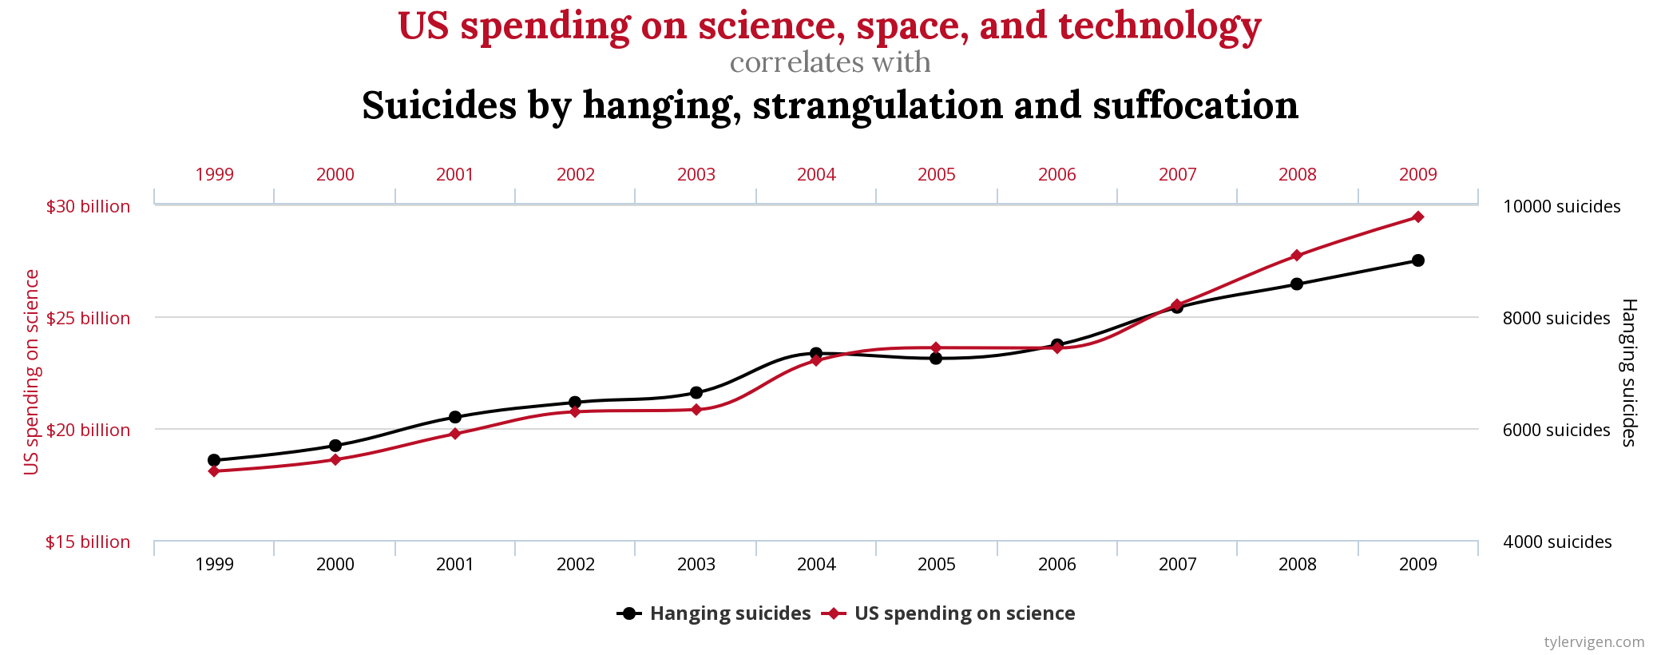
Abuse of Visualization: Axes of Evil
An entire gallery
There are books on the topic
Notes:
Might be a textbook example of spurious correlation, if there is a common time component but you never know for sure…

Slide 24
Color: Palettes and Color Harmonies
Color psychology is a good starting point
There are several tools to build your own palettes which follow the color harmony rules, and check if the images are color-blind-friendly:
https://color.adobe.com/create/color-wheel
https://paletton.com/
Color blindness simulator. allows to display images as seen by people with different types of color vision deficiency
See this article on creating color blind-friendly visualizations. tl;dr version – avoid combinations of red and green
Notes:
It’s a broad topic, so we will just briefly mention the sources

Slide 25
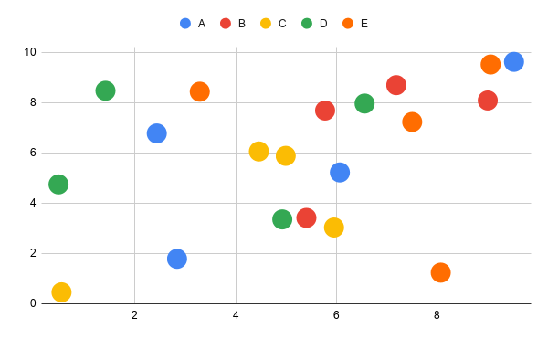

Color Blindness
Original
Green-blind
The most common types of color blindness affect ability to discriminate red and green colors
Image credit: Chaulio Ferreira

Slide 26
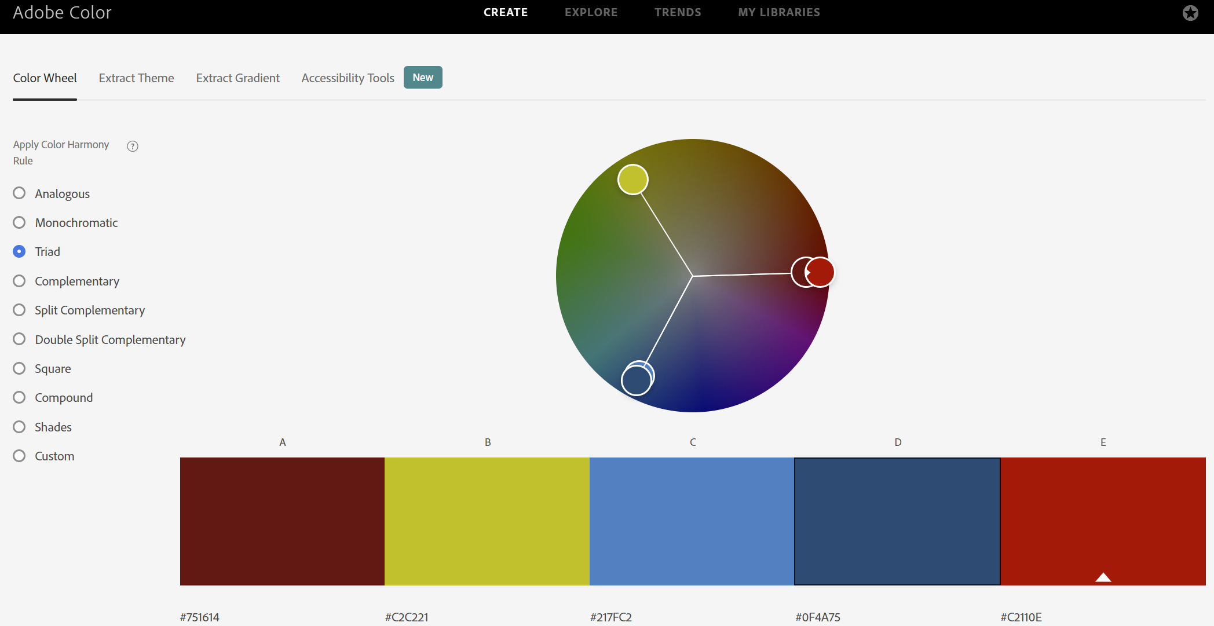
Color Wheel: Custom Palettes
Notes:
Triad color harmony rule: 120 degrees on a color wheel + plus different levels of saturation for different shades of the same color

Slide 27
Notes and Hints
Currently we are bombarded with data and visuals. Use 'active viewing' approach -- when you see, for instance, a chart in a scientific or in media, pause for a moment and ponder: 'what is good or bad about this chart?' or 'what would I do differently?'.
A similar technique can be applied to reading and writing.
Maintain a gallery of the charts you make: some rare operations are quite forgettable, so you will save time by referring to your own work instead of sifting through stackoverflow posts.
The less is better: if you can avoid cluttering a single chart and do several charts instead, do it!
Notes:
Currently we are bombarded with data and visuals. Use 'active viewing' approach -- when you see, for instance, a chart in a scientific or in media, pause for a moment and ponder: 'what is good or bad about this chart?' or 'what would I do differently?'.
A similar technique can be applied to reading and writing.
Maintain a gallery of the charts you make, for instance in a jupyter notebook, including the data you use and a well-commented code. Some rare operations, like using axis locators in matplotlib are quite forgettable, so you will save lots of time by referring to your own work instead of sifting through stackoverflow posts.
The less is better: if you can avoid using multiple axes on a single chart and do several charts instead, do it!

Slide 28
Links
David McCandless on data visualization
National Geographic article on visualization
A short video on chart manipulation

