Slide 1
Magnetic Spin Dynamics Simulations
Ata Utku Özkan

Slide 2
Outline
Theory
Simulations
Literature
Discussion

Slide 3
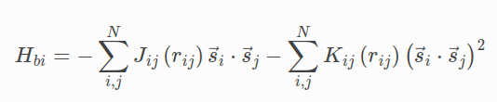

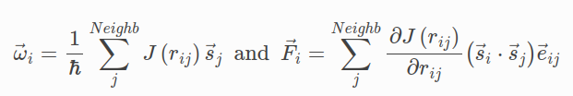
Theory
w
s
r
Massively parallel symplectic algorithm for coupled magnetic spin dynamics and molecular dynamics J. Tranchida et al.

Slide 4

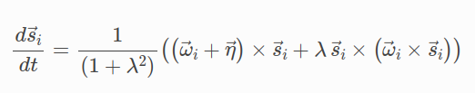


Theory
w (random)
Langevin thermostat with Temperature T
Selection of a Stochastic Landau-Lifshitz Equation and the Stochastic Persistence Problem Jacky Cresson (LMAP), Yasmina Kheloufi, Khadra Nachi, Frédéric Pierret (IMCCE)

Slide 5
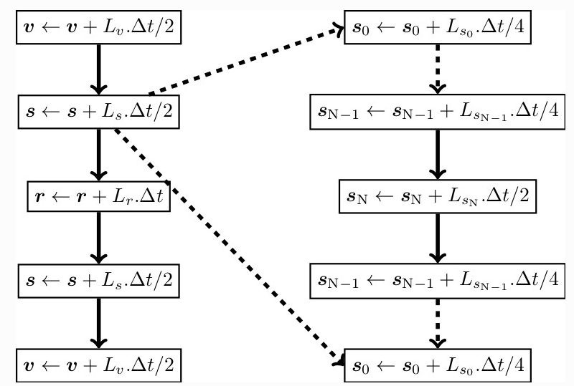


Theory
Only relevant quantity is s as our lattice is frozen.
L is the Liouville operator

Slide 6
Simulations
mass = grams per mole
force = eV/Angstrom
distance = Angstroms
time = picoseconds
energy = eV
torque = eV
temperature = Kelvin
magnetization = magnetic moment per unit volume
magnetic moment = eV/K
20 K
Iron – BCC
Cubic Anisotropy
(Easy Axis along 111)
Fixed Boundary
Units: Metal

Slide 7

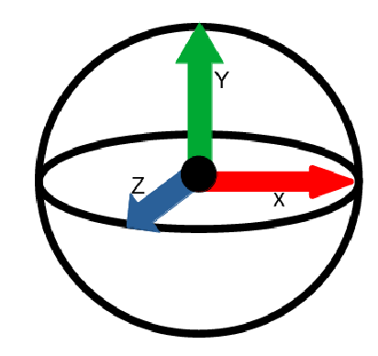
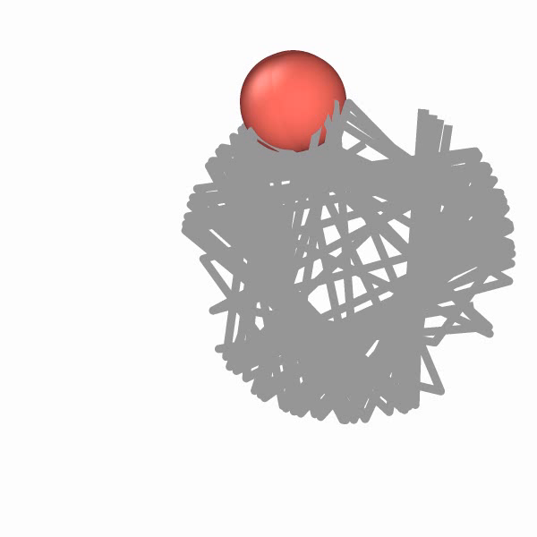
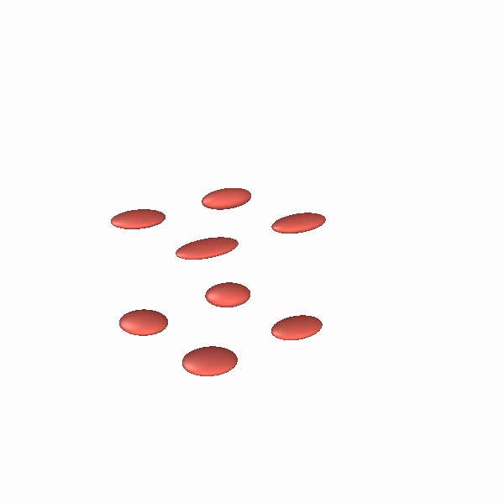
Simulations
Spin directions as positions

Slide 8
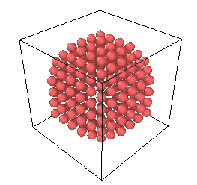
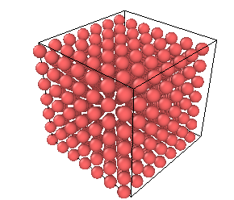
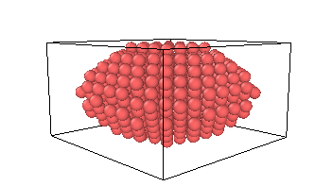
Simulations

Slide 9
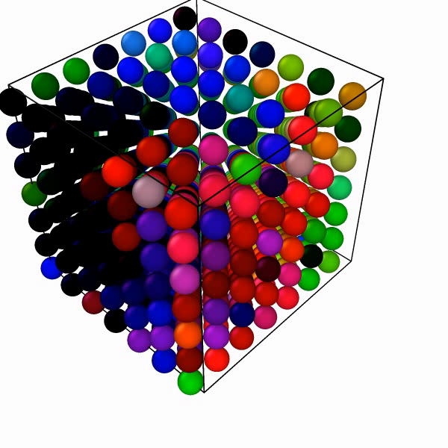
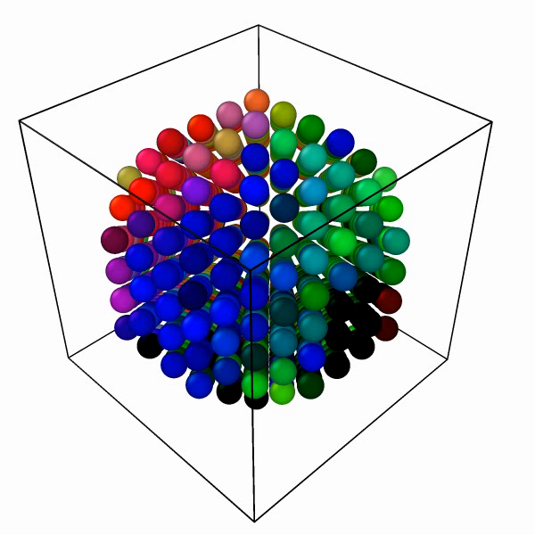
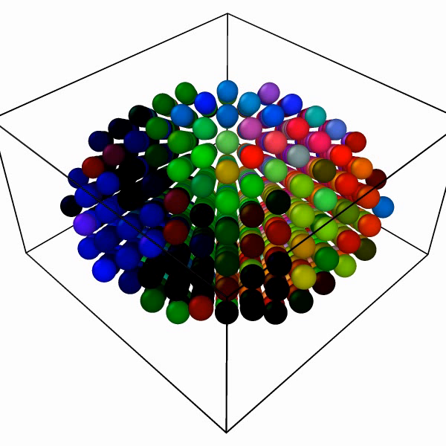
Simulations
Cube
Sphere
Ellipsoid

Slide 10
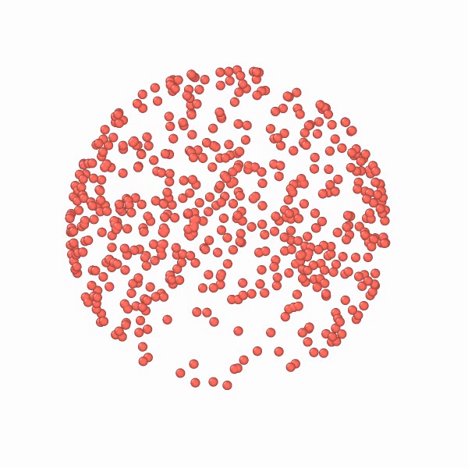
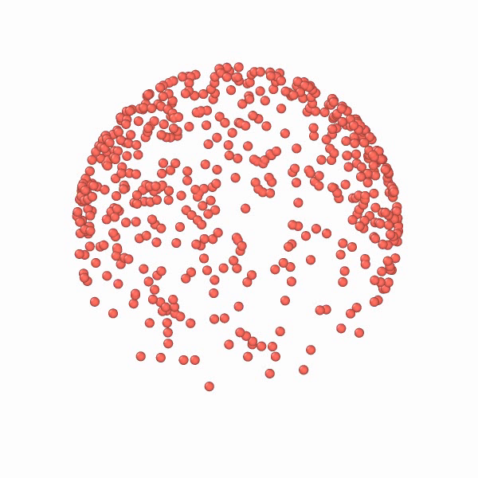
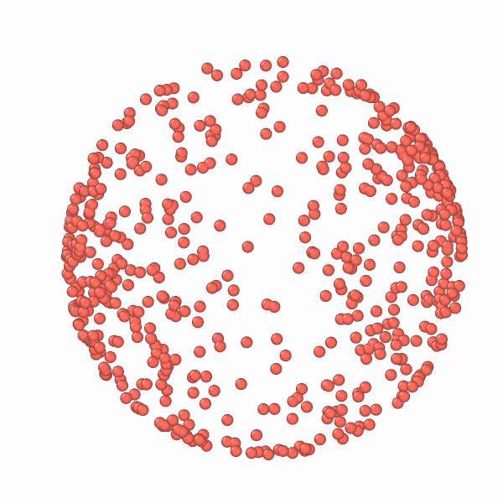
Simulations – Phase Space
Cube
Sphere
Ellipsoid

Slide 11
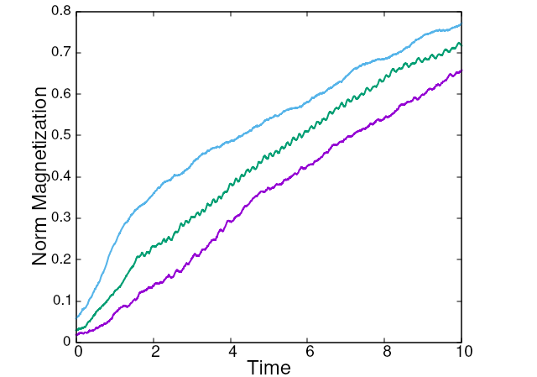
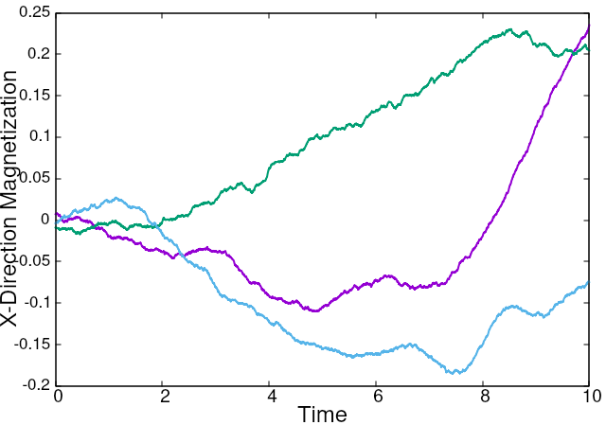
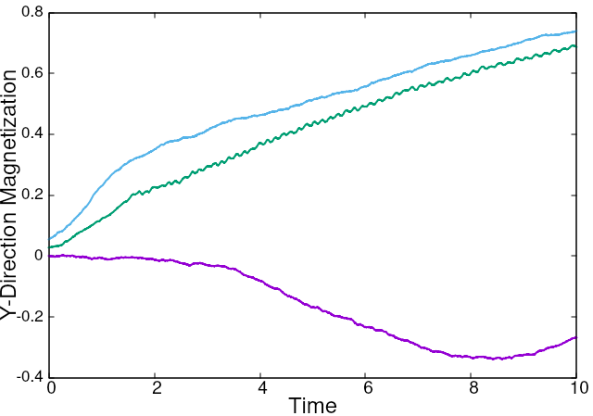
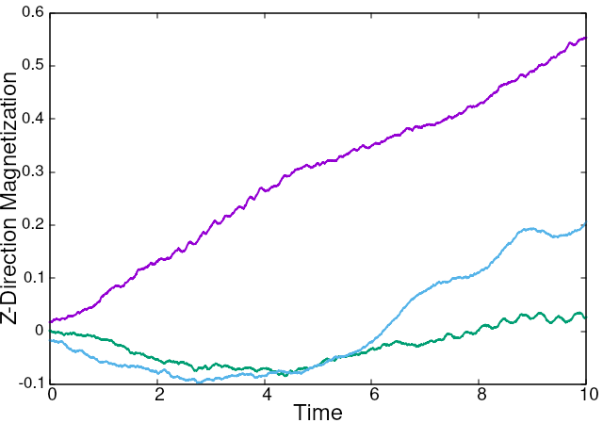
Simulations

Slide 12
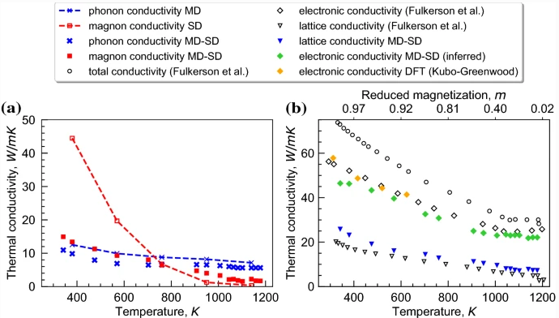
Literature
Nikolov et al.
Dissociating the phononic, magnetic and electronic contributions to thermal conductivity: a computational study in alpha-iron.
Nikolov, S., Tranchida, J., Ramakrishna, K. et al. Dissociating the phononic, magnetic and electronic contributions to thermal conductivity: a computational study in alpha-iron. J Mater Sci 57, 10535–10548 (2022). https://doi.org/10.1007/s10853-021-06865-3

Slide 13
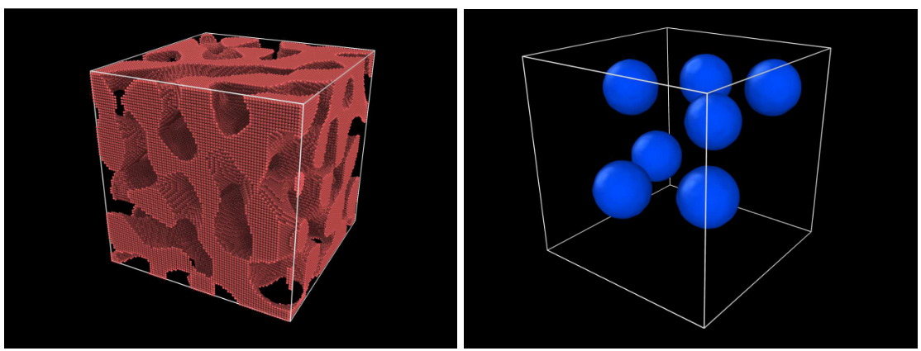
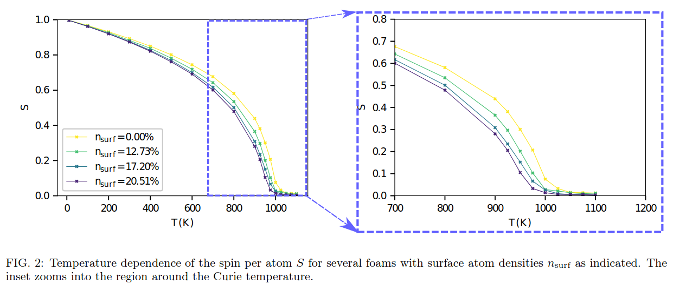
Literature
Meyer et al.
Temperature-dependent magnetism in Fe foams via spin-lattice dynamics
fraction of surface atoms in foams = nsurf
Robert Meyer, Felipe Valencia, Gonzalo dos Santos, Romina Aparicio, Eduardo M. Bringa, Herbert M. Urbassek, Temperature-dependent magnetism in Fe foams via spin-lattice dynamics, Computational Materials Science, Volume 211, 2022, 111483, ISSN 0927-0256, https://doi.org/10.1016/j.commatsci.2022.111483.

Slide 14
Discussion
At this small scales initial configuration of spins is a determinant.
Shape affects magnetic properties at ~ 1nm ~ 1ps scale
Spin waves are both visualizable and easy to analyze with this model
Completely classical model
Can be used to model moving spins (i.e spins of liquid atoms)
Parametrization is hard

Slide 15


