Slide 1

LLM Integration Exercise: Email Classification and Automation
Presented by:
Ata Mohseni

Slide 2
Goal:
To build a system that uses Large Language Models (LLMs) to classify incoming emails and automate the responses based on the classification
Approach:
There are three main steps to build this system:
The classification Module: it gets a received email, and return a corresponding category for that email
The response generation module: the input is a received email and a corresponding category of the email from step 1, and the output is a generated response email
The automation module: the automated pipeline to implement the step 1 and step 2 process

Slide 3
Diagram for three main steps:
Input: customer email
Automation module
Classification Module
Response Generation
Module
Output: generated response email

Slide 4
Classification module has
three main component in itself
Response Generation module has
three main component in itself
Classification Module
Response Generation Module
Prompt
Prompt
LLM
LLM
Raw Output
Raw Output

Slide 5
Controlling LLM output and error handling
Controlling the LLM output with prompt (i.e., prompt engineering):
Modify the prompt and try to use the best prompt to get the most desirable output corresponding to the specific task
Note that modifying prompt does not guarantee the desired output
Verify the input data, and the LLM output with custom verification check
Verify the input data type and format to every module before passing it to the prompt and make LLM API call
Verify the output of LLM to make sure it is an acceptable output

Slide 6
Classification Prompt:
Option 1: extraction prompt
Given the following email, classify the email and assign one
Of given categories.
…..
Structure your output in the following format:
<output>
<string name=“sentiment” format= “chose from category1, category2,… ” />
</output>
Classification Module
Prompt
LLM
Option 2: use function calling ( Preferred)
functions = [
{
"name": "classification",
"description": "classify the email and assign one of given categories.",
"parameters": {
"type": "object",
"properties": {
"sentiment": {
"type": "string",
"description": f""“ sentiment of the email, should be one of category 1,category2,…""“,
"enum": [category 1,category2,…],
},
},"required": ["sentiment"]
},
}
]
Raw Output

Slide 7
Classification Prompt – Function calling ( OpenAI gpt-3.5-turbo and OpenAI gpt-4 )
What is function calling?
Given the function name, description, and information about function argument in structured format in prompt as well as user input task, LLM return the name of the function and appropriate arguments of function to complete the user input requested task.
Advantages of Function calling:
Easy to add more thing to extract
Make sure to get structured format data
You can assign that use of function calling
is mandatory, optional, or forbidden.
You can assign which function arguments
are mandatory and which ones being optional.
Option 2: use function calling ( Preferred)
functions = [
{
"name": "classification",
"description": "classify the email and assign one of given categories.",
"parameters": {
"type": "object",
"properties": {
"sentiment": {
"type": "string",
"description": f""“ sentiment of the email, should be one of category 1,category2,…""“,
"enum": [category 1,category2,…],
},
},"required": ["sentiment"]
},
}
]

Slide 8
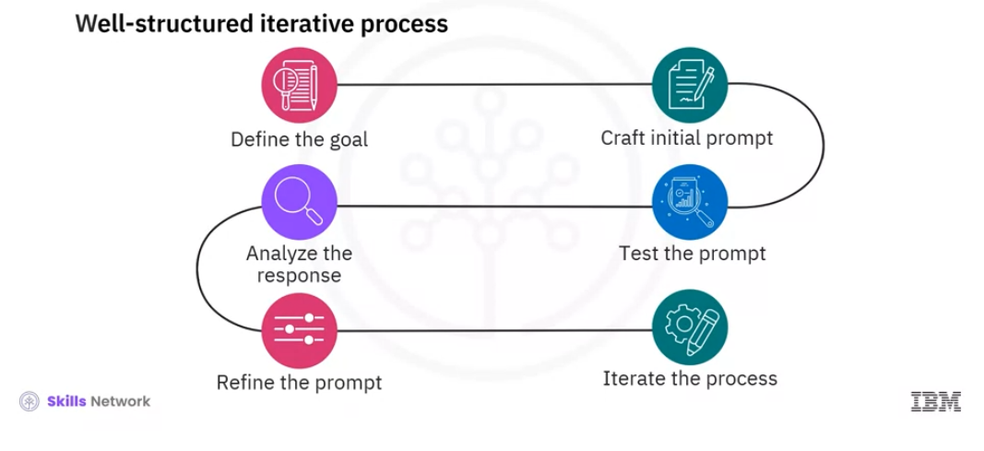
Email Generation Prompt
Process involved in prompt engineering:

Slide 9
Email Generation Prompt
complaint_template = f"""You are a great customer service agent \
who can reply to a complaint emails promptly. Based on the \
following received email, write an appropriate email response \
to the customer, and let the customer know that we recieved the complain. \
Let the customer know that a member of team will reach to him soon to address
the issue. \
Make sure to use the polite and understanding tone. \
Do not use placeholder in email, use "customer" for the recipient's name. \
Only Sign the response email with "Customer Service Team".
Here is the received email information:
customer email body: {email['body’]}
"""
Prompt specification:
Goal: given the email and its corresponding classification, LLM should generate appropriate response respectively.
Unique prompt: One specific prompt for each classification category.
Use Domain expert: use domain specific role and terminology.
i.e. you are a customer service agent with 10 years of experience …
Include contextual guidance and style
Include output format: use “customer” for recipient name. Only sign the response email with “Customer Service Team”

Slide 10
Verification and Error Handling
Input email data format
LLM classification output
LLM email generation output
yes
OpenAI No-refusal?
yes
No place holder?
yes
No empty message?
yes
Type Dict?
yes
Correct Keys?
yes
Non-empty values?
yes
OpenAI No-refusal?
yes
Is JSON?
yes
Valid Category?

Slide 11
Email input
Received email is OK
Automation Module
customer
email
customer
email
yes
Type Dict?
yes
Correct Keys?
yes
Non-empty values?
classification
Received Email data Verification
Classification Module
Response generation Module
Prompt
Prompt
LLM
LLM
Raw Output
Raw Output
yes
OpenAI No-refusal?
yes
No place holder?
yes
No empty message?
yes
OpenAI No-refusal?
yes
Is JSON?
yes
Valid Category?
LLM response generation verification
LLM output classification verification
pass
pass
classification
Classification specific handling task
Generated email
Response Email output

Slide 12
github:
https://github.com/AtaMohseni/llm-email-classifier-completed

