Slide 1
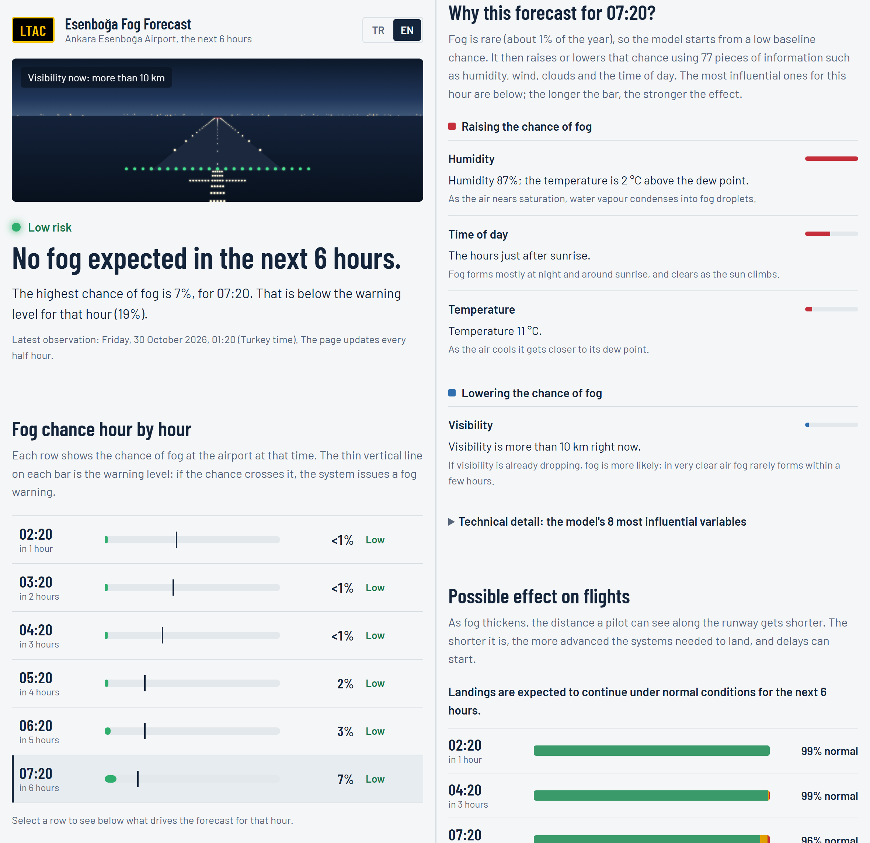
Explainable Machine-Learning Nowcasting of Fog and Low Visibility at Esenboğa
An explainable early-warning system
Ata Sakik (25290085)
YMH453 Machine Learning, Ankara University Software Engineering, 2026
Notes:
Hello. In this project I built an early-warning system that nowcasts fog and low visibility at Ankara Esenboğa Airport 1, 3 and 6 hours ahead, explains its decisions and runs live. I will cover the problem, data and method, results and the application.

Slide 2
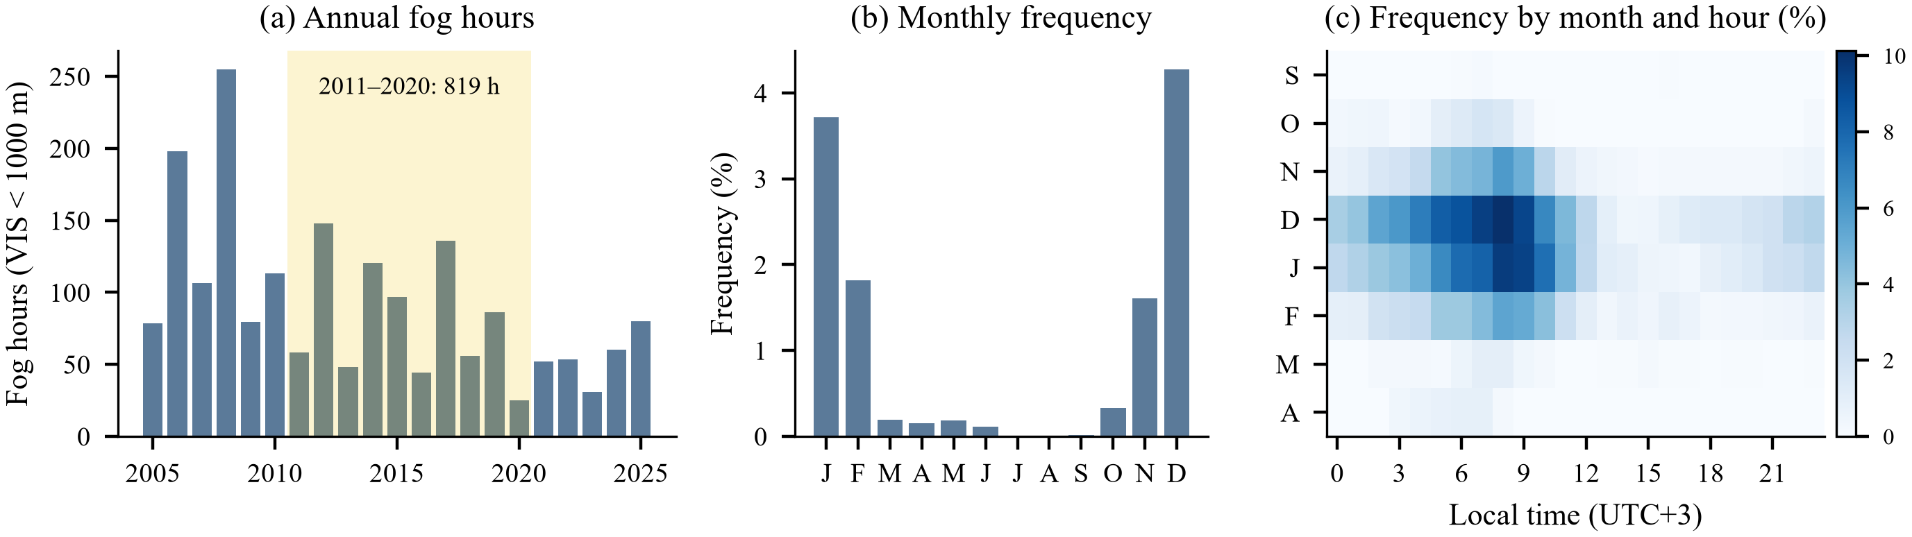
Fog is Esenboğa's key operational weather risk
94.6%
819.5 h
55.5%
of fog occurs October–February
fog hours 2011–2020 (literature ≈800 h)
of fog observations with RVR ≤ 350 m (CAT III)
Notes:
Fog is the main cause of delays and diversions. Our data set reproduces the published climatology: 94.6% of fog in Oct–Feb, 819.5 fog hours in 2011–2020 (≈800 h reported), and RVR ≤ 350 m in 55.5% of fog observations.

Slide 3
Gap and contributions
State of the art
1
21.8-year open data set
quality-controlled METAR/SPECI reproducing the climatology
Esenboğa: climatological and synoptic analyses (2010, 2022)
No machine-learning forecast model
Fair comparison with official TAF/TREND is rare
What models learn is rarely explained
2
Benchmark of 6 model families
calibration, imbalance ablation, bootstrap significance
3
ILS/RVR category forecasts
ordinal formulation, onset/dissipation analysis
4
Explainability with SHAP
learnt relationships consistent with fog physics
5
Live early-warning application
same pipeline, tiered alerts, real-time verification
Notes:
Existing Esenboğa studies are climatological; no ML forecast exists. Internationally, matched comparisons with the official forecasts and physical explanations are rare. Our five contributions are listed on the right.

Slide 4
Data: 21.8 years of METAR/SPECI
385,018
99.7%
537
METAR/SPECI reports after QC
coverage of the 30-min grid
fog episodes; median duration 2 h
1.02%
99.9%
109 / 47
fog slots (VIS < 1000 m)
RVR reported when VIS < 1500 m
reports removed / values corrected
Sources: Iowa Environmental Mesonet (original METARs), Ogimet (gap filling 2005–2012), NOAA AWC (live data, last 30 days of TAFs). Synthetic ISD records (no RVR/TREND) were removed.
Notes:
Data come from the IEM archive; synthetic ISD-derived records without RVR/TREND were removed and gaps filled from Ogimet. A purpose-built decoder parses visibility, RVR of every runway, weather, clouds and TREND groups; QC applies range and spike checks.

Slide 5
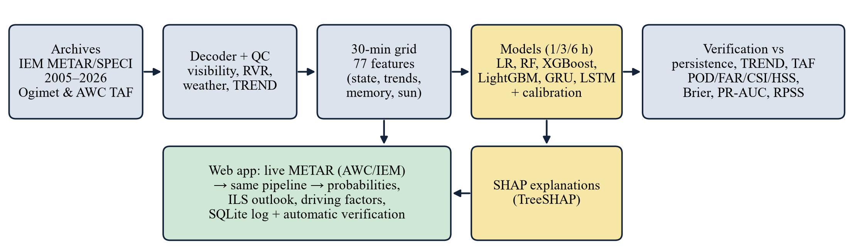
Method overview
Notes:
Pipeline: archives, decoder and QC, 30-min grid with 77 features, models and calibration, verification. The web app reuses the same code, so offline and live forecasts are identical (proven by a parity test).

Slide 6
Targets and predictors
Predictands (1, 3, 6 h ahead)
Group | n | Examples
Current state | 21 | visibility, RVR, T, Td, T−Td, RH, wind, QNH, cloud
Present weather | 11 | FG, BCFG/MIFG, BR, HZ, DZ, RA, SN
Tendencies | 19 | 1/3/6-h cooling, drying/moistening, visibility trend
Memory | 13 | cooling since 12-h max, hours since fog, snow fraction
Sun and calendar | 13 | solar elevation, time to sunrise
Fog: prevailing visibility < 1000 m
CAT I+: RVR ≥ 550 m
CAT II: 350 ≤ RVR < 550 m
CAT III: RVR < 350 m
Boundaries: Çamalan et al. (2010), ICAO Doc 9365.
Notes:
Two targets: visibility below 1000 m and ILS categories (550/350 m, as used for Esenboğa). The 77 predictors form five groups; valid-time solar terms are deterministic and known in advance.

Slide 7
Models and leakage-free validation
Training
2005–2019
Validation
2019–2022
Test
2022–2026
Live
2026–
Models
Imbalance and calibration
Leakage control
Logistic regression (baseline)
Random forest
XGBoost and LightGBM (Optuna, 30 trials)
Multi-task GRU and LSTM (12-h sequence, GPU)
Fog is only 1% of samples
SMOTE/weights distort probabilities
Calibration: none/Platt/isotonic
Threshold: max CSI on validation
Features use data up to t only
Target is a new report at t+h
Automated leakage tests (17 tests)
Test seasons evaluated once
Notes:
Chronological, season-aligned split; six model families; Optuna tuning on validation seasons; no resampling in the final models because SMOTE and class weights distort probabilities; calibration chosen by leave-one-season-out CV.

Slide 8
All models significantly beat persistence
+12% +45% +130%
relative CSI gain at 1/3/6 h (LightGBM)
6 / 6
models significant at every lead (bootstrap, p < 0.05)
1 h: LightGBM
3–6 h: GRU/LSTM best probabilistic skill
Notes:
On four independent test seasons the best CSI is 0.73/0.47/0.34 vs 0.65/0.32/0.13 for persistence (+12/45/130%). All six models are significantly better at every lead time (paired day-block bootstrap). Boosting wins at 1 h, recurrent nets at 3–6 h.

Slide 9
It also beats the official TREND forecast
CSI at 1 h
LightGBM
0.73
Persistence
0.65
TREND (official)
0.62
ΔCSI = +0.105
LightGBM − TREND, 95% CI [0.075, 0.140]
Notes:
TREND (the forecaster's official 2-h forecast) reaches CSI 0.62, persistence 0.65 and LightGBM 0.73 on identical cases: ΔCSI = 0.105 [0.075, 0.140]. Skill decays smoothly with lead time while the gap to persistence widens. In the 30-day TAF window no fog occurred and neither TAF nor the model raised a false alarm.

Slide 10
The hard part: fog onsets
86%
dissipations forecast 6 h ahead (GRU; persistence 68%)
2–21%
onsets captured at the max-CSI thresholds
×2–3
more onsets flagged at the watch level
Notes:
Persistence cannot predict onsets or dissipations. Dissipations are captured well (GRU 86% at 6 h); onsets are hard (6–21% at the max-CSI thresholds). The tiered alert design helps: the watch level (half the threshold) flags 25/21/38% of onsets 1/3/6 h ahead at a small CSI cost.

Slide 11
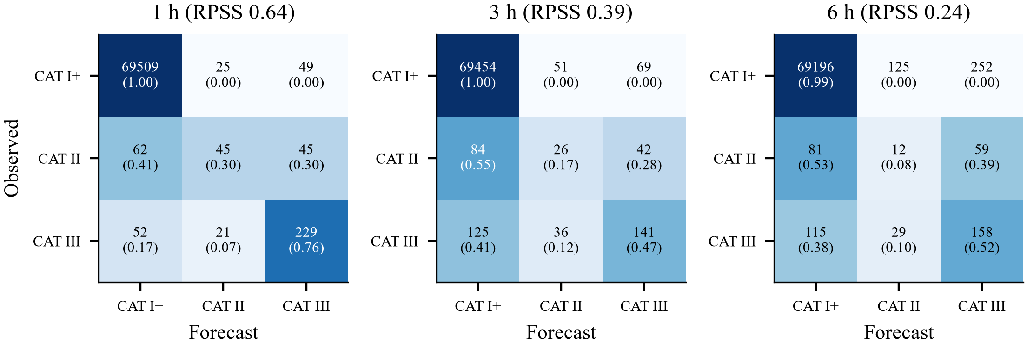
ILS-category forecasts
0.64
RPSS 1 h
0.41
RPSS 3 h
0.28
CAT III (RVR < 350 m): 76% correct at 1 h
CAT II: narrow transitional band, often confused
Persistence RPSS: 0.43 → −0.17 → −0.70
RPSS 6 h
Notes:
ILS categories are forecast as an ordinal problem with two binary models (RVR < 550 m, < 350 m). RPSS reaches 0.64/0.41/0.28 at 1/3/6 h (persistence −0.70 at 6 h). CAT III is recognised in 76% of cases; CAT II, a narrow transitional band, is hardest.

Slide 12
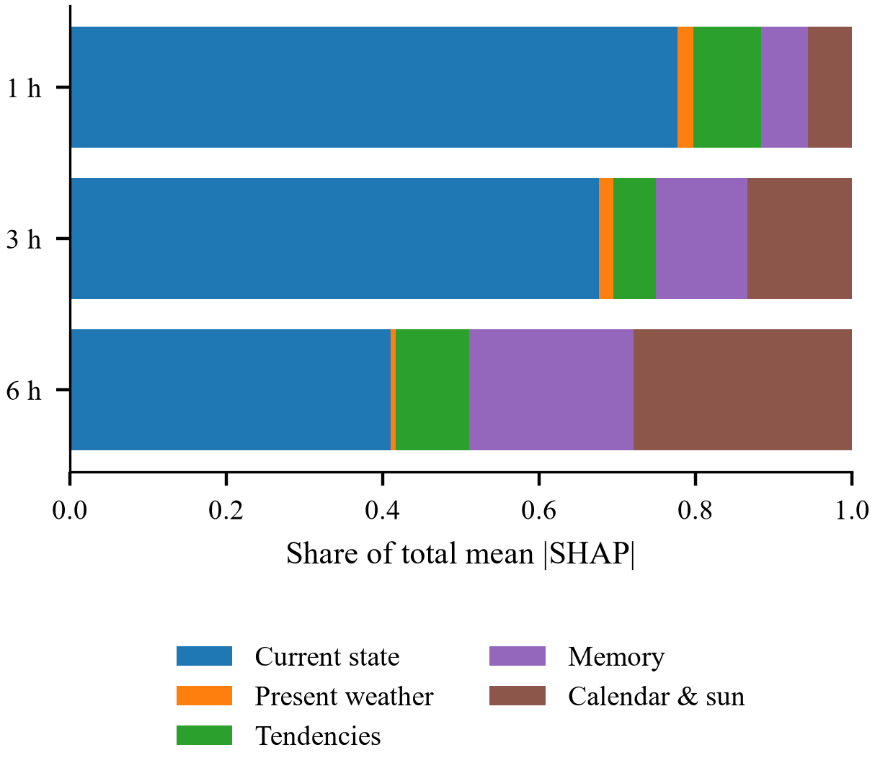
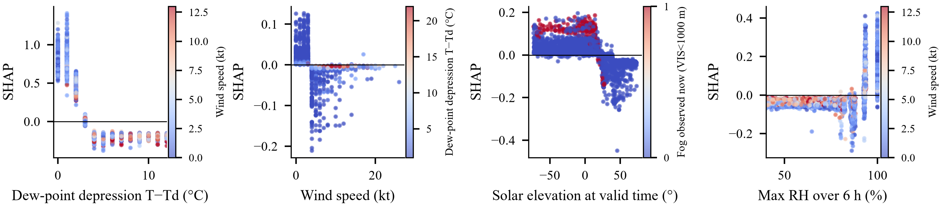
Explainability: the model learnt fog physics
1 h: current humidity and visibility (78%)
6 h: sun/calendar 28%, memory 21%
T−Td ≤ 2 °C and wind ≤ 3 kt → fog
After sunrise → dissipation
Notes:
SHAP shows the current state dominates at 1 h (78%), while at 6 h sun/calendar (28%) and boundary-layer memory (21%) rise. Dependence plots reproduce textbook physics: T−Td ≤ 2 °C raises the risk, winds > 3 kt suppress fog, sunrise dissipates it.

Slide 13
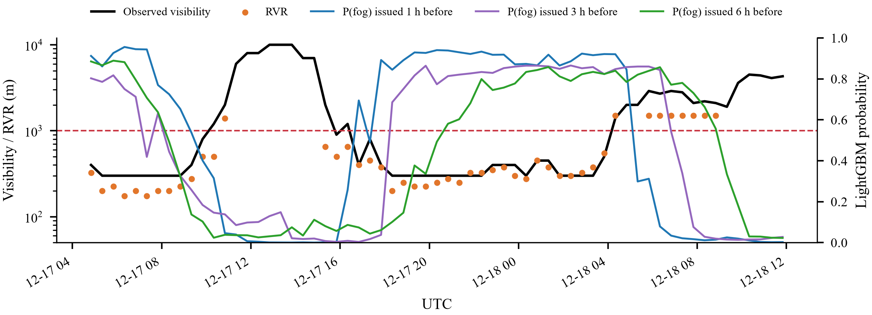
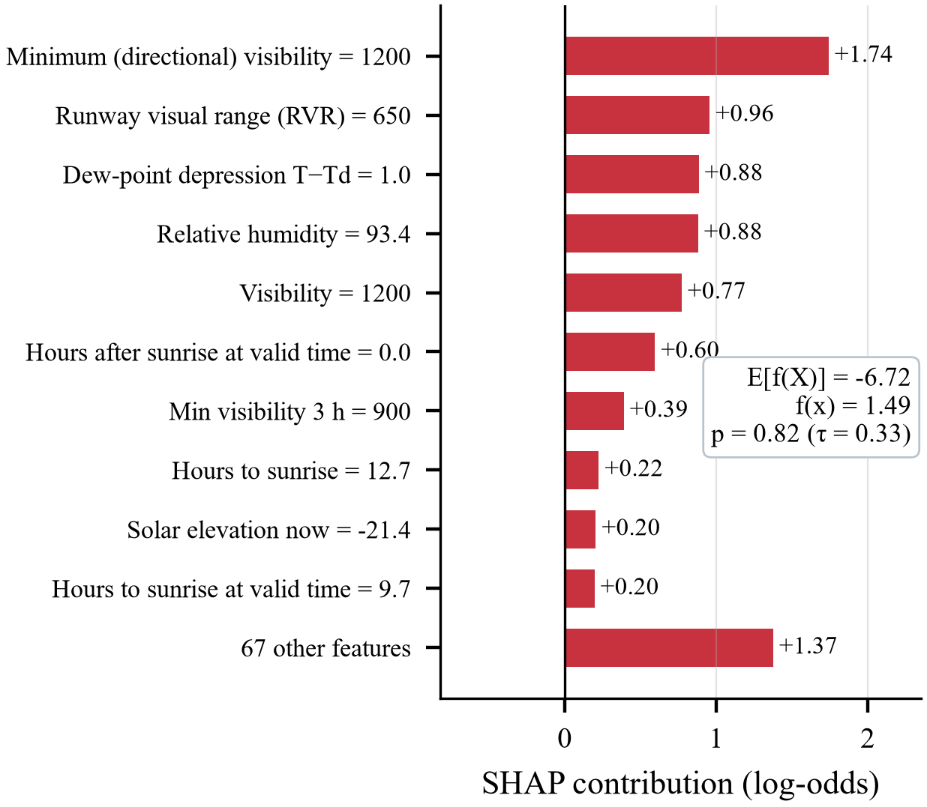
Case study: 17–18 December 2022
p = 0.82
30 min
fog probability for +3 h issued at 16:20 UTC (threshold 0.33)
later, fog formed (16:50 UTC)
Notes:
A two-stage episode: fog cleared in the afternoon and re-formed at 16:50 UTC. At 16:20, with visibility still 1200 m, the 3-h model warned with p = 0.82. The SHAP explanation shows the reasons: falling minimum visibility, RVR 650 m, T−Td 1 °C and RH 93%.

Slide 14
Live early-warning application
Live METARs every 10 min (NOAA AWC, IEM fallback)
Identical pipeline to training: parity difference 0.0
Tiered alerts: green / yellow (watch) / orange / red
SHAP-based driving factors in plain language
SQLite log with automatic real-time verification
July–October 2026: 5,700+ forecasts, 0 false alarms
Live page (GitHub Actions, every 30 min): atasakik.github.io/esenboga-fog-nowcasting
Notes:
Every 10 minutes the app fetches the latest METARs, runs the same pipeline and shows 1–6 h probabilities, the ILS outlook, an alert level and SHAP explanations. Every forecast is logged and verified automatically. Parity test: zero difference in 240 comparisons. July–October 2026 replay: no fog and not a single false alarm.

Slide 15
Conclusion
0.73 / 0.47 / 0.34
+0.105 CSI
Physically consistent
best CSI at 1/3/6 h; persistence 0.65 / 0.32 / 0.13
over the official METAR TREND at 1 h (significant)
SHAP: saturation, weak mixing, radiative cycle
Future work
NWP, satellite and ceilometer predictors for onset detection
Full-season TAF comparison (live log)
Transfer to other Turkish airports
Thank you
github.com/AtaSakik/esenboga-fog-nowcasting
Notes:
In summary: the first ML fog nowcast for Esenboğa; all models beat persistence and the official TREND; the models are physically consistent and run live. Future work: NWP and satellite predictors, full-season TAF comparison, transfer to other airports. Thank you — questions are welcome.

