Slide 1
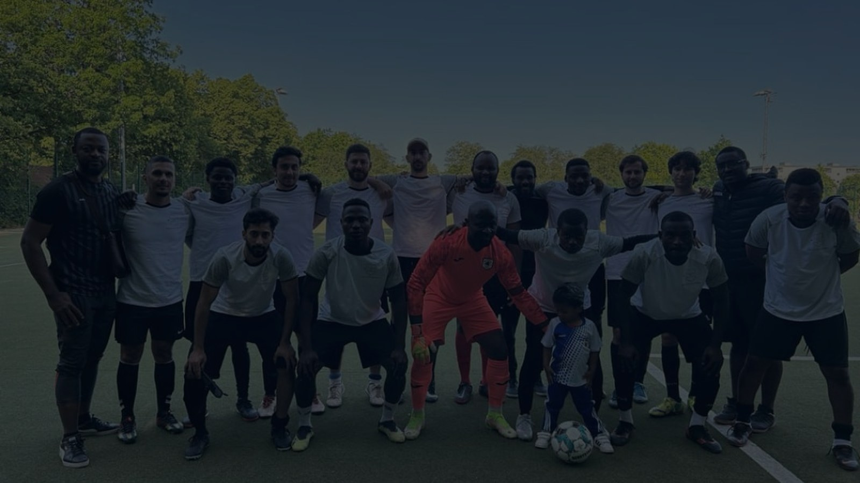

SC METROPOLIS 25 BERLIN e.V.
MEMBERS UPDATE · JULY 2026
One Club.
One City.
One Movement.
2019
Founded in
Berlin-Lichtenberg
37
Registered
Members
133+
Community
Members
Wo Berlin pulsiert, wächst unsere Stärke.
10+
Nationalities
in our squad
What started with seven friends has become one of Berlin's newest football clubs.
Notes:
SLIDE 1 — WELCOME & STATE OF THE CLUB Good evening everyone, and welcome. I'm really glad so many of you could join us tonight. We are SC Metropolis 25 Berlin e.V. — and this is our first official online members' meeting. That in itself is something worth acknowledging. We have a club. We have members. We have a community. And tonight, we want to share with you everything that has been built, everything that is in motion, and everything we need from each of you to take this to the next level. Let me start where it all began. In 2019, a small group of friends — seven of us — started meeting every Saturday in Berlin-Lichtenberg to play football. No club. No structure. Just a ball and a passion for the game. Today, we are a registered non-profit sports club with 37 registered members, over 133 community members, representing more than 10 nationalities. From seven friends to one of Berlin's newest officially registered football clubs. That journey is remarkable, and it was built by this community. Our motto captures it perfectly: 'Wo Berlin pulsiert, wächst unsere Stärke.' — Where Berlin pulses, our strength grows. [PAUSE — let the slide speak] So tonight, let's talk about where we are, how far we've come, and where we're going.

Slide 2
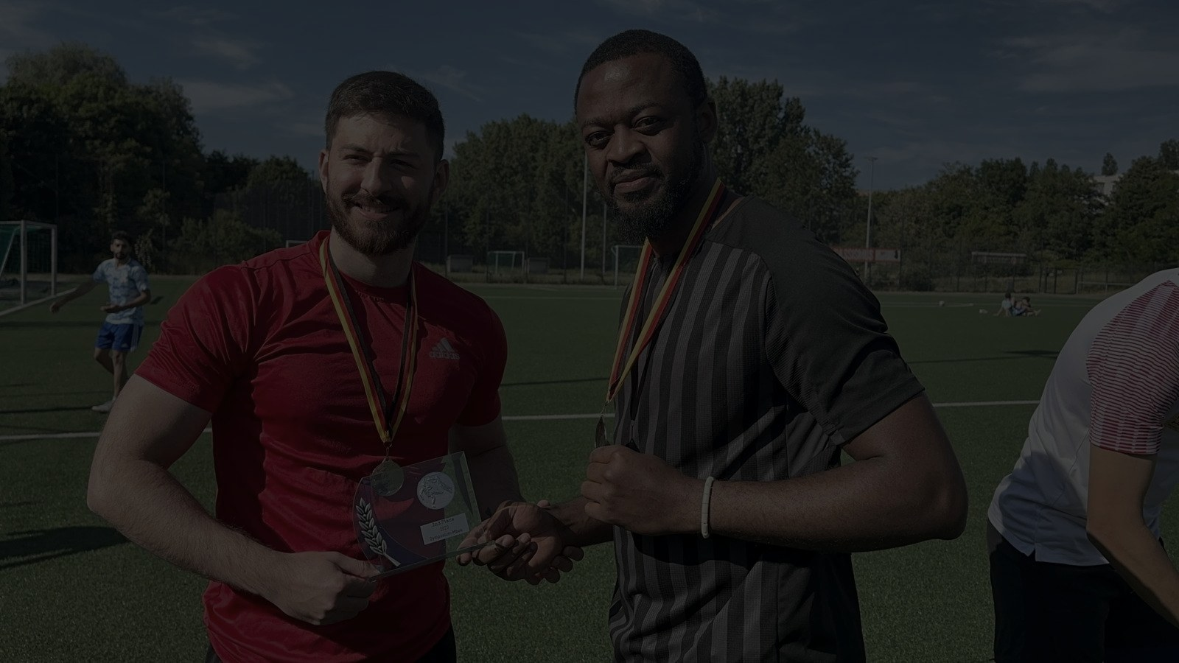





WHAT WE HAVE ACHIEVED
From a group of friends to a fully registered Berlin sports club.
FOOTBALL
CLUB DEVELOPMENT
ADMINISTRATION
GROWTH
First men's team established
Registered association (e.V.)
Provisional BFV admission
Sponsorship presentation ready
Symposium Mboa 2023 Finalist
Non-profit status secured
Statute amendments prepared
Sponsor outreach launched
Tournoi Intégration Berlin 2026
QF — Symposium Mboa 2026
Website launched
Sporting recognition applied
First companies contacted
QF — African Cup Berlin 2026
Club branding completed
Legal structure in place
Community growing fast
DFBnet registration underway
An incredible amount has been achieved within a very short time.
Notes:
SLIDE 2 — WHAT WE HAVE ACHIEVED Now let me walk you through what this club has actually built — because sometimes we are so busy with the next step that we forget to appreciate how far we've come. On the football side: we have an established men's first team. We reached the final of the Symposium Mboa 2023. And in 2026, we officially participated in multiple Berlin tournaments — the Tournoi de l'Intégration Berlin, where we competed strongly; the Symposium Mboa 2026, where we reached the quarter-final; and the African Cup Berlin 2026, where we again reached the quarter-final. We are currently registering on DFBnet — the official German football player management platform. This is not a Sunday kickabout. This is a real club going places. On club development: we are a registered non-profit association — an 'eingetragener Verein.' That is a legal status that took real work to achieve. We have a professional website, a complete visual identity, and a brand that represents us with pride. On administration: we have been provisionally admitted into the Berlin football system. Our statutes have been amended to meet all legal requirements. We have filed an application for official sporting recognition — and we are waiting for that to be confirmed. And on growth: our sponsorship presentation is complete. Outreach has started. Several companies have already been contacted. The community around this club continues to grow every week. [PAUSE] An incredible amount has been achieved in a very short time. And I want you to feel proud of that — because you are all part of it.

Slide 3




WHERE WE STAND TODAY
A clear-eyed view of our current position.
COMPLETED
IN PROGRESS
HIGHEST PRIORITY
· Registered Association (e.V.)
· Sporting recognition
· Permanent training facility
· Football team structure
· Sponsor acquisition
· BBV basketball reg. by Aug 30
· Website live
· Bank account setup
· Club branding
· Women's football planning
· Sponsorship presentation
· Partnerships & networks
· Provisional BFV admission
OUR IMMEDIATE PRIORITY: PERMANENT TRAINING GROUND
We are actively working with district sports offices and football clubs to secure a permanent facility. We are fully flexible on: location · weekday · training time · shared use.
The club is ready. The missing piece is our permanent home.
Notes:
SLIDE 3 — WHERE WE STAND TODAY I believe in being transparent with you. So let me show you exactly where we are — what is done, what is in progress, and what our most urgent priority is. In green — completed: We are a registered association. We have a football team structure. Our website is live. Our branding is done. Our sponsorship presentation is complete. And we have received provisional admission into the Berlin football system. These are done. These are real. In amber — in progress: We are waiting for official sporting recognition from the Berlin authorities. Sponsor acquisition has begun and is ongoing. We are planning the launch of a women's section. And we are building partnerships with other organisations in Berlin. Now — red. One single priority stands above everything else right now. And I want to be honest with you about it. We do not yet have a permanent training ground. This is our biggest constraint. Without a fixed location, we cannot regularise our training schedule, we cannot register for official league football, and we cannot build the kind of structure that takes a club to the next level. We are actively working on this. We are in conversations with district sports offices in several Berlin boroughs. We are approaching football clubs about shared use. We are completely flexible — any location, any weekday, any training time, shared or exclusive use. If anyone here tonight knows a school, a sports club, a football facility, or has a contact in a district sports office — please, come and speak to us after this meeting. This is the one thing that will change everything. [PAUSE] The club is ready. The missing piece is our permanent home.

Slide 4
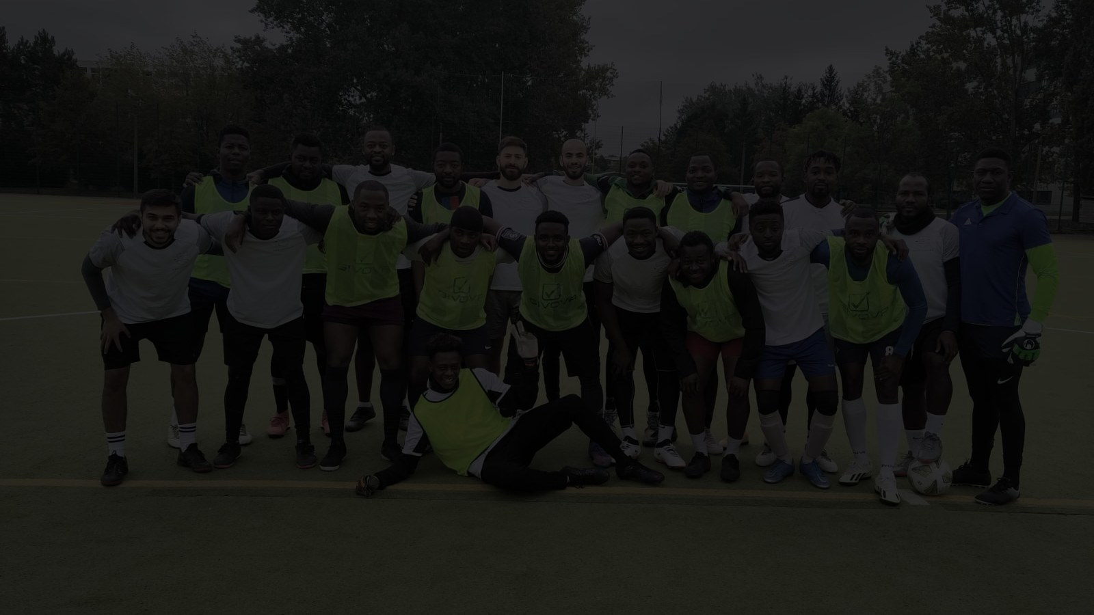


VISION 2030
Building More Than A Football Club.
PHASE 1 · NOW
PHASE 2 · 2026
FUTURE VISION
Football First
Basketball
Full Sports Club
Establish official
league football in Berlin
Launch basketball
dept. · 25+ members
BBV registration
by Aug 2026
Handball · Volleyball
Tennis · Youth dev.
Women's football
Community events
Our immediate priority is football. Our long-term ambition is to become one of Berlin's leading multicultural community sports clubs.
Notes:
SLIDE 4 — VISION 2030 Now I want to share something that I think will inspire you — our vision for what SC Metropolis 25 can become by 2030. We are not building a football club. We are building a multicultural community sports club for Berlin. Phase 1 — and this is our absolute immediate focus — is to establish official league football. Get our team into competitive fixtures, registered on DFBnet, and playing in the Berlin football system. This is the foundation. Without this, nothing else happens. Phase 2 — and this is very close — is basketball. We already have over 25 members who are interested. We have a concrete plan to register a basketball department with the Berliner Basketball Verband by the end of August 2026. If anyone here tonight is a basketball player, or knows one — speak to us tonight. And looking further ahead — the future of SC Metropolis 25 includes handball, volleyball, tennis, youth development, women's football, and community events that bring all of our communities together. I want to be clear: we are not rushing. Every phase depends on building the previous one properly. Football first — then everything else follows. But I want you to know the direction we are going. Because when you pay your membership fee, when you help us find a training ground, when you introduce us to a potential sponsor — you are not just supporting a football club. You are building something much bigger. [PAUSE] SC Metropolis 25 — one of Berlin's leading multicultural community sports clubs by 2030. That is the vision. And we are already on the way.

Slide 5




THE NEXT CHAPTER STARTS WITH ALL OF US
Every Member Can Make A Difference.
MEMBERSHIP FEE
SPORTS FACILITY
SPONSORS
VOLUNTEER
€10 / month
Help Us Find a Home
Introduce Us
Your Time Matters
Covers federation fees, insurance, player registrations, facilities, equipment, website, training & kits.
Do you know schools, football clubs, sports halls, facility managers or district officials? Any lead helps.
Your employer, local businesses, restaurants, gyms, banks, insurance companies, startups. One introduction can change everything.
Football, basketball, events, social media, administration, community building. Every hour counts.
Pay via PayPal
kontakt@sc-metropolis25.de
⚠ Bank account setup in progress
SC Metropolis 25 was not built by one person.
It was built by a community. The next chapter begins with all of us.
Notes:
SLIDE 5 — THE NEXT CHAPTER STARTS WITH ALL OF US And now we come to the most important part of this meeting. Because everything I've shown you tonight — the structure, the vision, the achievements — none of it continues without your active contribution. So I want to speak very directly about four ways every single member can help. First: the membership fee. Ten euros a month. That is not a large amount — but it is essential. Right now, before we have sponsors, your membership fees are the primary source of income for this club. They pay for our federation fees, our insurance, player registrations, training facilities, equipment, website, and our team kits. Until we secure long-term sponsors, this is what keeps SC Metropolis 25 running. Please pay your fee. And please pay it consistently. Second: help us find a sports facility. This is our number one challenge, and your network might hold the answer. Do you know a school with a sports hall? A football club with a pitch that's available? A facility manager? A contact at a district sports office? Any lead — no matter how small — could be the one that solves this. Please share anything you know. Third: help us find sponsors. You know people we don't know. Your employer, your local businesses, restaurants, gyms, banks, insurance companies, startups. One introduction to the right person can unlock a sponsorship that changes the financial picture of this club. We have a professional sponsorship deck ready to share. All we need is the door to open. Fourth: volunteer. We need people for football, for basketball planning, for events, for social media, for administration. If you have one hour a week to give, we will find something meaningful for you to do. [PAUSE] SC Metropolis 25 was not built by one person. It was built by a community. Every one of you sitting here tonight is part of that community. The next chapter begins with all of us. Thank you. And now I'd like to open the floor for questions and discussion. [Q&A — allow 10–15 minutes. Key topics to be ready for: membership fee payment methods, training ground timeline, BFV registration status, basketball launch date.]

Slide 6
THANK YOU
Questions & Discussion
We welcome every question, idea, and suggestion.
kontakt@sc-metropolis25.de · sc-metropolis25.de
Wo Berlin pulsiert, wächst unsere Stärke. · SC Metropolis 25 Berlin e.V.
Notes:
SLIDE 6 — THANK YOU & Q&A And on that note — thank you. Thank you for being here tonight. Thank you for being part of SC Metropolis 25. Thank you for everything you have already given to this club — your time, your energy, your belief. We have covered a lot tonight: where we come from, what we have built, where we stand, and where we are going. And I hope you leave this meeting feeling proud, informed, and motivated. Now — the floor is yours. Please ask any question, share any idea, or raise anything that is on your mind. This is your club. Your voice matters here. [OPEN Q&A — suggested duration: 10–15 minutes] Key topics to be prepared for: — Membership fee: when and how to pay (PayPal: kontakt@sc-metropolis25.de — bank account coming soon) — Training ground: current status and how members can help — BFV and DFBnet registration: timeline and what it means — Basketball department: launch plans and BBV registration by Aug 30 — Women's football: interest and planning status — Sponsorship: how members can make introductions [CLOSE] Thank you all once again. Stay connected. Stay involved. And let's make the next chapter of SC Metropolis 25 the best one yet. Wo Berlin pulsiert, wächst unsere Stärke.

