Slide 1

Ip lookup algorithms
Algorithm implementation Complexity analysis
Switching and Routing 2019/20 Professor: Guido Maier Tutor: Sebastian Troìa Group 2

Slide 2


What is ip lookup
A router holds a routing table which contains prefix entries, and destination port.
When a router receives a packet, it searches for the longest prefix of the destination IP address in its routing table.

Slide 3
Binary tries
p1
p2
p3
0
1
p4
A multi-way tree with each node containing next-hop info and 0/1/2 pointers to child node(s)

Slide 4
Binary tries
Binary trie represented prefix of different lengths and lookup for the longest prefix that matches the destination IP. Each node has the value of the leaf node which is store in the next hub. A node can have 0, 1 or2 child that is indicated with the left and right side of that node.
it makes its path to reach prefix under the branch of each node. When we have destination address it goes through the algorithm to find the longest matched path but if it can't find the longest it will return the last matching prefix.
If a node containing a prefix mark (*) is seen, store it somewhere as the longest match.

Slide 5
Binary Function describe
AddChild
add child to each nodes
Lookup
looking for the next hub for backtrack
reaching prefixes
Create
reading IP address from database
LookupNonRecursive
Creating trie by calling AddChild
Save backtrack
convert_in_bin
convert received IP to binary

Slide 6
Multibit tries
create
0
result
1
result
0
Back
track
0
1
0
1
0
Back
track
0
1
Stride 1
Stride 2
Each node is a mini complete tree, with number of levels
equal to the stride

Slide 7
Multibit tries
In the multibit trie structure, each node has a record of $2^{\text{stride}}$ entries and each has two fields: one for the stored prefix and one for a pointer that points to the next child node.
In the multibit trie structure, each node has a record of 2^"stride" entries and each has two fields: one for the stored prefix and one for a pointer that points to the next child node.
Stride looks in several bits in time. the number of strides indicates the number of bits that we want to traverse and prefix shorter than of stride expanded to the stride.
Despite its advantage that lookup improved by n times when it is n bit, it has a disadvantage of using large memory space.
N-bit are inspected at each step. Each Node has potentially child nodes. The result is a faster lookup, as each step more then one bit is inspected.

Slide 8
Multibit Function describe
stride
AddChild
add child to each nodes
Lookup
looking for the next hub for backtrack
reaching prefixes
stride
stride
Save backtrack
Create
reading IP address from database
LookupNonRecursive
Creating trie by calling AddChild
convert_in_bin
convert received IP to binary

Slide 9
NFV SAR-application
A pre-developed sar-application has been modified to send IP addresses from a client virtual machine to a server virtual machine
client side sar-application frequently sends IP addresses to be looked up on server side
Server side sar-application calls unibit or multibit lookup algorithms to find the received IP address among the trie
The trie is made by functions explained before using a random database of 100 prefixes

Slide 10
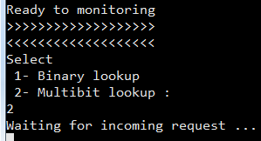

Sar application
By running server-side sar-application we have two choices:
Binary lookup
Multibit lookup
In this case, Multibit lookup has been chosen and application waits for incoming request from the client
After receiving every IP packets, Multibit lookup algorithm will run and starts looking up for the received IP address from client among its trie.
After each lookup, the consumed time will be printed on the screen and also saved on a text document.

Slide 11

Performance
Lookup complexity: $O(W)$
Update complexity: $O(W)$
Where
is the number of prefixes
$$where$$
$$N: number of prefixes$$
$$A lookup by linear search would have complexity: O(N)W: maximum length (in bit) of the prefix$$
Binary trie
complexity

Slide 12

Real run Nfv implement
Numerical result for unibit:
Numerical results under the following conditions
Data-base entries: 100 IPs
To search enries : 5000 IPs
Sum of all lookup times: 0.031 s

Slide 13

Multibit trie complexity
Performance
- Lookup complexity: $O(\frac{W}{k})$
Lookup speed improves k times by a k-bit trie
- Update complexity: O(W/k+$2^{k}$)
Worst case: search through W/k nodes and access to each child of the last node (2k)
Where
N: number of prefixes
W: maximum length of the prefix
k: length of lookup strid

Slide 14


Real run Nfv implement
Numerical result for Multibit:
Numerical results under the following conditions
Data-base entries: 100 IPs
To search entries : 5000 IPs
Stride : 3
Sum of all lookup times: 0.0135 s
Stride 4
Sum of all lookup times: 0.0090 s

Slide 15
Compare graphs
All the results by CPU: intel core i5 – 3320M – 2.6 GHz

Slide 16
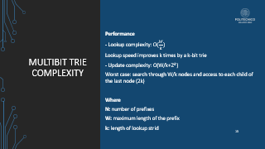
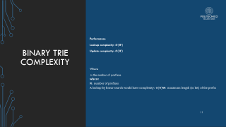
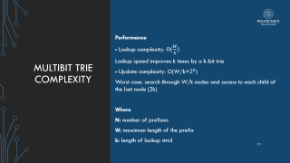
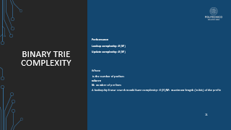
Comparing results
theoretically, based on the complexity, we expect that multibit trie should run faster than unibit trie
By implementing the algorithms and running them in a real environment we can get the expected results
As it can be seen, the complexity of the multibit trie is “k” times lower than the complexity of the unibit trie
In this regard, the graph from experimental results completely matches the theoretical values

Slide 17
Comparing results
The graph is based on looking up 5000 IPs. this value is based on running the algorithm for different number of IPs .
This means that the algorithm runs 50 times, each time the number of ips are increased 100 ips until it reaches 5000 ips.
For instance, at first run it looks up 100 ips, at 10th run it looks up 1000 ips and at the last run it looks up all the 5000 ips.
The graph shows that the efficiency of multibit trie is higher than binary trie. Also, by increasing the stride, we can see that efficiency gets better in case of time complexity.

Slide 18
Comparing results
The graph is based on looking up 5000 IPs. this value is based on running the algorithm for different number of IPs .
This means that the algorithm runs 50 times, each time the number of ips are increased 100 ips until it reaches 5000 ips.
For instance, at first run it looks up 100 ips, at 10th run it looks up 1000 ips and at the last run it looks up all the 5000 ips.
The graph clearly shows that the complexity of the algorithm is linear.
Also, like as previous graph, efficiency of the algorithm is proportional to the number of the stride

Slide 19



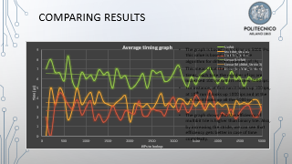
conclusion
From the theoretical point of view, the complexity of the binary lookup algorithm is linearly proportional to the number of the prefixes.
On the other hand, multibit trie algorithm is “k” time faster than unibit trie which k is the value of the stride
In this regard, by implementing both above-mentioned algorithm and running it a real environment, the expected result achieved correctly, and it shows that in real run of the algorithm, multibit trie has a faster looking up time

