Slide 1

Ip lookup algorithms
AMIRHOSEIN ataei hiva amiri kimia kiyan aida rezaeepoor tina emami

Slide 2

What is ip lookup
A router holds a routing table which contains prefix entries, and destination port.
When a router receives a packet, it searches for the longest prefix of the destination IP address in its routing table.

Slide 3
Binary tries
Function describe
p1
p2
p3
1
1
p4

Slide 4
Binary tries
AddChild : is implemented to add child to each nodes for reaching prefixes.
Lookup : looking for the next hub to indicate the path and if it is necessary to backtrack.
LookupNonRecursive :
Create : for reading IP address from database.
convert_in_bin : convert received IP to binary

Slide 5
Binary tries
Binary trie represented prefix of different lengths and lookup for the longest prefix that matches the destination IP. Each node has the value of the leaf node which is store in the next hub. A node can have 0, 1 or2 child that is indicated with the left and right side of that node.
it makes its path to reach prefix under the branch of each node. When we have destination address it goes through the algorithm to find the longest matched path but if it can't find the longest it will return the last matching prefix.
If a node containing a prefix mark (*) is seen, store it somewhere as the longest match.

Slide 6
Multibit tries
Function describe
create
left
Back track
result
right
Result
Strid 1
Strid 2
Strid 3
Back track

Slide 7
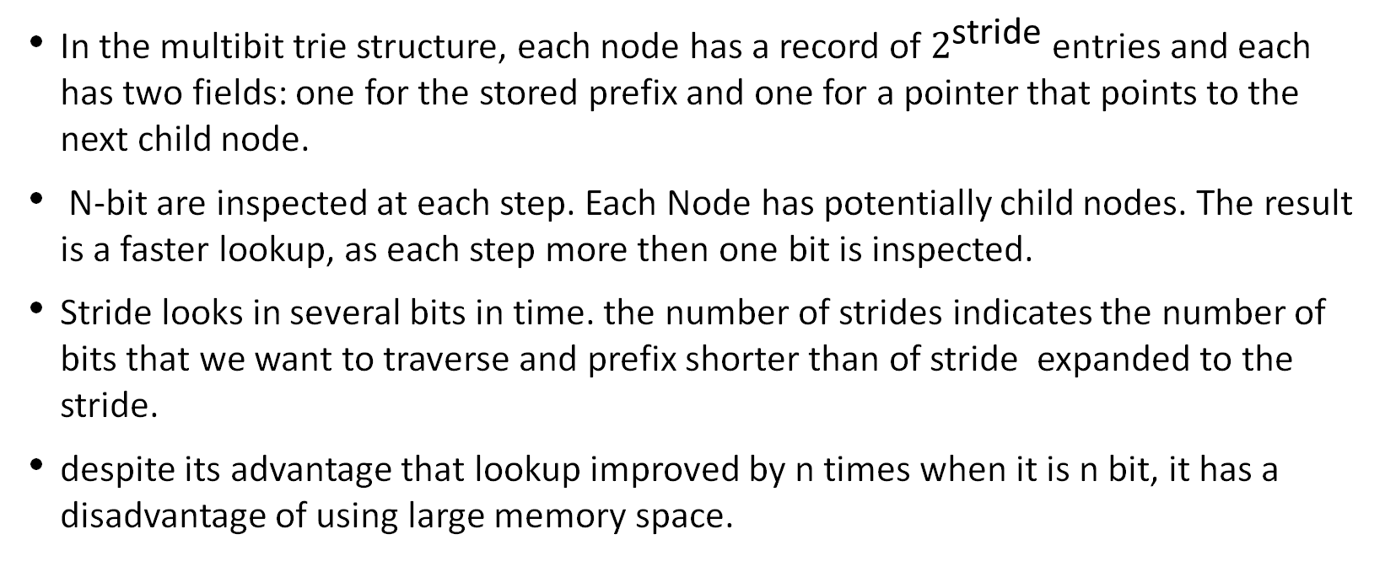
Multibit tries
In the multibit trie structure, each node has a record of $2^{\text{stride}}$ entries and each has two fields: one for the stored prefix and one for a pointer that points to the next child node.
N-bit are inspected at each step. Each Node has potentially child nodes. The result is a faster lookup, as each step more then one bit is inspected.
Stride looks in several bits in time. the number of strides indicates the number of bits that we want to traverse and prefix shorter than of stride expanded to the stride.
despite its advantage that lookup improved by n times when it is n bit, it has a disadvantage of using large memory space.

Slide 8

Performance
$$− Lookup complexity: O\left(W\right)$$
$$− Update complexity: O\left(W\right)$$
$$where$$
$$N: number of prefixes$$
$$W: maximum length (in bit) of the prefix \\ A lookup by linear search would have complexity: O(N)$$
Binary trie
complexity

Slide 9
Real run Nfv implement
Numerical result:

Slide 10

Multibit trie complexity
Performance
- Lookup complexity: O(W/k)
Lookup speed improves k times by a k-bit trie
- Update complexity: O(W/k+$2^{k}$)
Worst case: search through W/k nodes and access to each child of the last node (2k)
Where
N: number of prefixes
W: maximum length of the prefix
k: length of lookup strid

Slide 11
Real run Nfv implement
Numerical result:

Slide 12
complexity
Compare graphs

Slide 13
Describe compare

Slide 14
Multibit is more efficient
conclusion
2020

