Slide 1
PROJECT PRESENTATION ENSF 607
TITLE: GROUP PROJECT 3
TEAM MEMBERS:
Olayinka Afolabi
Oludare Busari
Pamela Ofurum
Emmanuel Alafonye

Slide 2
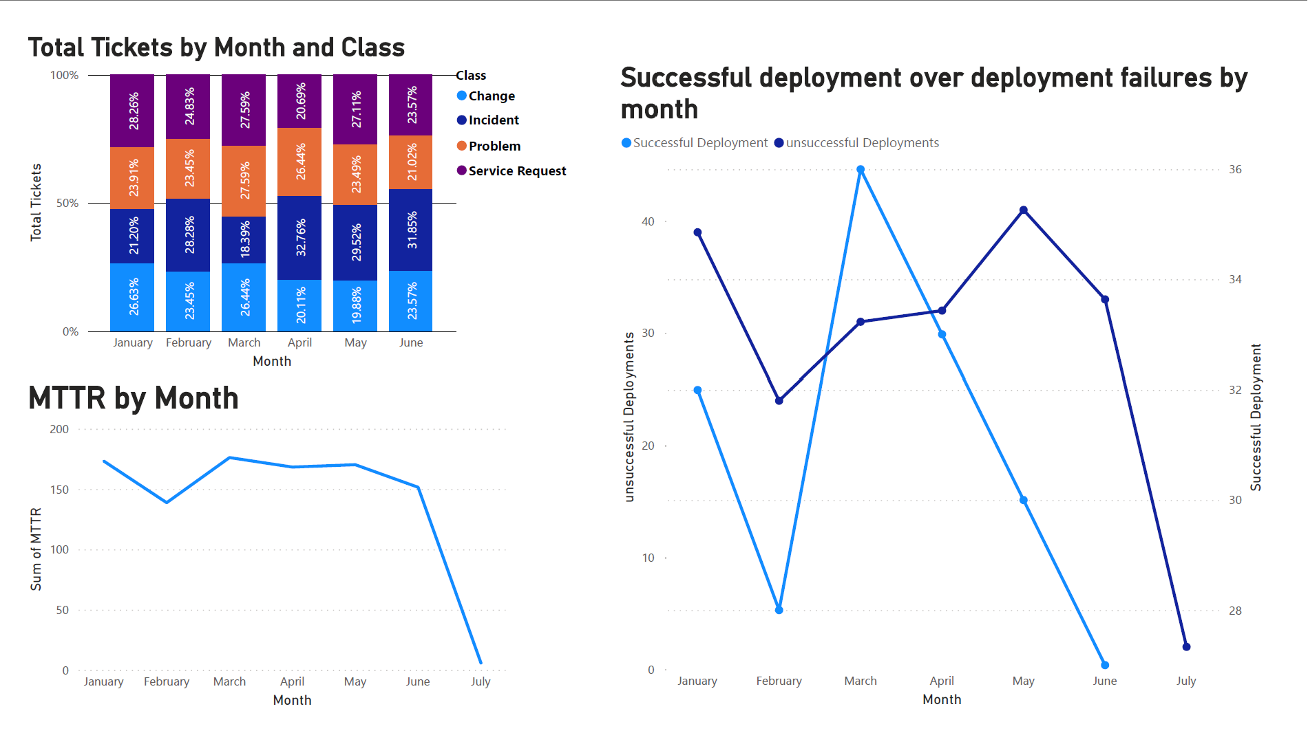
DASHBOARD SHOWING EVENT LOGS

Slide 3
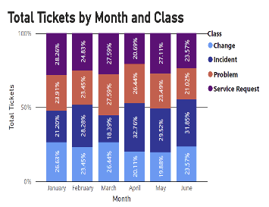
TOTAL TICKET BY MONTH & CLASS
Created a new measure to calculate the total number of tickets.
Using 100% stacked bar chart visualization, the start date on x-axis, total number of ticket on y-axis and legend distributed by class.
This dashboard broke down the number of tickets per class in a month.

Slide 4
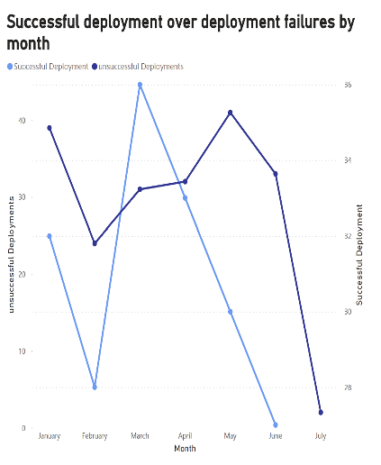
SUCCESSFUL DEPLOYMENT OVER DEPLOYMENT FAILURES OVER TIME
Ticket status column has 5 features which includes, Deployed, Deployed Failed, Open, in Process and on Hold.
Using the model view on power BI, we created a new measure called successful deployment and unsuccessful Deployment to filter out the required features.
From the dashboard we can see the Total Number of tickets that were Deployed or Deployment Failures in every month.
Looking at the month of April we have one more successful deployments (33) than unsuccessful deployments (32).

Slide 5
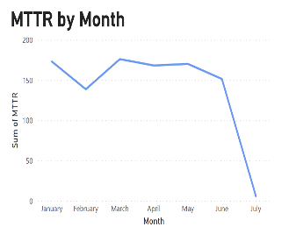
MTTR OVER TIME
The Mean Time to Repair(MTTR) is a measure of the time it takes to repair or restore a system, service or component after a failure.
If the number of case Id with a class indicated problem, the MTTR tends to be high and drops significantly when the number of the case Id indicated as a problem is low.
The lower the number of cases in a month, the lower the number of MTTR.

