Slide 1
Homework Assignment 0
Due Thursday (Midnight Baltimore Time)

Slide 2
Add yourself to the course website on Github Due Wednesday (Midnight Baltimore Time)
0. Download these slides at
1. If you do not already have a Github account, create one at https://github.com/
2. Fork the class repo https://github.com/JEFworks-Lab/genomic-data-visualization-2025
3. Clone the repo to your computer
4. Add a small 600x600px profile picture under the /profiles/ as [jhed].jpg
5. Create a profile for yourself under the /_authors/ folder as [jhed].md
6. Commit and push your local changes to your Github
7. Make a pull request to submit this assignment and merge your changes back to the class repo

Slide 3
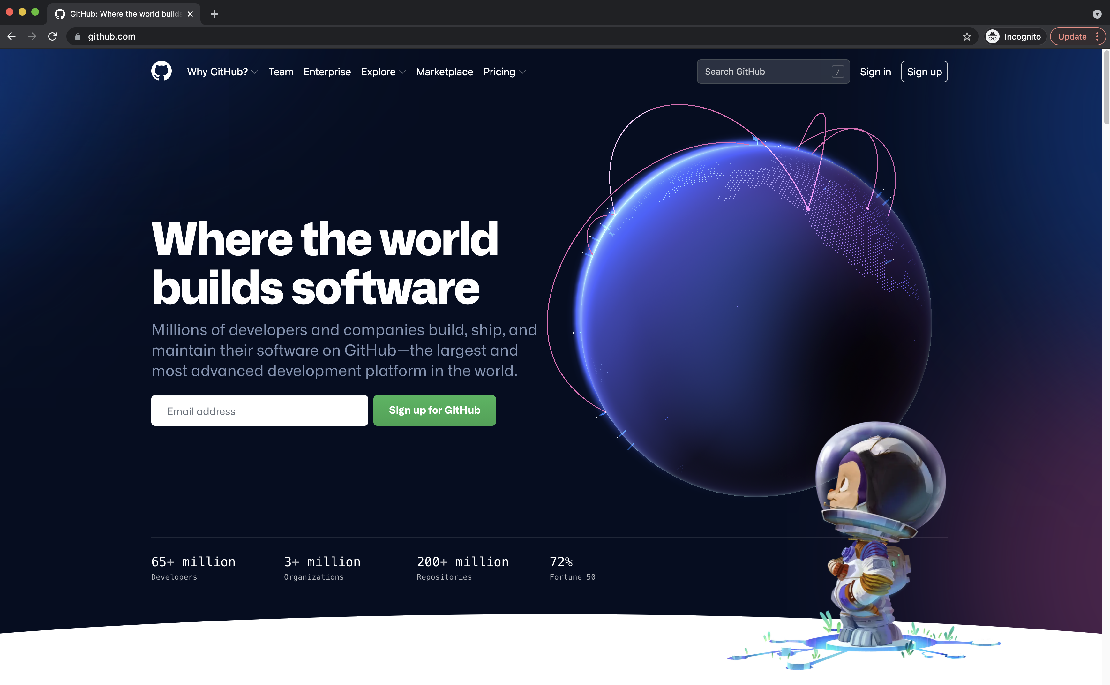
1. If you do not already have a Github account, create one at https://github.com/

Slide 4
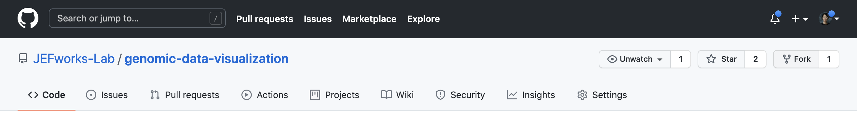
2. Fork the class repo https://github.com/JEFworks-Lab/genomic-data-visualization-2025

Slide 5
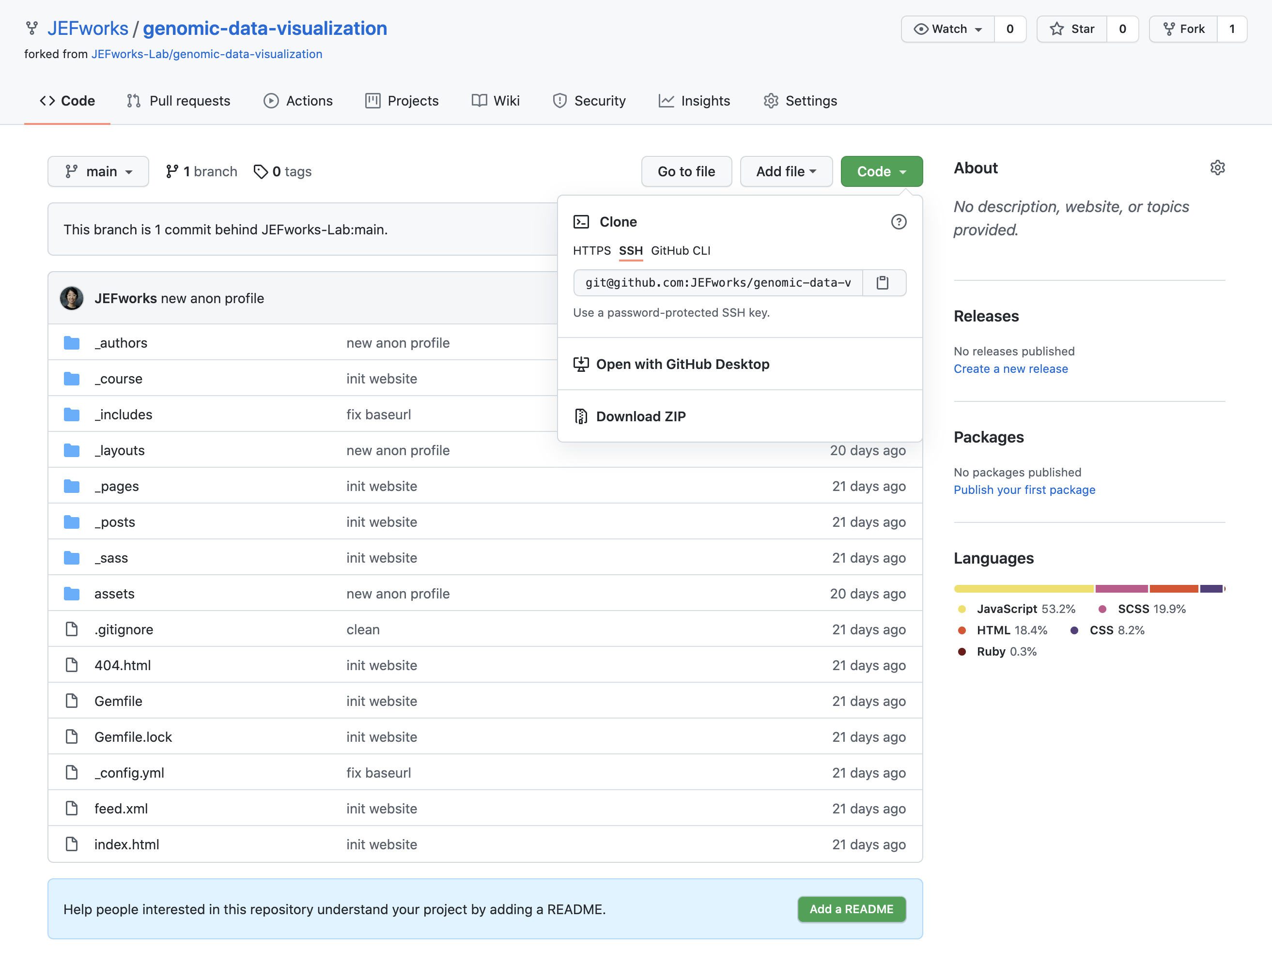
3. Clone the repo to your computer
An easy way to do this is using the command line. Copy the ssh text here, and in the command line (in a location you want to create this folder) type:
git clone [paste ssh text]
This will copy (or clone) the entire GitHub repo to your local machine.

Slide 6
4. Add a profile picture under the /profiles/ as [jhed].jpg
On your computer, add a 600x600 pixel photo of yourself under the profiles/ folder as [jhed].jpg
You can use a real photo of yourself, an avatar, or any fun (appropriate) picture.

Slide 7
5. Create a profile for yourself under the _authors/ folder as [jhed].md
under the _authors/ folder, copy the samplestudent.md markdown file to be [jhed].md
please do note overwrite samplestudent.md
edit the name to your first name and last initial
change the avatar URL to the image name you added under the /profiles/ folder

Slide 8
6. Commit and push your local changes to your Github.
Please double check that your changes are indeed on Github

Slide 9
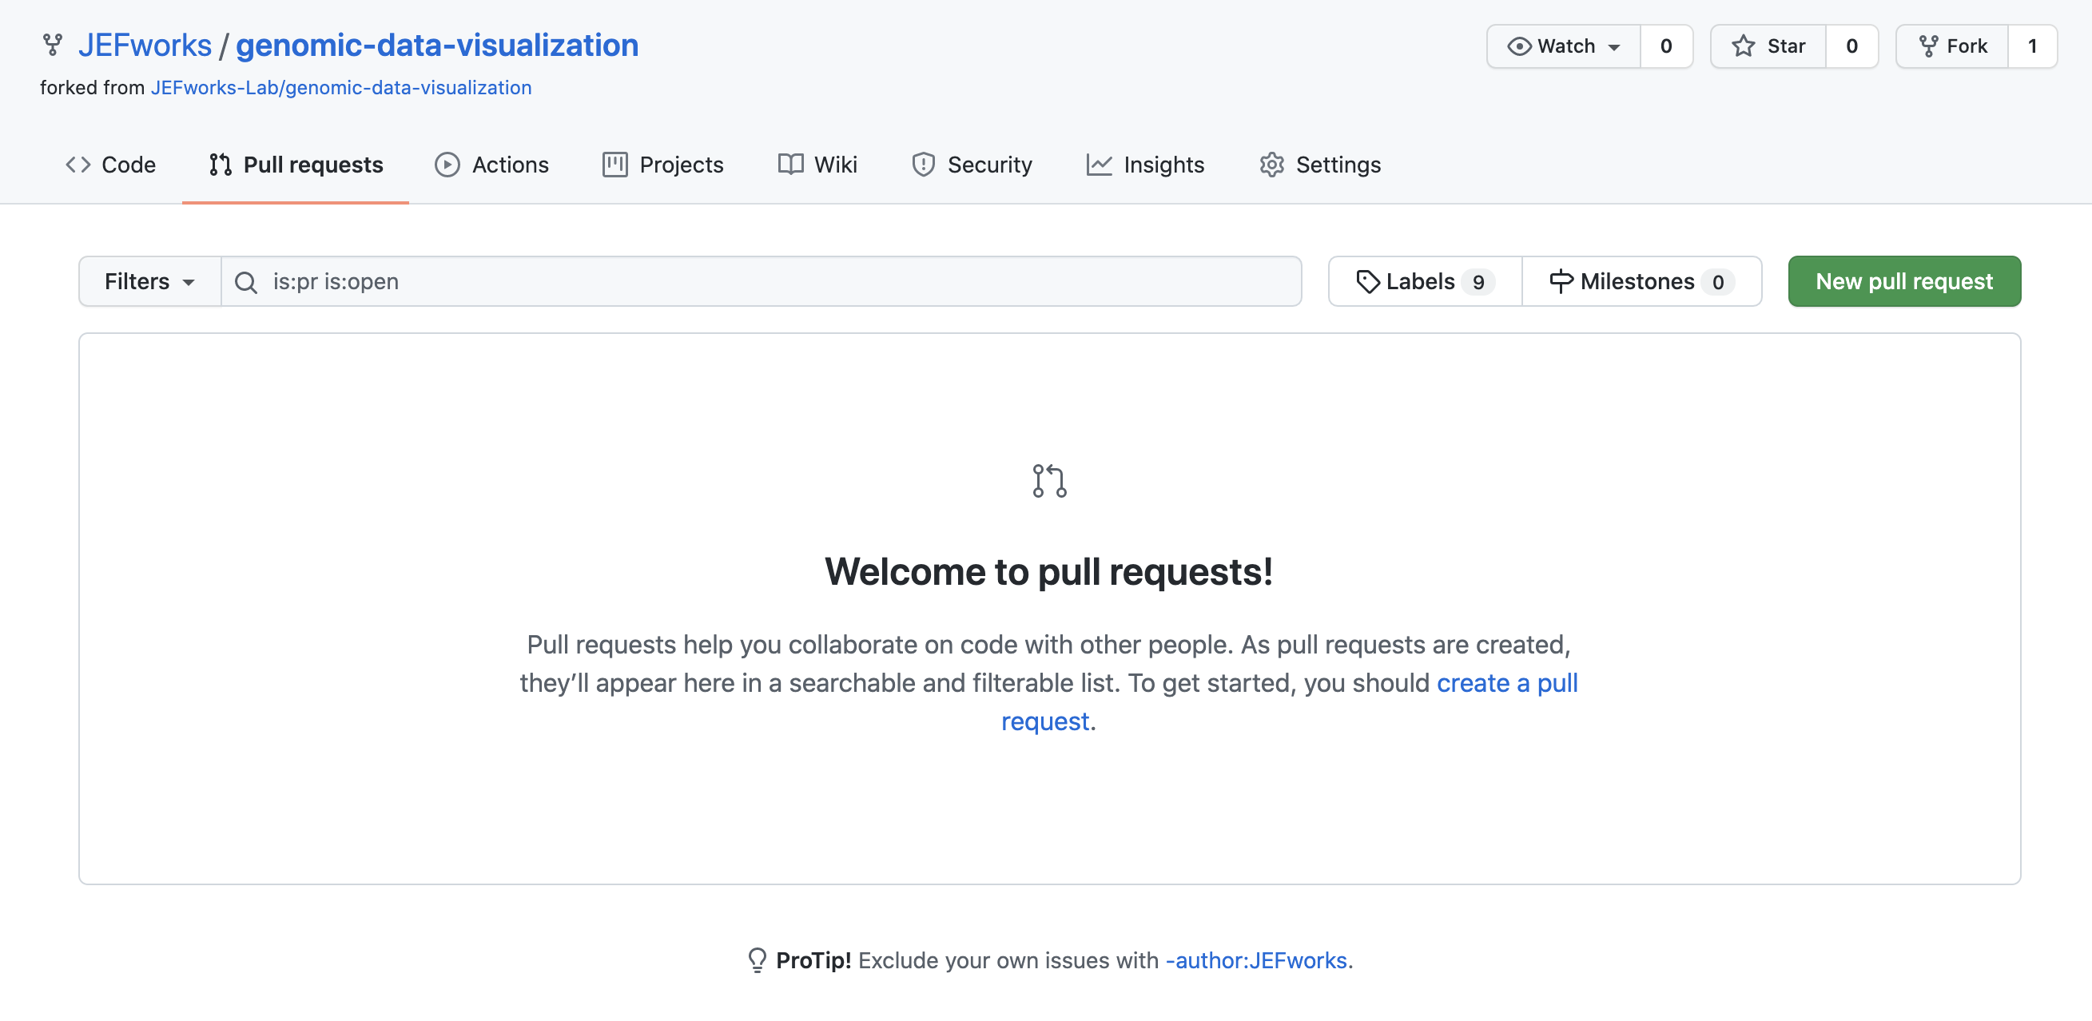
7. Make a pull request to submit this assignment and merge your changes back to the class repo.

Slide 10
Common mistakes
Do double check that your file names are exactly as you intend them to be
If you refer to a file as ‘jfan9.jpg’ but then commit a ’jfan9.png’ or ‘jfan9.JPEG’, it will cause an error resulting in a 5% deduction in your grade because we will have to fix it
Please do not submit high resolution images
If your images are too large, they will take up bandwidth to load and make the website slow, resulting in a 5% deduction in your grade because we will have to fix it

