Slide 1
Optimizing Energy Use in Smart Grids with the Bellman-Ford Algorithm
Making energy distribution more efficient and cost-effective

Slide 2
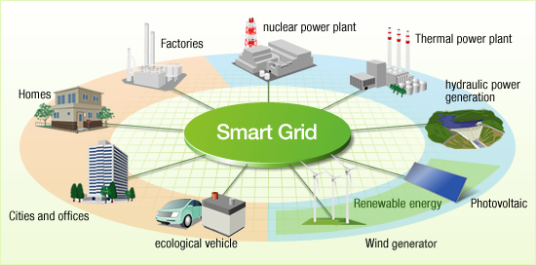
Challenges in Smart Grids
Smart grids face several big challenges:
Energy waste due to inefficiency.
Difficulty balancing energy load.
High costs while ensuring everyone gets energy

Slide 3
Using the Bellman-Ford Algorithm
The Bellman-Ford algorithm finds the shortest paths in a network.
It can handle negative weights, which represent energy losses.
Nodes are energy sources, substations, and users.
Connections represent energy lines and their costs.

Slide 4
How We Implemented It
Set initial distances to all nodes as infinity, except for the start node.
Update the shortest paths based on energy line costs.
Check for negative weight cycles.
Simulation shows reduced energy waste and balanced loads.

Slide 5
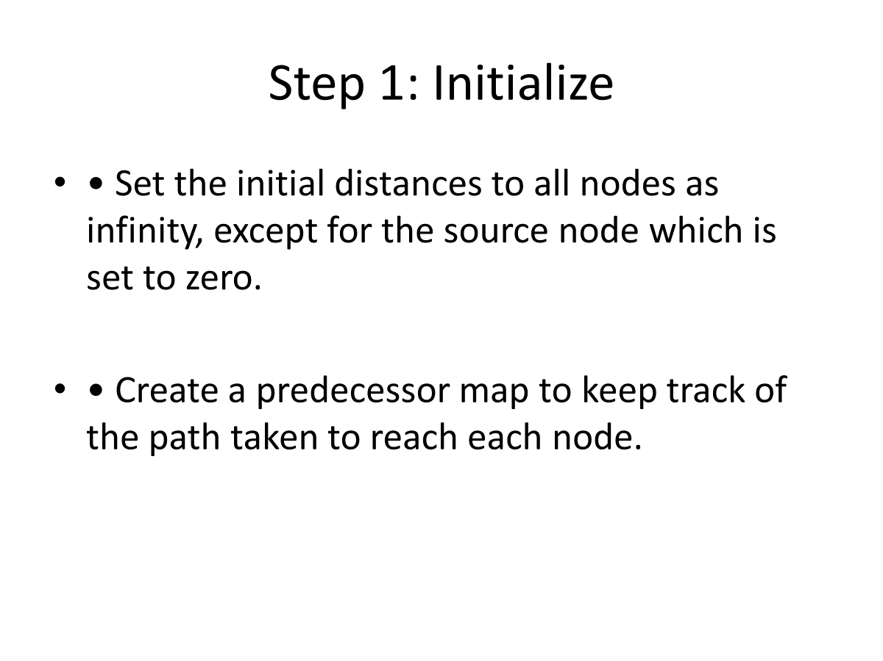

Slide 6
Step 2: Relaxation
For each edge, check if the known distance to the destination node can be shortened by taking the edge from the source node.
If yes, update the distance and the predecessor.

Slide 7
Step 3: Repeat Relaxation
• Repeat the relaxation process for (|V| - 1) iterations, where |V| is the number of nodes.
• This ensures that the shortest paths are found.

Slide 8
Step 4: Check for Negative Weight Cycles
• After all iterations, check for any further distance improvements.
• If any are found, it indicates a negative weight cycle.

Slide 9

Results and Conclusion
Our algorithm reduces energy waste and balances the load better.
Compared the efficiency before and after using the algorithm.
Significant improvement in energy distribution.
Future work: Apply this to real-world grids and make further improvements.

