Slide 1


TYK 5.13 · OBSERVABILITY
Tyk v5.13:
Observability.
Native OpenTelemetry metrics and logs for your APIs, in the Grafana, Prometheus and Loki you already run.
AGENDA
01 The questions teams ask
02 What’s new in 5.13
03 Live demo
04 Getting started
Tyk Gateway 5.13 · OpenTelemetry metrics, logs and traces
Notes:
Introductions and agenda. Frame the session around a common situation: teams already run Grafana, Prometheus and Loki, and want to understand API usage by endpoint and by API key, plus latency, errors and volume. Everything in this session is metrics and logs; tracing is optional.

Slide 2
WHAT TEAMS ASK
Where most API teams are today.
The stack is already in place. The questions about API consumers are what’s hard to answer.
CURRENT STACK
HOSTING
SIGNALS
Grafana, Prometheus and Loki, often with a SQL database alongside.
Self-managed, in their own cloud or data centre.
Metrics and logs first. Traces when they’re ready.
USAGE
PAIN POINT
WHAT MATTERS
Most-used endpoints by API and by API key; query parameters in use; calls per API by key.
It’s hard to compare API usage between API keys.
Latency, error rates and number of calls.
Context · 02
Notes:
The typical starting point. The bottom row (usage, the per-key pain point, and latency/errors/volume) drives the whole demo; the top row shapes the architecture: their existing Grafana, Prometheus and Loki, self-managed, and no tracing required.

Slide 3
BEFORE AND AFTER
Why comparing API keys is hard today.
The cause is in how keys are identified, not in Grafana.
TODAY
WHAT WE FOUND
— Five components in the metrics path
Gateway → Redis → Pump → Prometheus → Grafana.
…Y0In0=
is the “last six characters” of every Dashboard-issued key: keys are base64-encoded JSON, so the default api_key dimension can’t tell them apart.
— A fixed metric shape
No endpoint × API key × query parameter view without custom work.
— Key suffixes are not identities
Every Dashboard-issued key ends in the same six characters.
✓ Give each consumer app’s key an alias and use the session · alias dimension instead. Every chart then names the app.
The problem · 03
Notes:
Dashboard keys are base64 of {"org","id","h"}, so the last-6-characters api_key dimension collapses every key into one series. Tyk exposes the key alias as a metric dimension: readable, stable and bounded. Ask how their keys are issued today and whether they carry aliases.

Slide 4




NEW IN TYK 5.13
Four things you can now measure.
All four are configuration only, and all four are opt-in.
01
02
03
04
Native OTLP metrics
Custom dimensions
Cardinality control
Gateway health
The gateway exports metrics over OpenTelemetry directly. No Pump or Redis in the metrics path.
Slice by endpoint, key alias, query parameter, header, context variable or API config data.
Each instrument has its own dimensions and filters, so detail costs only where you need it.
APIs and policies loaded per gateway, plus Go memory and GC. Catch a bad release early.
What is new · 04
Notes:
Outcomes, not features. 01 removes components from the metrics path. 02 answers the usage questions. 03 is the safety net that makes 02 safe in production. 04 is operational health for the platform team.

Slide 5
TYK PUMP VS TYK GATEWAY
Pump custom metrics versus gateway custom metrics.
Both can feed Prometheus. Only the gateway sees endpoints, headers, query parameters and your own values.
 | TYK PUMP · PROMETHEUS CUSTOM_METRICS | TYK GATEWAY 5.13 · API_METRICS
Where metrics are made | Afterwards, from analytics records queued in Redis | In the request path, as each call completes
How they leave | Prometheus scrapes the Pump’s /metrics (no built-in auth or TLS) | OTLP push to any backend: Collector, Prometheus, Grafana Cloud, Datadog…
Labels available | A fixed list of traffic-log fields: host, method, path, response_code, api_key, alias, api_id, org_id, oauth_id, ip_address… | Six sources: metadata, session, request headers, response headers, context variables, API config data
Endpoints | Raw request path only | Tracked templates such as /projects/{id}, so series stay bounded
Headers and query parameters | Not available | Any request or response header; any declared query parameter
Your own values | Not possible | Anything a plugin writes to a context variable, such as the key hash
Latency | Histograms always observe request_time | Total, gateway-only or upstream-only, with custom buckets
Scope and health | Labels per metric; no gateway health | Filters per metric (API, method, status); Go runtime and config state
What is new · 05
Notes:
Sources: Tyk Pump custom metrics (https://tyk.io/docs/api-management/metrics/metrics-pumps#custom-metrics) and gateway custom metrics (https://tyk.io/docs/api-management/metrics/custom-metrics). The Pump builds metrics from analytics records after Redis, with labels limited to traffic-log fields. The gateway builds them in the request path with six dimension sources, including headers, context variables and endpoint templates.

Slide 6





ARCHITECTURE
How it fits your existing stack.
No new backend. Tyk speaks OpenTelemetry to the Prometheus and Loki you already operate.
METRICS
Prometheus
OTLP · JSON LOGS
metrics · yours today
Tyk Gateways
OTel Collector
Grafana
Kubernetes, VMs or any cloud
OTLP in, logs from stdout
ready-made dashboards
LOGS
Loki
SQL database · optional
Pump SQL for long-term records
Traces · later
same collector → Tempo
logs · yours today
Architecture · 06
Notes:
The gateway sends OTLP to a collector (or straight to Prometheus's OTLP receiver); access logs are structured JSON on stdout that the collector (or Alloy/Promtail) ships to Loki. Traces use the same collector later. A SQL database can stay as an optional Pump sink for long-term per-request records.

Slide 7
HOW IT WORKS
Your questions, answered in configuration.
Each question maps to one dimension on a gateway metric. No code in your APIs.
QUESTION | DIMENSION (SOURCE · KEY)
Most-used endpoints | metadata · endpoint (tracked templates)
…by API key | session · alias + context · hashed_api_key (plugin)
Query parameters in use | context · request_data_<name>
Calls per API by API key | metadata · api_name + session · alias
Latency | histogram · total, gateway, upstream
Error rates and calls | metadata · response_code
GATEWAY CONFIG · EXCERPT
{
"name": "tyk.consumer.requests",
"type": "counter",
"dimensions": [
{ "source": "metadata", "key": "endpoint" },
{ "source": "session", "key": "alias",
"label": "consumer" }
],
"filters": { "api_ids": [
"demo-project-management", … ] }
}
How it works · 07
Notes:
Map each question to a dimension. Endpoints use tracked templates (/projects/{id}, not /projects/PRJ-1042), so they stay bounded. API keys use the alias, plus the key hash from an optional plugin. Query parameters come from context variables request_data_<name>: you declare the ones that matter. filters.api_ids scopes these instruments to the APIs that need them.

Slide 8

02
LIVE DEMO
The API Consumer
Insights dashboard.
Three APIs, six consumer applications, one dashboard row per question.
Notes:
Switch to Grafana: API Consumer Insights folder → API Consumer Insights, last 15 minutes. Slides 9–15 are screenshots of the same panels in the same order: use them if the live environment misbehaves.

Slide 9
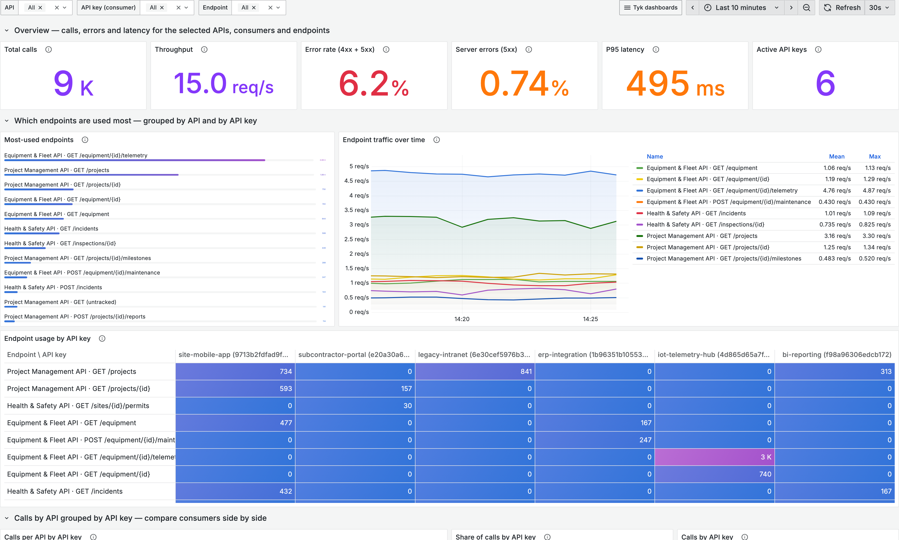
WALKTHROUGH
The numbers at a glance.
Calls, errors and latency for every demo API in the last 10m, with API, key and endpoint filters on every panel.
8.9k
6.2%
CALLS
ERROR RATE · 4XX + 5XX
531 ms
6
P95 LATENCY
ACTIVE API KEYS
Walkthrough · 09
Notes:
The KPI row answers latency, errors and volume at a glance. The API, API key and Endpoint variables at the top filter every panel.

Slide 10
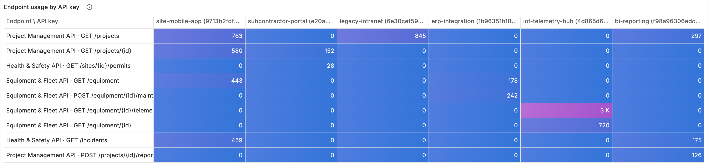
USAGE
Most-used endpoints, by API and by API key.
Read across a row to see which apps call an endpoint; down a column to see what one app uses.
Busiest endpoint Equipment & Fleet API · GET /equipment/{id}/telemetry: 32% of all calls.
Try it live Set API = Project Management API and every panel follows the filter.
Walkthrough · 10
Notes:
Endpoints (rows) by API key (columns), each key shown as alias (hash). Endpoints are templates thanks to tracked endpoints, so the list stays readable and bounded.

Slide 11
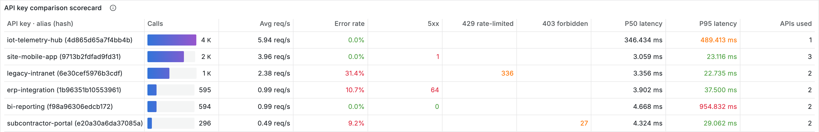
PAIN POINT SOLVED
Compare API keys side by side.
One row per key: volume, errors, rate-limit and access denials, and latency. Sort by any column.
Top consumer iot-telemetry-hub: 40% of all calls.
Problems by key ERP 10.2% upstream 5xx · intranet 359 rate-limited · subcontractor 28 denied.
Walkthrough · 11
Notes:
The scorecard has one row per API key (alias and key hash): calls, throughput, error rate, 5xx, 429 and 403 counts, P50 and P95 latency and the number of APIs each key uses.

Slide 12
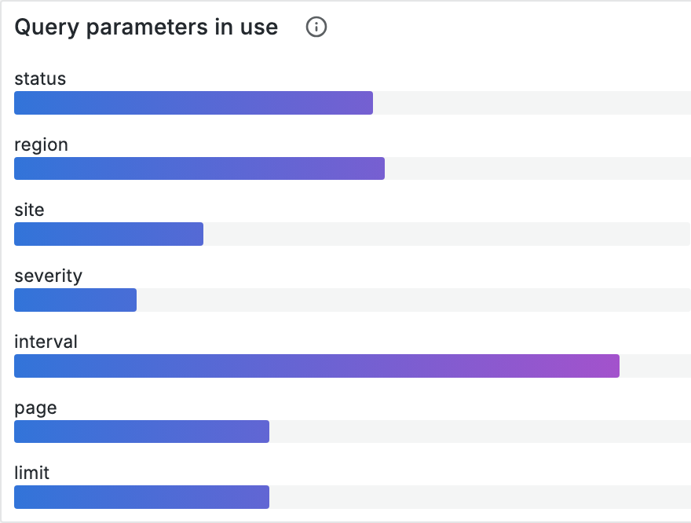
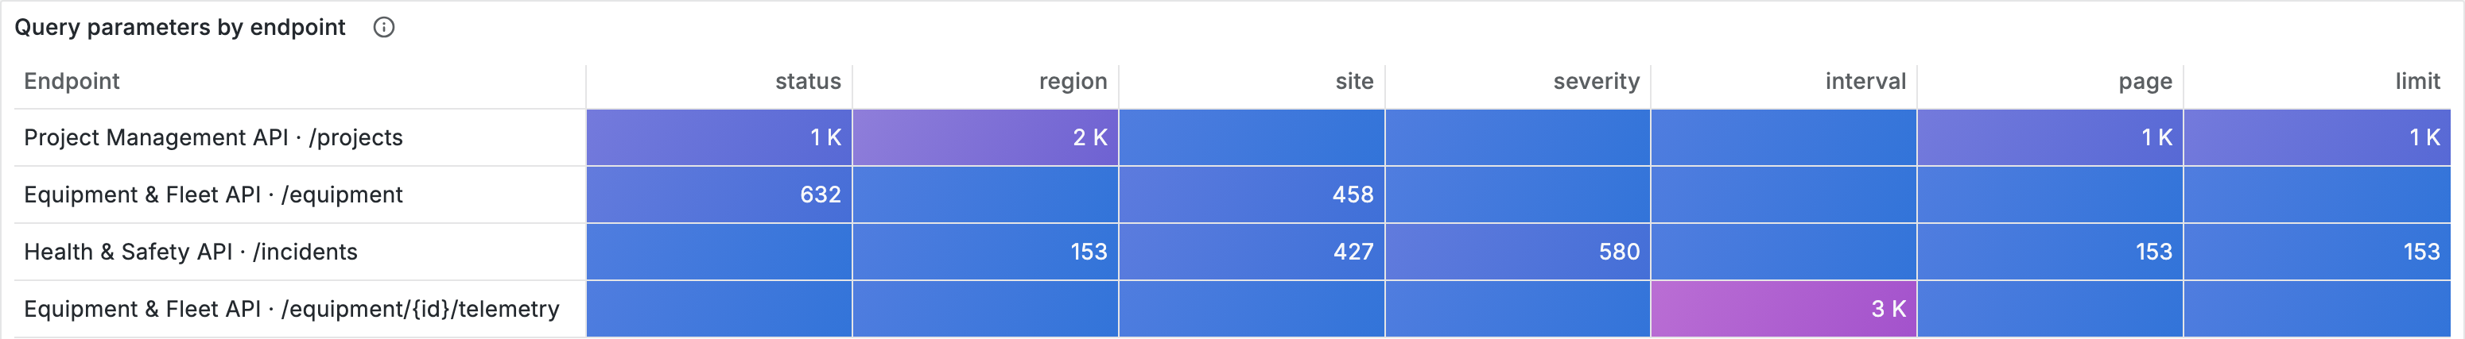
USAGE
Which query parameters are used, and where.
You declare which parameters to track, so values stay bounded and query strings never reach the logs.
Insight bi-reporting asks for limit=500 on 100% of its paginated calls. That makes it a candidate for caching or a scheduled export, and it explains why its latency is the highest.
Walkthrough · 12
Notes:
Every query parameter is available as a context variable (request_data_<name>). The demo tracks status, region, site, severity, interval, page and limit.

Slide 13
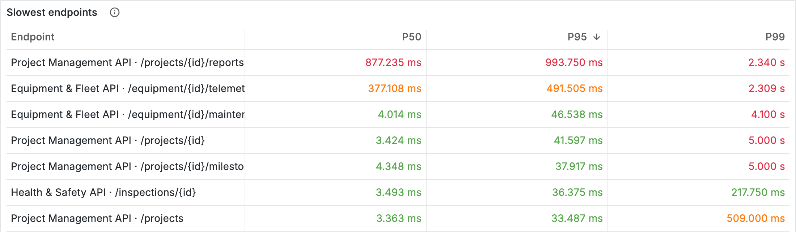
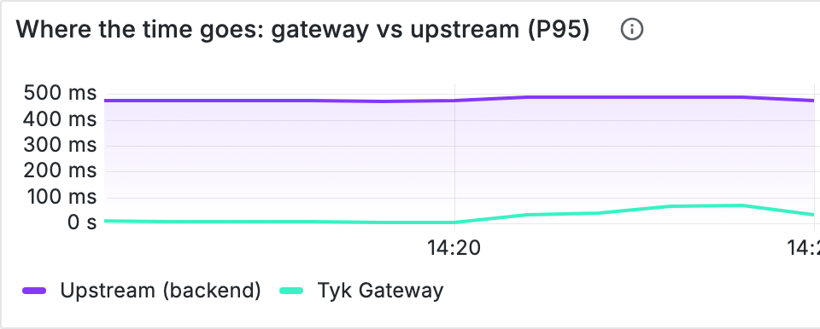
WHAT MATTERS MOST
Latency, and where the time goes.
P50, P95 and P99 per endpoint, and the gateway’s share of every request.
104 ms
488 ms
Slow calls are in the backend, not the gateway. Report generation is the slowest endpoint, so the conversation goes straight to the team that owns it.
TYK GATEWAY · P95
UPSTREAM · P95
Walkthrough · 13
Notes:
The right chart splits latency into Tyk processing time and backend time using the default Tyk instruments: the fastest answer to "is it the gateway or the API?".

Slide 14
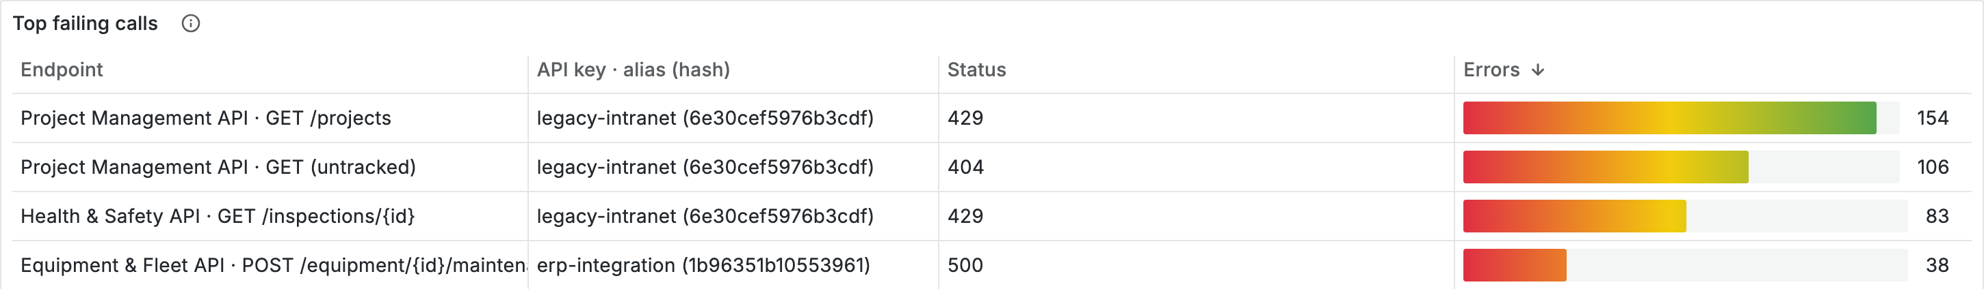
WHAT MATTERS MOST
Error rates, explained by cause.
Every failing endpoint, API key and status code, so each error has an owner and an action.
403
404
429
5xx
Key not allowed on this API. Fix the policy.
Unknown or retired endpoint. Update the client.
Rate limit reached. Raise it or spread the load.
Upstream failure. Escalate to the API owner.
Walkthrough · 14
Notes:
Error rate by API and by API key are on the dashboard; this slide shows the why. Each status code maps to an action and an owner.

Slide 15
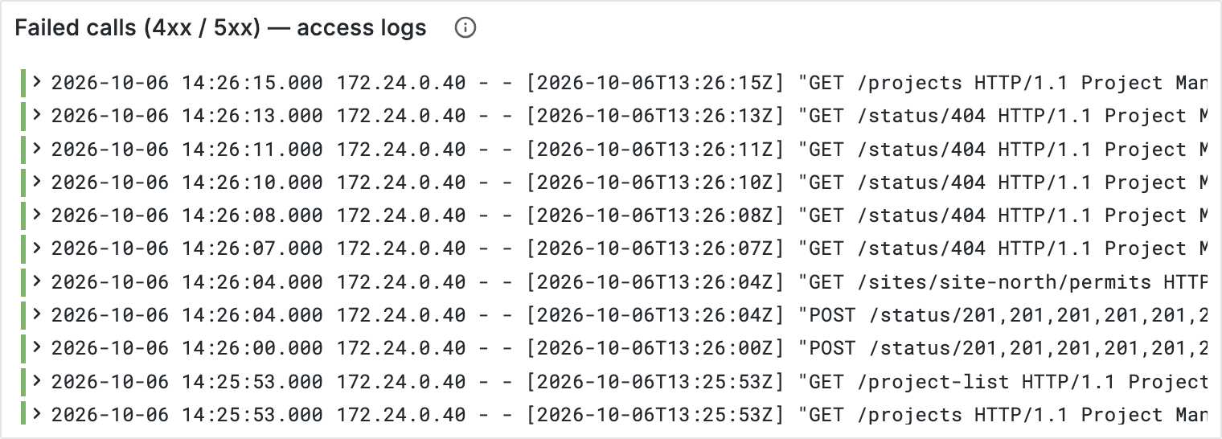

LOGS
Logs, in the Loki you already run.
Metrics tell you something is wrong. The access logs show you the individual calls.
Structured JSON
API, path, status, latency split and response flag on every call.
Private by default
API keys are hashed; query strings are not logged.
Ready for traces
Every line already carries a trace ID, for when you adopt tracing.
Walkthrough · 15
Notes:
Logs go to Loki. Traces are optional, but trace IDs are already in the logs, so nothing needs redoing later.

Slide 16
RECAP
What you saw.
Usage by endpoint and key
Keys you can compare
Query parameters in use
Every endpoint, broken down by the consumer app that calls it.
Aliases and key hashes replace key fragments, so every app has a readable name.
Declared parameters, counted per endpoint and per key.
Latency with attribution
Errors with a cause
Your stack, unchanged
Gateway time and backend time, separated on every request.
Status code, endpoint and key, so each error has an owner.
Prometheus, Loki and Grafana in your own environment. No new backend.
Recap · 16
Notes:
Six-card recap of the demo. Pause here for questions before moving to rollout.

Slide 17

03
GETTING STARTED
From demo
to your estate.
Guardrails, a three-step rollout and a one-week pilot.
Notes:
Transition to the platform team's questions: safety, cost and effort.

Slide 18



PRODUCTION-READY
Guardrails, built in.
Detailed metrics stay safe and cheap because detail is scoped, bounded and validated.
Scoped instruments
Readable key identity
Declared parameters
filters.api_ids limits extra dimensions to the APIs that need them.
Key aliases are bounded, stable and meaningful.
Only the query parameters you choose ever become series.
Validated config
Low overhead
Opt-in
The gateway warns on risky dimensions and instruments with more than 10.
4.6% CPU for native metrics against 6.9% for Pump, with P99 unchanged.
Existing Pump pipelines keep working. Move at your own pace.
Getting started · 18
Notes:
Overhead figures are from Tyk's published benchmark: https://tyk.io/docs/api-management/observability/guides/best-practices#performance-impact-summary

Slide 19
ROLLOUT
Three steps to production.
The configuration in this demo is the configuration you would run.
01
02
03
Enable
Connect
Visualise and alert
Turn on OTLP metrics and JSON access logs on the gateways. First metrics arrive within a minute.
Point the gateways at an OpenTelemetry Collector that writes to your Prometheus and ships logs to Loki.
Import the dashboard, add key aliases and tracked endpoints, and alert on errors and P95 per key.
Getting started · 19
Notes:
Keep the ask concrete and small. The dashboard is a JSON file teams import into their own Grafana (scenario/consumer-insights-dashboard.json).

Slide 20
QUESTIONS WE HEAR
Frequently asked questions.
Do we still need Tyk Pump?
Not for metrics. Keep it for Dashboard analytics or long-term records in a SQL database.
What does it cost in performance?
4.6% CPU against 6.9% for Pump in Tyk’s benchmark, with P99 unchanged.
Which backends are supported?
Anything that speaks OTLP: Prometheus, Grafana Cloud, Elastic, Datadog, Dynatrace and more.
Are there breaking changes?
No. Everything is opt-in and existing configuration keeps working.
How does it work with MDCB?
Data-plane gateways emit metrics and traces, next to your traffic.
Can we add business dimensions?
Yes: any header, context variable or API config data, or a value set by a plugin.
Getting started · 20
Notes:
Backup slide. Only bring it up if questions stall.

Slide 21
NEXT STEPS
What happens next.
A small pilot on your APIs, reviewed together after one week.
01
02
03
04
Choose the scope
Name the consumers
Pick the dimensions
Review together
A non-production environment and 2–3 APIs.
Agree an alias for every consumer app’s API key.
List the endpoints and query parameters to track.
Walk through the dashboard and alert thresholds.
Week 1
Week 1
Week 1
Week 2
Next steps · 21
Notes:
Close with a concrete, low-effort pilot. Offer the dashboard JSON and the gateway configuration used in the demo.

Slide 22

THANK YOU
Any questions?
tyk.io
REFERENCES
Metrics tyk.io/docs/api-management/logs-metrics
Default metrics tyk.io/docs/api-management/metrics/default-metrics
Custom metrics tyk.io/docs/api-management/metrics/custom-metrics
Playbook tyk.io/docs/api-management/observability/guides/gateway-playbook
Notes:
References: https://tyk.io/docs/api-management/logs-metrics · https://tyk.io/docs/api-management/metrics/default-metrics · https://tyk.io/docs/api-management/metrics/custom-metrics · https://tyk.io/docs/api-management/observability/guides/gateway-playbook

