Slide 1


WEBREM
A Remembrances or Condolences Web Service
COMP 4920 Senior Project Design Project Presentation, Fall 2022
02 June 2023, Version 1.2
Alican Daşdemir 18070001041
Atakan Aktakka 1807001032
Doğukan Tez 18070001051
Kadir Ülge 18070001014
Department of Computer Engineering
Yaşar University

Slide 2
Acknowledgements
First and foremost, We would like to thank our supervisor Mehmet Ufuk Çağlayan who guided us in doing these projects. He provided us with invaluable advice and helped us in difficult periods.

Slide 3
Motivation
As the project team of the WEBREM service, our team is motivated by the idea that the WEBREM service has the potential to make an impact on people's lives by providing a central platform to commemorate important people and institutions.

Slide 4
Outline
Introduction
User Activity Diagram
Admin Activity Diagram
Software System Structure
Benefits of WEBREM

Slide 5
Introduction
The project's objective is to create the WEBREM service, which will enable users to upload memories of significant individuals or institutions as texts and photos, to a database with a web interface, store them there in a moderated manner, index.

Slide 6
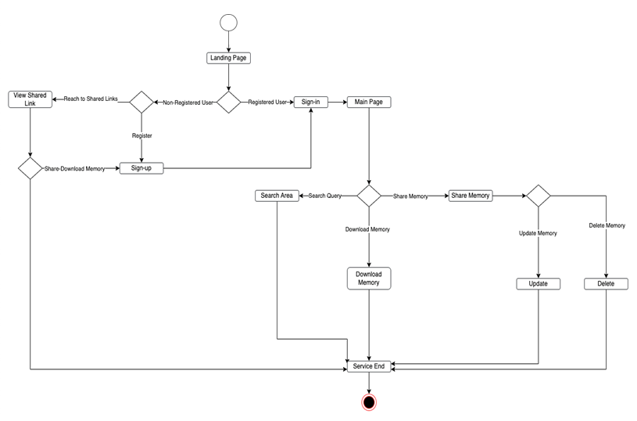
User Activity Diagram

Slide 7
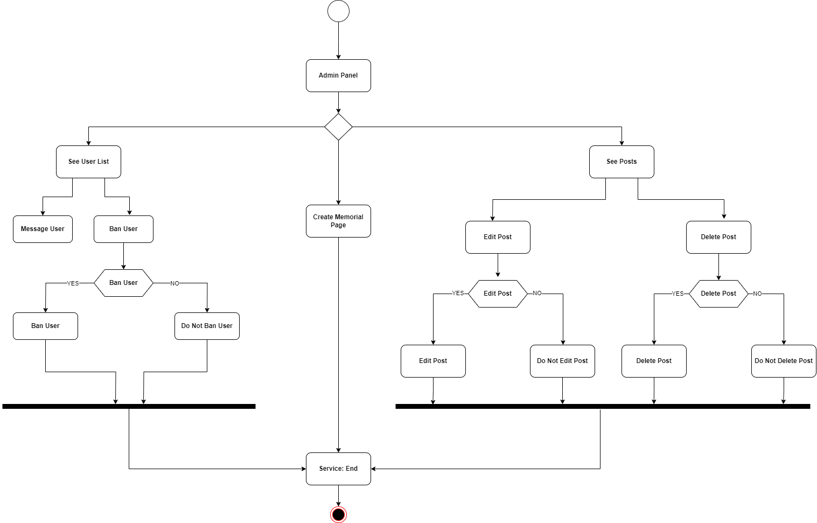
Admin Activity Diagram

Slide 8
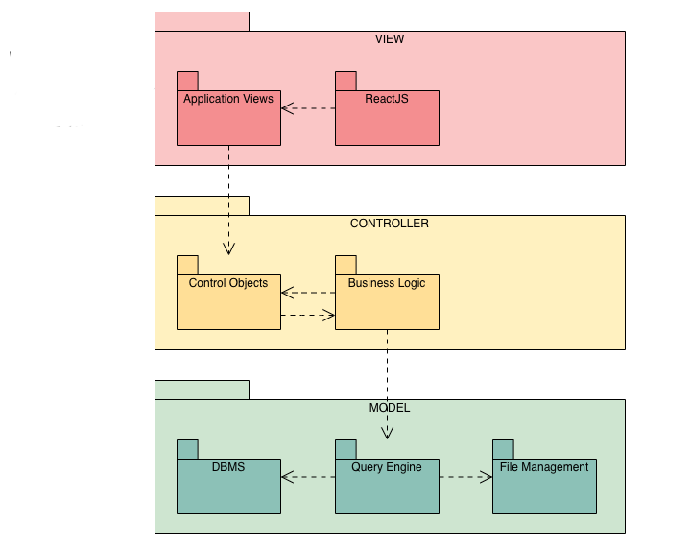
Software System Structure

Slide 9
Benefits of WEBREM
Thanks to the environment we will create in our project, people will be able to create an archive of memories about people/institutions they know and care about.
They will be able to share and talk about their common values.
Anyone who wants to do research about the person/institution can obtain information thanks to the shared files and memories and can use these documents as a source if they wish.

Slide 10
Conclusions
In order to make it simpler for users to access and search for these memories, the WEBREM project seeks to provide a platform that enables users to share and save memories of significant individuals or institutions (condolences to the departed) in multiple forms.

Slide 11
References
System Requirements Specification Document, Revision 2.1, in file WEBREM-RSD-2022-12-19-Rev-2.1.doc.
High Level Design, Design Specifications Document, Revision 1.6, in file WEBREM-DSD-Rev-1.6.doc.
Final Report, in file FinalReport-2020-12-21-Rev-1.1.doc.

Slide 12
Thank You For Your Attention
Atakan Aktakka, 18070001032
Kadir Ülge, 18070001014
Doğukan Tez, 18070001051
Alican Daşdemir, 18070001041
Department of Computer Engineering
Yaşar University

