Slide 1


Slide 3
Outline
Road Centerline Approximation
Basic concepts
Approximation of clothoids
Combination of segments
Results
Trajectory Planning
Basic concepts
HCC maneuver
Position correction maneuver
Effect of road curvature
Arc-spline trajectory
Comparative results

Slide 4
Motivation Behind Road Centerline Approximation
High definition maps (HD maps)
Road geometry extraction
Route and trajectory planning
Centimeter level accuracy*
*Cambridge University Press. (2021). Minimum required accuracy for HD maps. The Journal of Navigation. Retrieved from Cambridge Core
Notes:
-HD maps have waypoint data stored in them. It is necessary to fill the road between waypoints. Some road segments are very large
-Roads are designed using clothoids. Clothoids can be approximated by arc splines which have analytical representation. This proves useful for some trajectory planning algorithms.
-HD maps help autonomous vehicles plan routes for large distances. These maps can also be used for trajectory planning algorithms. In the upcoming sections I will be describing our new trajectory planning algorithm.
-Centimeter level accuracy is required for autonomous driving purposes.

Slide 5
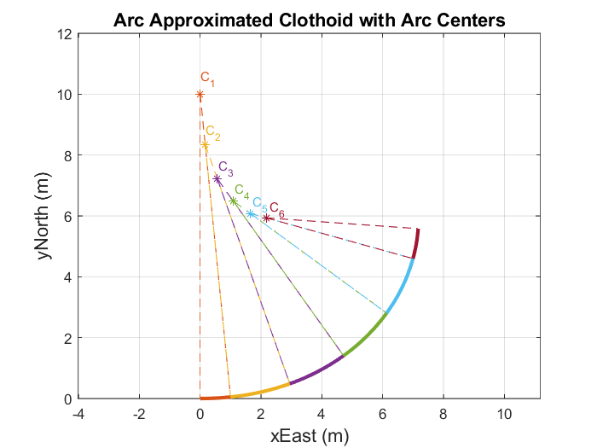
Background Information – Arc-splines
Consecutive arc segments
Increasing or decreasing curvature
Notes:
-Arc splines consist of consecutive arc segments with increasing or decreasing curvature with the rules given in thesis. Pg 13-33
-High enough accuracy proven by Ardam’s thesis.

Slide 6
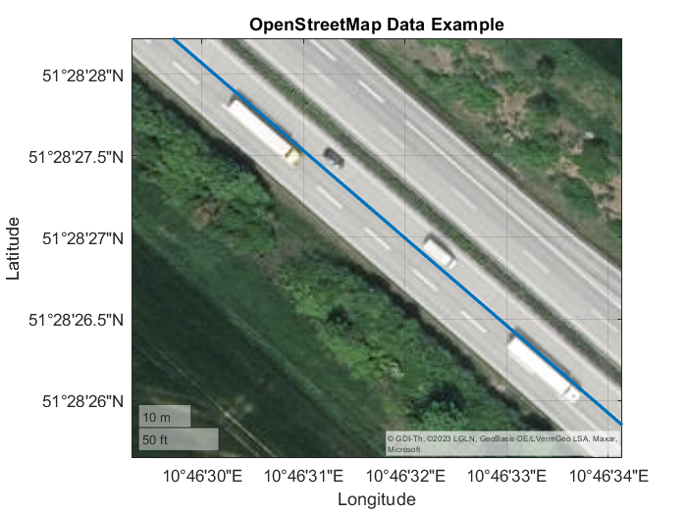
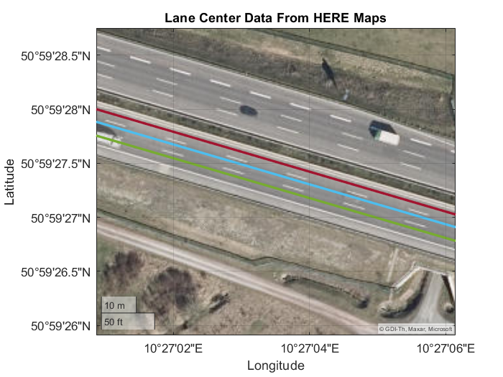
Background Information – Data Source
OpenStreetMap (OSM) data
Single waypoint set for each road
Inconsistent lane data
HERE Maps
Individual lane information
More accurate
Notes:
-OSM map data provides a single waypoint set for a direction. This waypoint set changes line throughout the road. Therefore it is not possible to understand which lane does the waypoint belong without seeing it on satellite image.
-HERE maps data has much more accurate data the figure may show an offset between road centerline but it is normal since this is a satellite image and it is not very accurate as well. Each lane has individual waypoint set therefore dataset is consistent.

Slide 7
Background Information – Clothoid Fitting
Single nonlinear function to solve
G1 continuous
Notes:
-Roads are known to be designed using clothoid curves. This method helps us have a ground truth between waypoints.
We can use this ground truth to measure our approximation result.
-Single nonlinear function to solve makes the algorithm fast and easy to use.
-G1 continuous means that the tangent is continuous. G1 continuity is generally harder to achieve than G0 continuity.
-Since the algorithm outputs G1 continuous it is considered to be highly accurate for autonomous vehicle applications.

Slide 8
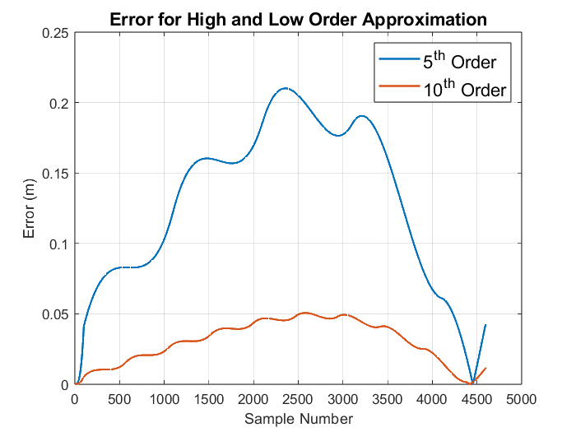
Approximation of Clothoids – Arc-spline Segment
Try to fit arc-spline segment
Adjust the order of arc-spline
Notes:
-First an arc-spline with an order of 5 is tried to fit to clothoid. Based on pre defined error metrics and required accuracy of an HD map, the order is increased or decreased.
-If the error is higher than allowed error, the order is increased, if the error is lower than allowed, a lower order arc spline is tried.

Slide 9
Approximation of Clothoids – Line Segment
Try to fit line segment
Compute error
Notes:
-Roads are known to be designed using clothoid curves. This method helps us have a ground truth between waypoints.
We can use this ground truth to measure our approximation result.
-Single nonlinear function to solve makes the algorithm fast and easy to use.
-G1 continuous means that the tangent is continuous. G1 continuity is generally harder to achieve than G0 continuity.
-Since the algorithm outputs G1 continuous it is considered to be highly accurate for autonomous vehicle applications.

Slide 10
Background Information – Clothoid Fitting

