Slide 1


Slide 3
Outline
Road Centerline Approximation
Basic concepts
Approximation of clothoids
Combination of segments
Results
Trajectory Planning
Basic concepts
HCC maneuver
Position correction maneuver
Effect of road curvature
Arc-spline trajectory
Comparative results

Slide 4
Motivation Behind Road Centerline Approximation
High definition maps (HD maps)
Road geometry extraction
Route and trajectory planning
Centimeter level accuracy*
*Cambridge University Press. (2021). Minimum required accuracy for HD maps. The Journal of Navigation. Retrieved from Cambridge Core
Notes:
-HD maps have waypoint data stored in them. It is necessary to fill the road between waypoints. Some road segments are very large
-Roads are designed using clothoids. Clothoids can be approximated by arc splines which have analytical representation. This proves useful for some trajectory planning algorithms.
-HD maps help autonomous vehicles plan routes for large distances. These maps can also be used for trajectory planning algorithms. In the upcoming sections I will be describing our new trajectory planning algorithm.
-Centimeter level accuracy is required for autonomous driving purposes.

Slide 5
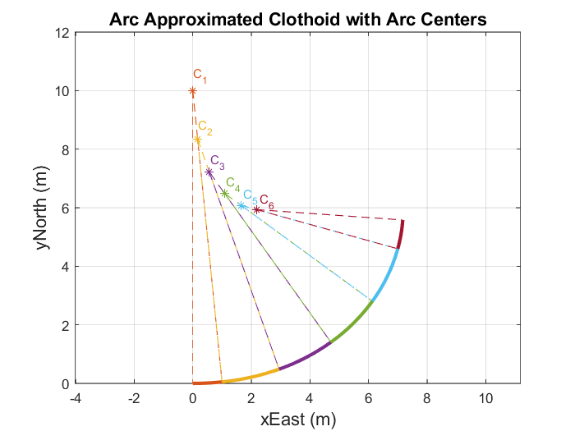
Background Information – Arc-splines
Consecutive arc segments
Increasing or decreasing curvature
Notes:
-Arc splines consist of consecutive arc segments with increasing or decreasing curvature with the rules given in thesis. Pg 13-33
-High enough accuracy proven by Ardam’s thesis.

Slide 6
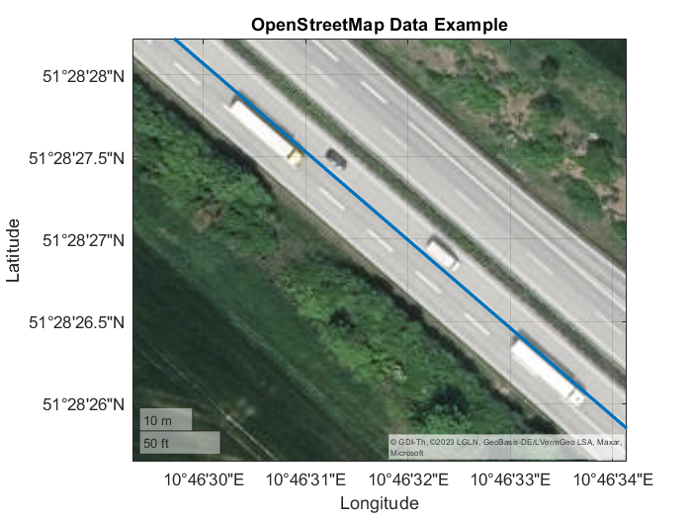
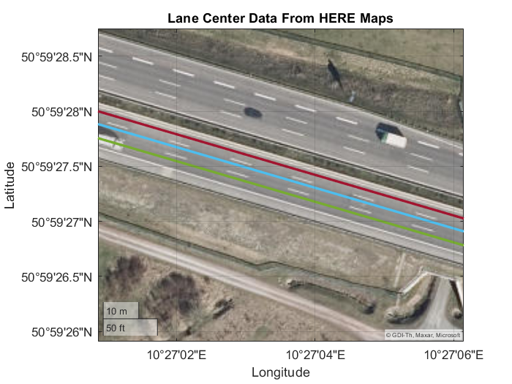
Background Information – Data Source
OpenStreetMap (OSM) data
Single waypoint set for each road
Inconsistent lane data
HERE Maps
Individual lane information
More accurate
Notes:
-OSM map data provides a single waypoint set for a direction. This waypoint set changes line throughout the road. Therefore it is not possible to understand which lane does the waypoint belong without seeing it on satellite image.
-HERE maps data has much more accurate data the figure may show an offset between road centerline but it is normal since this is a satellite image and it is not very accurate as well. Each lane has individual waypoint set therefore dataset is consistent.

Slide 7
Background Information – Clothoid Fitting
Single nonlinear function to solve
G1 continuous
Notes:
-Roads are known to be designed using clothoid curves. This method helps us have a ground truth between waypoints.
We can use this ground truth to measure our approximation result.
-Single nonlinear function to solve makes the algorithm fast and easy to use.
-G1 continuous means that the tangent is continuous. G1 continuity is generally harder to achieve than G0 continuity.
-Since the algorithm outputs G1 continuous it is considered to be highly accurate for autonomous vehicle applications.

Slide 8
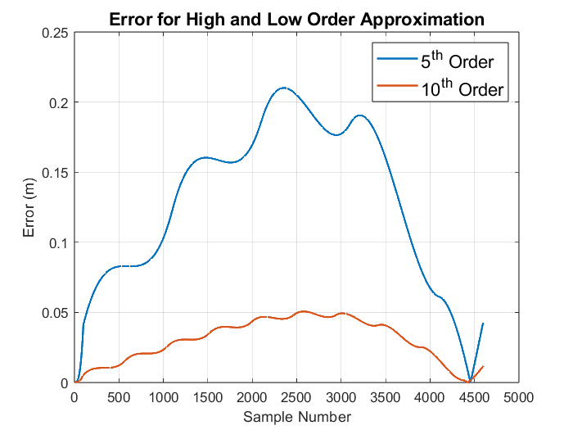
Approximation of Clothoids – Arc-spline Segment
Try to fit arc-spline segment
Adjust the order of arc-spline
Notes:
-First an arc-spline with an order of 5 is tried to fit to clothoid. Based on pre defined error metrics and required accuracy of an HD map, the order is increased or decreased.
-If the error is higher than allowed error, the order is increased, if the error is lower than allowed, a lower order arc spline is tried.

Slide 9
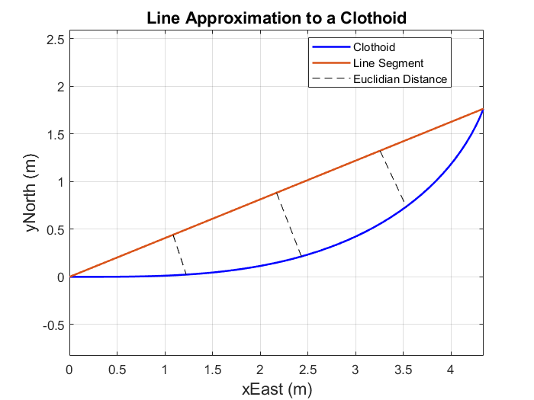
Approximation of Clothoids – Line Segment
Try to fit line segment
Compute error
Notes:
-Roads are known to be designed using clothoid curves. This method helps us have a ground truth between waypoints.
We can use this ground truth to measure our approximation result.
-Single nonlinear function to solve makes the algorithm fast and easy to use.
-G1 continuous means that the tangent is continuous. G1 continuity is generally harder to achieve than G0 continuity.
-Since the algorithm outputs G1 continuous it is considered to be highly accurate for autonomous vehicle applications.

Slide 10
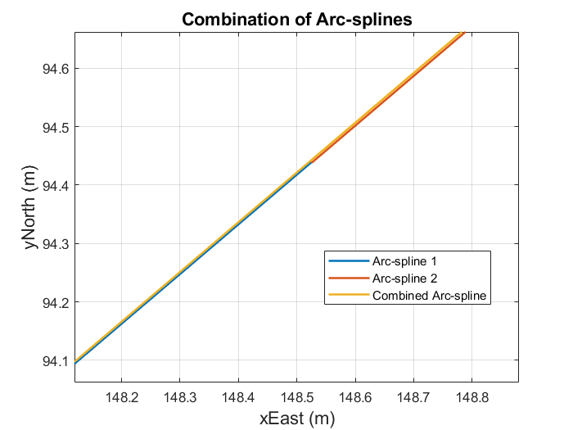
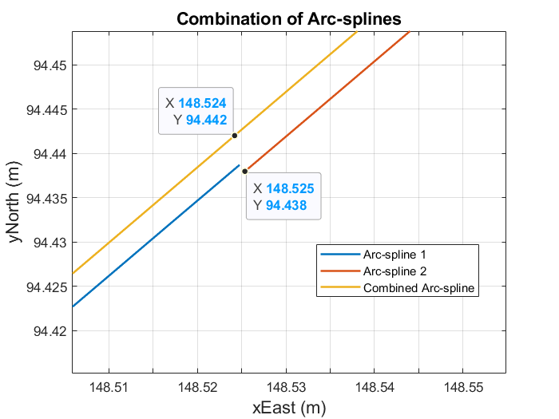
Combination of Segments
Try to fit line segment
Compute error
Notes:
-Roads are known to be designed using clothoid curves. This method helps us have a ground truth between waypoints.
We can use this ground truth to measure our approximation result.
-Single nonlinear function to solve makes the algorithm fast and easy to use.
-G1 continuous means that the tangent is continuous. G1 continuity is generally harder to achieve than G0 continuity.
-Since the algorithm outputs G1 continuous it is considered to be highly accurate for autonomous vehicle applications.

Slide 11
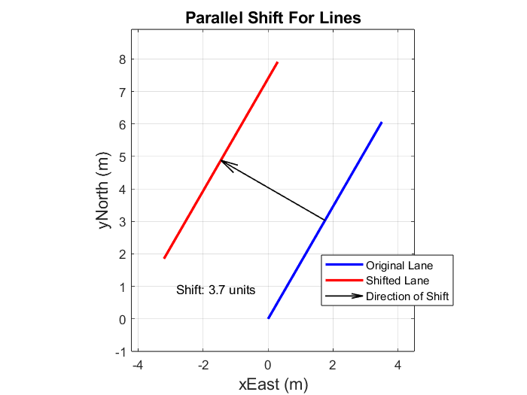
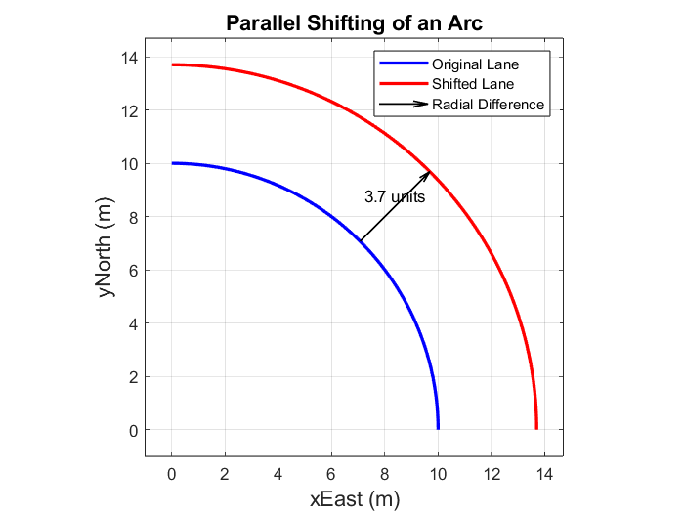
Parallel Shifting
Translate line segments
Change the turning radii of arcs
Notes:
-Line segments are translated perpendicular to the direction of motion. To do the lane information of the current road segment should be known. For example if the information at hand is known to be left lane, the line segment should be translated to the right hand side of the heading.
-Arc segments have curvature and it is equivalent to turning radius for roads. Parallel shifting corresponds to changing the turning radius of an arc. Similarly if the road is known to be the left lane and if the road segment is turning left, the turning radius should be increased with lane width amount.

Slide 12
Results – Road Centerline Approximation
Performance metrics:
Euclidian distance RMS (10cm)
Euclidian distance max (15 cm)
Number of segments
Notes:
-Euclidian distance RMS is important to understand the overall performance of the approximation. The lower the better. However, RMS error alone may be deceiving since the error may peak at some point and RMS, by its nature would conceal this peak. Therefore maximum error is also inspected to not overlook a peak error.
-Euclidian maximum error is set to 15 cms in this work. Over the segment the maximum of the Euclidian distance is computed.
-Number of segments is also a performance metric since it directly affects the amount of memory used to represent the road.

Slide 13
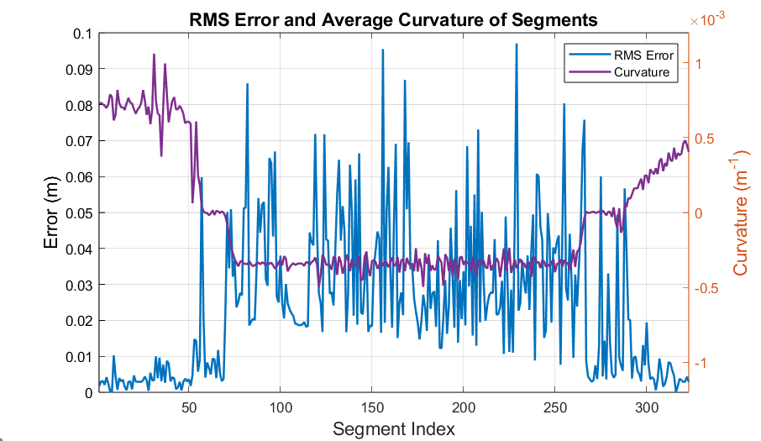
Results – RMS Error Over a Autobahn 38
Predefined maximum RMS error value: 0.1 meters
Low correlation between curvature and RMS error
Notes:
-Road is represented with 0.1 maximum RMS error.
-There is low correlation between curvature and RMS error

Slide 14
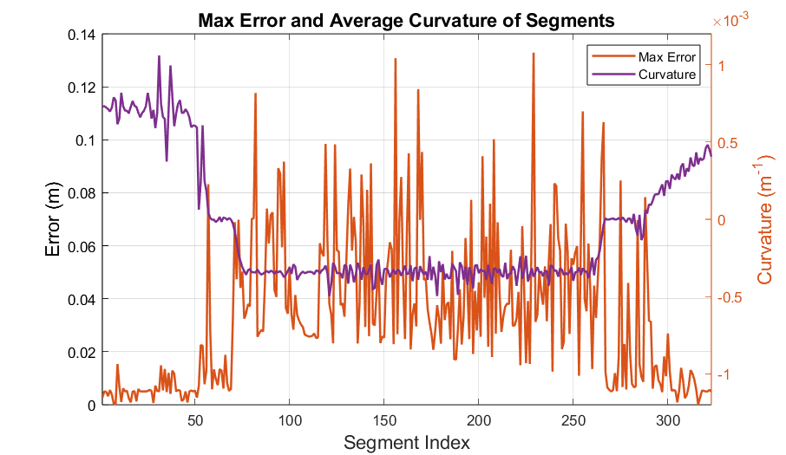
Results – Maximum Error Over a Autobahn 38
Predefined maximum max error value: 0.15 meters
Low correlation between curvature and maximum error
Notes:
-Road is represented with 0.15m maximum allowed Maximum error.

