Slide 1


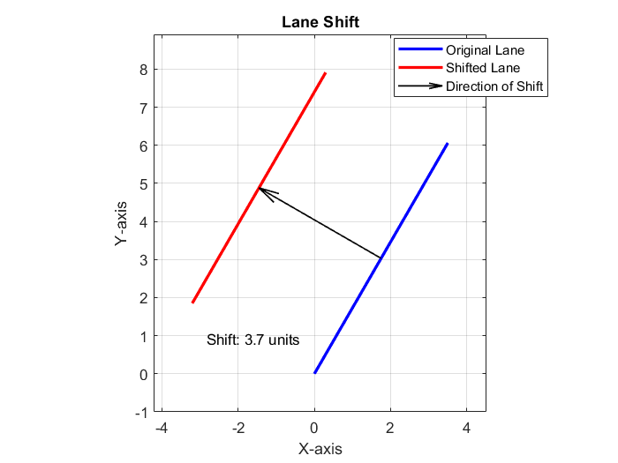
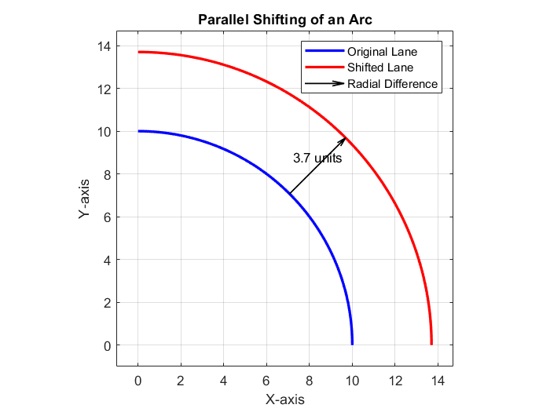

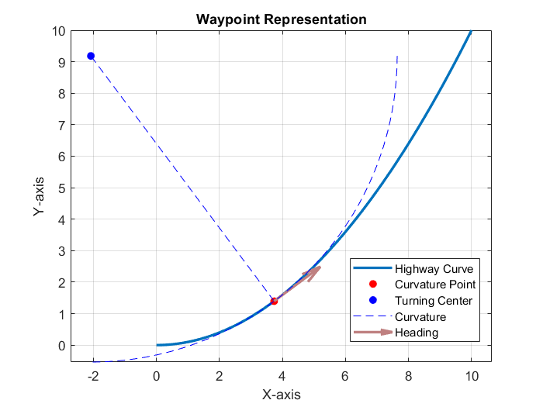
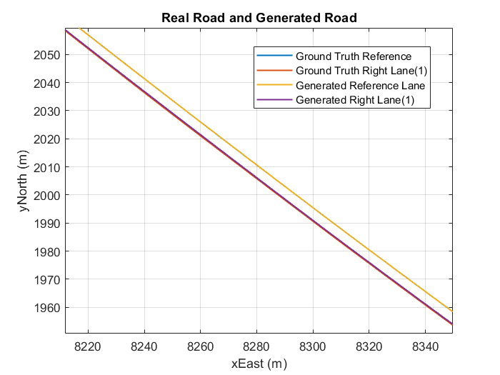
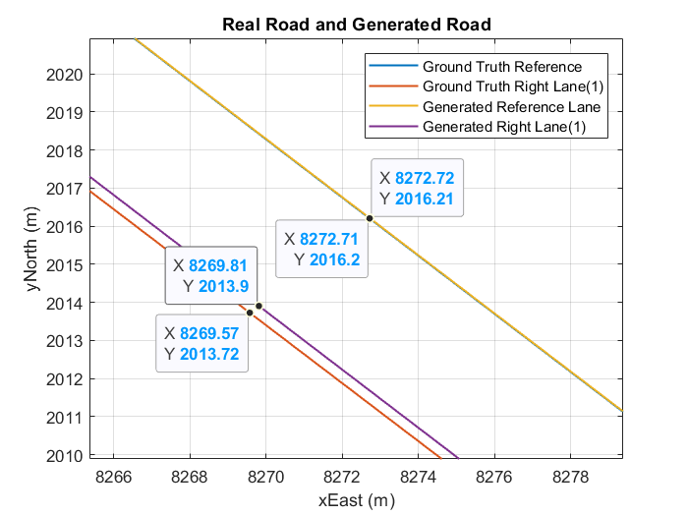

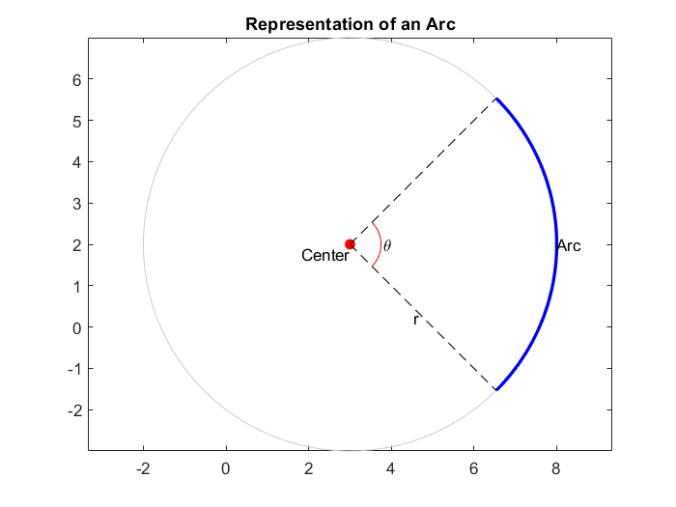
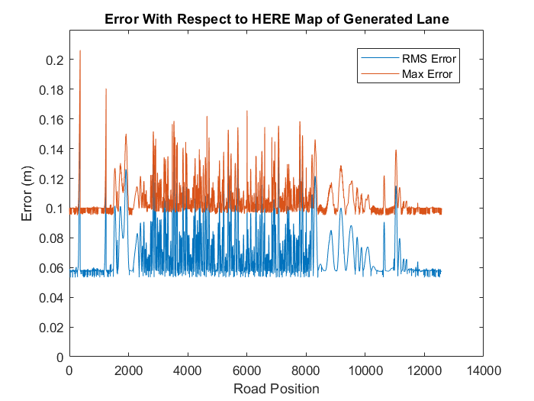
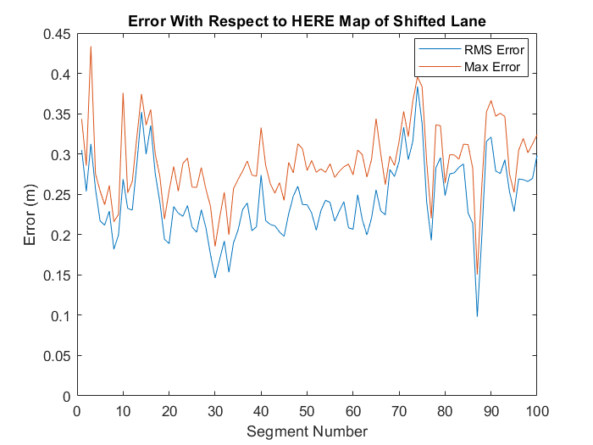
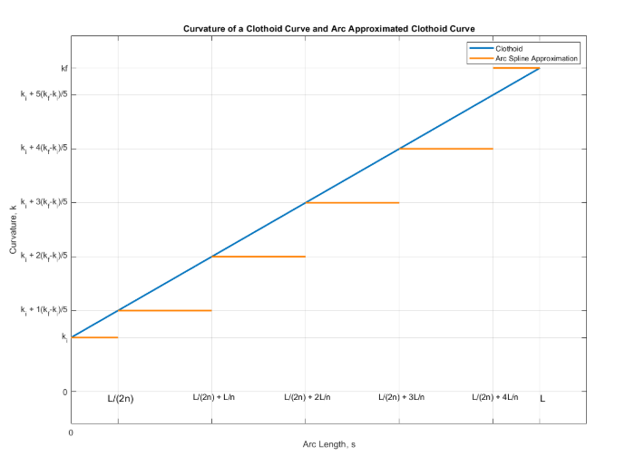
An Efficient Road Representation for Autonomous Vehicles Using Arc-Splines with Application to Trajectory Planning
Atakan Salih Bolat, Klaus Werner Schmidt Electrical-Electronics Engineering Dept., Middle East Technical University, Ankara, Turkey
atakan.bolat@metu.edu.tr
Introduction
Autonomous vehicles are more and more common each day [1]. Even if the vehicles are not fully autonomous they usually have some level of autonomy. Some of the features are:
Lane keeping assist
Trajectory planning
For trajectory planning applications following data is required:
Position
Heading
Curvature
Only a part of the road representations in the literature has these information.
Highways are designed using clothoids to ensure smooth transitions in curvature and alignment [2].
This research involves efficiently representing waypoints given along a road removing the disadvantages of current methods while maintaining the requirements for trajectory planning algorithms.
B-spline and Cubic spline algorithms require more computational power and it is difficult to find control points. Another disadvantage of these splines are it is not possible to represent the other lanes with parallel shifting.
Quintic Beziér curves are utilized to plan the trajectory which are able to achieve initial and final poses [3].
If an arc spline group is to be concatenated the first road segment’s initial waypoint and final road segment’s final waypoint is given as input to arc spline computation. Again, the number of intermediate arcs depend on position error of approximation.
After these computations a single lane in a road is represented
with either line or arc spline segments. From this single lane other
lanes can be generated with small error by parallel shifting.
Line road segments are shifted perpendicular to heading of the
segment by the amount of lane width.
Arc spline road segments consist of a series of arcs so they
cannot be shifted similarly. However, since each arc has a turning
radius, the turning radius of arc can be changed according to
lane width which would create the same effect as parallel shifting.
Trajectory Planning
The input of trajectory planning is a road segment and a ego vehicle pose. Pose consists of position, heading and curvature.
With these information a Quintic Beziér curve is generated between the initial pose of the vehicle and final pose of the vehicle.
The P₀ and P₅ control points of the trajectory are the initial position of the vehicle and the final position of the road segment respectively.
P₁ and P₄ control points of the trajectory are related to initial heading of the vehicle and the final heading of the road segment respectively.
Similarly, P₂ and P₃ control points of the trajectory are computed using the initial curvature of the vehicle and final curvature of the road segment respectively.
Problem Statement
Suitable Road Representation
A suitable road representation is needed to use better trajectory generation algorithms. Suitable road representation should have the following properties:
Accurate enough to follow the trajectory without lane departure
Should have position, heading and curvature data
Efficient enough to store a large map
Analytically representable
The input to the algorithm is waypoints. Waypoints
are defined with following data structure:
Position
Heading
Curvature
The output of this research is the road
representation with the properties given above.
It is possible to use clothoids but they do not have analytical solution therefore they can only be used in error evaluation part.
A road segment is defined as the road between two waypoints. For highways roads are designed as clothoids therefore a road segment can be assumed as a clothoid.
Clothoids have linearly increasing or decreasing curvature by definition. These curves start from a position with certain initial heading then the curvature is increased along the curve.
Arc Spline
Arc spline is a curve where the curve consists of a
series of arcs. Each arc has a turning center, curvature
(same as turning radius) and length (same as central angle).
If enough number of arcs are used clothoids can be
closely approximated.
While approximating the clothoids small number of
parameters should be used for efficiency.
Trajectory planning
Quintic Beziér curves can be used to plan trajectory for a
since these curves take initial and final pose as input.
Arc spline based trajectories may also be used
since the road representation is already an arc spline.
Results
A sample road segment is shown on the right.
Reference lane is the first approximated lane which
corresponds to left lane in reality. Right lane is generated
by parallel shifting.
Ground truth is generated with a G1 clothoid
fitting algorithm.
Approximated road segment is an arc spline type
segment.
RMS and maximum error over whole road can be found
on the right. For every 1 meter RMS and maximum error
is computed.
The number of segments were decreased by merge
operation. Approximately 12.5 km long road is represented by
277 segments. Most of these are line segments.
 | Number arc spline | Number of line segments | Total
Before Merge | 98 | 235 | 333
After Merge | 86 | 191 | 277
Conclusions
The new road representation has acceptable error levels for autonomous driving in highway conditions.
Parallel shifted road representation also has low error but it may not be acceptable in some cases. The error may also arise from the measurements. The lane position information may be gathered with different vehicles which would cause inconsistent lane width between lanes.
Merging segments further reduced the number of parameters which makes the algorithm’s output more memory efficient. It is proven that even 12.5 km long road may be represented with very small number of parameters and segments.
Future work will aim to improve how we measure errors and use up-to-date traffic information to make the road model more accurate and dependable. This will help ensure it works well in different driving situations.
Road Representation Method
An arc consists of initial position, initial heading, turning center and length. Arc splines consist of a series of arcs. The number of arcs may vary based on error requirements.
A road segment is assumed to be clothoid and to approximate a clothoid a series of arcs are used. First arc has the clothoid’s initial position, initial heading and initial curvature. Final arc has the clothoid’s final curvature.
The number of intermediate arcs is determined based on the position error between the approximation and the ground truth.
Depending on the heading difference between initial and final waypoints of a road segment, a road segment may be represented as a straight line rather than an arc spline.
Road segments may be combined to further decrease the number of parameters. If a group of consecutive, same type (arc spline or line) road segments exist in the road segment set each group may be concatenated into fewer road segments.
References
[1] Claussmann, L., Revilloud, M., Gruyer, D., & Glaser, S. (2019). A Review of Motion Planning for Highway Autonomous Driving. IEEE Transactions on Intelligent Transportation Systems, PP, 1–23. https://doi.org/10.1109/TITS.2019.2913998
[2] Marzbani, H., Jazar, R., & Fard, M. (2015). Better Road Design Using Clothoids (pp. 25–40). https://doi.org/10.1007/978-3-319-17999-5_3
[3] Artuñedo, A., Villagra, J., & Godoy, J. (2019). Real-Time Motion Planning Approach for Automated Driving in Urban Environments. IEEE Access, 7, 180039–180053. https://doi.org/10.1109/ACCESS.2019.2959432
METU Electrical & Electronics Engineering Department
GRADSTAR, 2024

