Slide 1


Slide 3
Outline
Motivation
Road Centerline Approximation
Basic concepts
Approximation of clothoids
Combination of segments
Results
Trajectory Planning
Basic concepts
HCC maneuver
Position correction maneuver
Effect of road curvature
Arc-spline trajectory
Comparative results

Slide 4
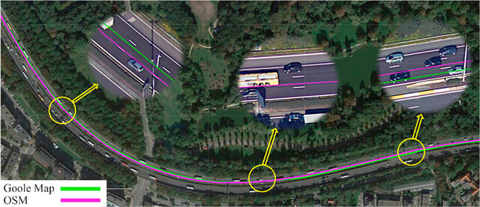
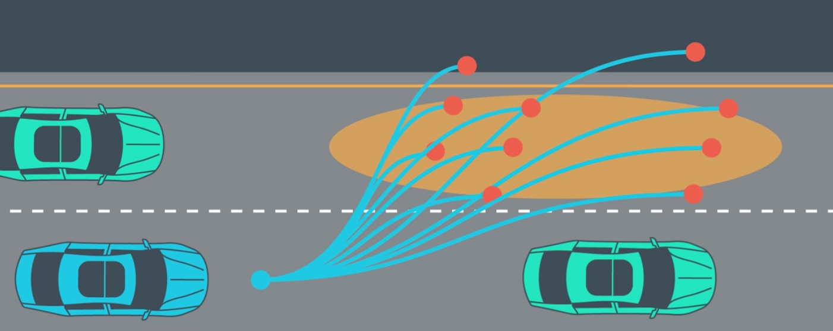
Motivation
High definition maps (HD maps)
Road geometry extraction
Lane-level road representation
Centimeter level accuracy*
Used for route and trajectory planning
Image source: Arman, M. A., & Tampère, C. (2021). Lane-level routable digital map reconstruction for motorway networks using low-precision GPS data.
Image source: Tech Reigns. (2018, August 3). Path planning for an autonomous vehicle aided by sensor fusion data.
*Cambridge University Press. (2021). Minimum required accuracy for HD maps. The Journal of Navigation. Retrieved from Cambridge Core
Notes:
-HD maps have waypoint data stored in them. It is necessary to fill the road between waypoints. Some road segments are very large
-Roads are designed using clothoids. Clothoids can be approximated by arc splines which have analytical representation. This proves useful for some trajectory planning algorithms.
-HD maps help autonomous vehicles plan routes for large distances. These maps can also be used for trajectory planning algorithms. In the upcoming sections I will be describing our new trajectory planning algorithm.
-Centimeter level accuracy is required for autonomous driving purposes.

Slide 5
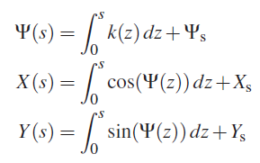

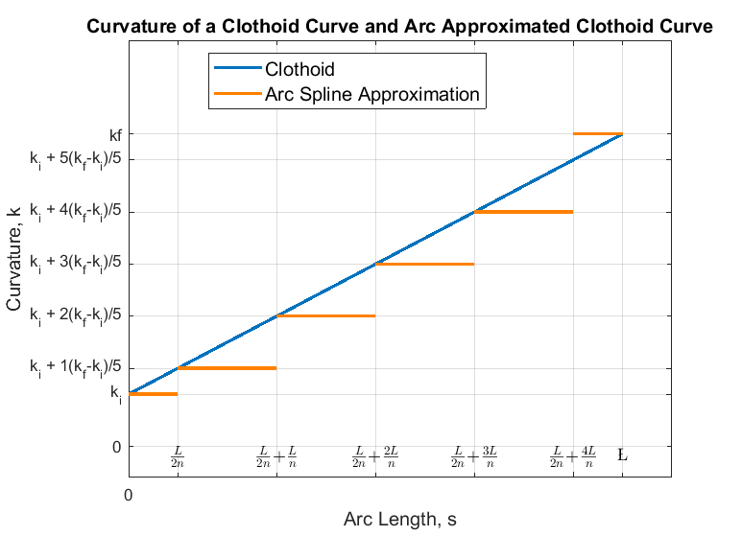
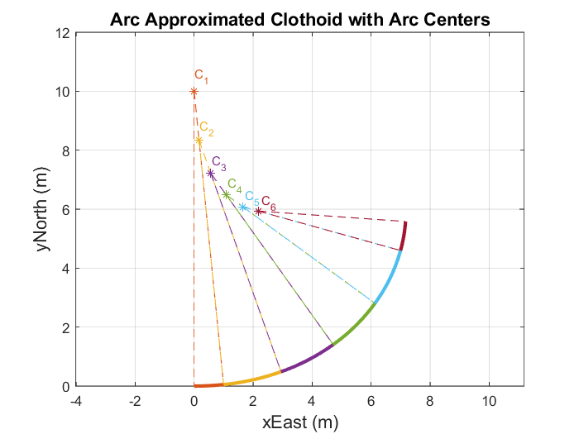
Background – Clothoids and Arc-splines
Arc-spline Approximation
Consecutive arc segments
Increasing or decreasing curvature
Clothoid
Linear change of curvature
Integral formulation
Notes:
-Arc splines consist of consecutive arc segments with increasing or decreasing curvature with the rules given in thesis. Pg 13-33
-High enough accuracy proven by Ardam’s thesis.

Slide 6
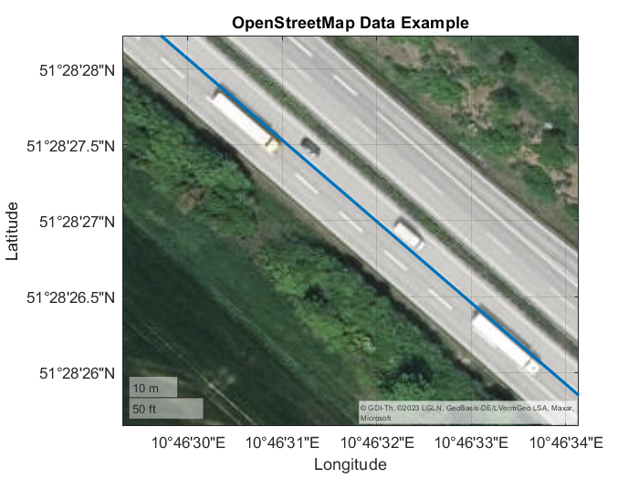
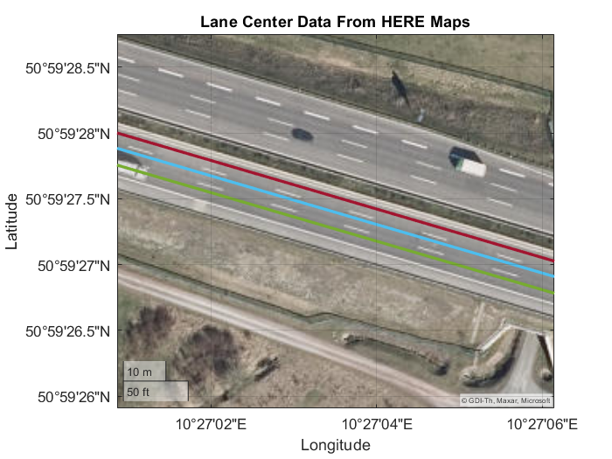
Background Information – Data Sources
OpenStreetMap (OSM) data
Single waypoint set for each road
Inconsistent lane data
HERE HD Live Maps
Individual lane information
More accurate
Notes:
-OSM map data provides a single waypoint set for a direction. This waypoint set changes line throughout the road. Therefore it is not possible to understand which lane does the waypoint belong without seeing it on satellite image.
-HERE maps data has much more accurate data the figure may show an offset between road centerline but it is normal since this is a satellite image and it is not very accurate as well. Each lane has individual waypoint set therefore dataset is consistent.

Slide 7
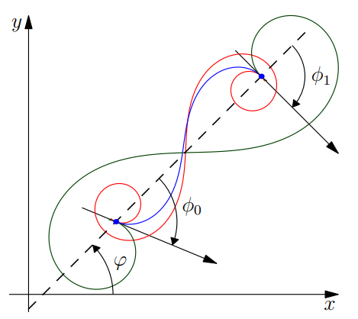
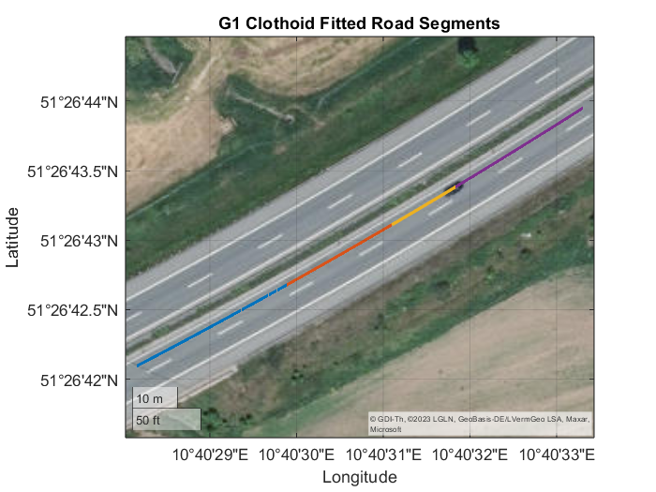
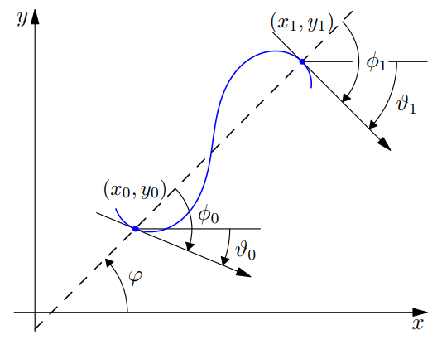
Background Information – Clothoid Fitting
Single nonlinear function to solve
G1 continuous
Figure: G1 Hermite interpolation
Figure: Possible solutions
Figure: Clothoid fitted road segments
Image source: Bertolazzi, E., Frego, M., & Vitti, M. (2014). Fast and accurate G1 fitting of clothoid curves.
Notes:
-Roads are known to be designed using clothoid curves. This method helps us have a ground truth between waypoints.
We can use this ground truth to measure our approximation result.
-Single nonlinear function to solve makes the algorithm fast and easy to use.
-G1 continuous means that the tangent is continuous. G1 continuity is generally harder to achieve than G0 continuity.
-Since the algorithm outputs G1 continuous it is considered to be highly accurate for autonomous vehicle applications.
-Hermite interpolation is the process of finding a clothoid curve that interpolates two points in a plane while matching the given unit tangent vectors at those points.

Slide 8
Road Representation Algorithm
Bounding box coordinates
Download waypoints
Generate ground truth
Generate additional lanes
Combine segments
Approximate each segment
Road segments
Notes:
First bounding box coordinates are provided to algorithm
Waypoints are downloaded in the bounding box
Ground truth is generate dusing G1 clothoid fitting algorithm
Each road segment is approximated with a line or arc spline segment
Segments are combined
Additional lanes are generated with the lane width and lane number knowledge
The output is road segments that are either line or arc-spline segments

Slide 9
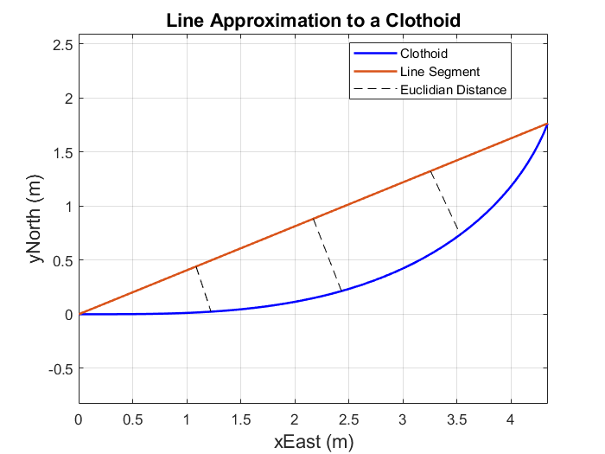
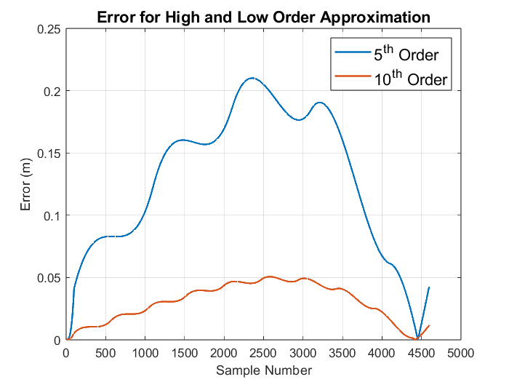
Approximation of Clothoids
Try to fit line segment
Compute error
Try to fit arc-spline segment
Adjust the order of arc-spline
Notes:
-A line segment is tried to fit the road segment as shown in the figure. This is a synthetic data for visualization. The error is computed, then based on the error metrics either line is fit or arc-spline is tried.
-First an arc-spline with an order of 5 is tried to fit to clothoid. Based on pre defined error metrics and required accuracy of an HD map, the order is increased or decreased.
-If the error is higher than allowed error, the order is increased, if the error is lower than allowed, a lower order arc spline is tried.

Slide 10
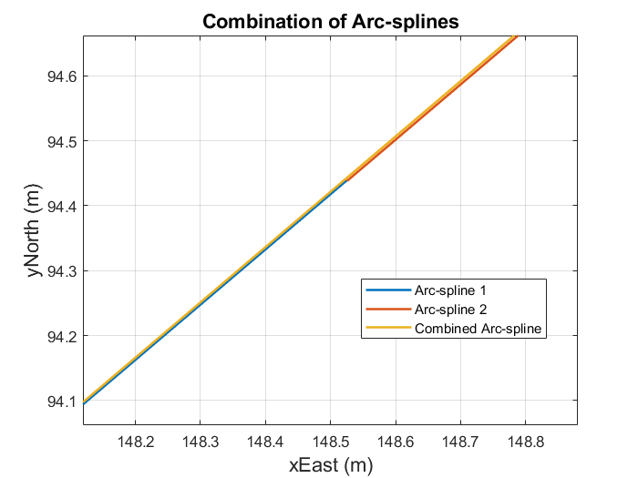
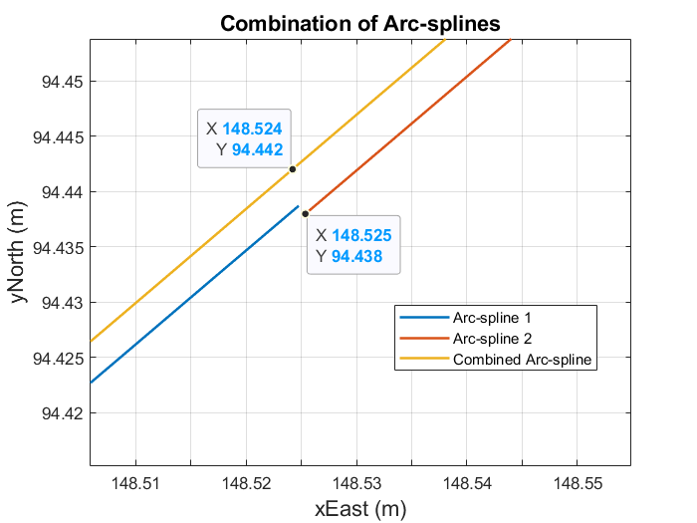
Combination of Segments
Try to combine segments
Decision between line and arc-spline segment
Decide arc-spline order
Error Metric | Maximum Allowed Value
RMS error | 0.1 meters
Maximum error | 0.15 meters
Heading deviation (line) | 0.2 degrees
Curvature error percent | 50%

Slide 11
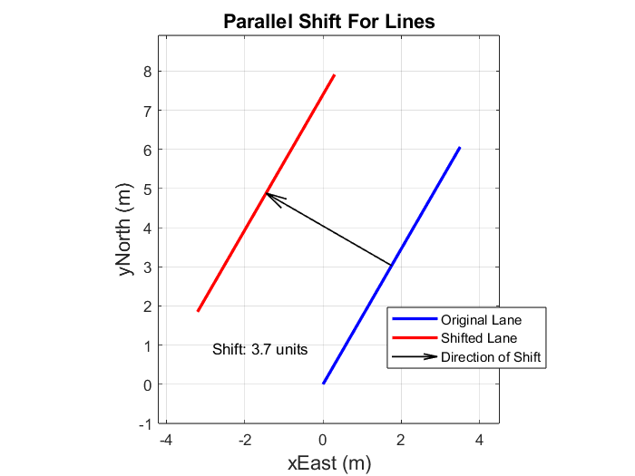
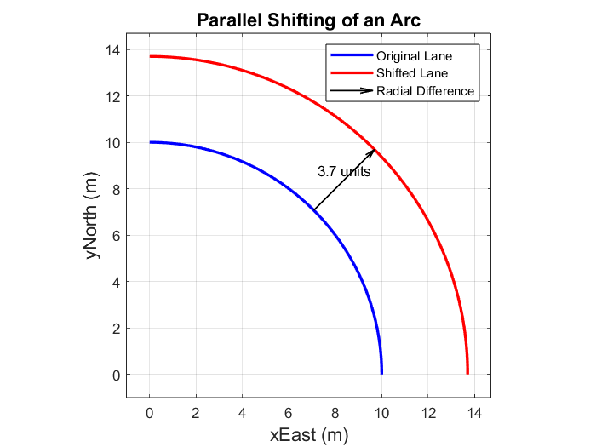
Parallel Shifting
Translate line segments
Lane width = 3.7 meters
Change the turning radii of arcs
Notes:
-Line segments are translated perpendicular to the direction of motion. To do the lane information of the current road segment should be known. For example if the information at hand is known to be left lane, the line segment should be translated to the right hand side of the heading.
-Arc segments have curvature and it is equivalent to turning radius for roads. Parallel shifting corresponds to changing the turning radius of an arc. Similarly if the road is known to be the left lane and if the road segment is turning left, the turning radius should be increased with lane width amount.

Slide 12
Results – Road Centerline Approximation
Performance metrics:
Euclidian distance RMS (10cm)
Euclidian distance max (15 cm)
Number of segments
Approximated Road Centerline
Notes:
-Euclidian distance RMS is important to understand the overall performance of the approximation. The lower the better. However, RMS error alone may be deceiving since the error may peak at some point and RMS, by its nature would conceal this peak. Therefore maximum error is also inspected to not overlook a peak error.
-Euclidian maximum error is set to 15 cms in this work. Over the segment the maximum of the Euclidian distance is computed.
-Number of segments is also a performance metric since it directly affects the amount of memory used to represent the road.

Slide 13
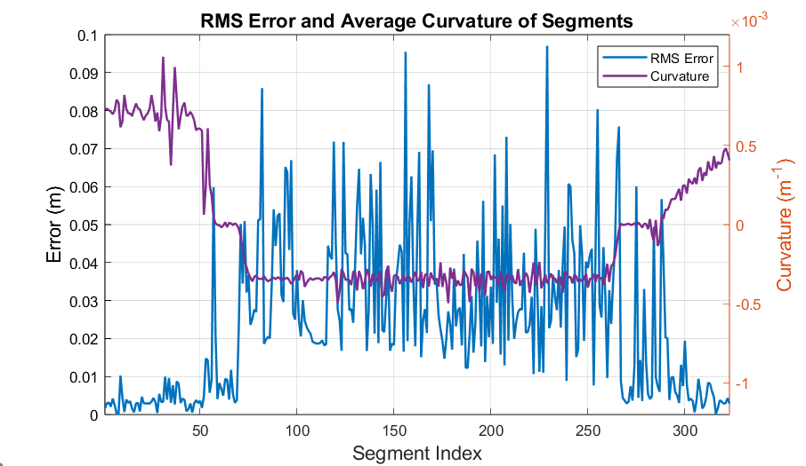
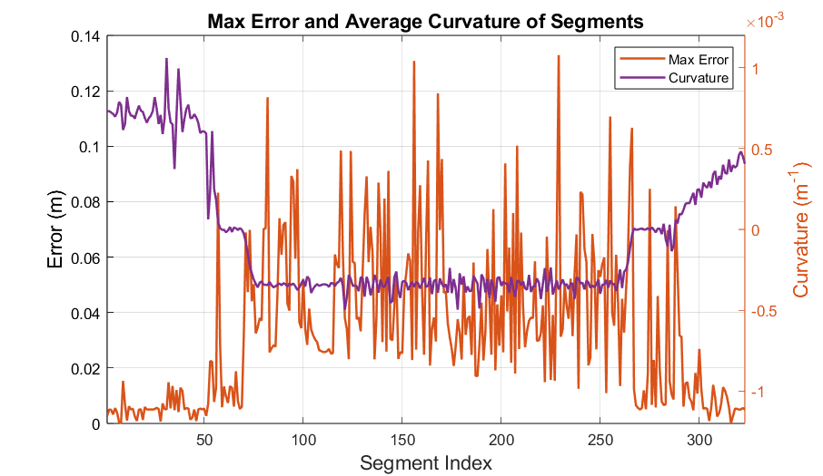
Results – Position Error Over a Autobahn 38
Predefined maximum RMS error value: 0.1 meters
Low correlation between curvature and RMS error
Predefined maximum max error value: 0.15 meters
Low correlation between curvature and maximum error
Notes:
-Road is represented with 0.1 maximum RMS error.
-There is low correlation between curvature and RMS error

Slide 14
Results – Number of segments
Autobahn 38 inspected (~12.5 kilometers)
Segment combination
Memory usage
 | Number of Arc-splines | Number of line segments | Total segments | Memory usage (bytes)
Before merge | 86 | 237 | 323 | 5942
After merge | 81 | 191 | 277 | 5081
Notes:
-A 12.5 kilometer section of Autobahn 38 is inspected.
-Number of arc-splines drop by 5 this may not be significant
-Number of line segments drop significantly
-Total number of segments drop hence memory usage drops

Slide 15
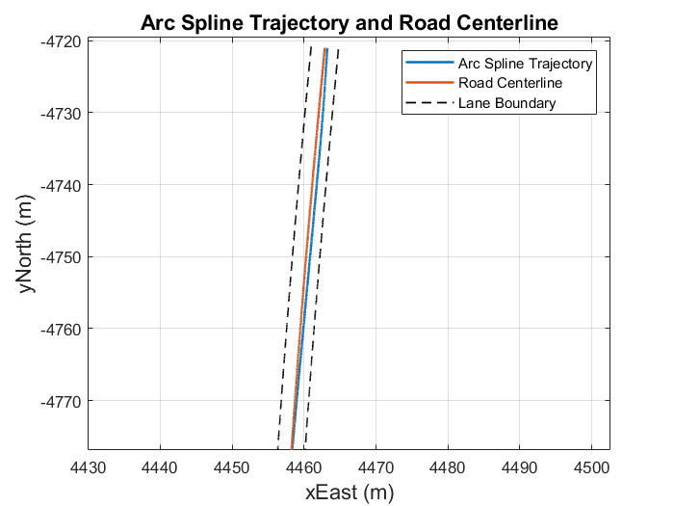
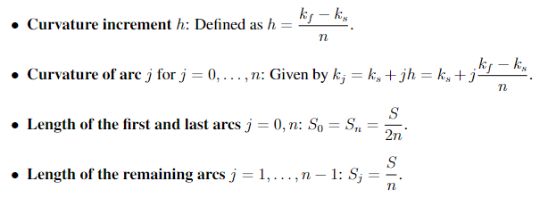

Arc-spline Trajectory
A trajectory between pose A and pose B is required
Pose A has position, heading and curvature error
Pose B is on road centerline
Similar mathematical representation to road centerline
Possible to superpose the arc-splines
Arc-spline properties:
$$Pose=[x,y,θ, κ]$$
Notes:
-We are aiming for a method to compute a trajectory between pose A and pose B.
-We propose a novel method based on arc-splines. This has various advantages, it has a similar mathematical representation to road centerline. It is possible to utilize the road curvature information with this method.
-It is possible to superpose arc-splines on top of each other.

Slide 16
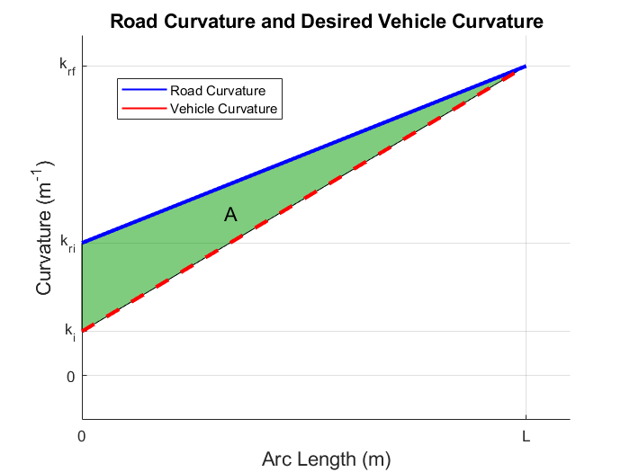
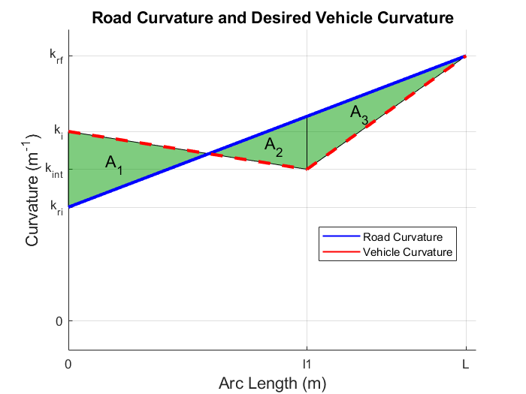

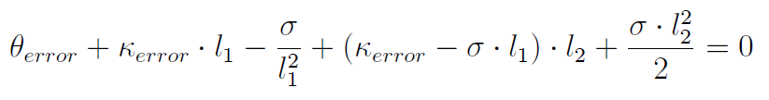



Heading and Curvature Correction (HCC) Maneuver
Heading and curvature corrected simultaneously
Introduces position error
General approach:
$${{\text{θ}}_{error}\text{ = }\text{θ}}_{change}=\text{κ}\text{(}\text{s}\text{)}∗s$$
${\text{θ}}_{error}$>0, ${\text{κ}}_{error}<0$
Case 1 equation:
Case 2 equation:
${\text{θ}}_{error}$>0, ${\text{κ}}_{error}>0$
Notes:
-HCC maneuver is developed to correct for heading and curvature error simultaneously. There are 4 cases, first 2 are opposite to each other and the other 2 are symmetric to first 2 cases.
-This maneuver does not care about position therefore it might introduce position error.

Slide 17
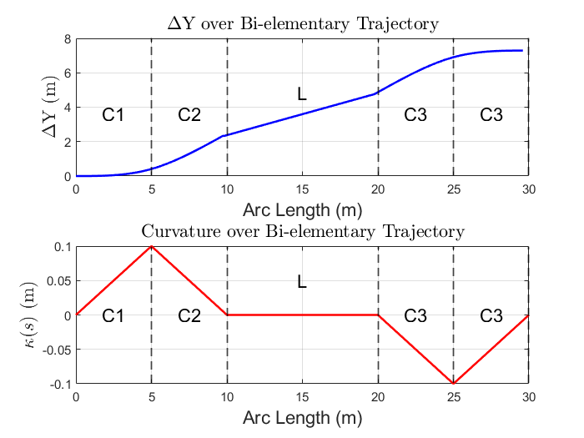
Position Correction Maneuver
Uses on Bi-elementary paths
Computed after applying HCC maneuver
Accounts for position error only
Ratios, ΔY and arc length is known
Notes:
-Uses bi-elementary paths that are frequently used in lane change maneuver applications. In this case it is used to correct for position offset from the centerline of the road. First HCC maneuver’s endpoint is computed and the position error is taken from HCC maneuver’s endpoint.
-This maneuver accounts for position error only, by its natüre it does not change the heading and curvature of the vehicle

Slide 18
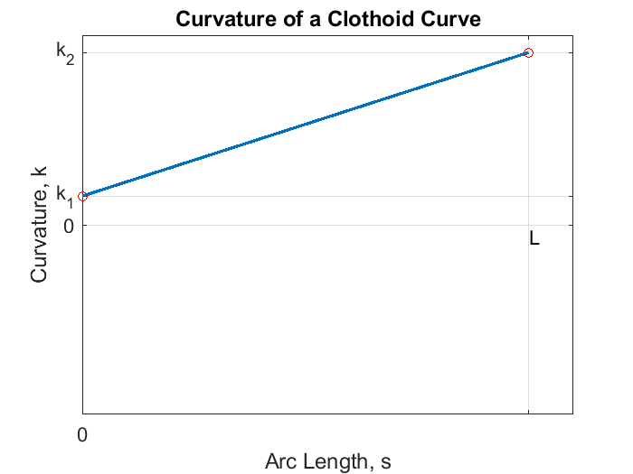
Road Curvature
Clothoid segments
Line segments
Easy to superpose based on arc length
Notes:
-If the road segment is clothoid, it has a curvature like the path on the left and it is easy to superpose since it is just a linear function
-If the road segment is a line segment, it has zero curvature so nothing needs to be superposed to compensate for road curvature.
-Since road curvature is a linear function, it is not computationally expensive and it is easy to compute.

Slide 19
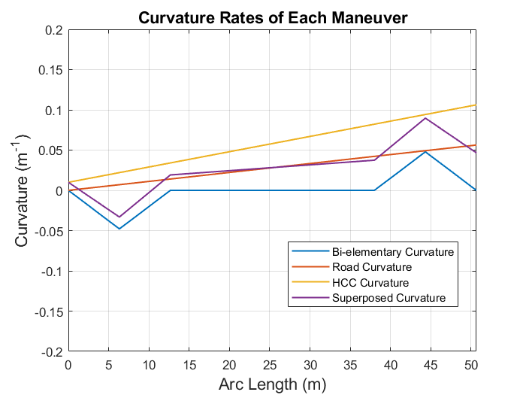
Maneuver Superposition
All maneuver curvatures directly added up
Arc-spline length is defined by HCC maneuver
Results is consecutive clothoids
Notes:
-All maneuvers are directly added up for superposition.
-Arc-length is defined by HCC maneuver.
-Resulting trajectory is a number of clothoids based on the required trajectory which is approximated by arc splines as previously discussed.

Slide 20
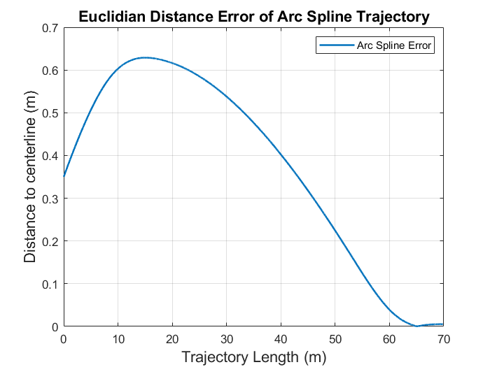
Evaluation Metrics
Euclidian distance
Heading error
Curvature error
Notes:
-Euclidian distance over the trajectory is an important metric to understand whether the vehicle leaves the road or not.
-Heading error is the heading difference between the vehicle and the road.
-Curvature error is the curvature difference between the vehicle curvature and road curvature.

Slide 21
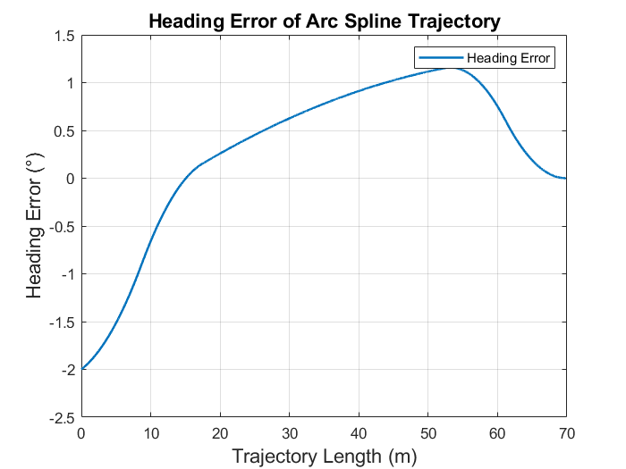
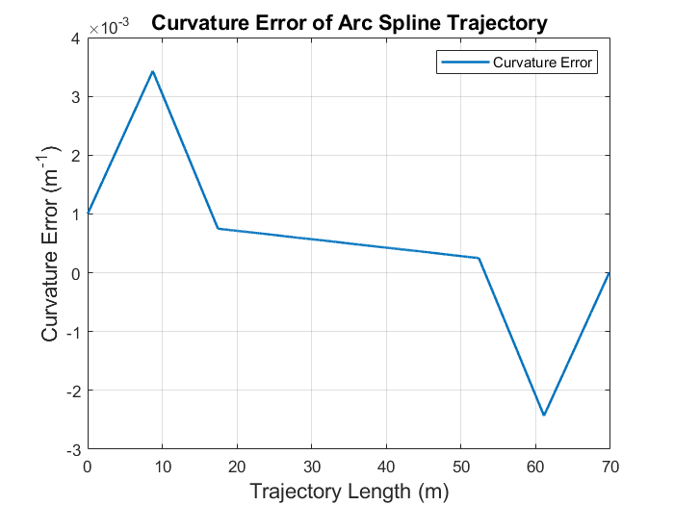
Arc-spline Trajectory Result for Case-1
$\text{Position} \text{error}\text{ = 0.35}\text{m}\text{ ,} {\text{θ}}_{error}\text{=}\text{+2°, }{\text{κ}}_{error}=−0.0010m^{−1}$
Notes:
-Plots may be observed.
-Error reaches zero for all cases.

Slide 22
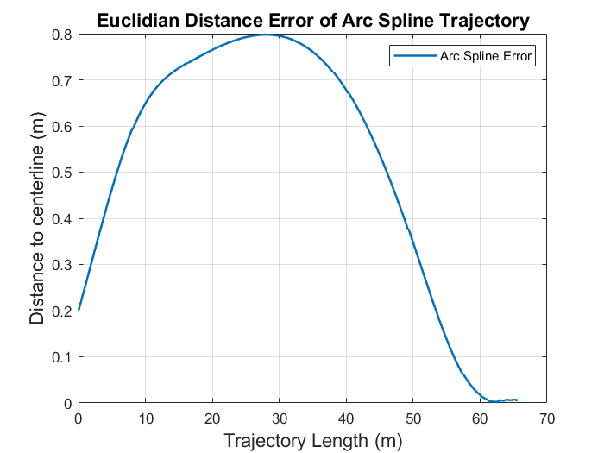
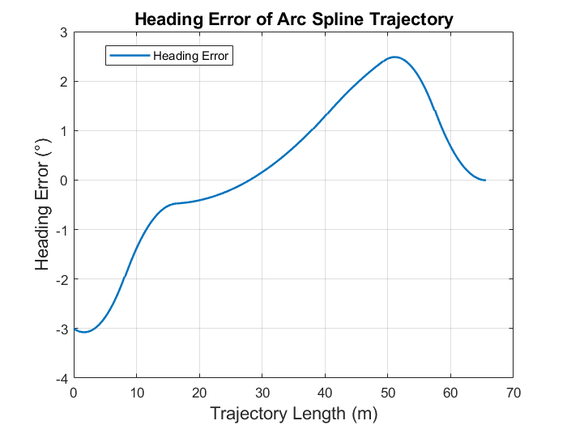
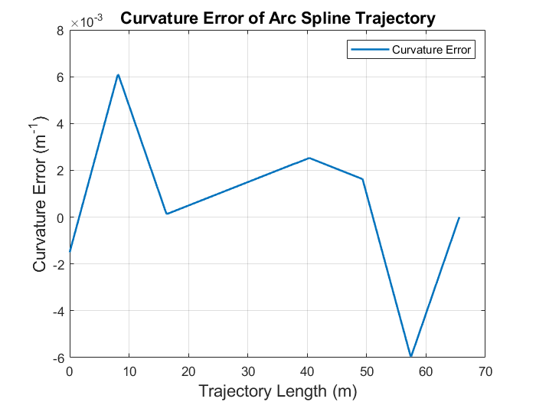
Arc-spline Trajectory Result for Case-2
$\text{Position} \text{error}\text{ = 0.20}\text{m}\text{ ,} {\text{θ}}_{error}\text{=}\text{+3°, }{\text{κ}}_{error}=+0.0015m^{−1}$
Notes:
-Plots may be observed.
-Error reaches zero for all cases.

Slide 23
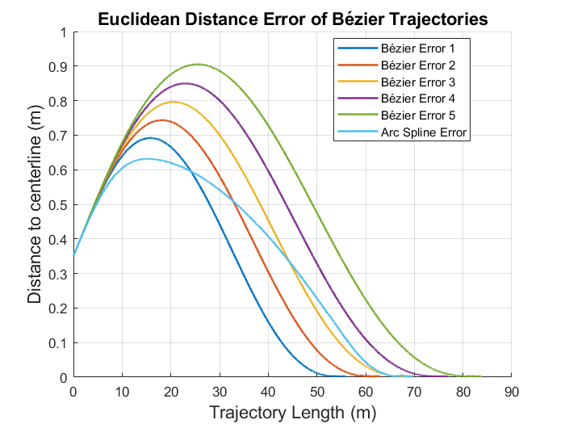
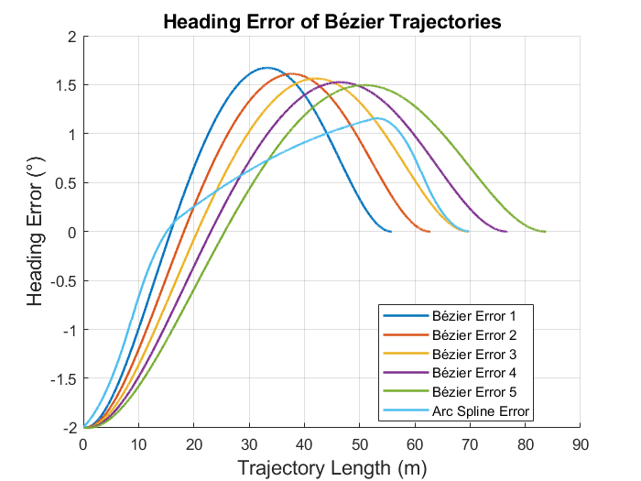
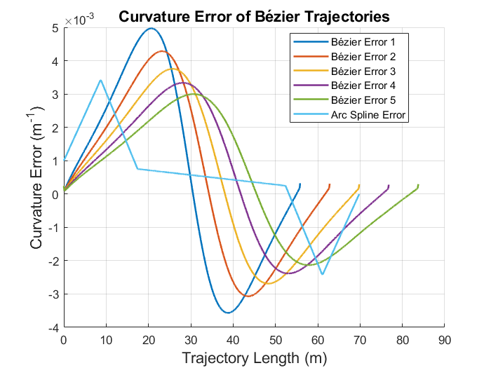
Arc-spline and Bézier Trajectories Comparison
Case – 1 is inspected.
Various length Bézier curves
Notes:
-Varying length of Bézier curves are inspected to have a variety of comparison
-Arc-splines tend to have a more stable solution.
-Position error approaches zero faster.
-Curvature error is almost always lower than Bézier curves

Slide 24
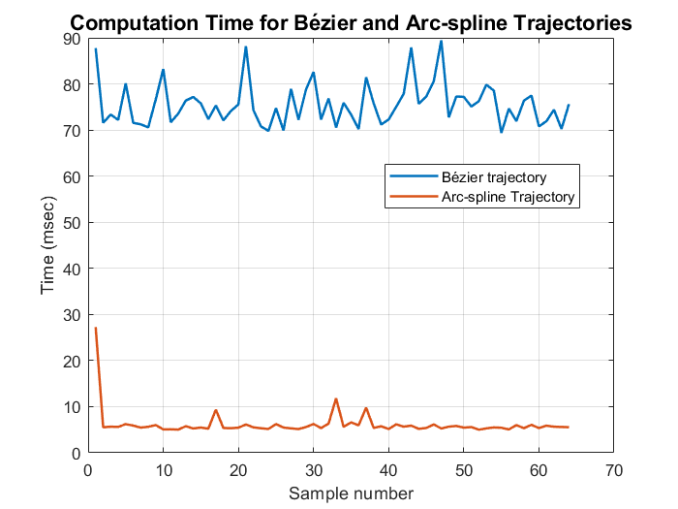
Arc-spline and Bézier Trajectories Comparison
Variety of cases are inspected
Arc-splines have analytical solution
Bézier curves have cost function
Notes:
-Arc-splines have analytical solution and representation hence they are generally very fast.
-Bézier curves on the other hand have a cost function. This cost function is utilized to pick the best curve from a family of Bézier curves. This especially increases the Bézier curve computation time.
-Thesis page (78)

Slide 25
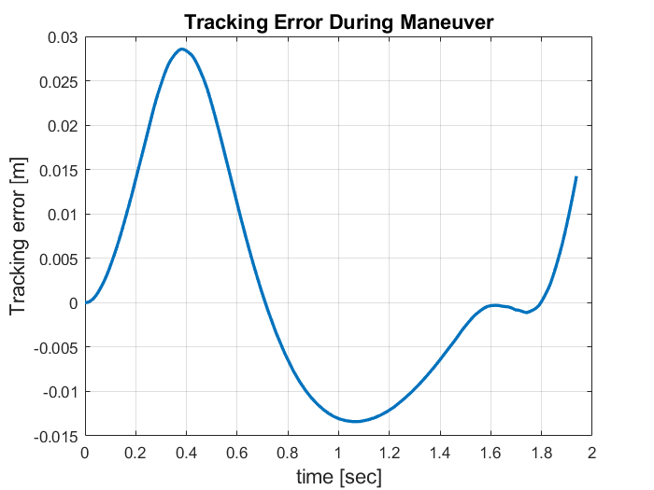
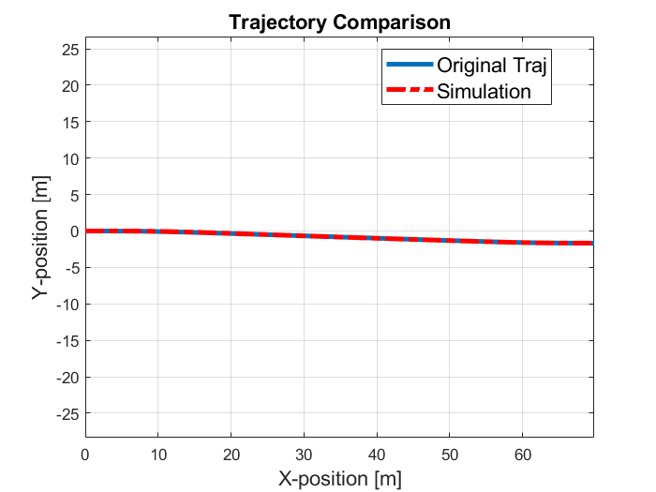
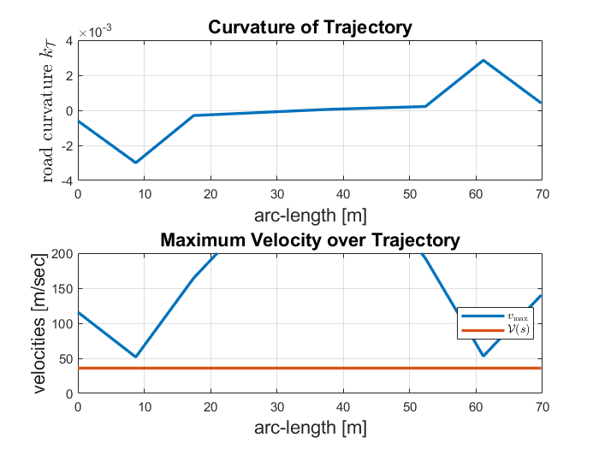
Trajectory Simulation
Case – 1 is simulated
Kinematic bicycle model for a sedan vehicle
Notes:
-Case-1 results are given below
-Tracking error is as low as a few centimeters
-Trajectory is given (coordinate system is changed so it does not look the same as previous results)
-Curvature plot is given and maximum velocity over trajectory is never exceeded.
-Vehicle model

Slide 26
Conclusion
Efficient HD map road representation
Arc-spline and straight-line segments
Controllable accuracy
Low memory usage
Analytical method for trajectory planning
Arc-spline road representation
Heading and curvature correction
Position correction using bi-elementary paths
Improved computational efficiency for trajectory planning
Notes:
-An efficient road representation is proposed.
-Low amount of memory is used for large maps while keeping the accuracy.
-New analytical method is introduced for trajectory planning.
-Computational efficiency is compared to Bézier curves

