Slide 1

Predicting IMDB Ratings
Atalay Barut
Istanbul Data Science Academy Project 2

Slide 2

Data Acquisition
Scraped 3127 movies data between 1990 and 2022
Only movies over 50.000 Ratings to avoid manupilation
Features : rating, raters, genres, director, writers, stars, release date, origin, language, budget, opening weekend, gross usa, gross worldwide, runtime, production company

Slide 3
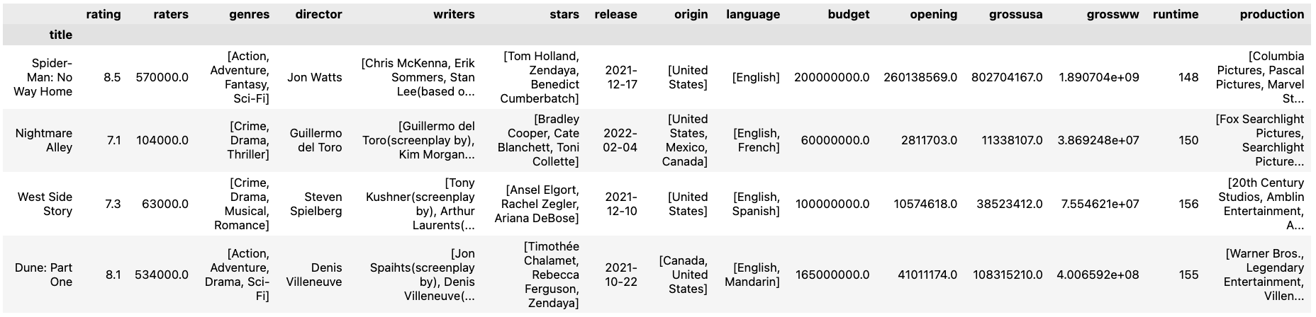
Data Pre-processing
Drop duplicates with the same ‘title’
(Number of duplicates were considerably low)
Drop Null values for ‘budget’, ‘opening’, ‘gross usa’ and ‘gross ww’
Correct data types for ‘rating’ and ‘release date’ features.

Slide 4
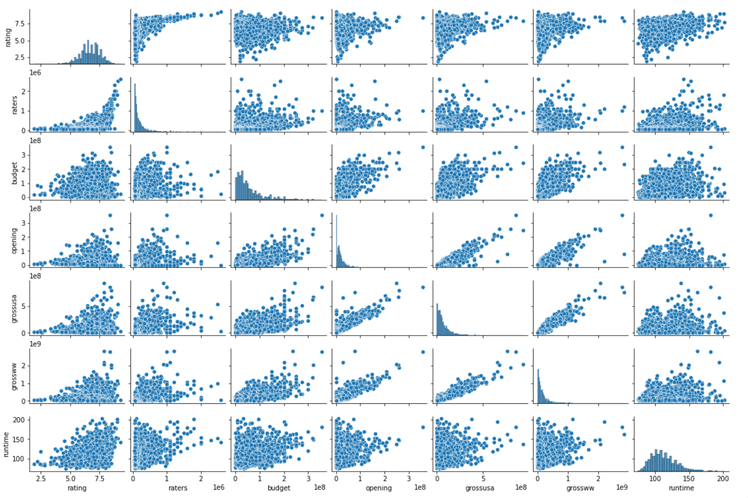
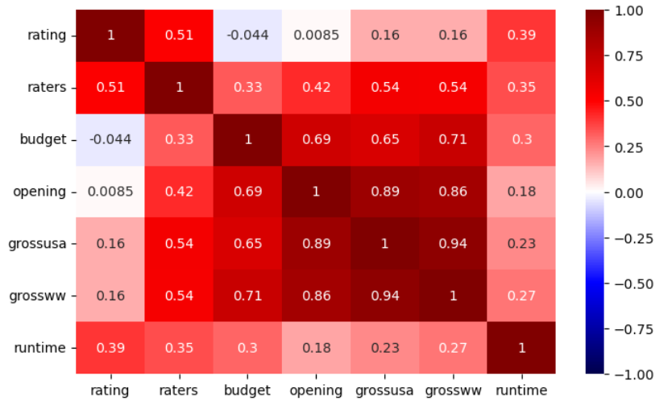
Data Understanding
Hints:
Looks like ‘raters’ and ‘runtime’ features have a higher correlation with ‘rating’
‘grossusa’, ‘grossww’ and ‘opening’ features have high correlation with each other (Multicollinearity)

Slide 5
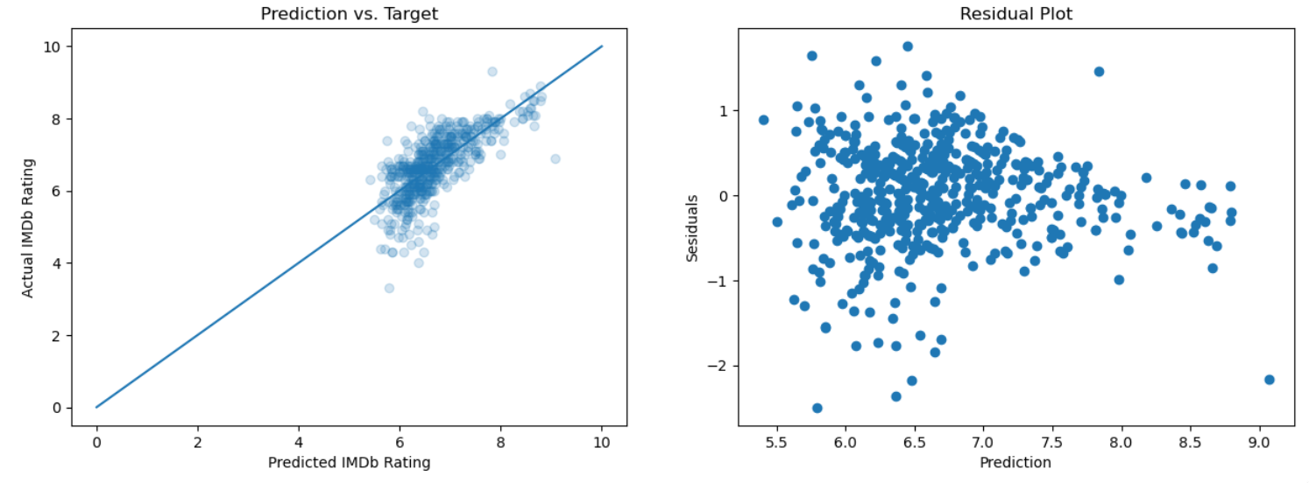
Baseline Model
 | Linear | Ridge | Polynominal
Train | 0.4119 | 0.4100 | 0.5457
Test | 0.4167 | 0.4158 | 0.5246

Slide 6
Working with Less Features
Highly correlated features can be exluded from the dataset
Also features that have low correlation can be ignored
Remove ‘opening’ and ‘grossusa’ features
 | Linear | Ridge | Polynominal
Train | 0.3945 | 0.3931 | 0.4861
Test | 0.3858 | 0.3906 | 0.4686
Remove ‘budget’
 | Linear | Ridge | Polynominal
Train | 0.3402 | 0.3389 | 0.4142
Test | 0.3436 | 0.3457 | 0.4308
We have lower R scores than Baseline model.
Looks like it didn’t make much help !

Slide 7
Feature Engineering
 |  | Linear | Ridge | Polynominal
Feature ‘YearsSinceRelease’ | Test | 0.4167 | 0.4158 | 0.5246
Polynominal Terms ‘raters’ and ‘runtime’ | Test | 0.3194 | 0.3136 | 0.3335
‘genre’ Dummy Feature | Test | 0.4908 | 0.4971 | 0.5335
‘stars’ Dummy Feature | Test | 0.4150 | 0.4148 | 0.5111
‘director’ Dummy Feature | Test | 0.4185 | 0.4181 | 0.4099
'production co.’ Dummy Feature | Test | 0.4367 | 0.4384 | 0.5103
Multiple Dummy Features | Test | 0.4998 | 0.5076 | 0.2657

Slide 8
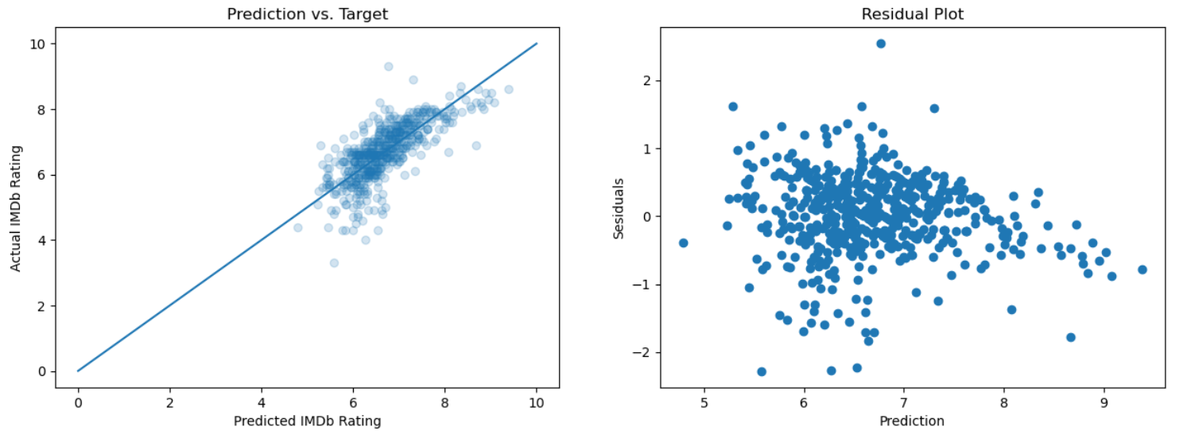
Conclusion
Most influencing numerical features were ‘runtime’ and ‘raters’
Our best model seems to be the one with ’genre’ dummy variables
Engineered Featured had a small improvement on the model
Our best score of R^2 : ~0,54 is not so bad but can’t be used in production

Slide 9
Future Work

Slide 10
Teşekkürler!
Sorular?

