Slide 1
Cloud 9
Call Center Data Visualization and Analysis

Slide 2
Question 1.1. The number of customers who called multiple times in the 2 week period?
Step 1: I extracted all incoming calls from the overall data set since we are looking for Customers who called in.
Step 2: I filtered out callers who called in more than once (number of call that are greater or equal to 2)
Step 3: I got the number of customers who called in multiple times
The number of customers who called in multiple times is 5346

Slide 3
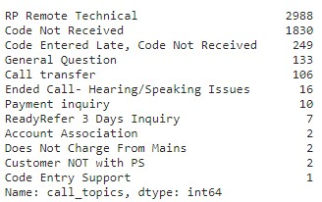
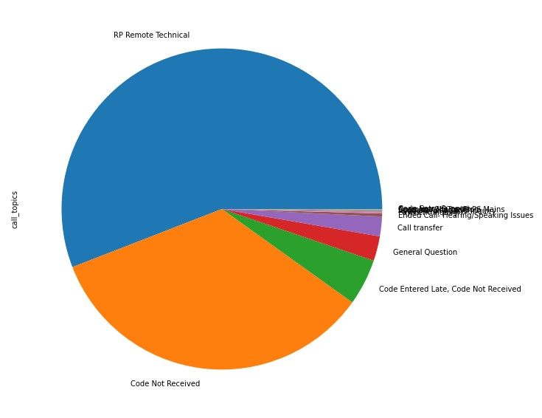
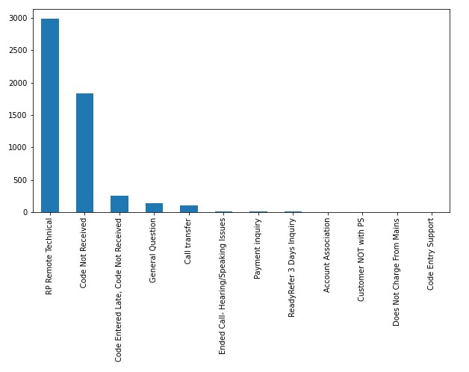
Question 1.2. Call topics discussed with the customers who contacted us multiple times?
Step 1: I got the number of call topics and generated a table of call topics and the times the CSRs used them, then plotted them on a pie chart and bar graph to see which occupation CSRs made most.
Analysis
As shown in both the pie chart and bar graph, the most frequently asked topics discussed based on the data set are RP Remote Technical issues and Code Not Received.

Slide 4
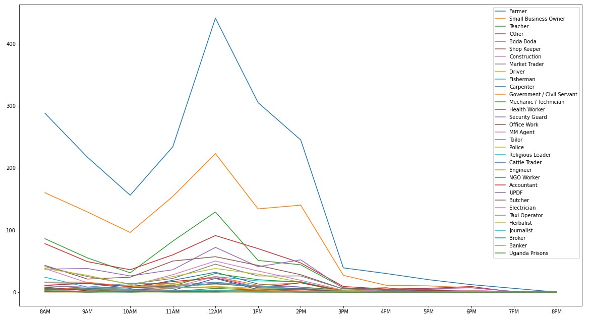
Question 2. Customer's occupation when we decide when to call them?
Step 1: I got information on Outgoing calls.
Step 2: I got number of calls per occupation of customer
Step 3: I filtered number of calls per work hour
Step 4: Plotted the data of each occupation data per work hour on a line graph
Analysis
As shown in the line graph above that maps number of calls per occupation against time, it is evident that we need to look at a customer's occupation before we call them, the availability of some customers is dictated upon by their type of work.

Slide 5
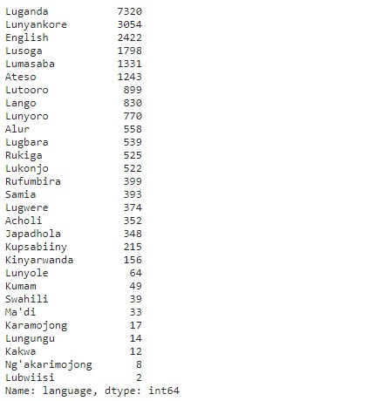
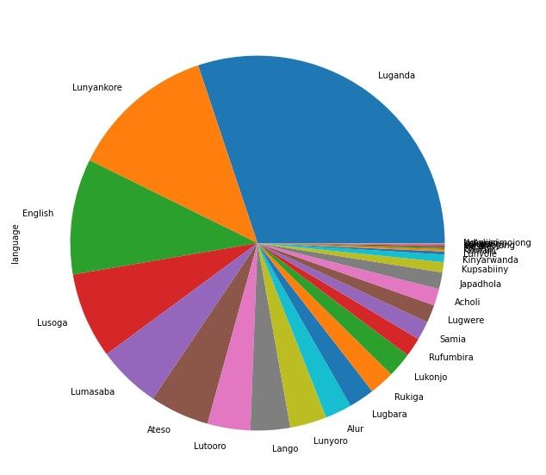
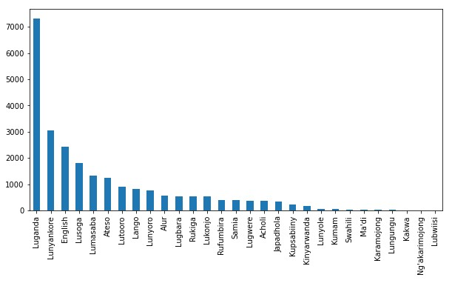
Question 3. From region of the country do we have the greatest number of customers?
Step 1: I extracted all incoming calls from the overall data set since we are looking for Customers
Step 2: I got number of callers per region using the 'language' column who called in.
Step 3: Plotted the findings on a pie chart and bar graph
Analysis
As per evidence of the data set extracted, the most callers are from the central region since Luganda has the highest number of callers.

Slide 6
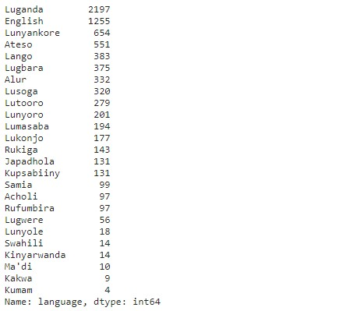
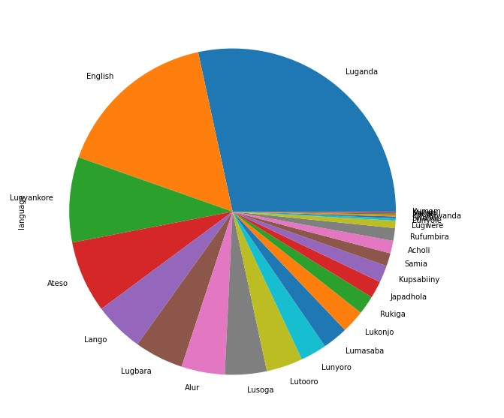
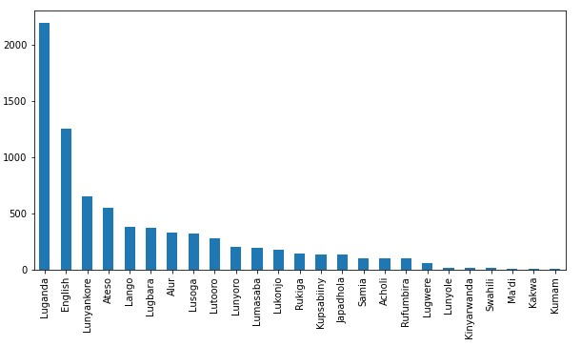
Question 4. Which language speaking customer care personnel should we employ most?
Step 1: Extract all outgoing calls from the overall data set since we are looking for CSRs per language that we ought to employ most.
Step 2: Get number of calls made by CSRs per region using the 'language' column.
Step 3: Plotted the findings on a pie chart and bar graph
Analysis
As per evidence of the data set extracted, the language customer care personnel to be employed the most ought to be a Luganda speaking individual, since they make the highest number of outgoing calls.

Slide 7
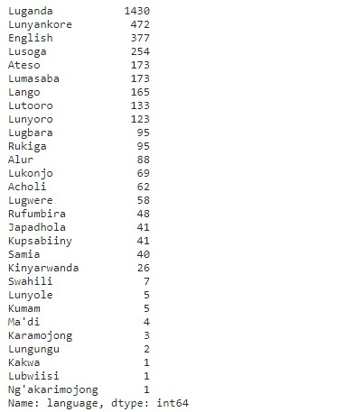
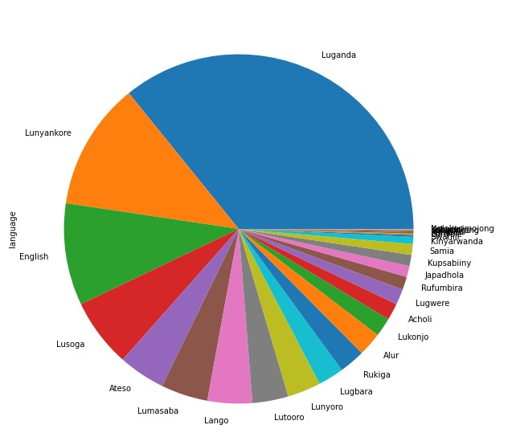
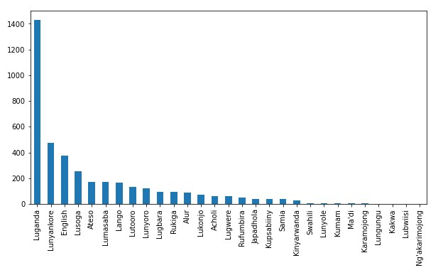
Question 5. Their are currently 3 available shifts i.e morning(8pm-12pm), afternoon(12pm-4pm) and evening(4pm-8pm) mentioned in the description of Company_A's work schedule, however, the data presented contains timestamps of an earlier time before the morning shift. Call this new shift day_break and show the number of customers who call in at this time per region.
Step 1: I got information on Incoming calls.
Step 2: I got customer calls between 4AM and 8AM per region.
Step 3: Plotted the findings on a pie chart and bar graph.

Slide 8
Question 6. How is this analysis impactful to Company_A's call center operations?
According to the analysis done, it's evident there is a significant number of callers who call in very early in the morning and mainly from the center region (Buganda). Thus more customer care personnel need to be brought to a shift that starts from 4AM to 8AM.
There is a need to employ more personnel for the Western region and these personnel should be added to the shift that starts from 4AM to 8AM given the second highest number of callers speak Lunyankore

