Slide 1

B.Tech Project Final Evaluation, VIIIth Sem
Health Insurance Settlement Using Blockchain
Presented by :-
Atamjeet Kohli - 2019001786
Manish Rai - 2019003752
Arshi Raies - 2019620291
Under the Supervision of:-
(Dr. Mayank Kumar Goyal)
Sharda University, Gr. Noida
DEPARTMENT OF COMPUTER SCIENCE & ENGINEERING
SCHOOL OF ENGINEERING AND TECHNOLOGY
August,2022

Slide 2
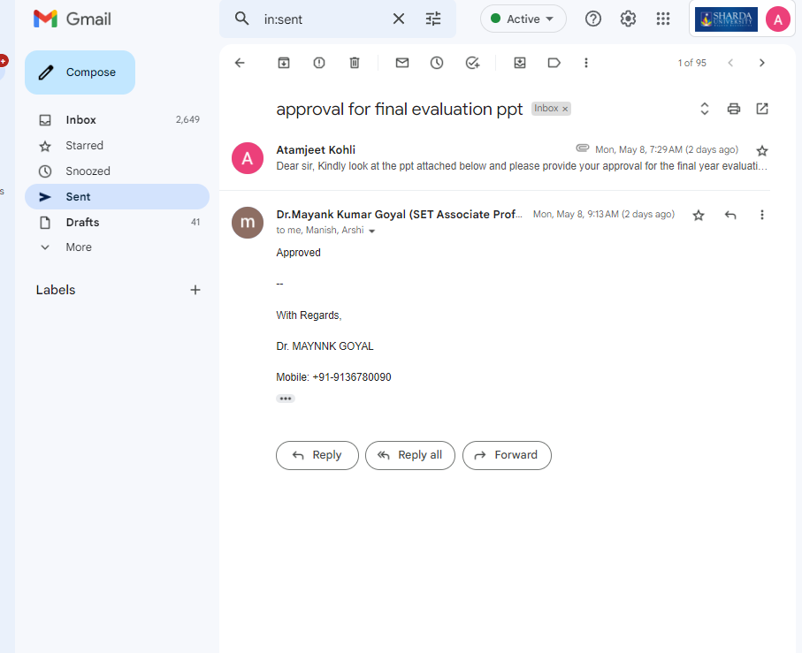
Approval from guide for the evaluation

Slide 3
Contents of the Presentation:
S. no. | Title
1. | Workload Distribution and Project Planning
2. | Introduction to the project
3. | Motivation for the project
4. | Literature Survey
5. | Objective
6. | Usage of Blockchain
7. | Solution Approach
8. | System Architecture
9. | Framework
10. | Design Tools Used
11. | Project Planning and work Schedule
12. | Result
13. | Outcome

Slide 4
Workload Distribution And Project Planning
Name | Task | Technologies
Atamjeet Kohli | Back-end implementation of project’s on blockchain, Smart contract. | Solidity/Javascript, Hyperledger/ Ethereum. Nodejs/Firebase.
Manish Rai | Front-end implementation of project, Back-end Implementation. | Html, CSS, Javascript, ReactJs, Solidity, NodeJs.
Arshi. | Frond-end, Research Paper, Data collection for project. | Html, CSS, Javascript

Slide 5
Introduction to the Project
Health record is a collection of clinical data related to the patient’s mental and physical health, gathered from different sources. Health record consists of:-
1. a patient’s medical history,
2. symptoms and disease examination,
3. diagnosis, treatment,
4. results of lab investigation,
5.scanning reports, alerts like allergic to etc.
Health records can be easily and quickly shared between medical institutions by integrating digital technologies in the healthcare system In this respect there are intense queries
about the
1.storage of patient’s data,
2.providing authorization to
3.access the data, security &
4.immutability of the data.

Slide 6
Introduction to the Project
The previously mentioned problems faced by the present methodology and technology used for handling the sensitive data of an individual can be solved by Blockchain.
A blockchain is a distributed database or ledger that is shared among the nodes of a computer network. As a database, a blockchain stores information electronically in digital format. Blockchains are best known for their crucial role in cryptocurrency systems,such as Bitcoin.
Blockchain:
1.Structured Data.
2.Decentralized
3.Hard to Tamper with
4.Secure Transactions
5.Provides authority.
6.Provides sense of authority.

Slide 7
Motivation for the project
The centralized approach of maintaining the health
records lead to data breaches:-
1. According to 2017 Ponemon Cost
of Data Breach Study, the cost of the data breach for healthcare
organizations estimated to be $380 per record.
2. According to 2016 Breach Barometer Report, 27,314,647 patient records were
affected.
These kind of breaches and attacks are dangerous for the data present in the databases
as it contains the sensitive data of an individual and since the patient have no control
over the data, the chances of data being misused is high. So we need a patient-centered
approach which is:-
1.completely decentralized,
2.which can identify data thefts,
3.prevent data manipulation, and
4.patient has the right in access control.

Slide 8
Motivation for the project
Blockchain Technology serves as a best solution to address all the problems and fulfill the needs.
Blockchain being a decentralized and distributed
ledger it can also impact on billing, record sharing, medical
research, identify thefts and financial data crimes in days to
Come.
For all of its complexity, blockchain’s potential as a decentralized form of record-keeping is almost without limit and some of its pros are:
1.Improved accuracy by removing human involvement in verification.
2.Cost reductions by eliminating third-party verification.
3.Decentralisation makes it harder to tamper with.
4.Transactions are secure private and efficient.
5.Transparent technology.
6.Provides a way to secure personal information for citizens of countries with unstable or underdeveloped governments.

Slide 9
Literature Survey
S.No. | Name of Paper | Year | Authors | Objectives | Algorithm / Methodology | Outcome
1. | Electronic health records in a Blockchain | 2019 | Andre Henrique Mayer,Cristiano Andre da Costa,Rodrigo da Rosa Righi | EHRs contain critical and highly sensitive private information for diagnosis and treatment in healthcare. The sharing of healthcare data is an essential step toward making the healthcare system smarter and improving the quality of healthcare service. Blockchain provides a possible future solution. | 1. BFT/CFT 2.PoS/ PoA 3.Hyperledger Caliper 4.Composer | Analyzing the results that were obtained from the literature review, we conclude that Blockchain technology might be a future suitable solution for common problems in the healthcare field, such as EHR interoperability, establishing sharing trust between healthcare providers, auditability, privacy, and granting of health data access control by patients, which would enable them to choose whom they want to trust and with whom to share their medical records
2. | Blockchain for efficient Medical Record Management | 2020 | Arindam Sengupta, Renyuan Zhang. | To find ow the introduction of this novel technology can create a more efficient and interoperable infrastructure to manage records that leads to improved healthcare outcomes, while maintaining patient data ownership and without compromising privacy or security of sensitive data. | 1.HL Fabric 2.SHA256 | The use of smart contracts allows patients’ consent preferences to be executed immediately, further reducing administrative costs. An off Blockchain data lake is scalable and can store a variety of data types, making it versatile and suitable enough for the developing forms of data brought about by the Internet of Things in the healthcare field,it supports high-throughput data analysis as well as machine learning strategies to be applied, while being encrypted and digitally signed to ensure data privacy

Slide 10
3. | Using Blockchain for Medical Data Access and Permission Management | 2016 c | Asaph Azaria, Ariel Ekblaw, Thiago Vieira, Andrew Lippman | When designing new systems to overcome these barriers, we must prioritize patient agency. Patients benefit from a holistic, transparent picture of their medical history [3]. This proves crucial in establishing trust and continued participation in the medical system | 1.Ethereum 2.PyEthApp 3.SQLite | We demonstrate an innovative approach for handling medical records, providing auditability, interoperability and accessibility via a comprehensive log. Designed for record flexibility and granularity, MedRec enables patient data sharing and incentives for medical researchers to sustain the system. We look forward to formalizing an onboarding procedure for medical research “miners”, and exploring mining data economics.
4. | Application of Blockchain to Maintaining Patient Records in Electronic Health Record for Enhanced Privacy, Scalability, and Availability | 2019 c | Dara Tith, Joong-Sun Lee, Hiroyuki Suzuki, W.M.A.B. Wijesundara, Naokko Taira, Takashi Obi, Nagaaki Ohyama | to build a system to access patient records easily among EHRs without relying on a centralized supervisory system. Methods: We apply consortium blockchain to compose a distributed system using Hyperledger Fabric incorporating existent EHRs. Peer nodes hold the same ledger on which the address of a patient record in an EHR is written. | 1.HL Fabric 2.SHA256/SHA512/MD5 3.AFGH algorithm | The results demonstrated that our system can be used by doctors to find patient’s records and verify patient’s consent on access to the data. Patients also can seamlessly receive their past records from other hospitals. The access log is stored transparently and immutably in the ledger that is used for auditing purpose. Our system is feasible and flexible with scalability and availability in adapting to existing EHRs for strengthening security and privacy in managing patient records

Slide 11
5. | Using Blockchain for Electronic Health Records | 2019 c | Ayesha Shahnaz, Usman Qamar, Ayesha Khalid | Some issues regarding the security of medical records, user ownership of data, data integrity etc. The solution to these issues could be the use of a novel technology, i.e., Blockchain. This technology offers to provide a secure, temper-proof platform for storing medical records and other healthcare related information | 1.Ethereum 2.IPFS 3.EVM | Our proposed framework is combination of secure record storage along with the granular access rules for those records. It creates such a system that is easier for the users to use and understand. Also, the framework proposes measures to ensure the system tackles the problem of data storage as it utilizes the off-chain storage mechanism of IPFS.
6. | Blockchain Based Electronic Health Record Management for Mass Crisis Scenarios | 2018 c | Filippo Boiani | To deploy and implement decentralized EHRs management systems and to solve some issues as described below: 1.No patient control. 2.Scattered records 3.Limited system interoperability 4.Inconvenient secure sharing. | 1.Hyperledger Fabric 2.BFT/ CFT 3.HL Caliper 4.JMeter | The prototype has been designed and implemented at IBM Sweden using Hyperledger Fabric to serve as an access control system to manage identities, provide traceability, and to be used in extreme situation to ensure the continuity of treatment while preserving privacy and confidentiality of users and patients. T

Slide 12
7. | Decentralized Patient Centric e-Health Record Management System using Blockchain and IPFS | 2019 c | Gaganjeet Singh Reen, Manasi Mohandas, S. Venkatesan | The traditional EHR systems have a lot of problems when it comes to privacy, security and ease of use. The records can be misused if the hospital does not have adequate security measures in place. Blockchain For Health Data and Its Potential Use in Health IT and Health Care Related Research [3] makes use of the blockchain to store encrypted medical record details such as where it is stored(hashed pointers) and who has access to it. | 1.Ethereum 2.AES encryption 3.SHA256 | The use of IPFS along with blockchain makes it a completely de-centralized system which does not require on any organization for logging or storing of data. IPFS ensures immutability of patient records while blockchain ensures the immutability of logged transactions. The use of bio metric encryption ensures that even in a scenario in which a patient is in a critical condition and can not provide access to his/her records, the records could still be accessed using his/her fingerprints.
8. | Blockchain Personal Health Records System | 2021 c | Hao Sen Andrew Fang, Teng Hwee tan, Yan Fang chreyl Tan, Chun Jin Marcus Tan | This cross-disciplinary systematic review on the blockchain PHR space has revealed that as of now, much of the development is still in the conceptual stage. However, there is a trend of growth and maturation. ally when the need to integrate with EMR systems and adopt health care data standards becomes more prominent | 1.PRISMA 2. Solidity | In terms of geographic interest, we found that although interest in blockchain PHR was multinational, there were obvious leaders in this space. Looking deeper among the leading countries, we noticed that since 2018 there has been an increase in publications from India, whereas those from China, South Korea, and the United States started to level off or decrease

Slide 13
9. | Blockchain tech applications in healthcare | 2021 c | Abid Haleem, Mohd Javaid, ravi Pratap Singh, Rajiv Suman, Shanay Rab | Protection of healthcare data, various genomics management, electronic data management, medical records, interoperability, digitalised tracking and issues outbreak, etc., are some of the technically derived and impressive features employed to develop and practice Blockchain technology | 1.BURSTIQ, FACTOM 2.CHR 3.NEBULA GENOMICS 4.ENCYPGEN 5.TIERION | Blockchain technology can well be used to improve patient history management, especially tracking and the insurance mediation process, thereby accelerate clinical actions with optimized data maintenance. Overall, this technology would significantly enhance and eventually revolutionize how patients and physicians treat and use clinical records and improve healthcare services.
10. | Blockchain-Based Medical Record Management with Biofeedback Information | 2020 | Hui Li Wang, Shao-I chu, Jiun-Han Yan, Yu-Jung Huang, Shy Ya Pan, Wei-Cheng Lin, Chao-tien Hsu, Chih-Lung Hung. | Deployment of blockchain in the medical record system not only provides the reliable service but also speeds up the medical record exchange. Owing to decentralization, the ownership of the medical record is returned to the patients, allowing them to manage the medical record directly and take care of their own health | 1.RC 2.PPR 3.Ethereum | This chapter investigated the blockchain-based and patient-oriented medical record system with the smart contract on EVM. In the future, the drug pedigree may be included into the blockchain. The drug traceability is thus carried out for efficient management and control.

Slide 14
11. | E-HelathChain- a Blockchain-based personal health information management system | 2021 c | Pravin pawar, Neeraj Parolia, Sameer Shinde, Thierry Oscar Edoh, Madhusdan Singh | Due to the proliferation of medical IoT devices in the consumer market, increasing amount of personal health data is being generated. A Personal Health Information Management System (PHIMS) is necessary to allow an individual to gather, store, update, and share personal health data as well as control access to personal health data in a secure and privacy-sensitive manner. | 1.REST APIs 2.OAuth2.0 3.Hyperledger Fabric 4.CFT/ BFT | The eHealthChain heavily focuses on an adapter component that collects data from the health device backend and transfers it to the blockchain for storage. The eHealthChain system architecture is extensible to accommodate several medical IoT devices and applications and it is language and platform agnostic. The use of HL7 Fast Health Interoperability Resources (FHIR) standard for sharing health record data will be a valuable addition to the eHealthChain system.
12. | Electronic Health Record System Using Blockchain | 2019 c | R. Sangeetha, B.Harshini, A.shanmugapriya, T.K.P. Rajagopal | The patient should have right to access his EHRs for managing and sharing them independently. By storing the data in a Blockchain the user’s data is encrypted and stored as blocks in etherscan. To create a open source, independently veirifiablle systems solve this issue. | 1.Ethereun 2.Testnet/ Mainnet 3.Geth/ Go-Ethereum 4.Merkle Patricia Trees | The private key is used for the patient which can be used for the further use of the reports. The one who don’t have the private key cannot involve in the process of retrieving data. Hence the Health Records of the patients are more secured with the BlockChain and can used with their own private key as well as they can make use of that for further reference.

Slide 15
13. | Applications of blockchain in ensuring the security and privacy of electroic health record systems | 2020 c | Shuyun Shi, Debiao he, Li Li, Neeraj Kumar, Muhammad Khurram Khan, Km-Kwang Raymond Choo | There is no trusted central authority. Thus, reaching a consensus for these transactions among un-trustworthy nodes in a distributed network is an important issue. For this to be achieved they have to reach an agreement to attack or retreat. | Algorithms used to reach consensus among all the distributed nodes before a new Block is added to blockchain: 1.POW, POS 2.DPOS(Delegated POS) 3.PBFT 4.Raft 5.PoA 6.PoC, PoET | Blockchain has shown great potential in transforming the conventional healthcare industry, as demonstrated in by integrating blockchain technology with existing EHR systems. It has been identified that a number of potential research opportunities, for example relating to IoT, big data, machine learning and edge computing. With hope that this review will contribute o further insight into the development and implementation of the next generation EHR systems, which will benefit our (ageing) society.
14. | Blockchain-based electronic healthcare record system for healthcare 4.0 applications | 2019 c | Sudeep Tanwar, Karan Parekh, Richard Evans | Access Control Policy Algorithm for Improving data accessibility between healthcare providers, assisting in the simulation of environments to implement the hyperledger based electronic healthcare record (EHR) sharing system that uses the concept of a chain code, performance metrics in blockchain networks, such ass latency, throughput, Round Trip Time have also been optimized for achieving enhanced results. | Frameworks and Tools to measure the performance of such systems:- 1.Hyperledger Fabric 2.Composer 3.Docker Container 4.Hyperledger Caliper 5.Wireshark Capture Engine | The Proposed work eliminated the central authority and a single point failure in the system. System security is achieved through immutable ledger technology as any user cannot modify the ledger. By improving the performance of the proposed system, it is improved by 1.75x and latency is decreased by 1.5x.

Slide 16
15. | Health Record Management through Blockchain Technology | 2019 c | V.M. Harshini, Manjunath R.Kounte | The traditional method which is followed in most of the hospitals for maintaining records is the manual method which includes papers and books. This method has serious limitations such as a need for large storage areas and retrieval of records is difficult. In this respect there are intense queries about the storage of patient’s data, providing authorization to access the data, security & immutability of the data. These problems can be solved by developing a decentralized digital health infrastructure that is by integrating Blockchain technology into the healthcare system | In our work, the proposed concept is developed as a contract by the name healthcare which works by: 1.Invoking the transaction. 2.New Record Creation. 3.Validation. | In this model, the patient is considered as the sole owner to his health records who would decide on sharing what data and with whom. Blockchain does not just help in decentralizing the data, it also gives the real-time data access, keeps the data confidential, handles high volumes of data efficiently, and also authenticate and authorize the data.

Slide 17
Objective
The traditional method which is followed in most of the hospitals for maintaining records is the manual method which includes papers and books.
There is no trusted central authority. Thus, reaching a consensus for these transactions among un-trustworthy nodes in a distributed network is an important issue. For this to be achieved they have to reach an agreement to attack or retreat.
To deploy and implement decentralized EHRs management systems and to solve some issues as described below:
1.No patient control.
2. Scattered records
3. Limited system interoperability
4.Inconvenient secure sharing.

Slide 18
Usage of Blockchain
Blockchain technology which is new and emerging really fast in the world can be find
effective and useful as it not only solve the above given issues but also comes with
advantages for the individual and provides:
1.Authorisation
2.Access Control
3.Consensus
4.Precision and accurate handling of data
5.Transparent and private transactions.

Slide 19
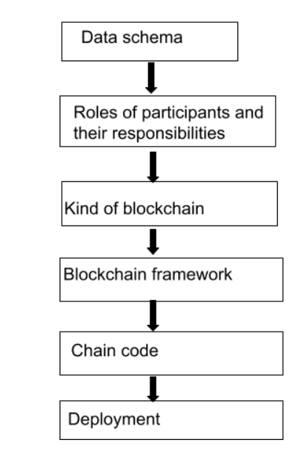
Solution Approach

Slide 20
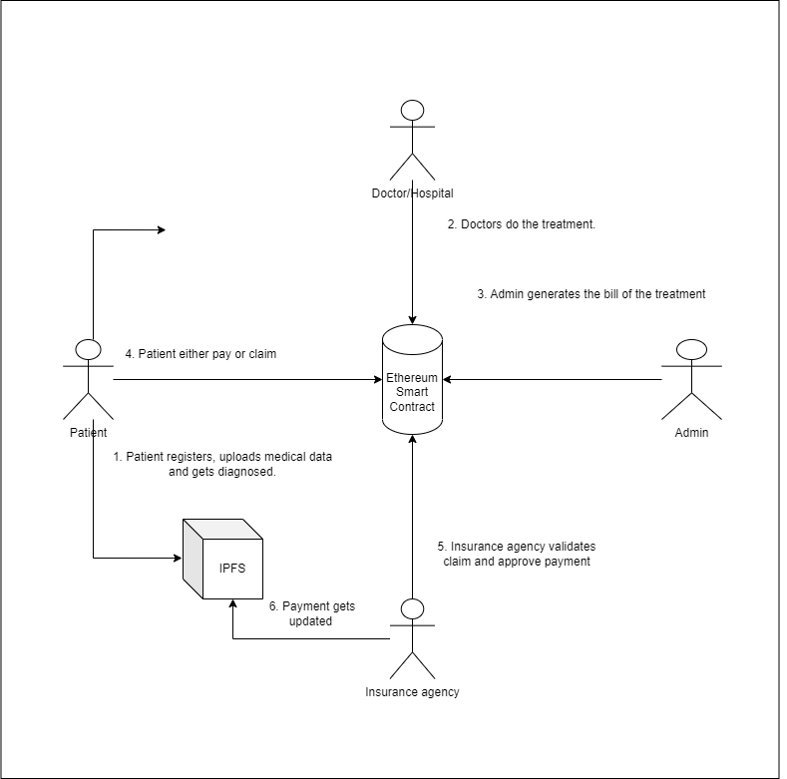
System Architecture

Slide 21
Framework
Ethereum is a decentralized blockchain platform that establishes a peer-to-peer network that securely executes and verifies application code, called smart contracts. Transactions are sent from and received by user-created Ethereum accounts. A sender must sign transactions and spend Ether, Ethereum's native cryptocurrency, as a cost of processing transactions on the network.
Smart contracts allow participants to transact with each other without a trusted central authority.

Slide 22
Design Tools Used
Metamask: Extension for accessing Eth enabled distributed applications.
Solidity : Ideal for developing smart contracts that run on EVM
Ganache: Rapid development of Eth and Corda shared apps
Truffle: Built-in functionality for compiling, deploying and linking smart contracts.
IPFS: File sharing peer-to-peer network for storing and sharing data in a distributed file system.

Slide 23
Project Planning and Work Schedule
Topic Selection | 01 / 04 / 2022 to 30 / 04 / 2022
Paper Collection | 01 / 05 / 2022 to 20 / 05 / 2022
Survey Literature | 21 / 05 / 2022 to 10 / 06 / 2022
Data Analysis | 11 / 06 / 2022 to 07 / 07 / 2022
Finalising Algorithms | 08 / 07 / 2022 to 20 / 08 / 2022
Implementing Algorithms | 21 / 08 / 2022 to 03 / 02 / 2023
Deploying Model/Website | 04 / 02 / 2023 to 15 / 03 / 2023
Testing Website | 16 / 03 / 2023 to 29 / 03 / 2023
Paper Writing | 29 / 03 / 2023 to 19 / 04 / 2023

Slide 24
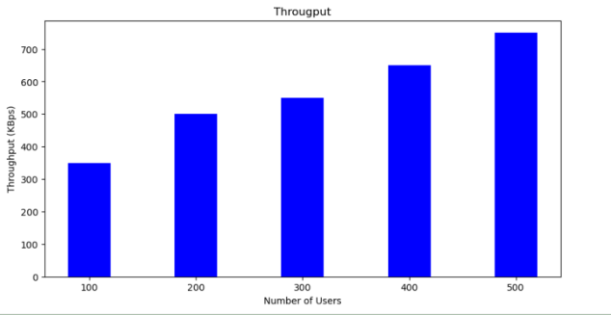
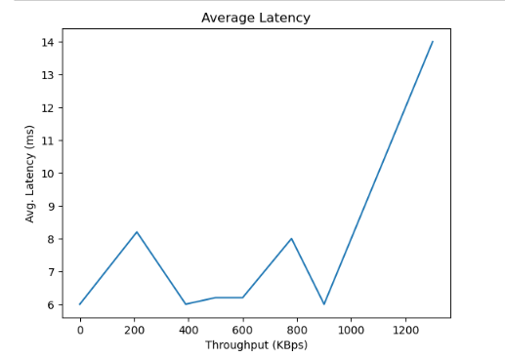
Result

Slide 25
Outcome
This drift from an institute-driven to patient-driven comes
with a bundle of challenges which are effectively addressed
by Blockchain by decentralizing the whole mechanism in
contrast to the traditional way of data management.
Blockchain does not just help in :-
1.Decentralizing the data, it also
2.Gives the real-time data access, keeps the
3. Data confidentiality,
4.Handles high volumes of data efficiently, and also
5.Authenticate and authorize the data
Our approach also deploys smart contracts, which is a code,
which executes on its own when both the parties agree on
the set of protocols.
Finally, a ready to be deployed and use model of electronic health record using Blockchain for the individual
and other parties which solves the above given issues and provides other advantages of the technology as well.

Slide 26
THANK YOU

