Slide 1
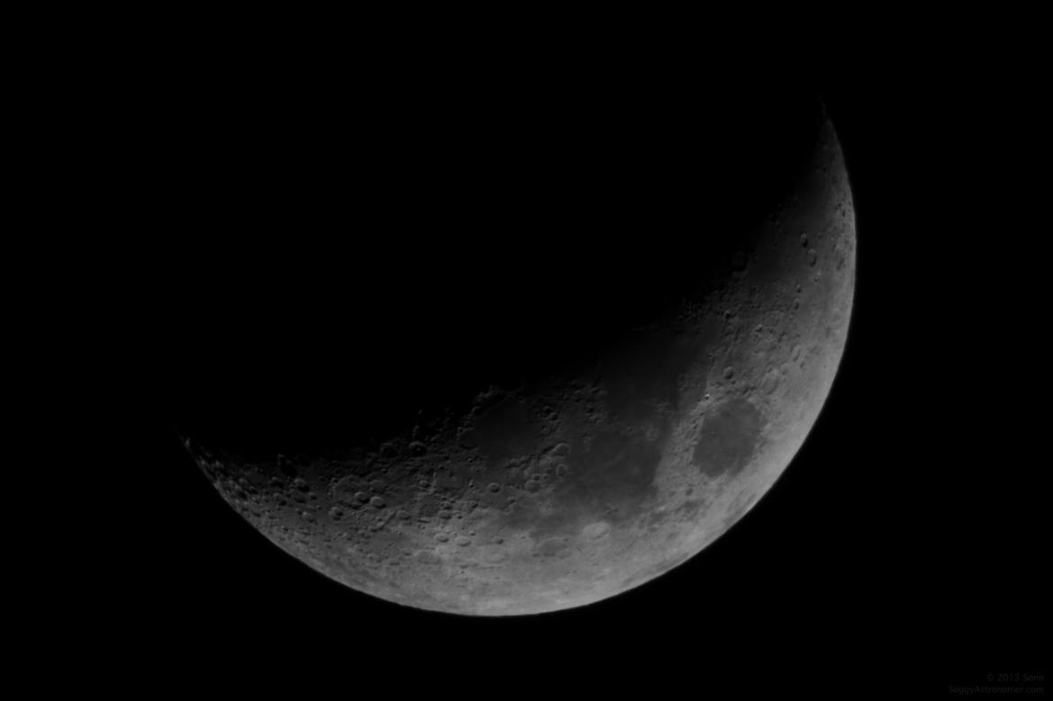


NASA Space App Challenge
Challenge: Book it to the Moon
Participants:
Vasko Atanasovski
Antonio Dimovski
Ferid Memed
Atanas Kostovski

Slide 2
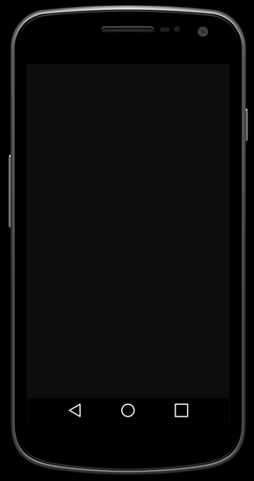
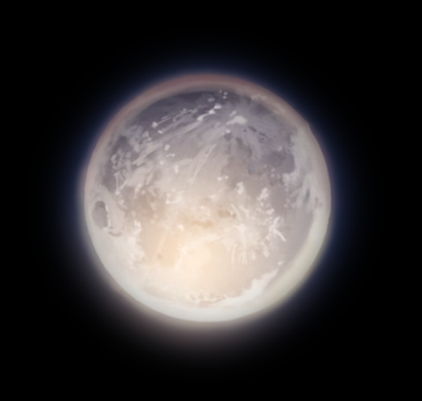


Slide 3





Luna - Discover
Phone must point to the
direction of the Moon
Discover
Message
Orient your phone
to the Moon

Slide 4



Luna - Discover
► Using the phone’s accelerometers
and gyroscopes it can determine
it’s position relative to the Moon
in real time.
► Once the Moon is targeted the
application will give you pictures
and stories about the Moon and
Moon’s missions

Slide 5
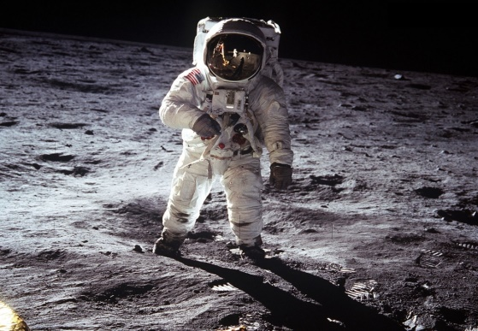
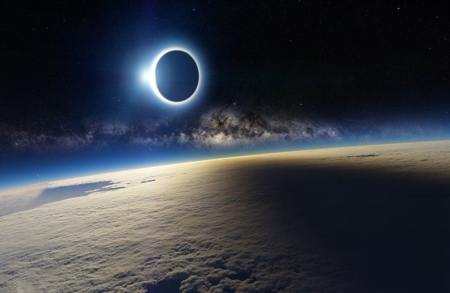



Luna - Discover
► “Read More” will generate
another story
Share it on social media
The first man that stepped on the moon was Neil Armstrong. This happened 47 years ago.
Then he said "This is one small step for man, one giant step for man kind."
► Share option allows sharing
the stories on social media
The Moon can cast a shadow on Earth.
When we stand in that shadow we have a solar eclipse.
During a total solar eclipse it looks like night outside!
Share
Share
Read More
Read More

Slide 6
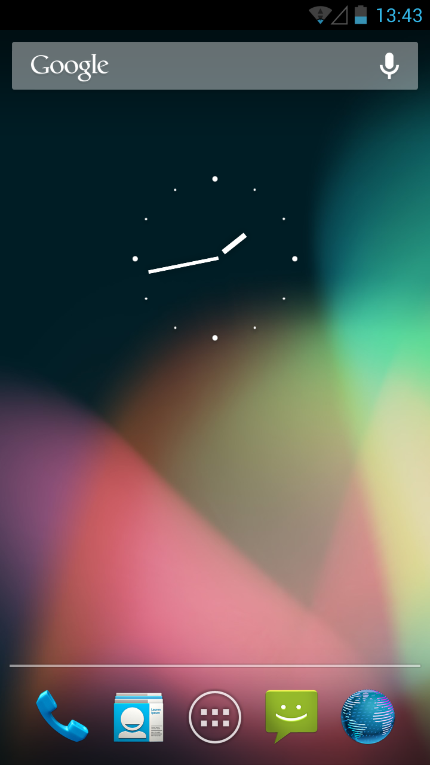



Luna - Message
Messages can be sent to
another user registered
on Luna, or through
friends on Facebook
Write a Message
Inbox
To:
Demouser
From:
Demouser
Type username...
Hey, did you saw the
landing of the Falcon 9?
They finally did it after
so many attempts.
Your message...
Hey, did you saw the
landing of the Falcon 9?
They finally did it after
so many attempts.
Discover
Discover
Message
Message
Luna:
User223 sent you a message
Orient your phone
to the Moon
Send
Reply
Sent
1 New

Slide 7
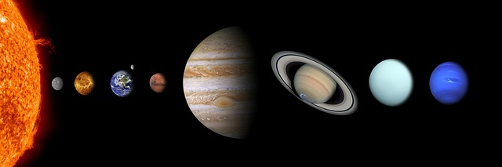
Luna – As imagined
Expanding the observable universe

Slide 8
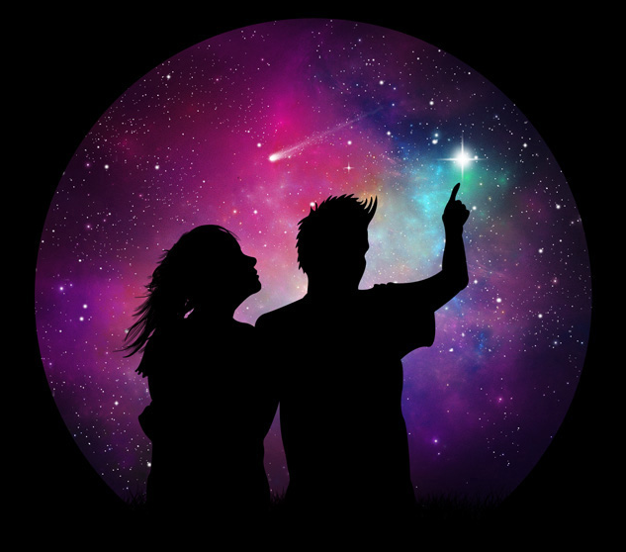
Thank you for your attention

