Slide 1
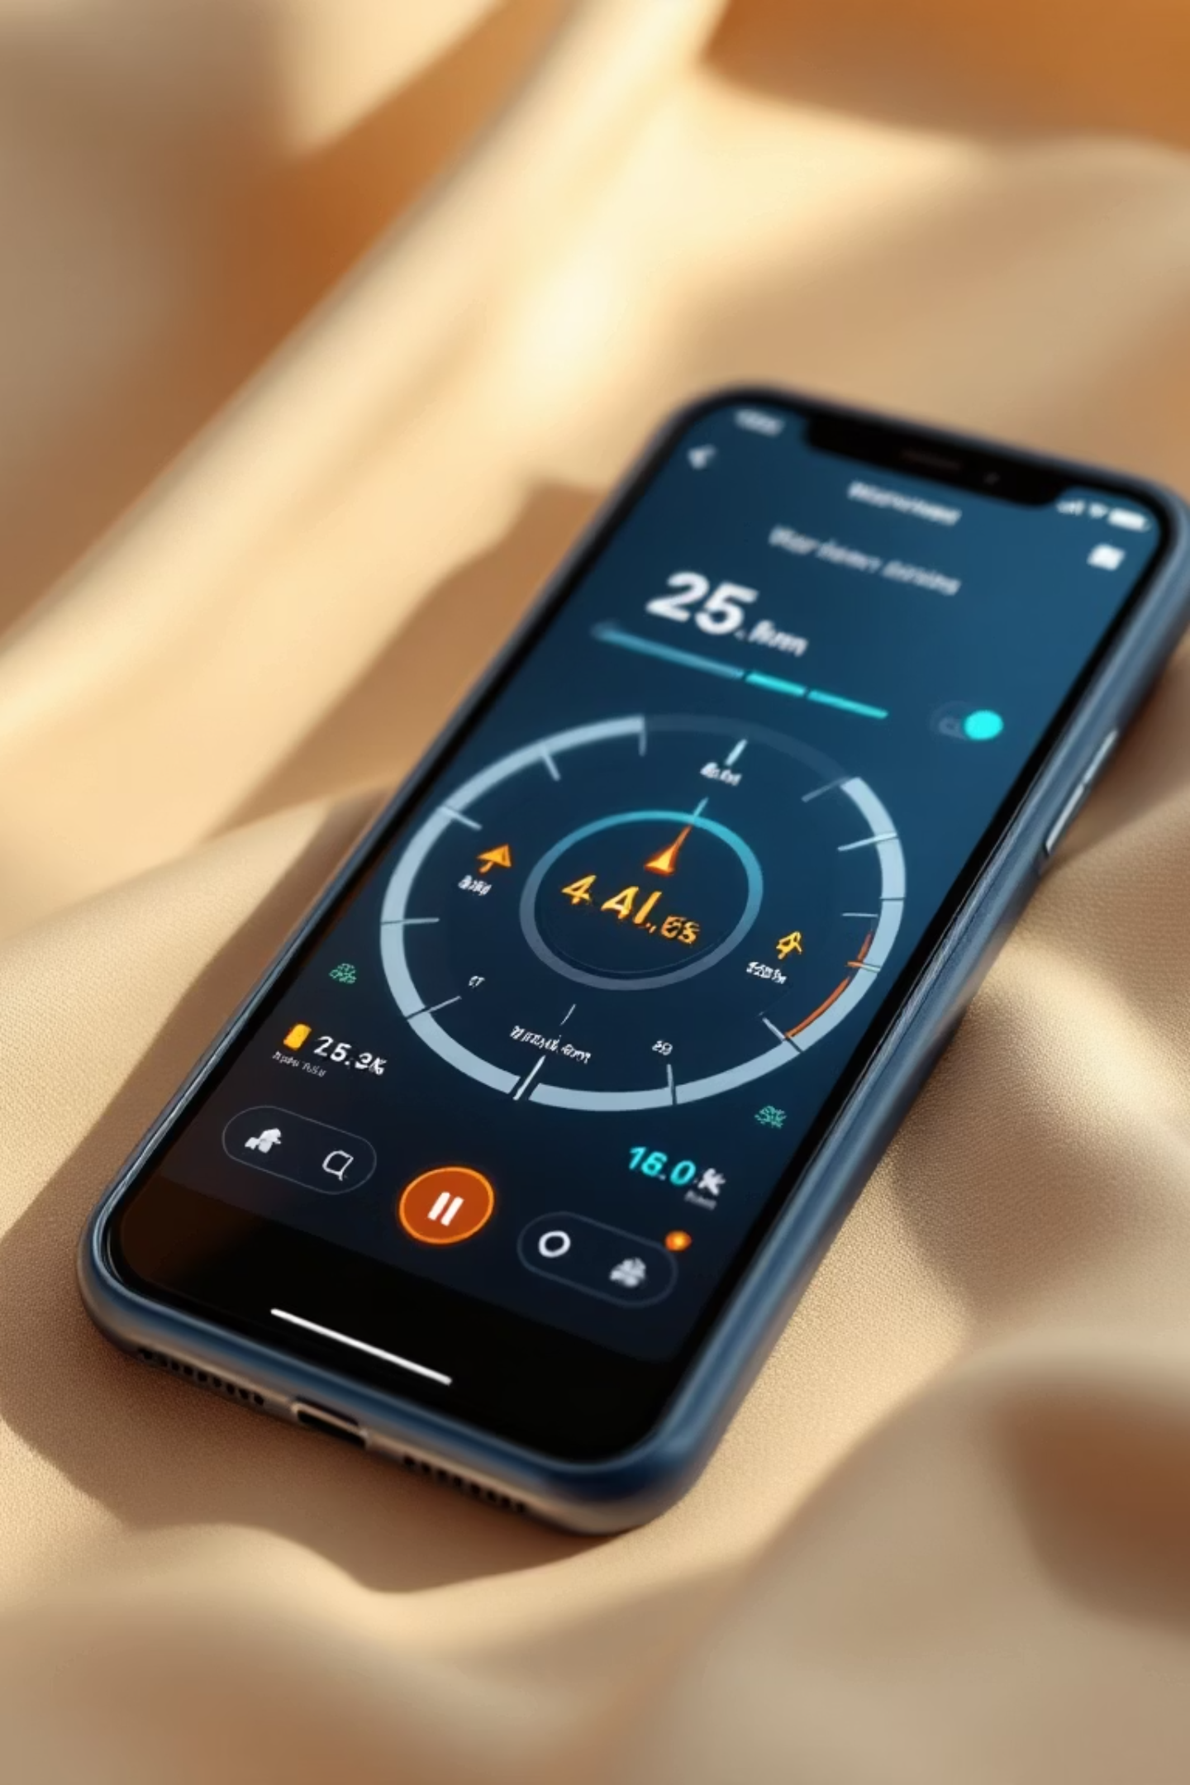
MFix: Car Fault Diagnostic Mobile Application
A mobile-based solution that empowers car owners to diagnose vehicle faults using only their smartphone's camera and microphone. Developed by Group 21

Slide 2


The Problem: Inaccessible Vehicle Diagnostics
Expensive Hardware Requirements
Traditional vehicle diagnostics require specialized OBD-II scanners that are costly and inaccessible to everyday users.
Technical Knowledge Barrier
Most car owners lack the expertise to interpret dashboard warning lights or engine sounds.
Limited Access to Services
In developing countries like Cameroon, access to certified diagnostic services is limited.

Slide 3
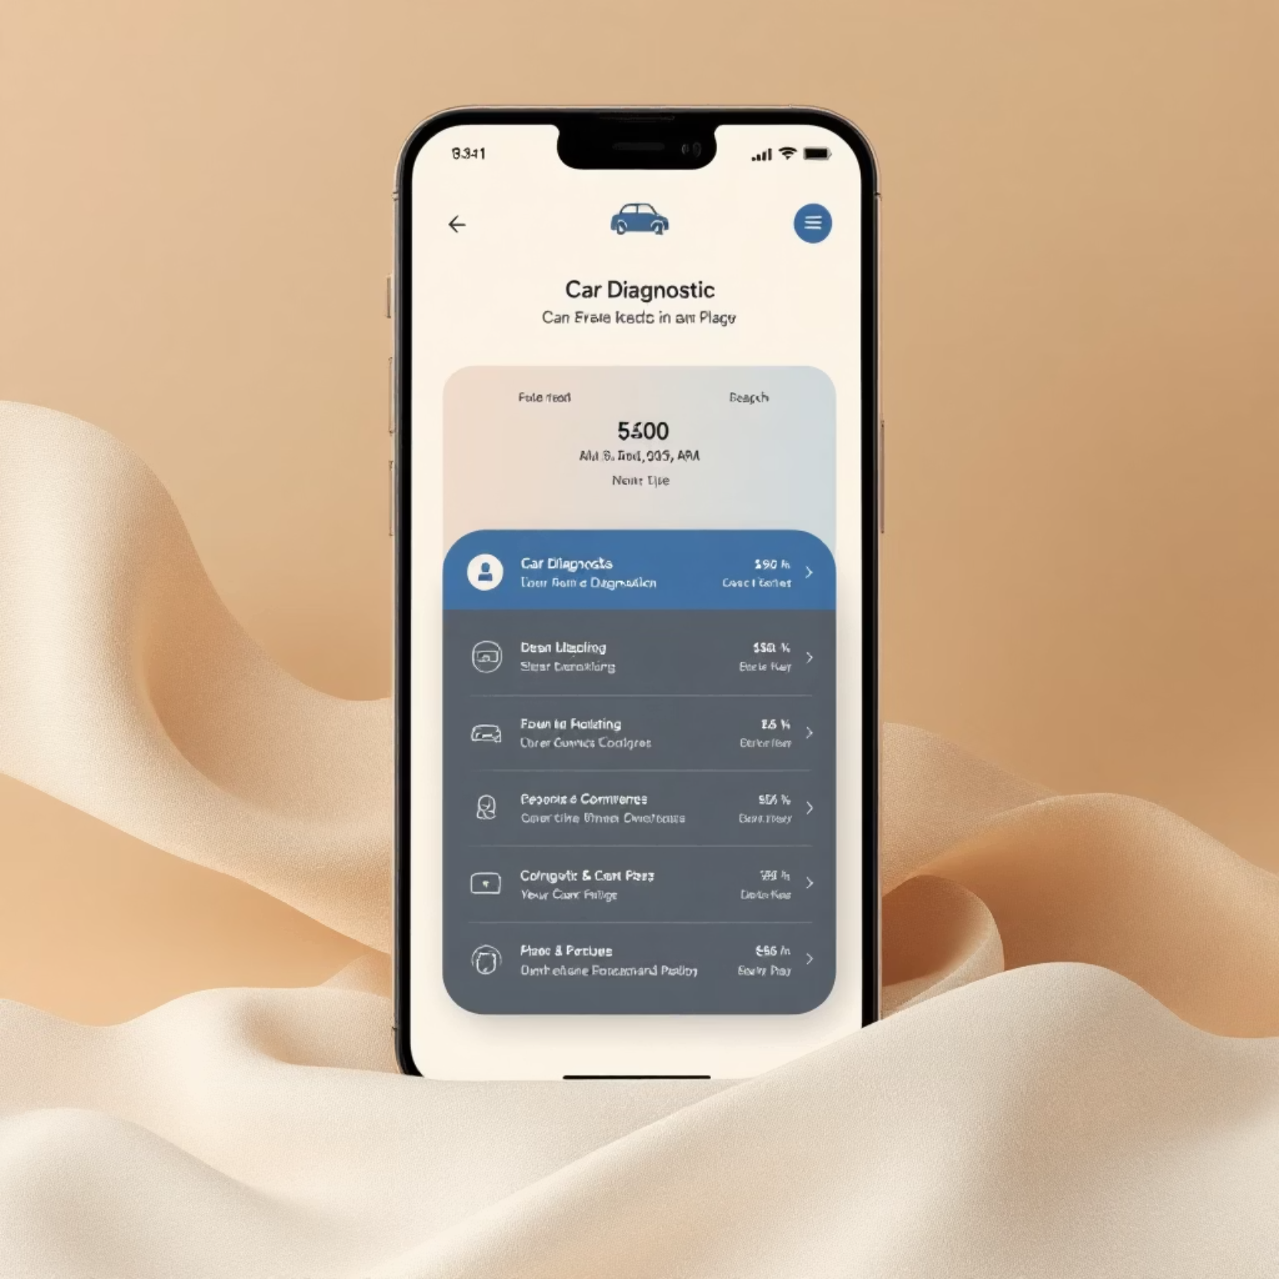
Our Solution: MFix Mobile Application
MFix is a cross-platform mobile application built with React Native (via Expo) and powered by Firebase Firestore. It enables users to:
Scan dashboard warning lights
Record and analyze engine sounds for fault detection
Receive real-time diagnostic feedback and recommendations
Access educational video tutorials for repairs
Connect with mechanics when professional help is needed

Slide 4
OBJECTIVES
General Objective
The general objective of this project is to design and implement an AI powered car diagnostic mobile application, this app enables car owners to diagnose vehicle faults by recognizing dashboard warning lights and analyzing engine sounds, using only their smartphone’s camera and microphone.

Slide 5
Specific objectives
Ø To develop a mobile application using React Native (Expo) that allows users to scan their vehicle’s dashboard and record engine sounds directly from their smartphone.
Ø To implement computer vision techniques capable of detecting and recognizing multiple dashboard warning lights from captured images, even when several indicators are active at once.
Ø To integrate machine learning or deep learning models that can analyze recorded engine sounds and classify them against known fault types such as knocking, squealing, or hissing.
Ø To provide automatic explanations of detected warning symbols, including their causes, urgency level, and consequences of neglect.
Ø To generate a list of likely mechanical issues along with suggested repair actions, general maintenance advice, and urgency levels.
Ø To integrate YouTube Data API v3 to fetch video tutorials from verified automotive experts, helping users understand step-by-step maintenance procedures for diagnosed issues.
Ø To ensure basic offline functionality by embedding pre-trained diagnostic models and symbol data for use without an internet connection.
To enable online capabilities such as accessing the latest fault databases, retrieving updated explanations, and streaming or embedding relevant video content

Slide 6
PROPOSED METHODOLOGY
To achieve the stated objectives, this study adopts a modular and iterative methodology combining mobile development, cloud-based services, and AI integration. The approach is structured into logical phases that support continuous testing, validation, and refinement of each system component. Each phase focuses on implementing specific features of the MFix diagnostic application in alignment with the user's needs and the system's functional requirements.

Slide 7
System Design and Planning
The project begins with the definition of functional and non-functional requirements, identification of core use cases, and development of user interface designs using Figma. These designs follow mobile UI/UX principles and reflect the user's interaction flow. A high-level system architecture is then designed, outlining the integration of the frontend (mobile app), backend server, AI services, and database components

Slide 8
PROPOSED METHODOLOGY
The design and analysis of the MFix system followed a structured, iterative approach inspired by the Agile methodology, which emphasizes adaptability, user feedback, and incremental refinement. Although full implementation was covered in later phases, the focus of this chapter is on how the system was conceptualized, modelled, and structured before development.

Slide 9
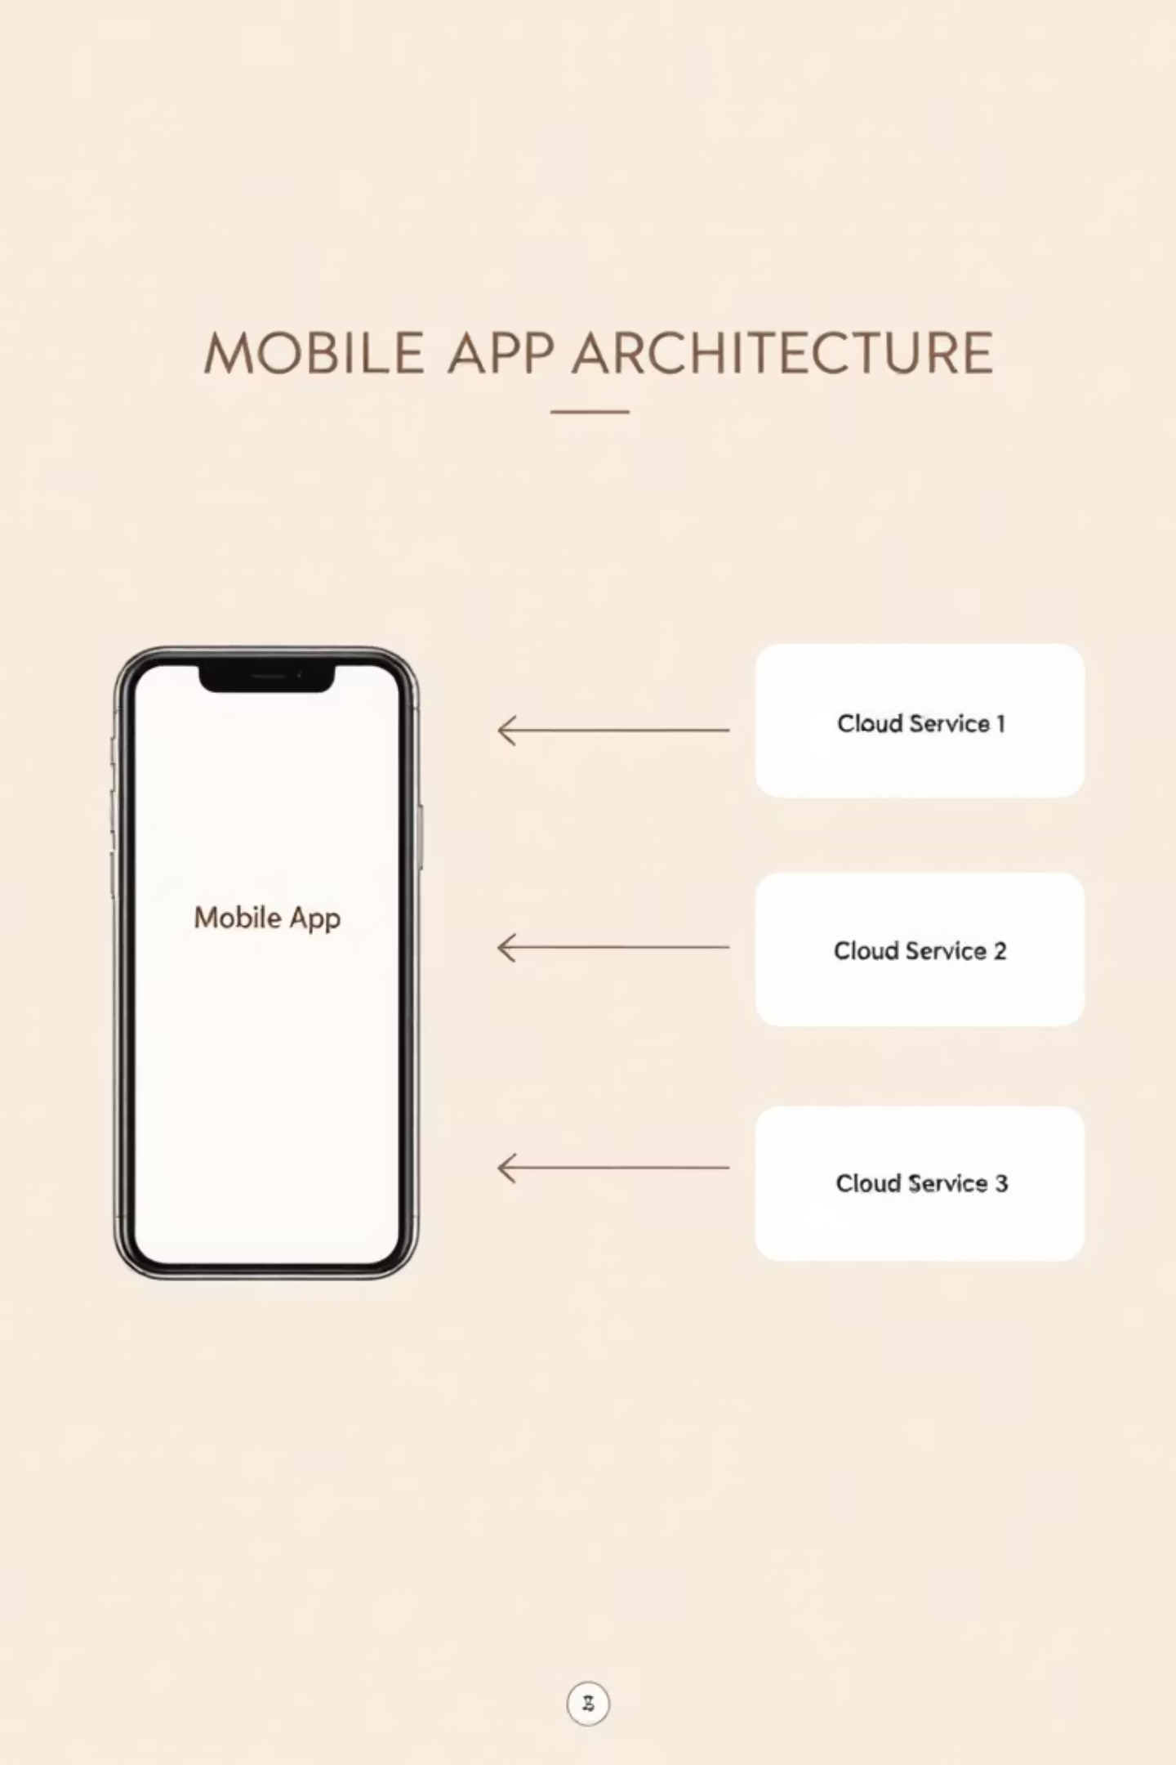



System Architecture
Presentation Layer
React Native & Expo frontend handling user interactions, navigation, and visual rendering
Business Logic Layer
Node.js & Express.js backend managing processing logic, routing, API definitions, and security
Data Layer
Firebase Firestore providing scalable NoSQL cloud database for storing users, vehicles, diagnostics, and results

Slide 10
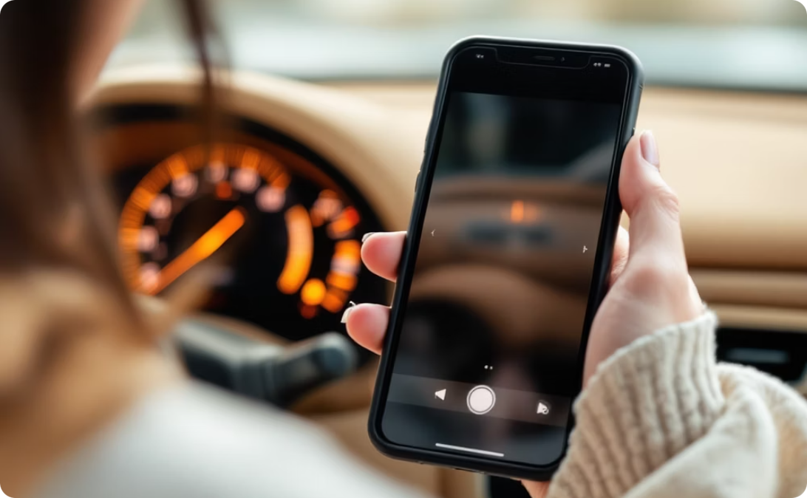
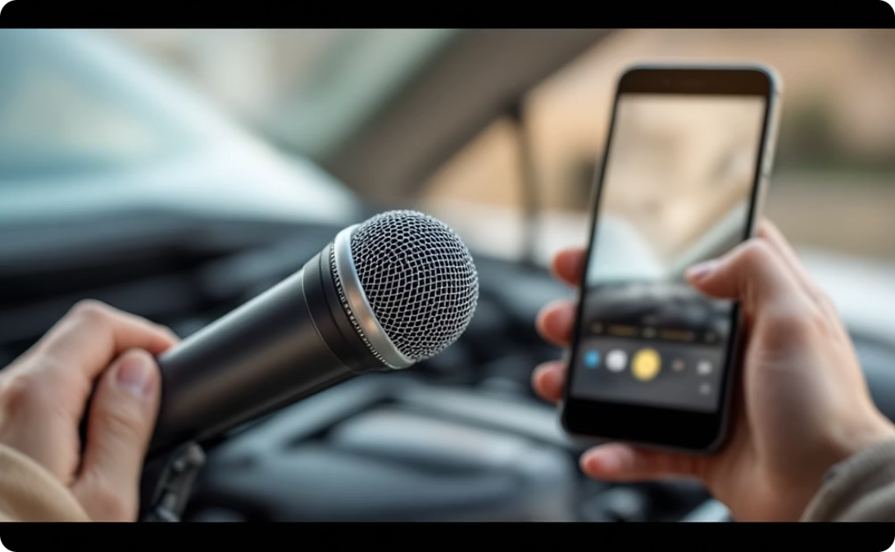

Key Features & Functionality
Dashboard Light Recognition
Engine Sound Analysis
Video Tutorials
Uses computer vision to identify warning lights and provide explanations of their meaning and urgency.
Records and analyzes engine sounds to detect patterns associated with common mechanical issues.
Integrates with YouTube API to provide relevant repair and maintenance videos from verified automotive experts.

Slide 11
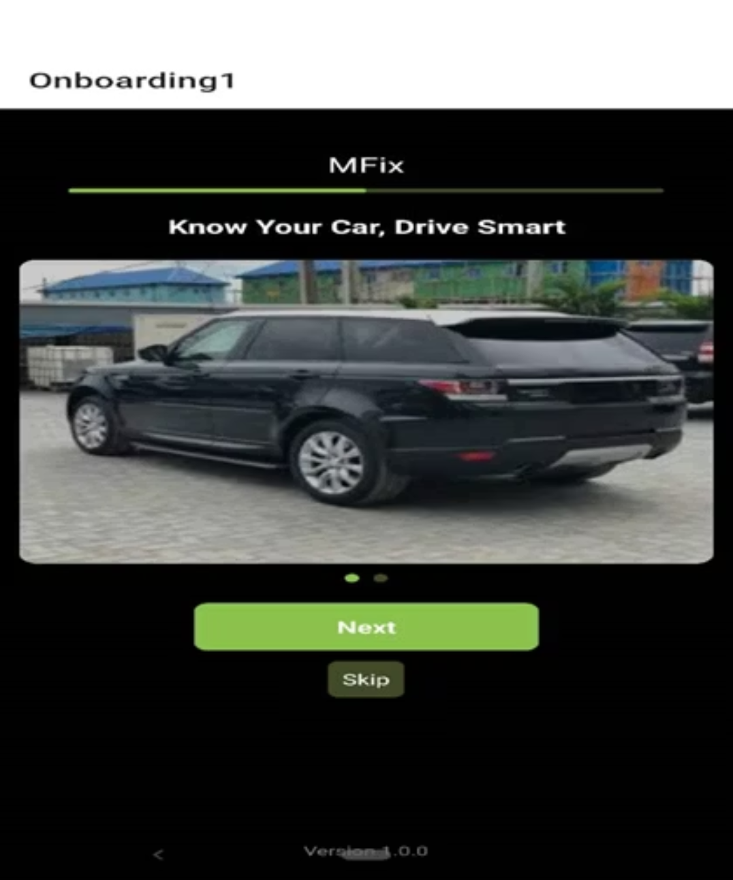
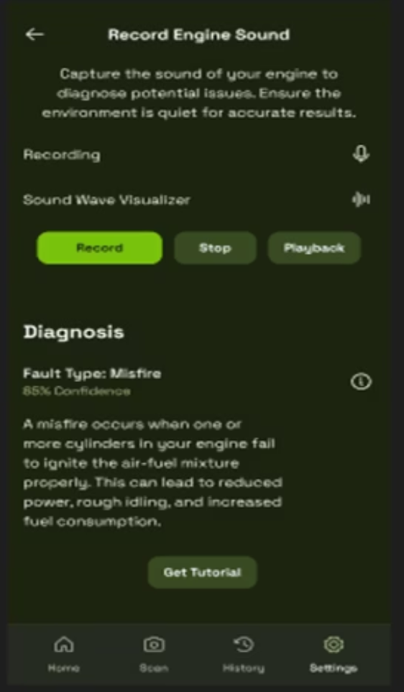
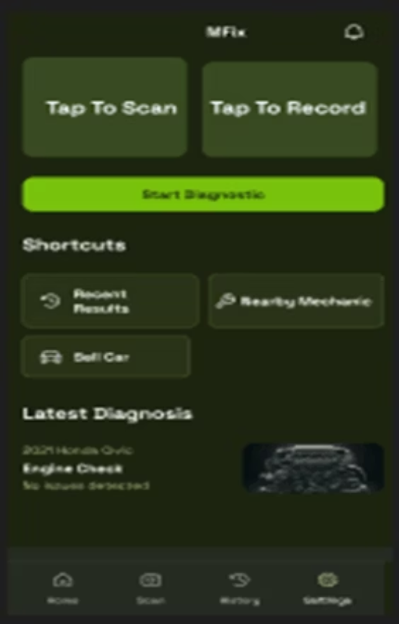
User Interface Design
Home Dashboard
Diagnostic Results
Welcome Screen
The UI was designed with a focus on simplicity and accessibility, ensuring that non-technical users can easily navigate and understand vehicle diagnostics.

Slide 12




Implementation Technologies
Frontend
React Native with Expo
React Navigation
React Context API
AsyncStorage
Backend & Database
Node.js & Express.js
Firebase Firestore
Firebase Admin SDK
Firebase Authentication
AI/ML Tools
HuggingFace Models
Kaggle Datasets
Audio Classification
Computer Vision

Slide 13
Results & Achievements
2
100%
0
User Roles
Core Objectives Met
Hardware Required
Regular users and mechanics, each with specific functionality tailored to their needs
Successfully implemented mobile app, real-time updates, and AI-ready architecture
No physical diagnostic tools needed beyond the smartphone itself

Slide 14
Contribution to Engineering and Technology
Ø Enhanced Accessibility: By shifting diagnostics from hardware tools to a smartphone app, MFix reduces reliance on physical OBD-II scanners, opening up diagnostics to users with minimal equipment.
Ø Cloud Integration: Real-time data handling via Firestore allows for immediate updates, collaboration, and request tracking across users and mechanics.
Ø AI-Ready Architecture: Although preliminary, the inclusion of sound-based diagnostics via a fine-tuned audio classification model demonstrates how machine learning can enhance automotive fault detection.
Ø User-Mechanic Ecosystem: Introducing a role-based service model, MFix supports request tracking and professional feedback loops, unlike most current apps which are user-only.
Ø Scalable Design: The architecture supports future expansion, including integration with IoT vehicle sensors, live diagnostics, and admin portals.

Slide 15
Challenges
Hardware Constraints
Limited development resources forced on a switch from flutter to react native due to system performance issues.
AI Training Dataset limitations
The dataset used for sound diagnostics was relatively small, which constrained model accuracy and generalization.
Limited testing Environment
Testing was primarily done on simulators and a few physical devices, restricting insight into performance on low-end or diverse real-world phones.
Internet Dependency
The current version relies on active internet connection due to Firebase integration.

Slide 16

Future Development
1
Bluetooth OBD-II Integration
Connect with physical OBD-II scanners for enhanced diagnostic capabilities and real-time vehicle data
2
Advanced AI Models
Train and deploy more robust machine learning models for improved accuracy in fault detection
3
Admin Dashboard
Develop analytics portal for monitoring diagnostic trends, mechanic efficiency, and user behavior
4
Multi-Language Support
Add language localization to make the app accessible in diverse geographic regions

Slide 17
Conclusion
MFix represents a significant step toward democratizing vehicle diagnostics, especially in developing regions where access to traditional tools is limited but smartphone usage is widespread.
Key Contributions
Enhanced accessibility to vehicle diagnostics
Cost-effective maintenance for car owners
Technological innovation in AI-integrated mobile apps
Support for local development in resource-constrained contexts

