Slide 1
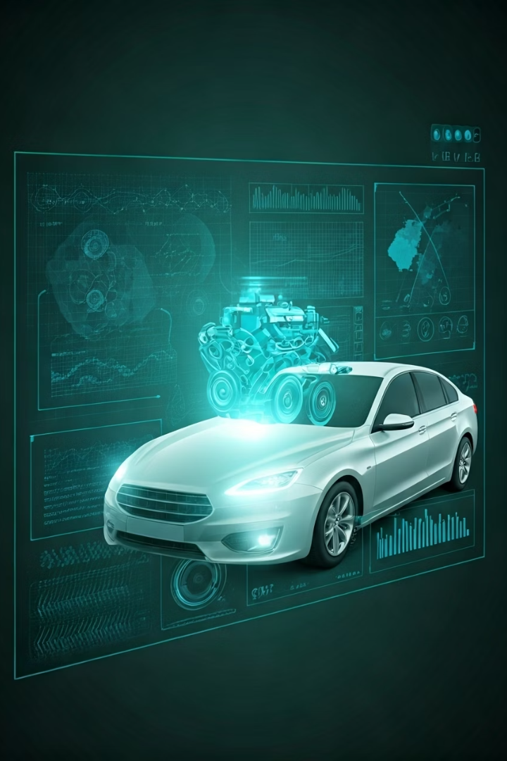
Car Fault Diagnostic App: Database Design & Implementation
Course code: CEF 440
Course Instructor: Dr. Nkemeni
Presented by group 21

Slide 2




Introduction & Purpose
This presentation outlines the complete backend and database design of the MFix Car Fault Diagnostic Application. The mobile system helps users identify vehicle issues through image and sound diagnostics.
Structured Data Management
Fault Repository
Store and organize vehicle data, user information, and diagnostic results efficiently.
Maintain comprehensive car fault codes, symptoms, and potential causes.
Track User Interactions
Fast Retrieval
Enable personalized recommendations through diagnostic history tracking.
Support quick, accurate diagnostic results for timely user feedback.

Slide 3










Key Entities & Attributes
Vehicle
User
VehicleID, UserID, Model, Year, VIN
UserID, Name, Email, Phone, Registration Date, Role
Diagnostic
DiagnosticID, VehicleID, Date, Type, Status
Notification
NotificationID, UserID, VehicleID, Message, Date, Type
Mechanic
MechanicID, Name, Speciality, ContactInfo, Availability

Slide 4

Database Implementation
Firebase Firestore
Logical Schema
Optimization
Chosen for its flexibility, scalability, and real-time capabilities. Perfect for mobile applications with minimal server management.
Implemented collections for users, vehicles, mechanics, diagnostics, results, requests, and notifications with consistent structure.
Created composite indexes for common queries. Used denormalization, pagination, and timestamps for performance.

Slide 5



Backend Implementation
Node.js & Express
Server-side JavaScript runtime with web framework for RESTful APIs
Firebase Admin SDK
Backend access to Firebase Authentication, Firestore, and Storage
RESTful Routes
Endpoints for users, vehicles, diagnostics, results, and requests

Slide 6





AI-Powered Diagnostics
Image Capture
API Processing
Fault Identification
Solution Delivery
User takes photo of dashboard
Gemini API analyzes image
System identifies potential issues
YouTube videos for repair guidance

Slide 7





Sound Diagnostics Innovation
Dataset Collection
34 labeled audio recordings of engine sounds from Kaggle
Model Training
Pre-trained audio classification model from HuggingFace
Fine-Tuning
Adapted to vehicle engine sound patterns
Implementation
Integrated with backend for real-time analysis

Slide 8








Future Enhancements
Google Sign-In
Secure OAuth2.0 integration
Route Protection
Token verification for API security
Push Notifications
Real-time alerts for diagnosis results
Diagnostics History
Comprehensive record of past analyses
The MFix backend provides a scalable, secure foundation for the diagnostic app. It enables seamless interaction between users, mechanics, and diagnostic data in a smart, responsive way.

