Slide 1
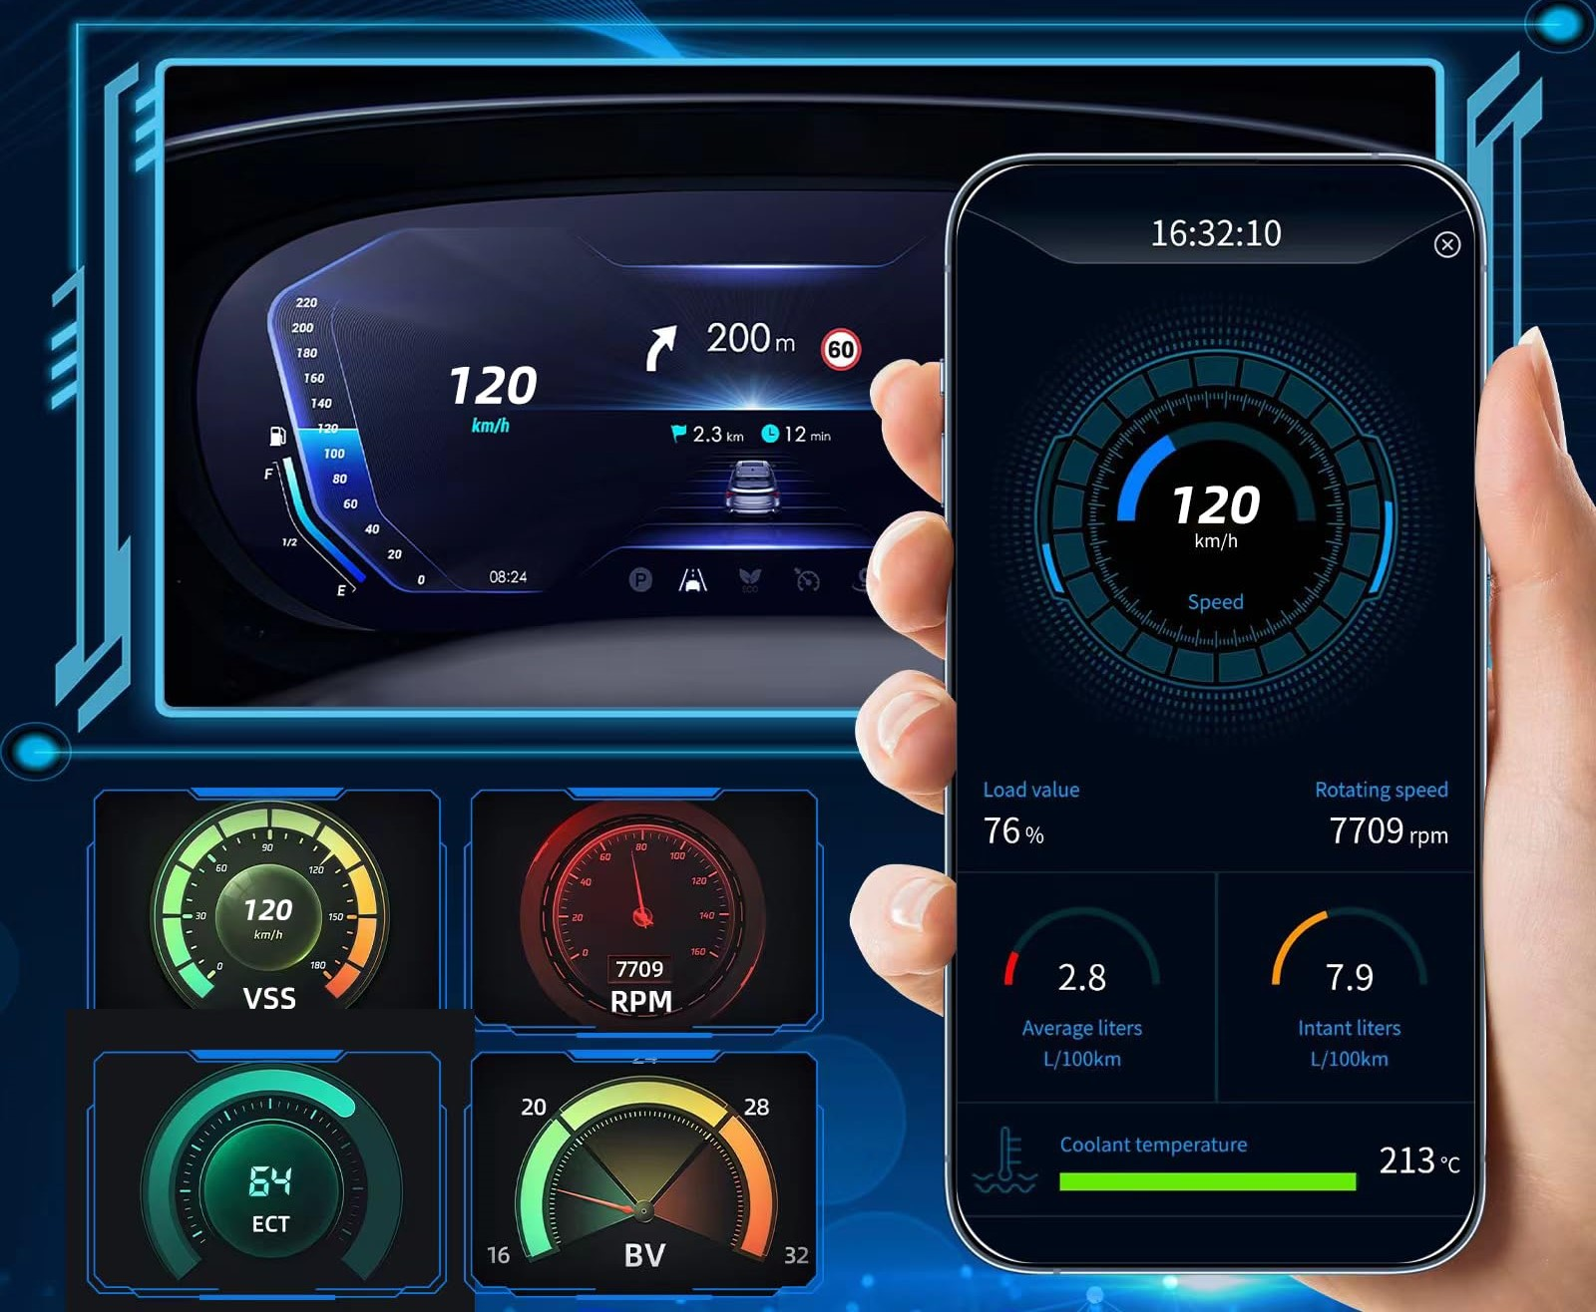
CAR FAULT DIAGNOSTIC APP UI DESIGN AND FRONTEND IMPLEMENTATION
Course code: CEF440
Course Instructor: Dr.Nkemeni
Presented by Group 21

Slide 2

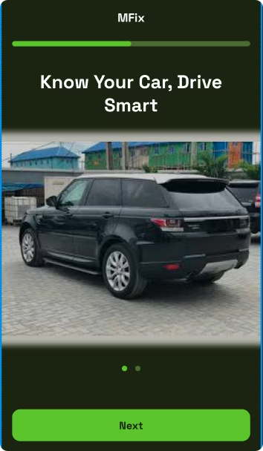
Smart Car Diagnostic Mobile App
This App bridges the gap between car users and repair services through a mobile diagnostic platform. It provides real-time monitoring and fault detection by scanning dashboards and recognising engine sounds.

Slide 3





App Identity
Name
Colour Theme
MFix
'M' stands for Moto (car in Cameroon pidgin). Reflects the app's purpose of diagnosing vehicle issues using mobile devices.
Green (innovation, trust), Black (modern, battery-friendly), and White (clarity, readability).
Target Users
Car owners, drivers, and mechanics seeking simple diagnostic solutions.

Slide 4





Core Features
Dashboard Recognition
Camera-based scanning of dashboard lights and signs.
Sound Analysis
Engine sound analysis using machine learning models.
Multilingual Support
English, French, and local languages.
Garage Suggestions
Geolocation-based mechanic recommendations.

Slide 5








User Interface(UI) Design
Design Principles
Simplicity
Visibility
Only essential actions and information on each screen.
Clear feedback through loading indicators and visual cues.
Consistency
Accessibility
Unified theme with consistent button styles, spacing, and iconography.
High contrast colours, readable fonts, and intuitive icons.

Slide 6
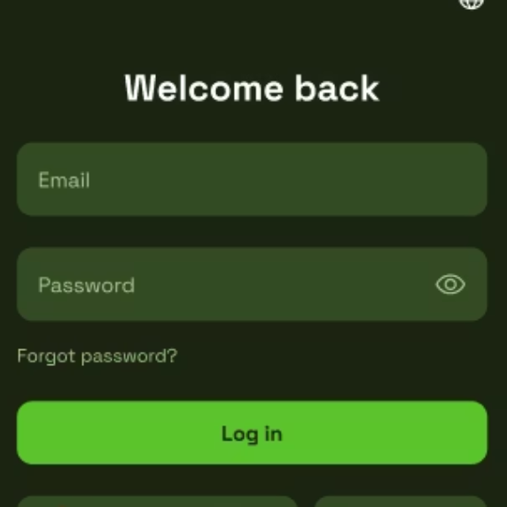
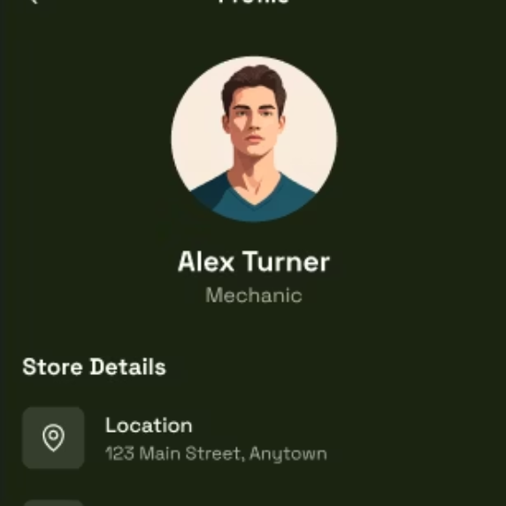
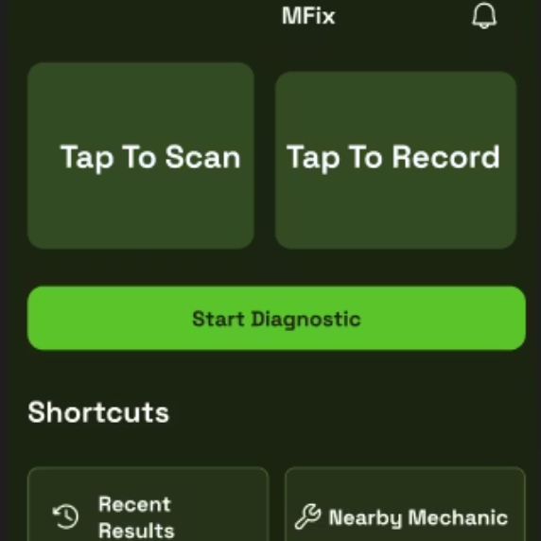
UI Design Process
User Flow Simulation
Visual Hierarchy
Mapped navigation between screens for intuitive experience.
Figma Prototyping
Established through size, spacing, and colour contrast.
Created consistent layouts using reusable components and shared styles.

Slide 7

Frontend Implementation
Frontend Technology
React Native & Expo
Cross-platform development framework allowing single codebase for Android and iOS. Expo simplifies builds and device previews.
JavaScript (ES6+)
Primary programming language offering flexibility and a wide ecosystem for mobile app development.
React Navigation
Handles routing across screens, supporting stack, tab, and drawer navigation patterns.
Context API & AsyncStorage
Global state management and persistent local storage for user data.

Slide 8
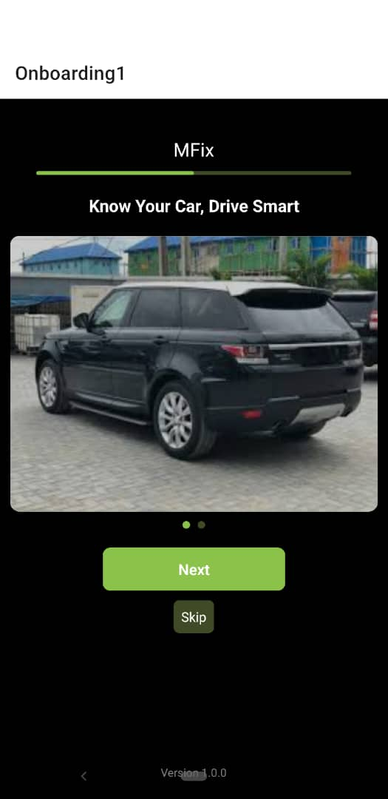
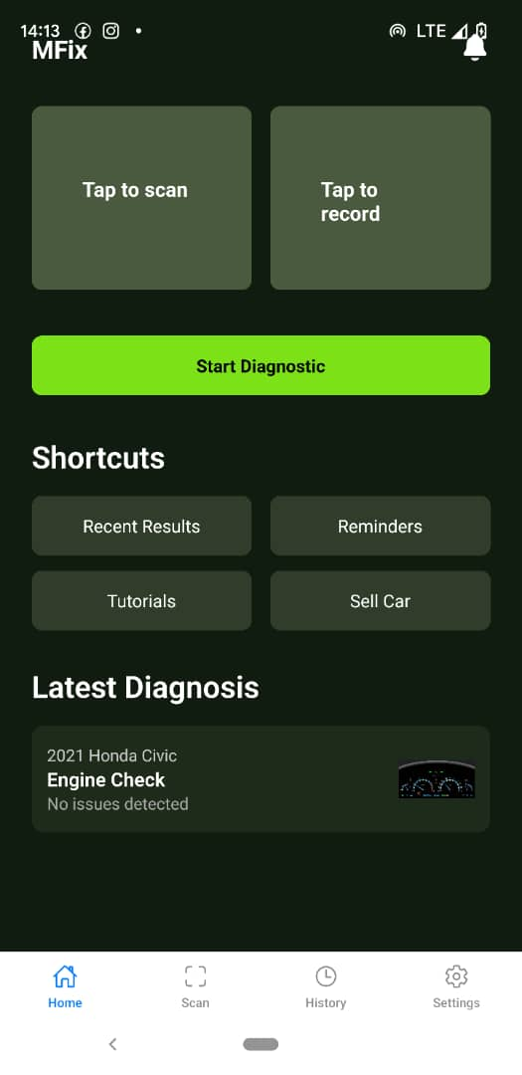
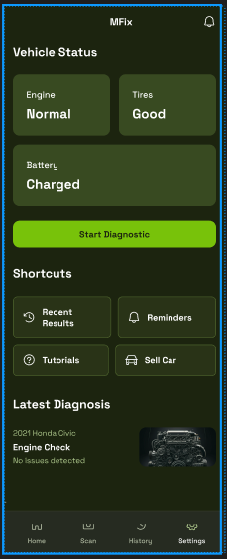
Frontend Implementation
UI Design Implementation
- Follows Figma design
- Uses modular components and reusable styles
- Lazy loading with ActivityIndicator
- Ready for backend with mock APIs and state management
Welcome page
Home page
Vehicle status page

Slide 9
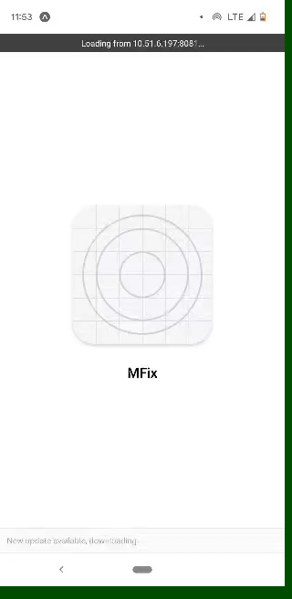
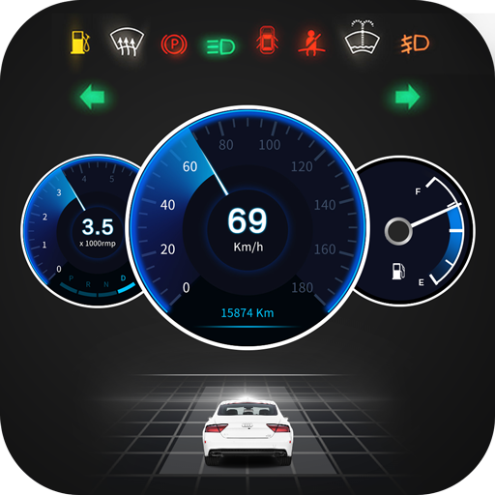
Frontend Implementation Demo
- Demo shows app flow and interactivity
- Interface follows planned mockups
- Visual consistency and responsiveness maintained

Slide 10
Implementation Challenges
Flutter Limitations
React Native Benefits
Initially planned to use Flutter but encountered hardware limitations:
Switched to React Native with Expo for:
Lightweight development
Low RAM capacity
Easy device testing
Slower processors
Less computational strain
Limited storage

Slide 11
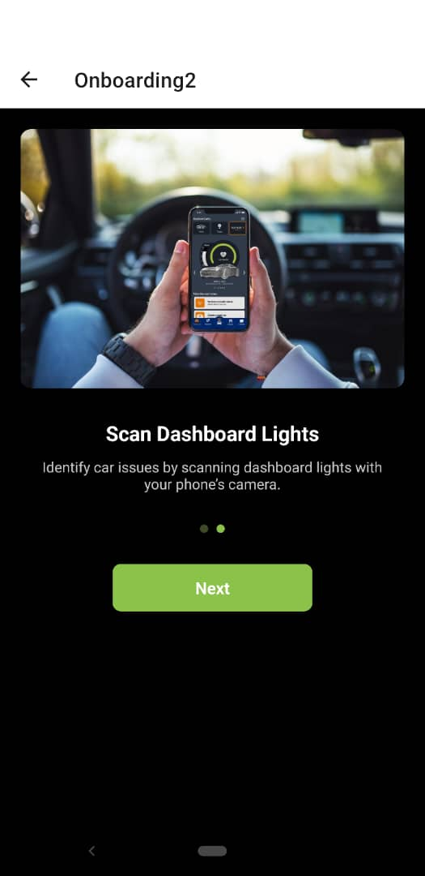
Conclusion
The MFix app frontend is functional, consistent, and ready for full integration.
Our design focused on simplicity, clarity, and real-world usability.
The demo will showcase our progress from concept to implementation.

Slide 12
THANK YOU

