Slide 1

Microservices Architecture

Slide 2

Agenda
1-Introduction To Microservices And System Architectures
2-Microservices Design Principles
3-Microservices EndPoints(API Gateway)
4-Example With .Net Core

Slide 3

Monolithic Architecture
A monolithic architecture is the traditional unified model for the design of a software program.
Ui => BL => DL => DB

Slide 4
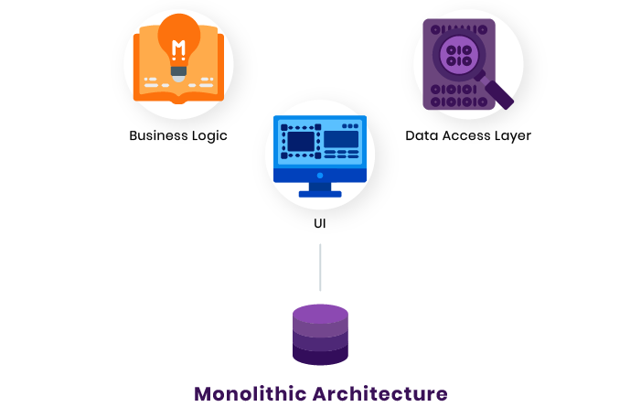
Title:

Slide 5
soa
Service-Oriented Architecture : is a structure that allows services to communicate with each other across different platforms and languages by implementing what is known as a “loose coupling” system.
While the concept of SOA has been around for many years, it is only within the past decade that it has risen to the forefront of software-related technologies.

Slide 6
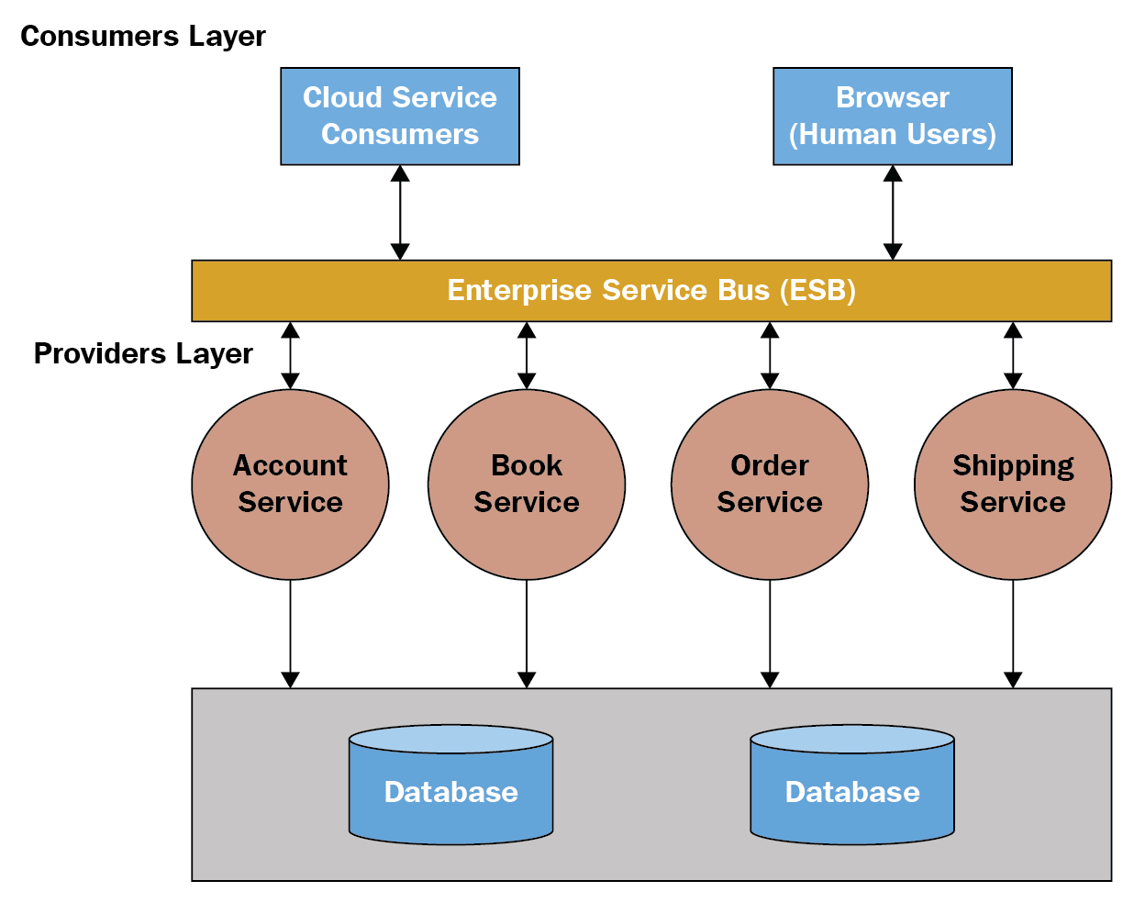
Title:

Slide 7
microservice architecture
microservice architecture - is an architectural style that structures an application as a collection of services.
The microservice architecture enables the rapid, frequent and reliable delivery of large, complex applications. It also enables an organization to evolve its technology stack.

Slide 8
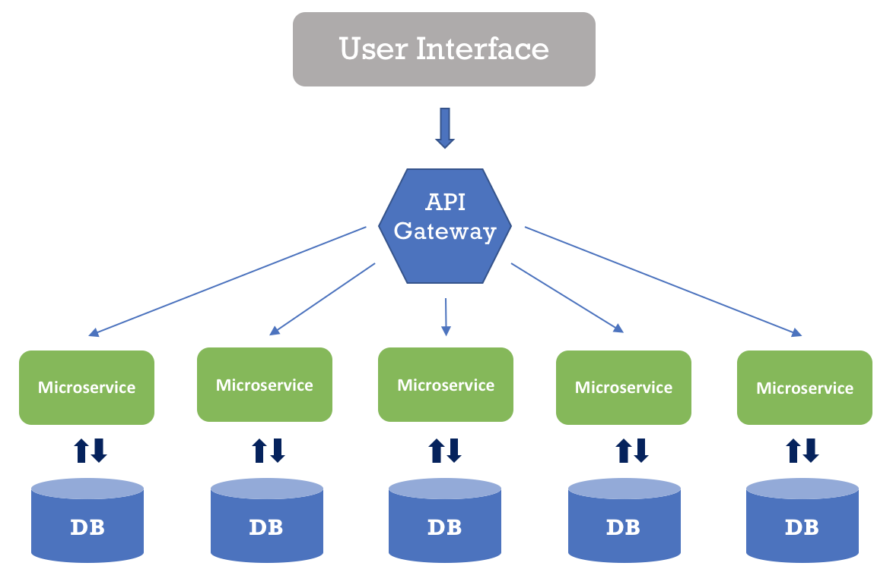
Title:

Slide 9
Benifits
Reliability
Automated Test Tools
Release And Deployment Tools
Many Technologies
Fast In Development
Enable Updates Easly
Security
Fast Issues Resolve
better Performance
Enable Distributed Teams

Slide 10
Problems
Complexity
Many Calls From Services To Another
Problem In Service May be Make Problem In Another Service And That is Make Find Issue Hard

Slide 11
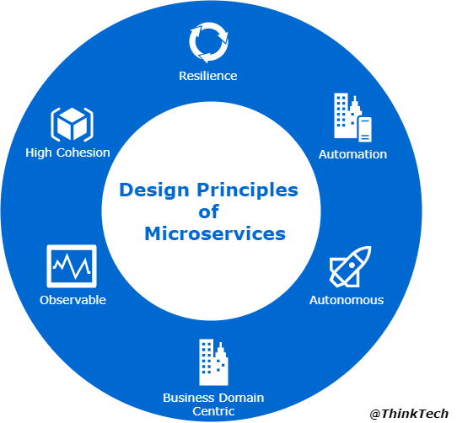
Microservice Principles
High Cohesion
Autonomous
Business Domain Centric
Resilience
Observable
Automation

Slide 12
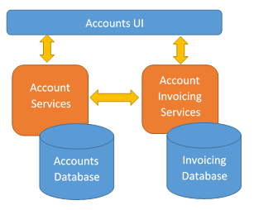
High Cohesion
The microservices content and functionality in terms of input and output must be coherent. It basically must have a single focus, and the thing it does it should do well with that single focus. this idea of a microservice having a single focus or a single responsibility is actually taken from the SOLID coding principles, and the single responsibility principle basically states that a class can only change for one reason, and this same principle is applied to microservices. It’s a useful principle because it allows us to control the size of the service, and we will not accidentally create a monolithic service by attaching other behaviors into the microservice which are not actually related.

Slide 13
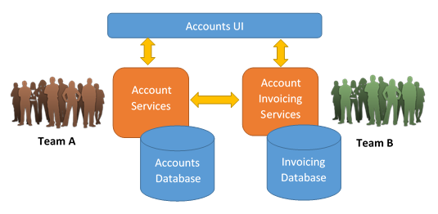
Autonomous
Microservices should also be autonomous. By autonomous we mean a microservice should not be subject to change because of an external system it interacts with or an external system that interacts with it. We’re basically saying there should be a loose coupling between the microservices and between the microservices and the clients that use the microservices, and by loose coupling, we mean a change to a microservice should not force other microservices to change or other clients to change. This means microservices must honor contracts and interfaces to other services and other clients, which basically means the way the inputs and outputs are formatted for a microservice should not change between versions because that might break any other services trying to interact with that microservice using those inputs and outputs

Slide 14
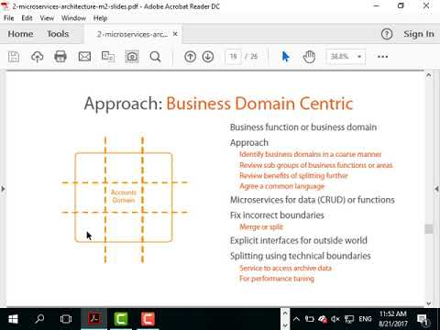
Business Domain Centric
A microservice should also be a business domain centric, and by this, we mean a service should represent a business function. The overall idea is to have a microservice represent a business function or a business domain, i.e., a part of the organization, because this helps scope the service and control the size of the service. This is an idea which is taken from domain driven design. You basically define a bounded context, which basically contains all the functionality which is related to a specific part of the business to a business domain or a business function, and you define the bounded context by defining boundaries and seams within the code. You basically highlight the areas where related functionality exists.

Slide 15
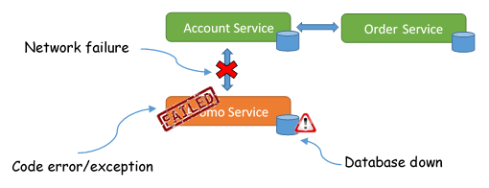
Resilience
Another key design principle for microservices is resilience. We basically need to embrace failure when it happens. Failure might be in the form of another service not responding to your service, or it might be a connection line to another system which has gone down, or it might be a third party system which fails to respond. Whatever the type of failure, our microservice needs to embrace that failure by degrading the functionality within our microservice or by using default functionality.

Slide 16
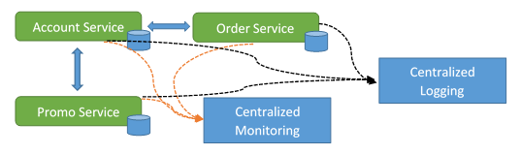
observable
Another key design principle that we need to build into our microservices architecture is the idea of our system being observable. We need a way to be able to observe our system’s health in terms of system status, in terms of logs, i.e., an activity currently happening in the system and errors that are currently happening in the system. And this type of monitoring and logging needs to be centralized so that there is one place where we need to go to in order to view this information regarding the system’s health, and we need this level of monitoring and logging in a centralized place because we now have distributed transactions.

Slide 17
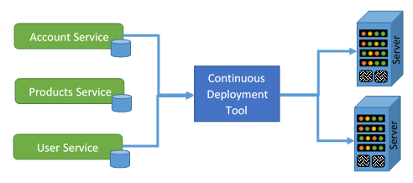
Automation
We also need to feature automation in our microservices architecture, automation in the form of tools, for example, tools to reduce testing. Automated testing will reduce the amount of time required for manual regression testing, and the time taken to test integration between services and clients, and also the time taken to set up test environments. Remember, in a microservices architecture our system is made up of several moving parts, and therefore testing can be quite complex, and this is where we need testing tools to automate some of that testing.

Slide 18
Microservices ENDPOINTS
Web Services
WCF (Windows Communication Foundation)
Web API

Slide 19
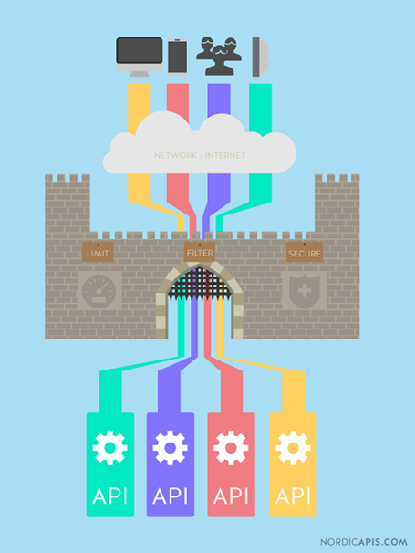
Title:
API Gateway

Slide 20
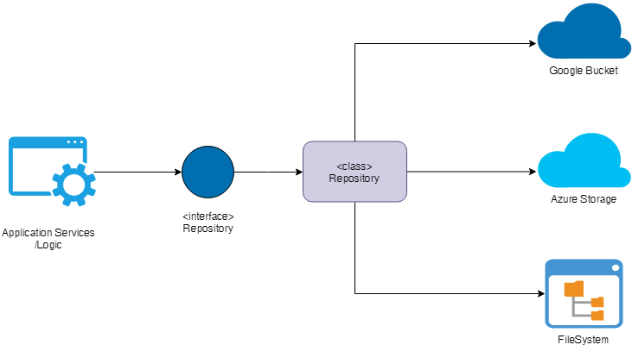
Title:
Repository Pattern

