Slide 1
ROOM STYLIST
An AI interior-style classifier and furniture
recommender for Berre.ca
Atash Kakabayev • 101641391
Full Stack Data Science Systems — Module 7 Case Study

Slide 2
OVERVIEW
Agenda
01
Problem
02
Why this problem
03
Literature review
04
Methodology — ML Canvas
05
Model benchmarking
06
Model deployment
07
Challenges & issues
08
Live demo
09
Q & A
Room Stylist — Berre.ca
2

Slide 3
01 — PROBLEM
Problem Statement
Berre.ca sells furniture across 6+ style families — from Mid-Century Modern to Bellona's Traditional collections.
Hundreds of individual products, but no fast way to match a room's style to the right furniture
Browsing by category name doesn't capture visual similarity
Shoppers scroll through pages that don't reflect what their room actually looks like
THE GOAL
Classify a room photo's style, then recommend real, in-catalog Berre products that match.
Room Stylist — Berre.ca
3

Slide 4
02 — MOTIVATION
Why this problem
Berre's catalog is large and highly visual — style is the single biggest factor in a shopping decision
A style-matching tool reinforces Berre's own curated-aesthetic brand, instead of bolting on a generic chatbot
High price points mean even a small lift in “found the right piece” conversion has real revenue impact
Combines computer vision, model benchmarking, and full deployment — exactly this course's skill set
$700–$8,000+
price per item — even small conversion gains matter
100s
of SKUs across the Berre catalog
6+
distinct interior style families
Room Stylist — Berre.ca
4

Slide 5
03 — LITERATURE REVIEW
Literature Review
Past available projects
Interior style classification is a known academic and Kaggle-style task
Most datasets are Houzz-sourced, with ~19 raw style labels
Similar projects
Pinterest Lens & Wayfair's “Shop the Look” use visual similarity search, not classification
CLIP zero-shot is a common, strong no-training baseline
Drawbacks
Public style categories don't map cleanly onto any one retailer's catalog
19 raw labels manually consolidated into 6 Berre-aligned categories
Most projects stop at classification — few connect to a live, purchasable catalog
Room Stylist — Berre.ca
5

Slide 6
04 — METHODOLOGY
ML Canvas
Value Proposition | Given a room photo, predict its interior style so Berre.ca can recommend matching furniture instead of the shopper browsing hundreds of SKUs.
Data Sources | Berre.ca product images/category tags; public interior-style dataset (Houzz-sourced, 19 raw labels, consolidated to 6 Berre-aligned buckets).
Prediction Task | Multi-class image classification. Input: room photo. Output: 1 of 6 style classes + confidence score.
Offline Evaluation | 70/15/15 train/val/test split. Metrics: accuracy, macro F1 (classes are imbalanced), confusion matrix per model.
Decisions | Predicted style filters/ranks the Berre product catalog → top-K products returned to the shopper.
Making Predictions | Batch offline during benchmarking; real-time single-image inference via the deployed Flask/Docker/Azure API.
Building Models | Transfer learning: fine-tuned ResNet-18 and EfficientNet-B0 with dropout; CLIP zero-shot as a no-training baseline.
Impact Simulation | Production metric would be click-through / conversion vs. a best-seller baseline; out of scope for this course build.
Room Stylist — Berre.ca
6

Slide 7
05 — METHODOLOGY
Model Benchmarking
Model | Accuracy | Macro F1 | Latency (ms/img) | Notes
ResNet-18 | 0.3816 | 0.3283 | 4.3 | Baseline transfer-learning CNN
EfficientNet-B0 | 0.4073 | 0.3736 | 4.4 | Winner — best accuracy & F1, no latency cost
CLIP zero-shot | 0.3341 | 0.3108 | 10.8 | No training needed; underperformed the fine-tuned models
EfficientNet-B0 selected for deployment — best accuracy and macro F1, no latency penalty vs. ResNet-18
CLIP zero-shot underperformed both fine-tuned models on this fine-grained, 6-class task
38–41% accuracy is well above the 17% random baseline for a 6-class problem
Interior style classification is genuinely hard — even humans confuse visually similar styles
Room Stylist — Berre.ca
7

Slide 8
06 — METHODOLOGY
Model Deployment
→
→
→
→
Notebook
Script
Flask API
Docker
Azure
Colab, T4 GPU
predict.py
POST /predict
containerized
public URL
Training and benchmarking run in a Colab notebook on a free T4 GPU
Winning model exported into a lightweight predict.py script
Wrapped in a Flask API with a single POST endpoint
Containerized with Docker so it runs identically anywhere
Hosted on Azure (Container Registry + Container Instances) — a real, public URL anyone can call
Room Stylist — Berre.ca
8

Slide 9
07 — REFLECTION
Challenges & Issues Encountered
01
02
Docker build failed locally (read-only filesystem) — fixed by freeing disk space and relocating Docker's virtual disk.
Flask debug mode caused silent connection resets in production — fixed by setting debug=False.
03
04
Azure Portal's container wizard threw vague conflict errors — switching to the Azure CLI gave clear, fixable messages.
Browser demo couldn't read API responses until CORS was explicitly enabled.
05
19 raw labels → 6 categories left some classes smaller — addressed by reporting macro F1 alongside accuracy.
Room Stylist — Berre.ca
9

Slide 10
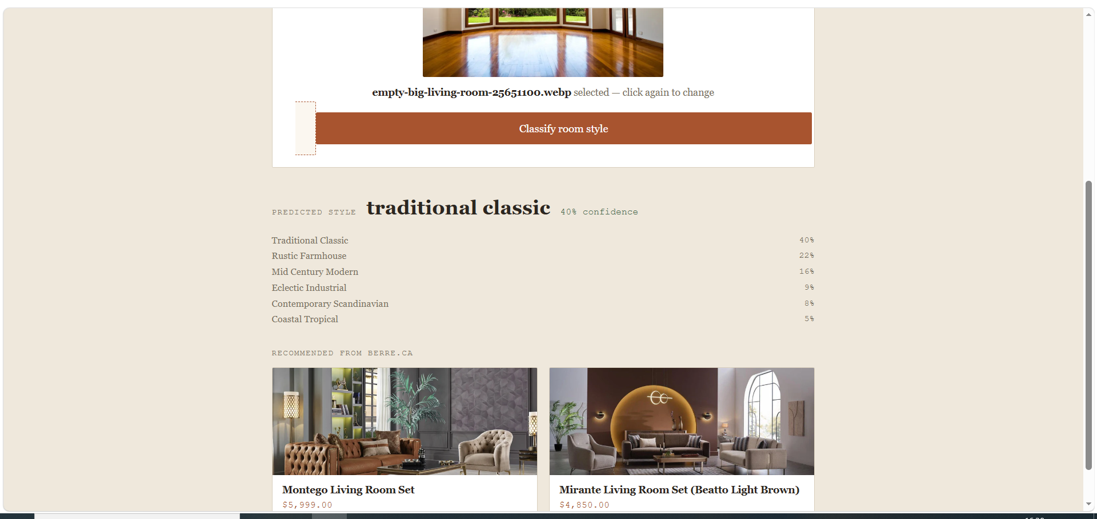
08 — DEMO
Live Demo
Shopper uploads a photo of their room
Model returns predicted style + confidence across all 6 categories
Real Berre products shown — photos, prices, links — pulled from the catalog
room-stylist-final-atash.canadacentral.azurecontainer.io:5000/predict
Room Stylist — Berre.ca
10

Slide 11
Thank you.
Questions welcome.
Live API
room-stylist-final-atash.canadacentral.azurecontainer.io:5000
Source Code
GitHub repo linked in submission

Slide 12
LOGISTICS
Presentation Bookkeeping
• 15 groups in total
• 240 minutes
• 16 minutes for each group
• 10 minutes for presentation
• 5 minutes for Q&A
• 1 minute for group changing

