Slide 1
ROOM STYLIST
An AI interior-style classifier and furniture
recommender for Berre.ca
Atash Kakabayev • 101641391
Full Stack Data Science Systems

Slide 2
OVERVIEW
Agenda
01
Problem
02
Why this problem
03
Literature review
04
Methodology — ML Canvas
05
Model benchmarking
06
Model deployment
07
Challenges & issues
08
Live demo
09
Q & A
Room Stylist — Berre.ca
2

Slide 3
01 — PROBLEM
Problem Statement
Berre.ca sells furniture across 6+ style families — from Mid-Century Modern to Bellona's Traditional collections.
Hundreds of individual products, but no fast way to match a room's style to the right furniture
Browsing by category name doesn't capture visual similarity
Shoppers scroll through pages that don't reflect what their room actually looks like
THE GOAL
Classify a room photo's style, then recommend real, in-catalog Berre products that match.
Room Stylist — Berre.ca
3

Slide 4
02 — MOTIVATION
Why this problem
Berre's catalog is large and highly visual — style is the single biggest factor in a shopping decision
A style-matching tool reinforces Berre's own curated-aesthetic brand, instead of bolting on a generic chatbot
High price points mean even a small lift in “found the right piece” conversion has real revenue impact
Combines computer vision, model benchmarking, and full deployment
$700–$8,000+
price per item — even small conversion gains matter
100s
of SKUs across the Berre catalog
6+
distinct interior style families
Room Stylist — Berre.ca
4

Slide 5
03 — LITERATURE REVIEW
Literature Review
Past available projects
Interior style classification is a known academic and Kaggle-style task
Most datasets are Houzz-sourced, with ~19 raw style labels
Similar projects
Pinterest Lens & Wayfair's “Shop the Look” use visual similarity search, not classification
CLIP zero-shot is a common, strong no-training baseline
Drawbacks
Public style categories don't map cleanly onto any one retailer's catalog
19 raw labels manually consolidated into 6 Berre-aligned categories
Most projects stop at classification — few connect to a live, purchasable catalog
Room Stylist — Berre.ca
5

Slide 6
04 — METHODOLOGY
ML Canvas
Value Proposition | Given a room photo, predict its interior style so Berre.ca can recommend matching furniture instead of the shopper browsing hundreds of SKUs.
Data Sources | Berre.ca product images/category tags; public interior-style dataset (Houzz-sourced, 19 raw labels, consolidated to 6 Berre-aligned buckets).
Prediction Task | Multi-class image classification. Input: room photo. Output: 1 of 6 style classes + confidence score.
Offline Evaluation | 70/15/15 train/val/test split. Metrics: accuracy, macro F1 (classes are imbalanced), confusion matrix per model.
Decisions | Predicted style filters/ranks the Berre product catalog → top-K products returned to the shopper.
Making Predictions | Batch offline during benchmarking; real-time single-image inference via the deployed Flask/Docker/Azure API.
Building Models | Transfer learning: fine-tuned ResNet-18 and EfficientNet-B0 with dropout; CLIP zero-shot as a no-training baseline.
Impact Simulation | Production metric would be click-through / conversion vs. a best-seller baseline; out of scope for this course build.
Room Stylist — Berre.ca
6

Slide 7
05 — METHODOLOGY
Model Benchmarking
Model | Accuracy | Macro F1 | Latency (ms/img) | Notes
ResNet-18 | 0.3816 | 0.3283 | 4.3 | Baseline transfer-learning CNN
EfficientNet-B0 | 0.4073 | 0.3736 | 4.4 | Winner — best accuracy & F1, no latency cost
CLIP zero-shot | 0.3341 | 0.3108 | 10.8 | No training needed; underperformed the fine-tuned models
EfficientNet-B0 selected for deployment — best accuracy and macro F1, no latency penalty vs. ResNet-18
CLIP zero-shot underperformed both fine-tuned models on this fine-grained, 6-class task
38–41% accuracy is well above the 17% random baseline for a 6-class problem
Interior style classification is genuinely hard — even humans confuse visually similar styles
Room Stylist — Berre.ca
7

Slide 8
06 — METHODOLOGY
Model Deployment
→
→
→
→
Notebook
Script
Flask API
Docker
Azure
Colab, T4 GPU
predict.py
POST /predict
containerized
public URL
Training and benchmarking run in a Colab notebook on a free T4 GPU
Winning model exported into a lightweight predict.py script
Wrapped in a Flask API with a single POST endpoint
Containerized with Docker so it runs identically anywhere
Hosted on Azure (Container Registry + Container Instances) — a real, public URL anyone can call
Room Stylist — Berre.ca
8

Slide 9
07 — REFLECTION
Challenges & Issues Encountered
01
02
Docker build failed locally (read-only filesystem) — fixed by freeing disk space and relocating Docker's virtual disk.
Flask debug mode caused silent connection resets in production — fixed by setting debug=False.
03
04
Azure Portal's container wizard threw vague conflict errors — switching to the Azure CLI gave clear, fixable messages.
Browser demo couldn't read API responses until CORS was explicitly enabled.
05
Azure Container Instances doesn't terminate HTTPS, so an HTTPS demo page can't call it directly — the public demo runs against a local copy of the same image; the Azure endpoint itself is still live, verified via curl.
19 raw labels → 6 categories left some classes smaller — addressed by reporting macro F1 alongside accuracy.
Room Stylist — Berre.ca
9

Slide 10
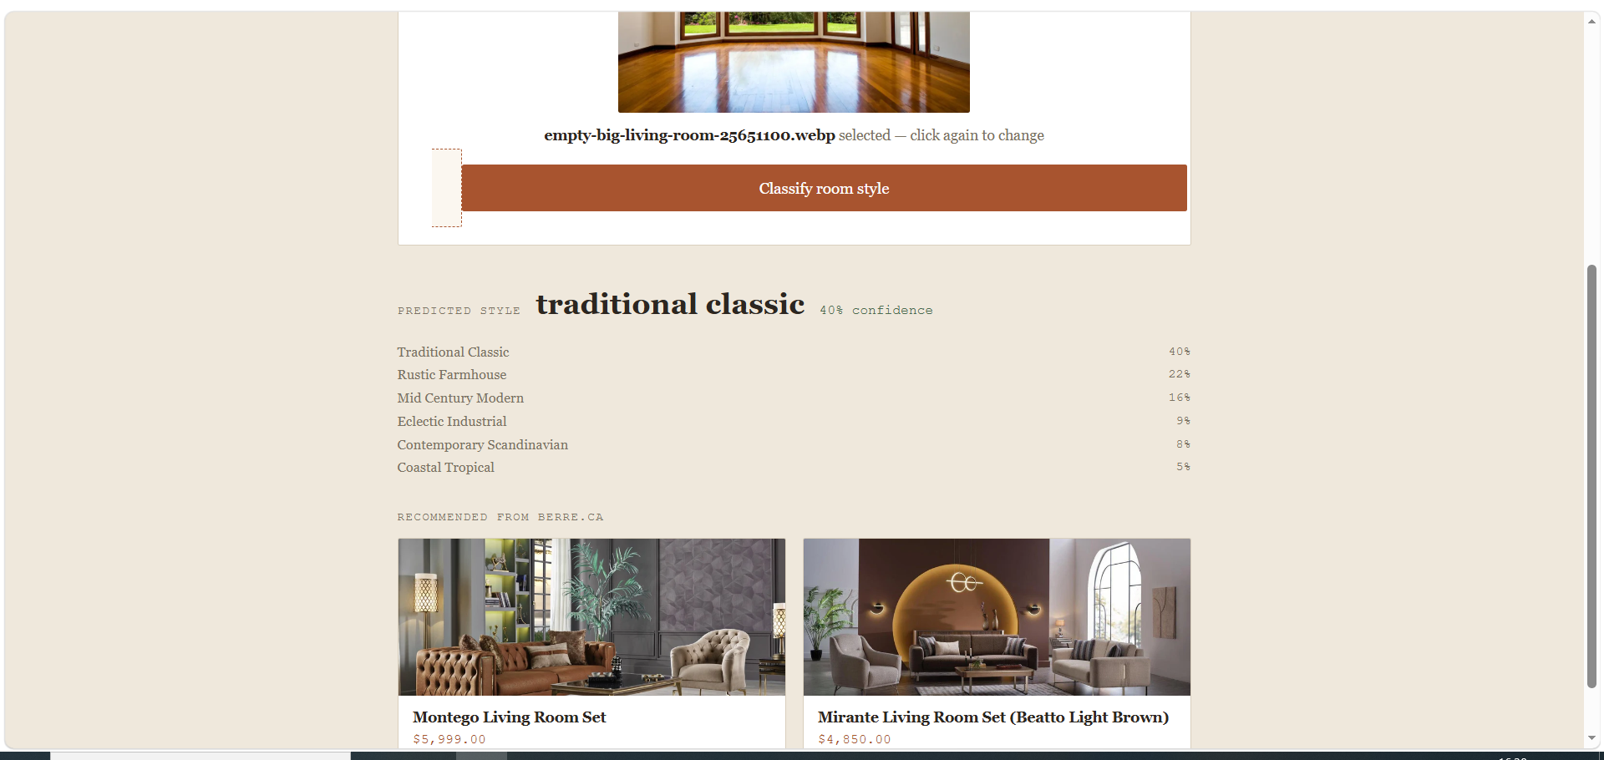
08 — DEMO
Live Demo
Shopper uploads a photo of their room
Model returns predicted style + confidence across all 6 categories
Real Berre products shown — photos, prices, links — pulled from the catalog
https://atash22.github.io/room-stylist-berre/room_stylist_demo_v2.html
Room Stylist — Berre.ca
10

Slide 11
Thank you.
Questions welcome.
Live API
room-stylist-final-atash.canadacentral.azurecontainer.io:5000
Source Code
GitHub repo linked in submission

