Slide 1
HACKATHON PITCH · MENTAL HEALTH × HARDWARE
You, Yourself
INI AKU — “it’s me”
Schizophrenia can break the brain’s “this is me” signal.
We built an outside one.
Watch the 3-minute film → you-yourself.vercel.app/film/
Notes:
Open quiet. Pause after the first line. Do not say ‘cure’. We are an aid that helps a person decide where a voice might come from.

Slide 2
MEET SENJA · A FICTIONAL STORY
She had no one to tell.
Senja is a young teacher in West Java. She stays late every day, and her family leans on her.
Lessons, exams, a school event, the bills at home. Lately, it has all been too much.
And she has no one to tell.
Senja is fictional. Her story reflects what many people who hear voices live with.
Notes:
Say it plainly: Senja is a fictional character; the science and the drawing-therapy data are real.

Slide 3
WHAT SHE HEARD
“Ayo pulang.” Come home.
“Ayo pulang.”
Then the whispers begin. “Ayo pulang” — come home. Again, and again.
A black shadow walks toward her. She covers her ears.
Her family brings her to a hospital, where her nurses try something simple: paper, and a box of crayons.
Notes:
Fictional scene. Voices and shadows like these are common experiences in schizophrenia.

Slide 4
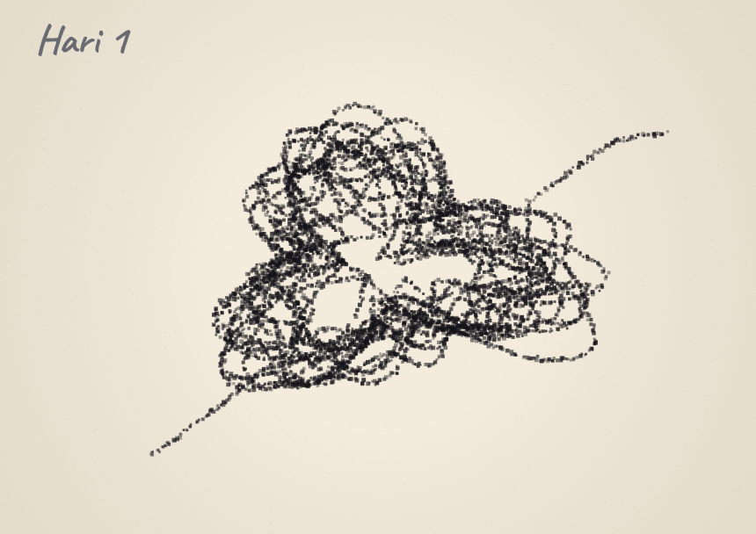
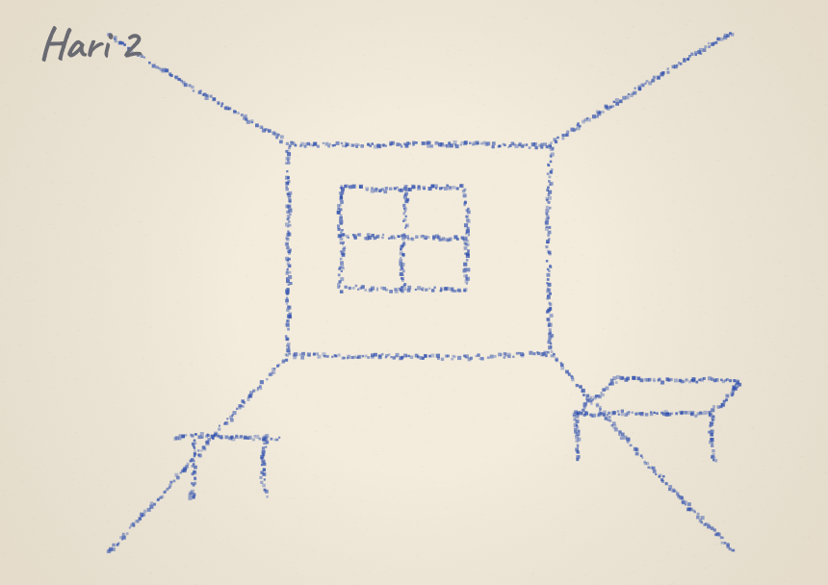
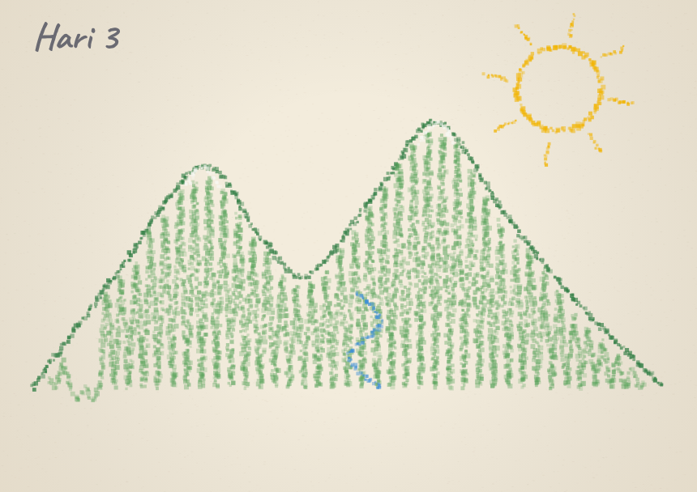
THREE DAYS, ONE BOX OF CRAYONS
On day three she drew home.
Day 1 · a tangled ball of black thread. She said it meant everything was piled up and tangled, and she didn’t know how to cope.
Day 2 · the room she sat in, in careful detail. Her focus was coming back.
Day 3 · the mountains she used to draw as a child, with her parents. She said she missed her family’s harmony.
A real case study: hallucination signs present (of 21 checked)
Drawings are illustrations from the film. The numbers come from a real 2025 case report (Amelia, Rafiyah & Widianti, SINERGI 2(2)): one patient, no control group — encouraging, not proof.
Notes:
The 9 → 5 → 3 → 1 data is from the published case report, not from Senja (who is fictional).

Slide 5
WHAT DRAWING GAVE HER
It put the inside, outside.
Her feelings had no outlet, so they stayed inside, where they were loud. The page made them visible, and that gave her a sense of control.
So we asked: what if the voice itself had something you could see? An outside signal that says whether a voice comes from you.
Notes:
This is the bridge. Drawing externalises emotion. You, Yourself externalises one specific signal: the speech muscles.

Slide 6
THE SCIENCE, AND THE HONEST LIMITS
Some voices may be your own inner speech.
142
11
59%
people in the 2025 EEG study. Those hearing voices showed an enhanced, not reduced, auditory response to sounds matching their inner speech. (Whitford et al.)
patients with more lip-muscle activity during silent voices. (Rapin et al. 2013)
fewer reported voices while humming, in a small 1990 study of 20 patients. (Green & Kinsbourne)
The brain normally sends a copy signal when you speak, even silently, that tags the sound as yours. If it is weak, your own inner speech can sound like someone else.
But 39% of voice-hearers describe voices as replayed memories, and the muscle evidence is small and mixed. So the device tests this for each person. It never assumes it.
Notes:
Say the caveat out loud: not every voice is inner speech. That is why this is a per-person test with a clinician.

Slide 7
WHY IT MATTERS HERE
Millions hear voices. Few get a tool that is theirs.
24 M
7 / 1000
~70%
people live with schizophrenia worldwide, about 1 in 300 (WHO 2022)
schizophrenia prevalence in Indonesia (Riskesdas 2018)
of people with schizophrenia hear voices; up to 30% do not respond to current treatment
Medication helps many, but not all. Therapy needs scarce specialists. Nobody hands a voice-hearer personal, objective evidence about where a voice might come from.
Our target is low-resource settings: a phone, a few parts, no scanner.
Notes:
Indonesia context from the manuscript: limited community services, pasung still used, pluralistic help-seeking.

Slide 8
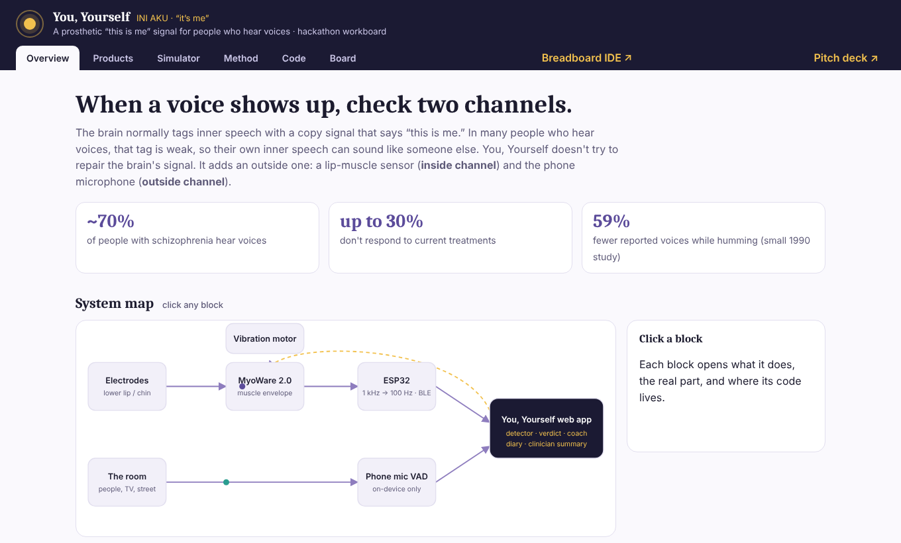
THE IDEA
When a voice shows up, check two channels.
Inside: a lip-muscle sensor (MyoWare 2.0 + ESP32) sees silent speech-muscle activity.
Outside: the phone microphone checks whether anyone nearby is actually speaking, on-device, nothing recorded.
Then one gentle verdict, never “definitely”, a two-tap vibration and a 30-second humming coach.
Notes:
We do not repair the brain’s signal; that would need stimulation we cannot do. We add an outside one.

Slide 9
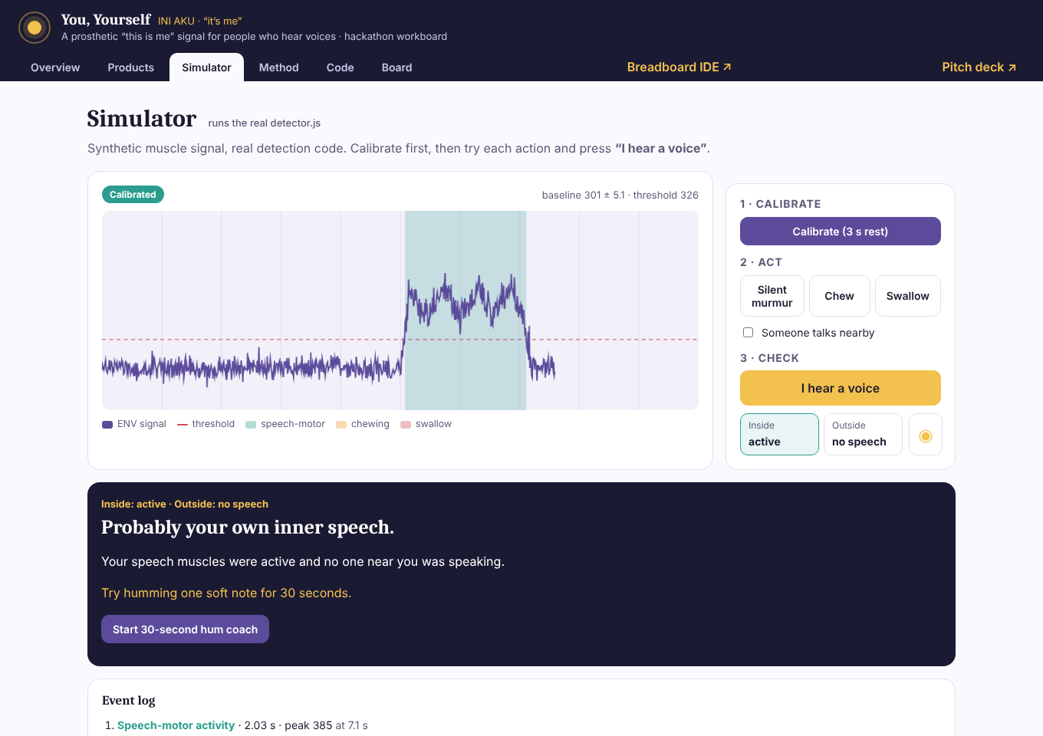
LIVE DEMO
Calibrate. Murmur. Press “I hear a voice.”
Runs the real detector.js: personal baseline, then speech-motor activity vs chewing vs swallowing.
Verdict: “Probably your own inner speech.” → hum coach.
Try it: open the workboard → Simulator, or plug in the wearable over Bluetooth.
Open the live demo → you-yourself.vercel.app/#sim
Notes:
Do this live. Order: Calibrate (3 s) → Silent murmur → I hear a voice. Then tick ‘Someone talks nearby’ and repeat to show the other verdict. Backup: the recorded video.

Slide 10
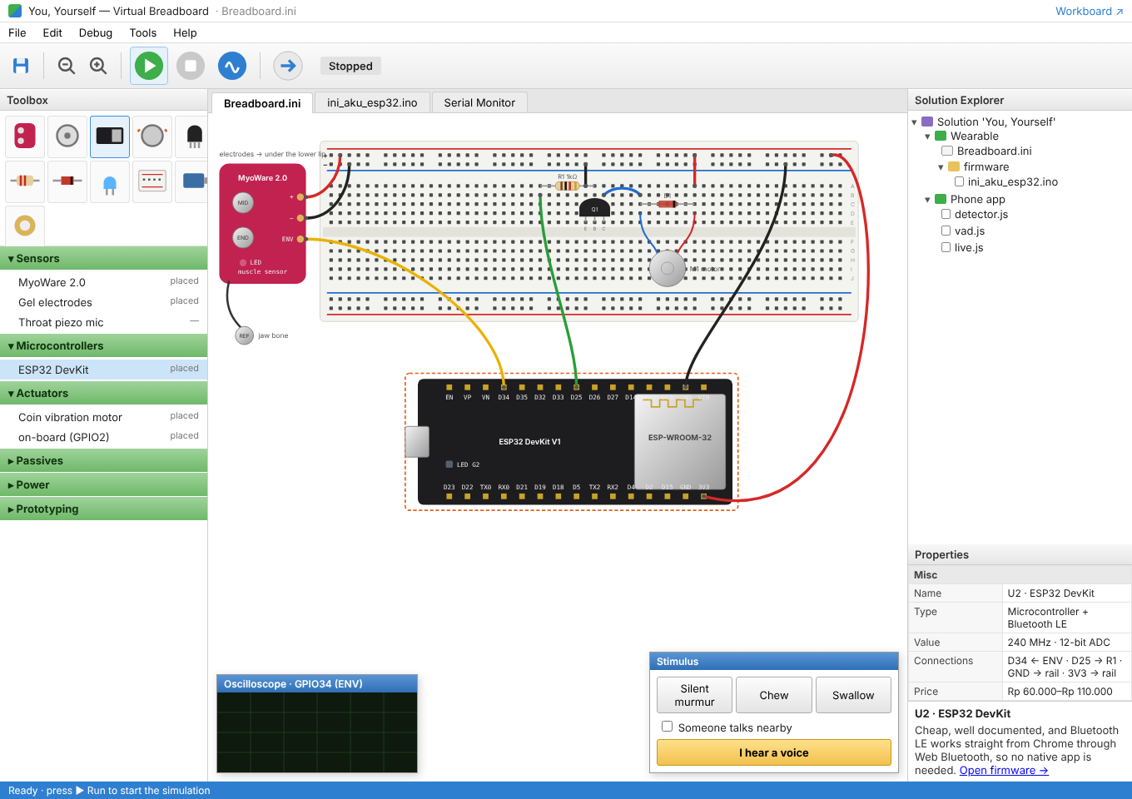
IT IS BUILDABLE
A wearable for about Rp 0.6–1 million.
MyoWare 2.0, ESP32, a coin motor, electrodes and a LiPo: Rp 610,000–1,050,000 (marketplace estimates).
Our Virtual Breadboard simulates the exact circuit and runs the real detector, so judges can inspect every wire.
Firmware is written (1 kHz → 100 Hz, BLE, haptics) but not yet flashed on a board. We say so.
Open the Breadboard IDE → you-yourself.vercel.app/ide.html
Notes:
Wiring rules: MyoWare at 3.3 V, ADC1 pin, NPN + flyback diode for the motor.

Slide 11
WE TESTED OUR OWN MATHS FIRST
The obvious test lies. We caught it before any patient.
85–100%
4.8–6.3%
≥ 80%
false positives from the naive “any muscle burst near the report” test when a button-press artefact exists, with no real coupling
false positives with our within-episode permutation test, across 16 null scenarios
power with 20 episodes when half the voices are coupled
A button press moves muscles too. Naively, “7 of 10 voices matched your muscles” appears with no coupling at all.
So our analysis plan compares each voice with the same person’s other moments and excludes the press. All numbers are from simulation; no human data yet.
EchoSelf manuscript v2, in-silico validation (16 null and 24 alternative scenarios).
Notes:
This is the credibility slide. Judges rarely see a team falsify its own first idea.

Slide 12
SAID UPFRONT
What this is not.
Not a cure
An aid that supports medication and clinicians. It never replaces them.
Not every voice
Many voices are not inner speech. We screen, and the app says “probably”, never “definitely”.
Small, old evidence
Humming and lip-EMG findings come from small studies. This is a tool to test properly, not a proven therapy.
Private by design
On-device only. No cloud. No audio recorded.
Built with voice-hearers
Some find their voices meaningful. The wording is co-designed and never dismissive.
Notes:
Pause here. Judges respect it.

Slide 13
ROADMAP
Ethics first, then people.
Now · 4-day build
Flash firmware → live graph → calibrate on 3 people → verdict, hum coach, diary → rehearse.
Stage 1
Bench and healthy-volunteer validation of detection accuracy and latency.
Stage 2
Usability testing and co-design with a lived-experience panel.
Stage 3
With ethics approval: single-case A–B–A–B study in voice-hearers.
Stage 4
Sham-feedback controlled pilot, with a partner lab for inner-speech EEG.
Notes:
No clinical claims until Stage 3 and 4.

Slide 14
SAY IT LOUDER
Senja found her way home with crayons.
You, Yourself
We want every voice-hearer to have a way to see where the voice comes from, and someone to tell.
Ayo pulang. Come home, to yourself.
Open the live demo → you-yourself.vercel.app/#sim
Notes:
End on the story. Senja is fictional; the feeling is real.

Slide 15
SOURCES
Evidence and data
1. Amelia GS, Rafiyah I, Widianti E. Penerapan intervensi menggambar pada pasien skizofrenia dengan halusinasi penglihatan dan pendengaran: case report. SINERGI Jurnal Riset Ilmiah 2(2):730–742, 2025. doi:10.62335
2. Whitford TJ et al. Corollary discharge dysfunction to inner speech and auditory verbal hallucinations. Schizophr Bull 2025. doi:10.1093/schbul/sbaf167
3. Whitford TJ et al. Mechanisms of inner speaking-induced suppression. eNeuro 2026. doi:10.1523/ENEURO.0047-26.2026
4. Rapin L et al. EMG of the lip muscles during covert auditory verbal hallucinations. J Speech Lang Hear Res 2013. doi:10.1044/1092-4388(2013/12-0210)
5. Green MF, Kinsbourne M. Subvocal activity and auditory hallucinations. Schizophr Bull 1990. doi:10.1093/schbul/16.4.617
6. McCarthy-Jones S et al. Phenomenological survey of auditory hallucinations. Schizophr Bull 2014. doi:10.1093/schbul/sbs156
7. Jack BN et al. Inner speech corollary discharge is temporally precise and content-specific. NeuroImage 2019. doi:10.1016/j.neuroimage.2019.04.038
8. World Health Organization (2022) schizophrenia fact sheet; Kemenkes Riskesdas 2018 (as cited in the case report).
9. EchoSelf design & protocol manuscript v2 and hackathon concept notes (team documents). Hardware prices: Indonesian marketplace estimates in the workboard.

