Slide 1
SUST TTS Corpus: A phonetically-balanced corpus for Bangla text-to-speech synthesis
Arif Ahmad, Md. Reza Selim, Md. Zafar Iqbal and M. Shahidur Rahman
Notes:
ataullha

Slide 2
Introduction
Publicly available Bangla TTS corpus.
Around 30 hours (almost 18 thousands utterances) of phonetically balanced Bangla speech.
Standard performance comparable to the current state-of the-art Bangla TTS system.
Notes:
ataullha

Slide 3
Motivation
Advancement of Deep Learning techniques.
Size (req. around 25 hours for TTS) of previously available corpus.
Quality of previously available corpus.
Not much ( Low resource) publicly available corpus for speech research.
To accelerate speech research in Bangla.
Notes:
ataullha

Slide 4
Background
LJ Speech (24.6 hours) Dataset for English Language.
Google (3 hours) multi-speaker TTS corpus.
IndicSpeech (contains 22 hours of Bangla speech) for Indian Languages.
Ruslan Dataset for Russian Language, JSUT Dataset for Japanese Language etc.
Notes:
ataullha

Slide 5
Corpus Design
Creating a Text Corpus
Speaker Selection
Speech Recording Process
Notes:
ataullha

Slide 6
Text Corpus
22 phonetically balanced scripts (after normalization).
almost 18357 stand alone sentences stored in [ID] [TEXT] format.
Speaker Selection
24 y/o male professional voice artist with clear pronunciation.
Speech Recording Process
Audacity for clipping, sampled at 48 KHz and stored at 16 bit PCM WAV format.
Notes:
ataullha

Slide 7
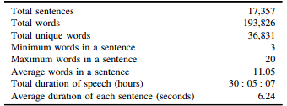
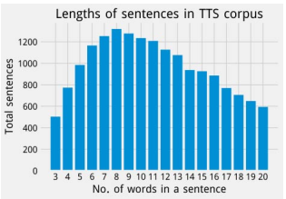
Corpus Statistics
About 17000 sentences from 3 to 20 words were used with an average of 6.24 sec.
Release the TTS for academic and commercial use.
Notes:
soumik

Slide 8
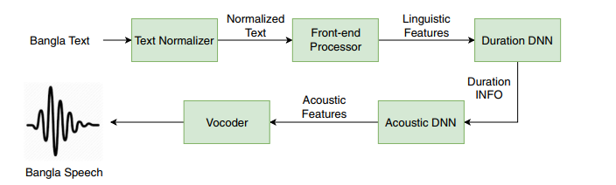
Experiments
Bangla Natural Speech synthesizer was used here. The functioning of SUST TTS is given below
Notes:
soumik

Slide 9
Results and Discussion
Objective evaluation with Perceptual Evaluation of Speech Quality (PESQ) score. 4 different datasets were used to measure the PESQ score. The datasets were splitted as below -
Subjective evaluation, with the Mean Opinion Score (MOS).A test performed by 30 people who gave score based on listening experience.
Training set 96%
Validation set 2%
Test set 2%.
Notes:
soumik

Slide 10
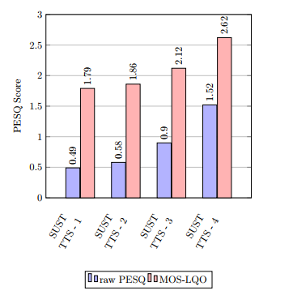
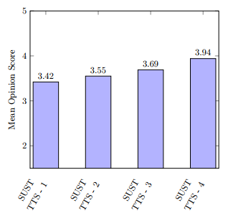
Both left and right figure indicates that SUST TTS4 which had 30 hour dataset has outperformed the other competitors.
Notes:
soumik

Slide 11
Conclusion
Scarcity of corpus.
Clear 30 hours of clean speech with rich coverage of phonetic units.Empirical results show that this corpus can be used to train a neural TTS system efficiently.
Future works
Including speeches of varying emotions would be the target of future works.
Expanding domain.
Notes:
soumik

Slide 12
Thank you
2018331045
2018331081
SUST TTS Corpus: A phonetically-balanced corpus for Bangla text-to-speech synthesis
Notes:
soumik

