Slide 1

MINI-INVESTIGATION REPORT
COMPANY: GOOGLE
PREPARED BY: ATCHAYA R
DATE: July 9, 2026

Slide 2
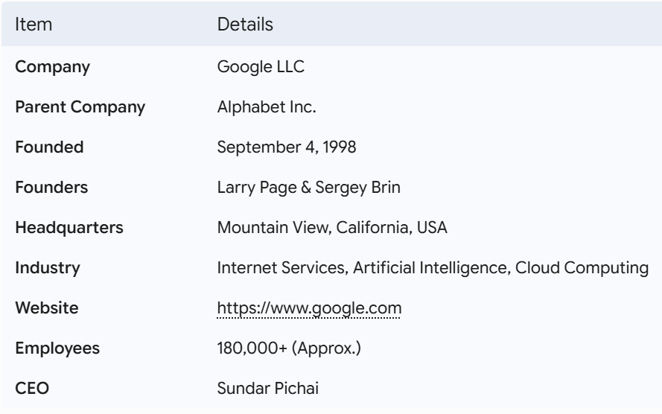
COMPANY OVERVIEW

Slide 3
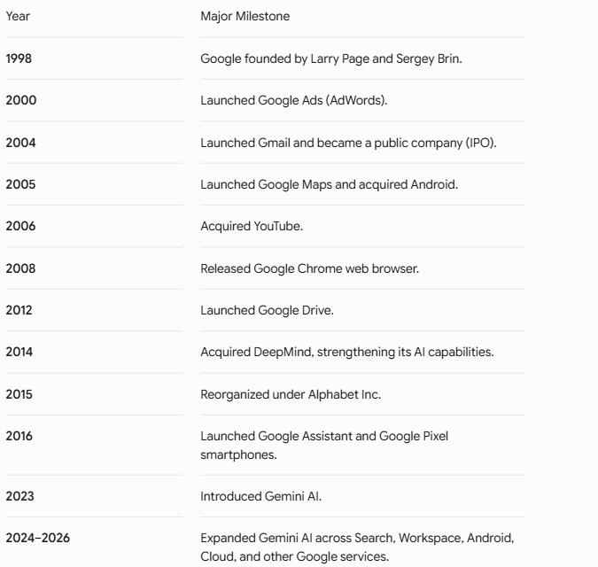
MAJOR MILESTONES TIMELINE

Slide 4
Executive Summary & Target Profile
Target Entity: Google LLC (Alphabet Inc.)
Objective: Analyze Google's digital footprint, infrastructure, technology stack, and online presence.
Sources Used: Official Website
WHOIS
DNS Lookup
BuiltWith
Wayback Machine
Google Search
Investigation Scope: Domain Analysis
DNS Infrastructure
Technology Stack
Digital Footprint
Metadata
Historical Analysis
Ethical Assessment
OSINT Mini-Investigation: Target Google | Page 2 of 10

Slide 5
Infrastructure & DNS Architecture
Primary Domain: google.com
Authoritative Name Servers: Google uses its own name servers (ns1.google.com to ns4.google.com) to manage and distribute DNS requests globally.
Autonomous System (ASN 15169): Google operates its own global network infrastructure, allowing efficient routing of internet traffic across its data centers worldwide.
Mail Infrastructure: Google uses a highly available and redundant email infrastructure to support services such as Gmail and Google Workspace.
DNS Security: Google implements security mechanisms such as SPF, DKIM, and DMARC to protect against email spoofing and phishing attacks.
Global Infrastructure: Google's worldwide network of data centers and Content Delivery Networks (CDNs) provides fast, reliable, and secure access to its services.
OSINT Mini-Investigation: Target Google | Page 3 of 10

Slide 6
Technology Stack Mapping
Technology Category | Detected Technology | Intelligence Observation
Web Server | Google Web Server (GWS) | Proprietary minimalist web framework optimized for ultra-low latency delivery.
Core Architecture | Borg / Kubernetes Orchestration | Enterprise container framework originally engineered internally by Google.
Edge CDN | Google Global Cache (GGC) | Edge nodes deployed inside localized global ISP networks to cache dynamic rich assets.
Security Controls | TLS 1.3 / BoringSSL / HSTS | Mandatory transit encryption layer across all primary and secondary corporate nodes.
OSINT Mini-Investigation: Target Google | Page 4 of 10

Slide 7
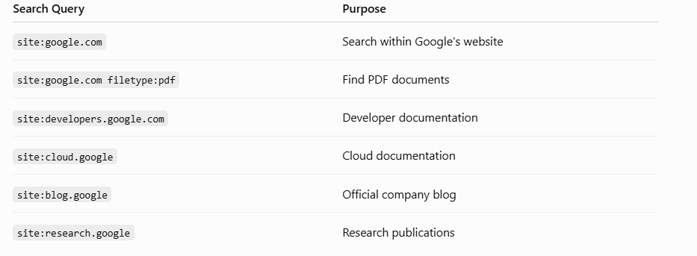
Advanced Search Intelligence
Google Dorking Methodology: Using advanced search string filters to systematically audit exposed assets and sensitive document repositories.
OSINT Mini-Investigation: Target Google | Page 5 of 10

Slide 8
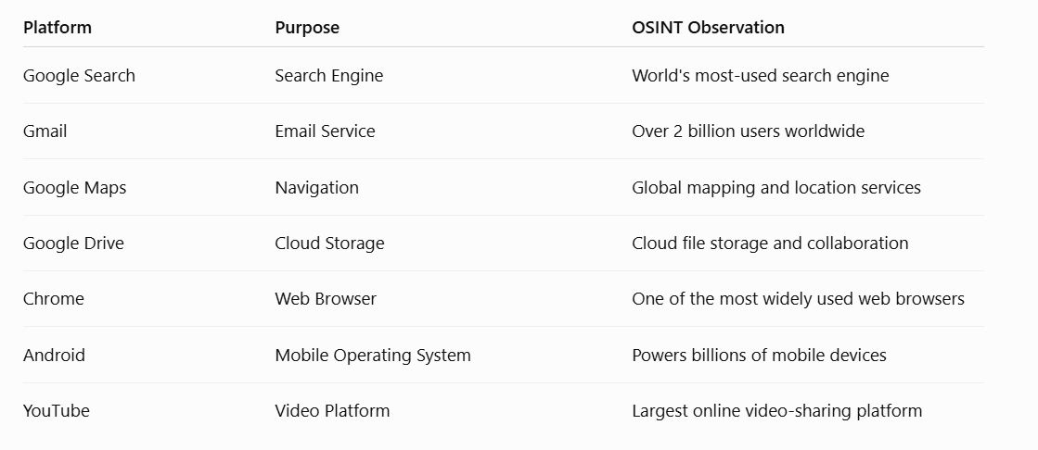
Digital Footprints
OSINT Mini-Investigation: Target Google | Page 6 of 10

Slide 9
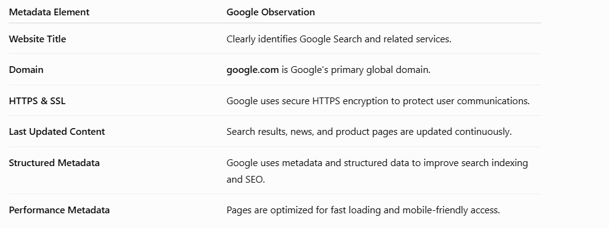
Metadata Analysis
OSINT Mini-Investigation: Target Google | Page 6 of 10

Slide 10
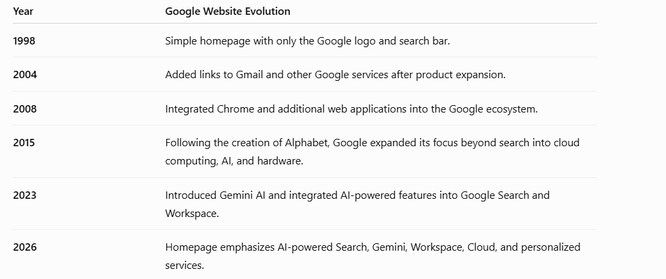
Historical Website Evolution
OSINT Mini-Investigation: Target Google | Page 6 of 10

Slide 11
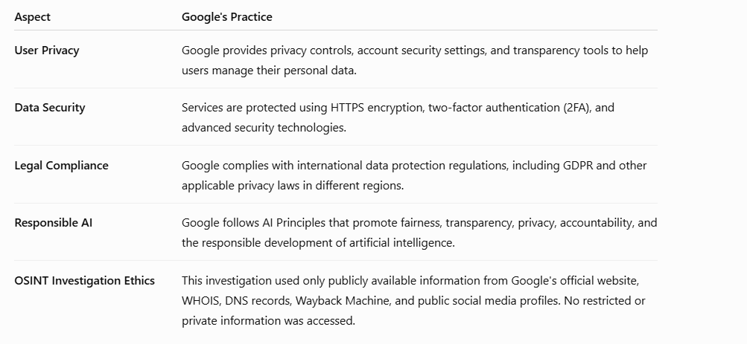
Ethical Boundaries & Legal Analysis
OSINT Mini-Investigation: Target Google | Page 8 of 10

Slide 12
Key Findings & Conclusion
Google has maintained a strong and trusted digital presence since its founding in 1998.
The company operates a secure and well-managed domain with reliable DNS infrastructure.
Google uses modern technologies, cloud infrastructure, and HTTPS encryption to ensure performance and security.
Historical analysis shows Google's evolution from a simple search engine to a global technology ecosystem.
Google has a significant digital footprint through products such as Search, Gmail, Maps, Chrome, Android, YouTube, and Gemini AI.
The company demonstrates a strong commitment to innovation, cybersecurity, and responsible AI development.
OSINT Mini-Investigation: Target Google | Page 9 of 10

