Slide 1

Atchison Presentation to KeyInvest Management Committee
Kev Toohey – Partner
Jake Jodlowski - Principal
Nick Hatzis – Investment Analyst
July 2025
July

Slide 2
Atchison
Founded in Melbourne in 2001, with satellite offices in Perth and Sydney.
Atchison provides holistic and bespoke advice and investment management to superannuation funds, wealth management groups, family offices, charities, foundations and endowment funds.
Assets under advice and management in excess of A$31 billion.
We specialise in three core pillars:
Governance, Solutions, and Consulting

Slide 3
Atchison – Value-add and Differentiation
Our value proposition has not changed since 2001, nor is it a static statement but evolves with each client relationship and requirement - a testament of Atchison’s plus 24 years of providing economic value to clients.
Our focus is on assisting our clients to increase return on investment made within acceptable risk parameters, across defined timeframe. We understand that clients seek outcomes, not just services.
Atchison’s methodology is to assess each client’s objectives and work alongside to achieve corporate and investment objectives.

Slide 4
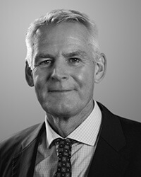
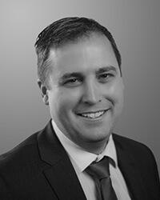



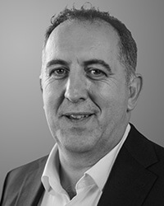

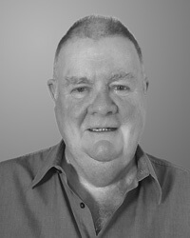

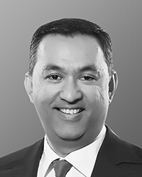
Our Team
Our linear structure ensures all members of Atchison can be effectively involved in contributing to maximising investment outcomes for our clients. All team members provide high quality research, advice, and both customised solutions and model portfolios.
Jake Jodlowski Principal
Kev Toohey Principal
Mishan Dahia Research & Investment Analyst
Nick Hatzis Investment Analyst
Ye Peng Developer & Data Analyst
Jamie Nemtsas Director
Drew Meredith Director
Terry Toohey Senior Consultant
Peter Williamson Principal (Perth)
Rohan Shan Senior Consultant

Slide 5
Planned Outcomes & Priorities
CIO Functions
KIMI Pre-Product DD
KIMI Build Out
Provide comprehensive governance of the approved product list as well as ongoing management and recommendations.
Execute initial build out of 3x investment products over 18 months.
Direct Loan Portfolio
Review and make recommendations of direct loan opportunities.
Conduct independent reviews of KIMI products, including analysis of corporate structures, personnel and process.
Quarterly asset allocation reviews. Providing alignment with current market dynamics and key objectives.
Construct new reporting system that helps streamline the direct loan portfolio and move away from excel based tracking.
Portfolio risk monitoring and reporting.
Manager due-diligence, selection and evaluation. Report on any changes within approved managers.
Provide ongoing investment management function of each product strategy.
Provide reports validating opportunity as well as identifying key risk factors.

Slide 6
CIO Functions
Participation in Investment Committee meetings providing timely market commentary and quarterly asset allocation reviews.
Conducting complete refresh of APL – including identifying gaps, recommending changes and constructing a process around manager due-diligence and research.
Improved Governance Oversight
Implement quarterly APL monitoring system and provide reports
Portfolio risk management and reporting.
Provide monthly market commentary and monthly key index performance files for distribution.
Action Items:
APRA requirements for APL changes – what has been discussed and decided?
Existing APL due-diligence – Any existing documentation?
Do Key Invest have the in-house capabilities to on-board SMA’s?

Slide 7
Direct Loan Portfolio
Provide weekly review of direct loan portfolio as well as direct loan opportunities
Monitor risks within the portfolio
Provide opinion on opportunities whilst considering requirements
Build new and more efficient tracking system
Move away from excel to a python-based model to allow for quicker tracking, communication and reporting
Action Items:
Handover of existing loan due-diligence and details.
Supporting documentation on all current loans within the portfolio.
Handover of contacts and leads for direct loan opportunities.
Need streamline of communication to us to review documents and opportunities weekly.

Slide 8
KIMI Project
Stage 1:
Conduct detailed reviews of KIMI products.
Provide comprehensive reporting around readiness and key risk factors.
Stage 2:
Management and oversight across the KIMI Product lifecycle.
Coordination of product launches and strategic execution.
Ongoing performance monitoring and governance.
Collaborate with marketing and sales to effectively position and distribute products.
Stage 3:
Ongoing investment product and management functions of each product developed under stage 2.
What do we need?
Had the existing team met with anyone and is there any key details to handover?

Slide 9
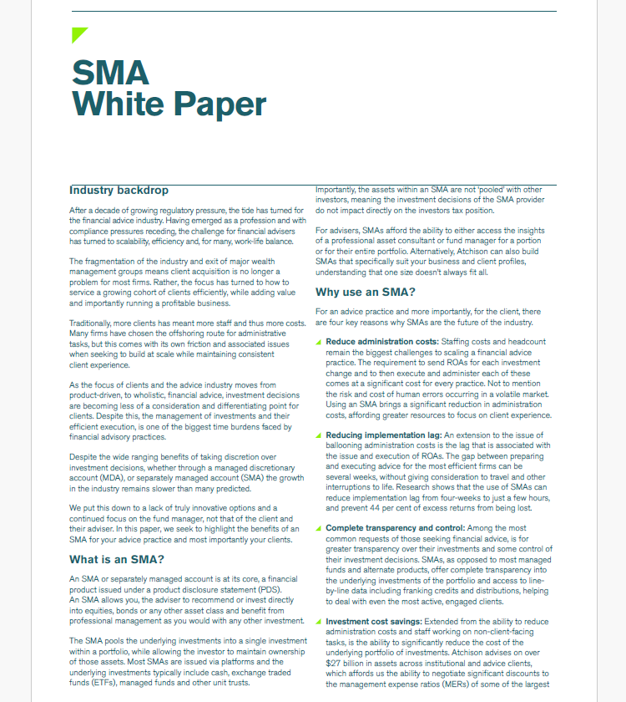
Example
Approved Product List
High Net Worth Alts
Link To: SMA White Paper for Advisers

Slide 10
Framework & Product Offerings

Slide 11
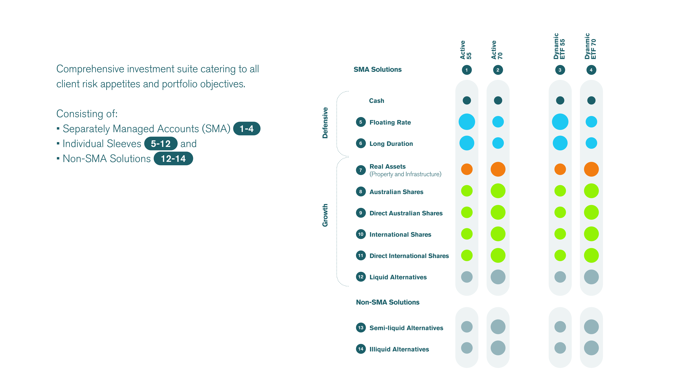
Investment Framework

Slide 12
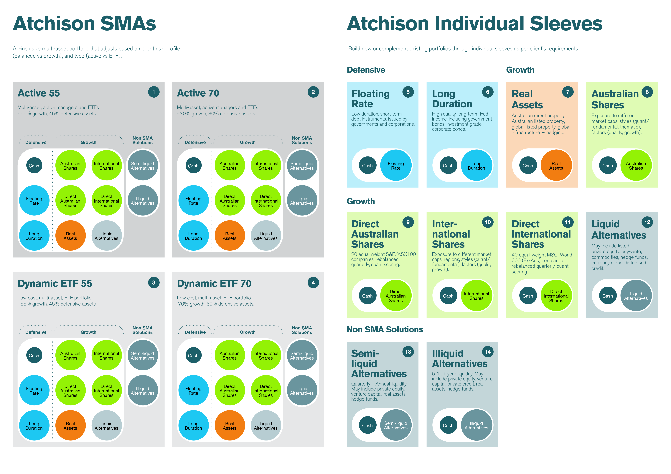
Active & Dynamic ETF SMAs

Slide 13
Individual Asset Class Sleeves

Slide 14
Philosophy & Process

Slide 15
Atchison’s Guiding Lights
Start and end with risk: Focus on compensated risk only; avoid hidden or style-based risks that don’t add value.
Asset allocation is the key return driver: Strategic and dynamic allocation decisions drive ~90% of long-term performance.
Active management has a role: Select true active managers (with high active share) who can improve returns and reduce volatility.
Automated rebalancing matters: Rebalancing should be systematic and rules-based to enforce discipline (buy low, sell high) and minimise behavioural risk.
Liquidity adds value: Liquidity enables rebalancing, adaptability, and resilience — especially in higher rate environments.
Trust in mean reversion: Markets revert to long-term trends over time — portfolios should not overreact to short-term themes or extrapolated narratives.
Costs and turnover matter: Long-term returns are impacted by excessive trading, fees, and tax drag — avoid unnecessary churn.
Always have an exit strategy: Every investment decision must have a clear exit framework — avoid emotion-driven decisions.

Slide 16
Atchison’s Investment Process
Short and long-term views of the market through SAA and TAA.
Set Return, Vol/Risk and Horizon targets.
In-house python models testing thousands of different portfolio scenarios and outcomes.
Select specialist managers or ETFs for each asset class.
Each asset is measured and combined using our stress testing framework, assessing risk/return and correlation metrics.
Final positions are overlayed to best meet whole of portfolio top-down and bottom-up constraints.
We track performance daily and alert you of any important changes.
1. Market Outlook
2. Portfolio Objectives
3. Stress Test and Optimise
4. Build Sector Portfolios
5. Bottom-up risk analysis
7. Monitor
6. Refine

Slide 17
Atchison SMA: Top-Down Design
Market Outlook
Portfolio Objectives
Stress Test and Optimise
1. Market Outlook
2. Portfolio Objectives
3. Stress Test and Optimise
4. Build Sector Portfolios
5. Bottom-up risk analysis
7. Monitor
6. Refine

Slide 18
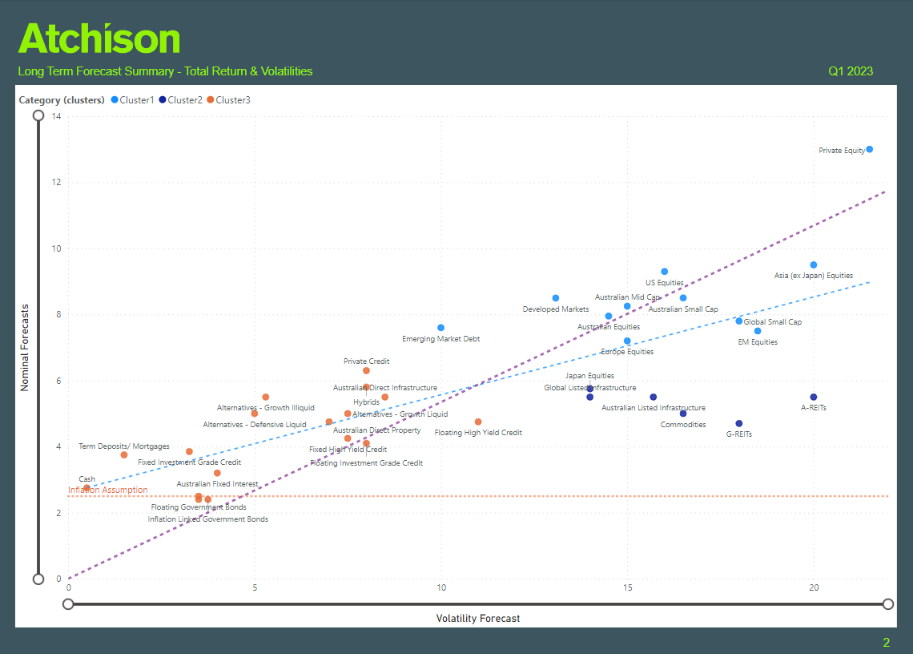
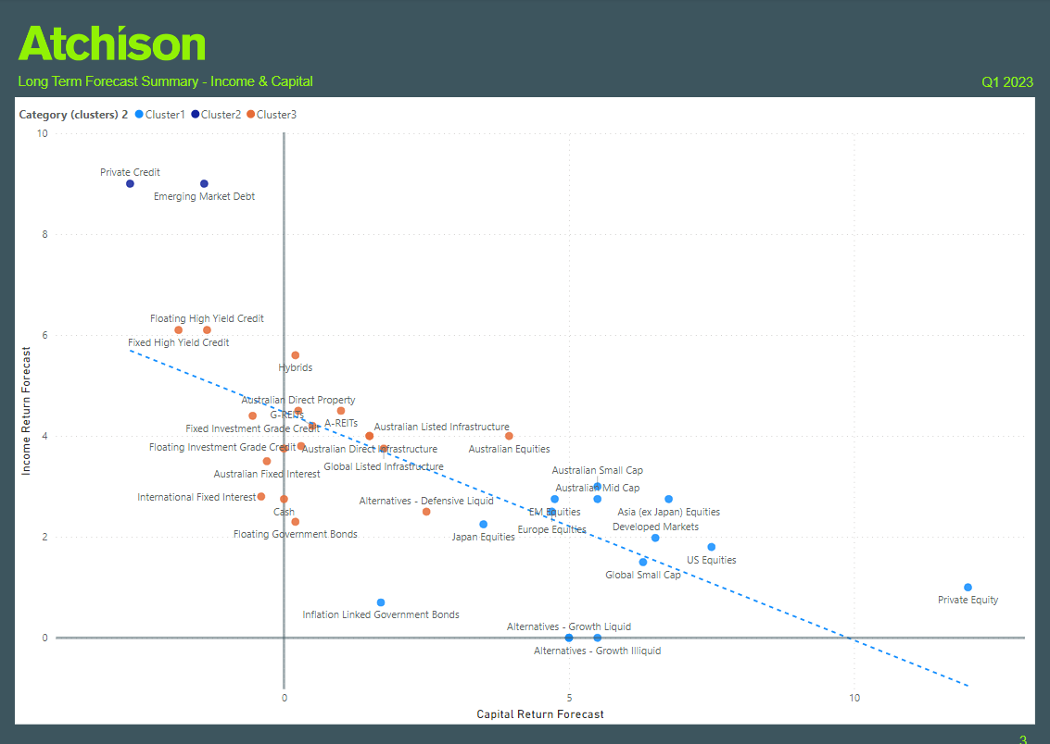
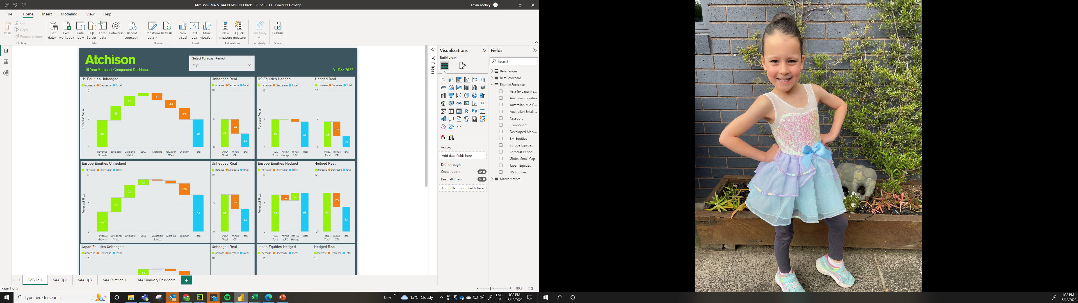
Top-Down: Long Term Forecasts
Link To: Capital Market Assumption Process
Link To: 2025 Capital Market Forecasts

Slide 19
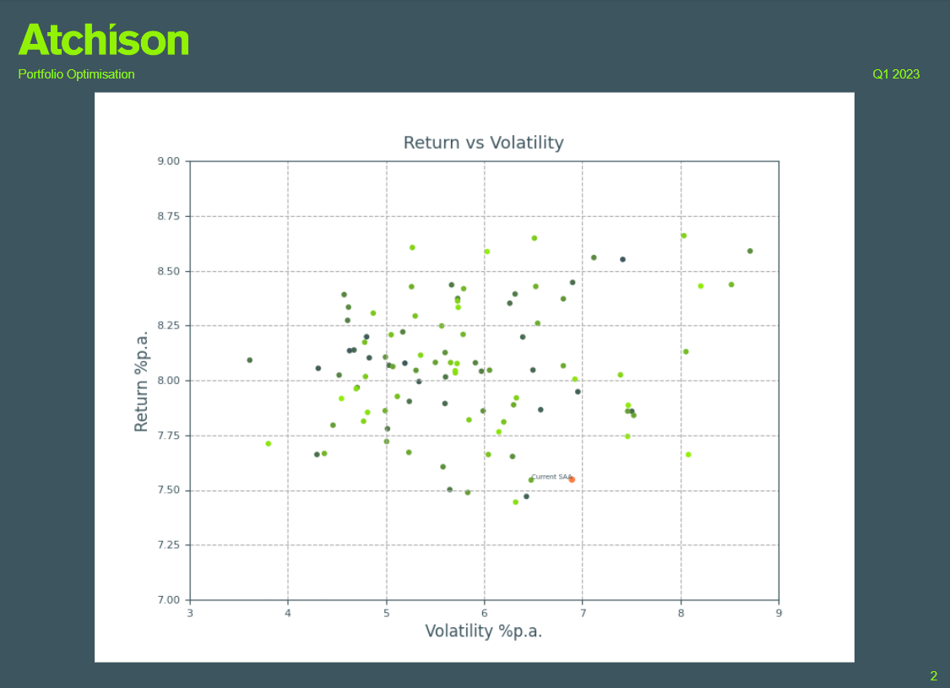
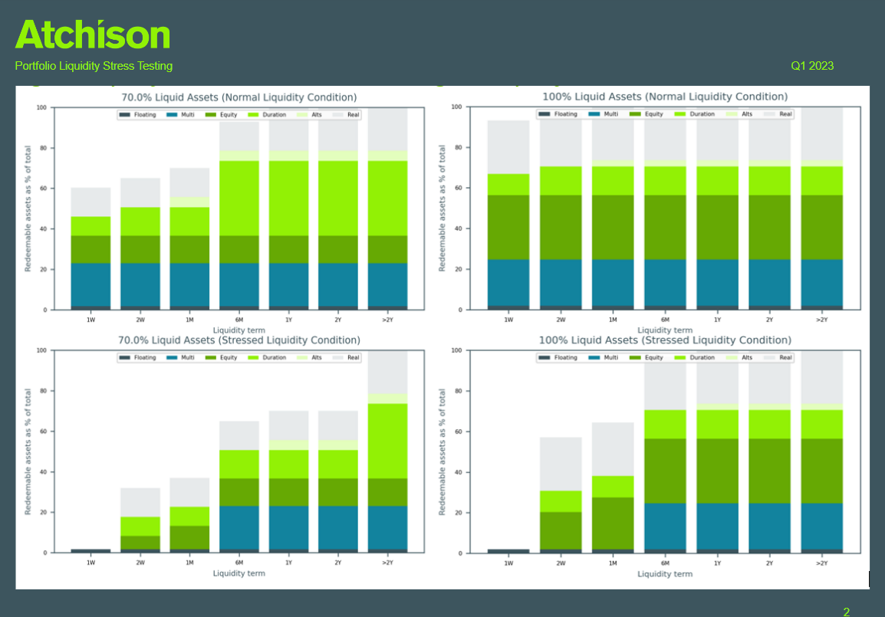
Top-Down: Objectives, Portfolio Optimisation & Stress Testing
Link To: Portfolio SAA Optimisation & Stress Testing

Slide 20
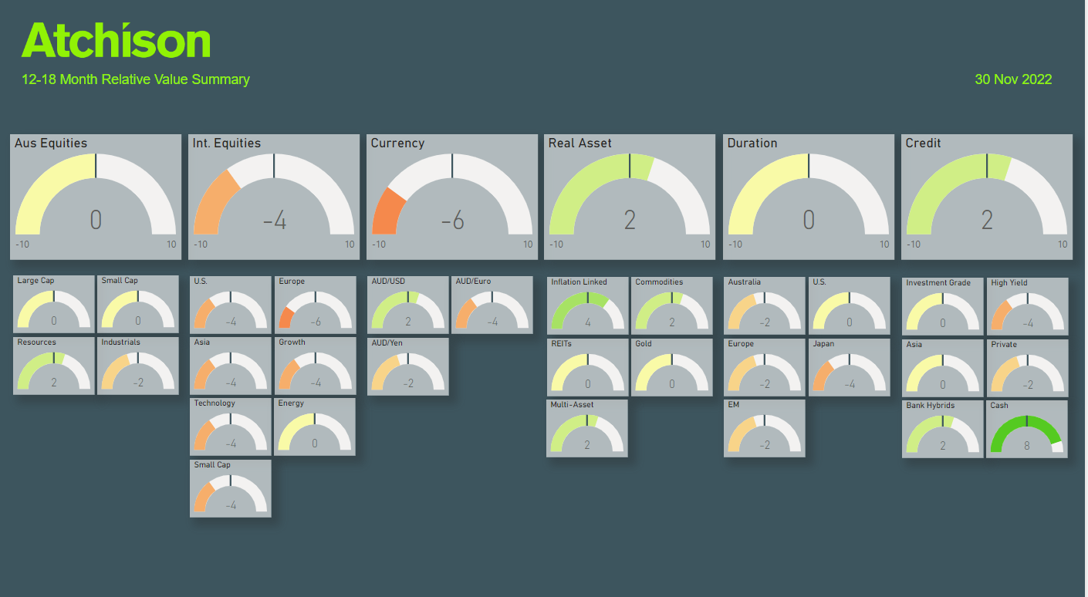
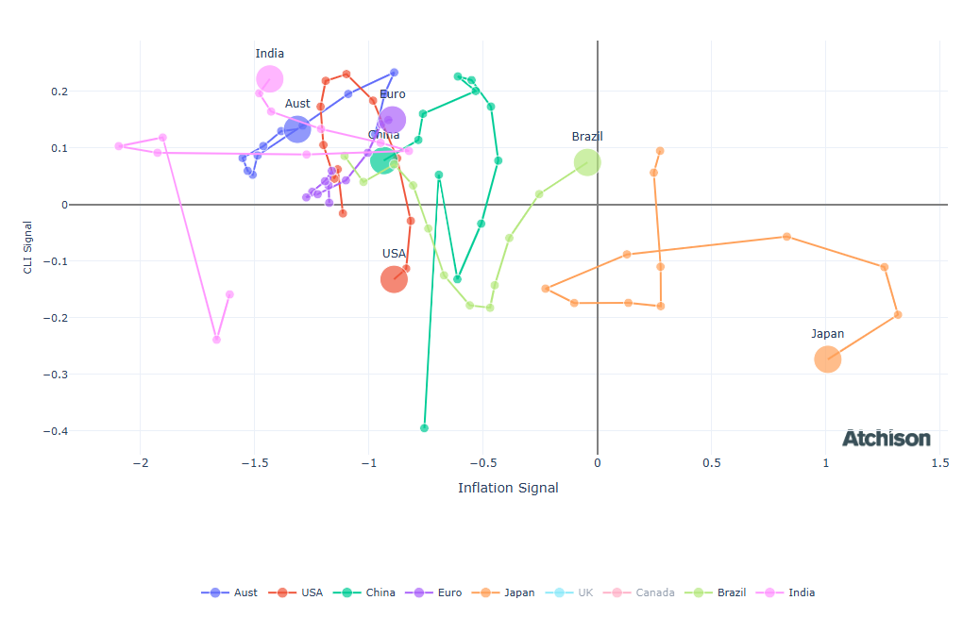
Top-Down: Tactical Asset Allocation (TAA)
Link To: Country Economic Regime Analysis
Link To: Tactical Asset Allocation Outlook

Slide 21
Atchison SMA: Bottom-Up Design
Bottom-Up Risk Framework:
Once top-down Betas are allocated across preferred ETFs / Managers, retest objectives and risk metrics build back up from component assets.
The purpose is to identify if in the allocation of beta bias and manager selection – a level of unintended basis risk / tracking error has built back into the portfolio outcome.
A sense check that the portfolio constructed by applying Steps 3 and 4; still sees an outcome that meets the requirements set in Step 2.
1. Market Outlook
2. Portfolio Objectives
3. Stress Test and Optimise
4. Build Sector Portfolios
5. Bottom-up risk analysis
7. Monitor
6. Refine

Slide 22
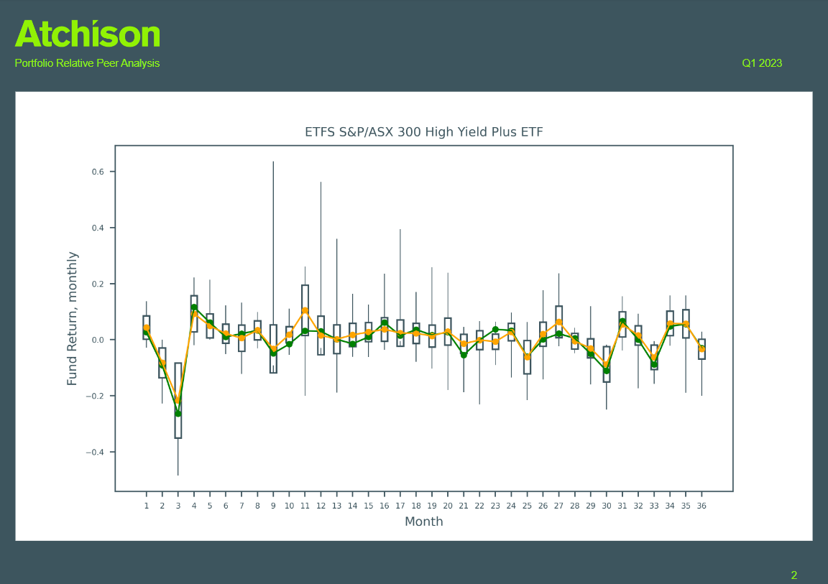
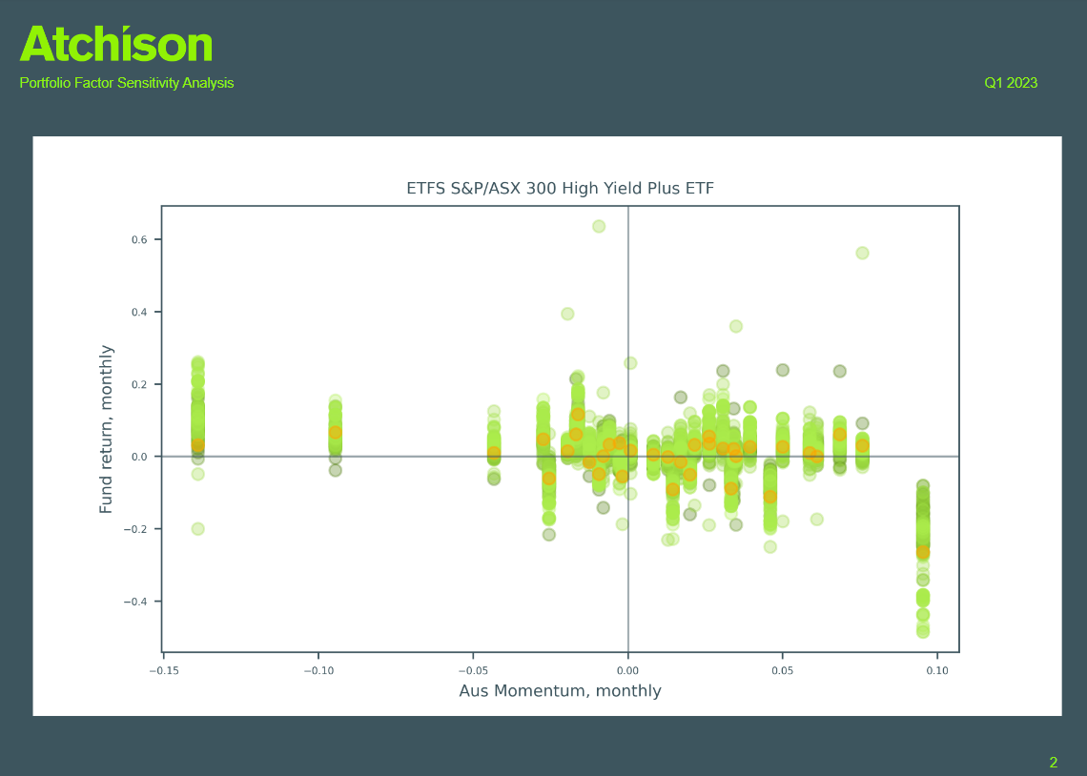
Style / Factor Analytics Engine

Slide 23
Atchison SMA: Portfolio Construction
1. Market Outlook
2. Portfolio Objectives
3. Stress Test and Optimise
4. Build Sector Portfolios
5. Bottom-up risk analysis
7. Monitor
6. Refine
Where 5 and 2 conflict, refine via iteration or overlay beta/factor hedges.
Utilise our APL monitoring program as the core for ongoing monitoring:
Risk-adjusted returns
Factor regression model

Slide 24
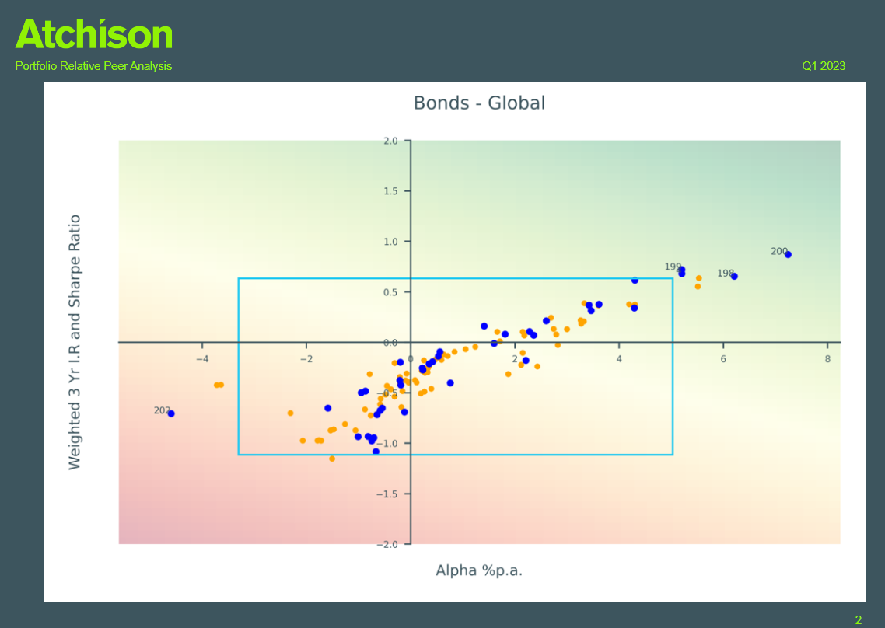
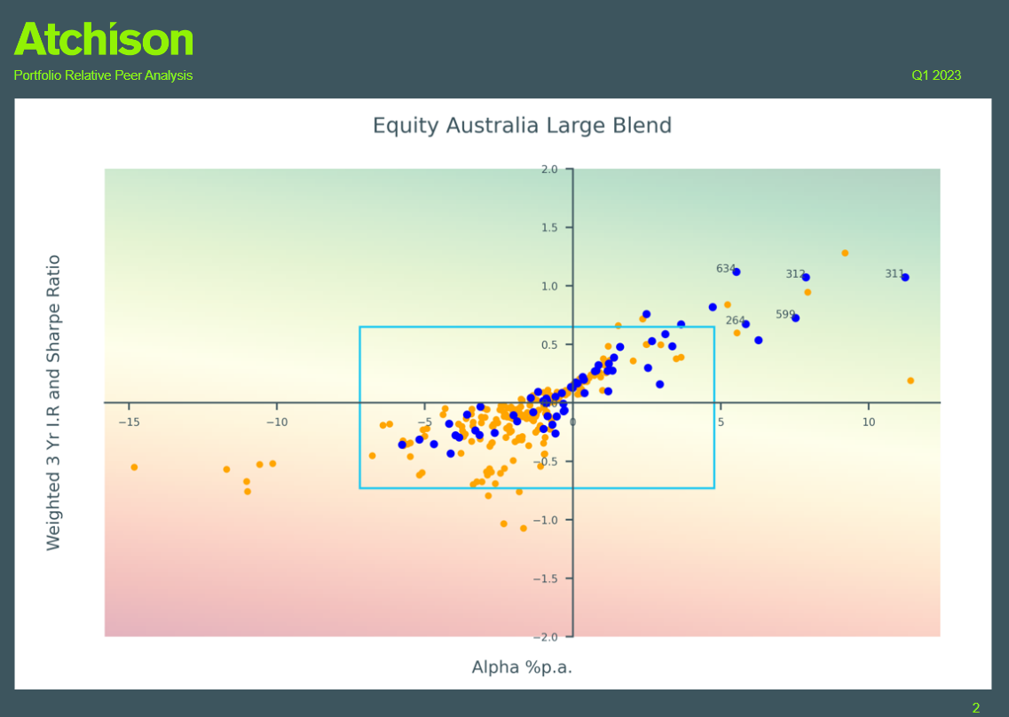
APL Monitoring System
Link To: APL Monitoring Report Q1 2025

Slide 25
Communication:
Supporting Client & Adviser Journey

Slide 26
Communication: Client & Adviser Journey
Daily Market Updates
Monthly Indices
Tactical Asset Allocation
Strategic Asset Allocation
Daily emails that keep advisers informed on overnight market moves to support timely client conversations.
Tracks benchmark performance across regions and asset classes.
Quarterly portfolio positioning based on a 12–18 month forward-looking asset class view.
10-year forecast of markets, using proprietary mean variance optimisation and stress testing model.
Monthly Market Updates
Digestible summary of key market themes to inform adviser commentary and strategy.
Provides additional thematic insights into gaming, Bitcoin, and healthcare.

Slide 27
Communication: Client & Adviser Journey
Approved Product List
Adviser & Client Relationship (meeting one)
Adviser & Client Relationship (meeting two)
A list of investment products available to advisers for client use outside of the SMA framework.
Pitch Deck: Concise, 6-slide presentation to help advisers articulate their value and how Atchison enhances their client offering.
Product 2 Pager: Overview of the product.
Interactive Adviser Portal
A centralised web portal, specific to Each Client, giving advisers access to all relevant investment resources in one place.
Atchison Booklet: Take home booklet outlining RP’s Investment Arm.
Performance Reports: Overview of performance of relevant solution.

Slide 28
Appendix

Slide 29
Governance
Outsourced CIO Function
APRA SPS530 & CPG229
ESG & Liquidity Testing
Risk Scenario Analysis
Improved IC oversight by working with KeyInvest internal investment team and all stakeholders.
Support APRA compliance team regarding investment function.
Liquidity management and cash-flow planning.
Modelling portfolio behaviors across market shocks and downturns.
Optimisation
Test thousands of portfolio combinations to improve risk and return outcomes.
Guard rails for financial advisers to choose appropriate investments in particular sub-categories.
Tailor asset allocation to objectives, time horizon, and volatility.
Support KeyInvest with maintenance and updating of compliance investment policies.
Identifies trigger points and resilience under adverse scenarios.
Provide strategic direction on all investment activities e.g. Approved Product Lists.
Research, investment manager DD, selection and continuous evaluation and reporting.
On-going asset allocation review and adjustment aligned to market dynamics.
Incorporate governance, ESG, and climate risk standards into portfolio reviews.
Portfolio risk management monitoring and reporting.
Assesses sustainability and ethical exposures across portfolios
Evaluate liquidity under normal and stressed market conditions

Slide 30
Solutions
Product Innovation
Direct Equities
Semi Liquid Alternatives
Bespoke
Conduct independent reviews of KIMI products and provide recommendations.
Australian Shares: 20 equal weighted holdings, quant-based. Ex: CBA, ANZ, BHP, CSL.
Paper portfolio of 6-10 semi-liquid alternatives, 30-50k min investment per product.
Collaborate with marketing and sales team to construct strategic product distribution partnerships.
Separately Managed Portfolios
International Shares: 40 equal weighted holdings, quant-based. Ex: APPL, GOOGL, NVDA.
Appropriate for clients who want to deploy 500k on semi-liquid alternatives.
ESG based investment solutions.
Active and Passive (ETF) SMA’s across different risk profiles, 40%, 55%, 70%, 85% Growth.
Product innovation and management e.g. FoF Credit portfolio.
Establishment of all inclusive Portfolios inc. Aus Shares, Int Shares, Fixed Income, Real Assets, Alternatives.
Co-ordinate product launches, including DD, market readiness, and strategic execution.
Provide on-going investment performance monitoring, benchmarking and product enhancements.
Regional based investment solutions.

Slide 31
Consulting
Investment Committee
Custom Indices
Peer Analysis & Ranking
Attribution & Contribution Data
Independent expertise, advice, oversight.
Measurement of performance against a benchmark aligned to a specific strategy / theme.
Marketing tool to showcase outperformance and adviser value-add.
Breaks down performance drivers by asset class, manager, or strategy.
White Papers
Positioning advisers as intellectual thought leaders on relevant topics.
Strategic and Tactical Asset Allocation Advice + Regime analysis.
Increase credibility, via deep dive analysis on requested investments / thematics.
Supports compliance with APRA Prudential Standards .
Product analysis / comparator tools.
Supports IC decisions and helps advisers explain “what worked, what didn’t” to clients.

Slide 32
Trusted by Leading Institutions
Corporates
Investment Platforms (Retail)
Wealth Advisory Groups
Fund Managers
Murray Irrigation Ltd
DASH
WestEnd Group
Yarra Capital
Superannuation Funds
Superhero
RAIZ Invest Australia
REI Super
Acclaim
Regional Prosperity
Euree Asset Management
Trustee Companies
MARQ Trustees
Equity Trustees
Non-For Profit
The Nehemiah Foundation
Mossaic Community Care Inc

Slide 33
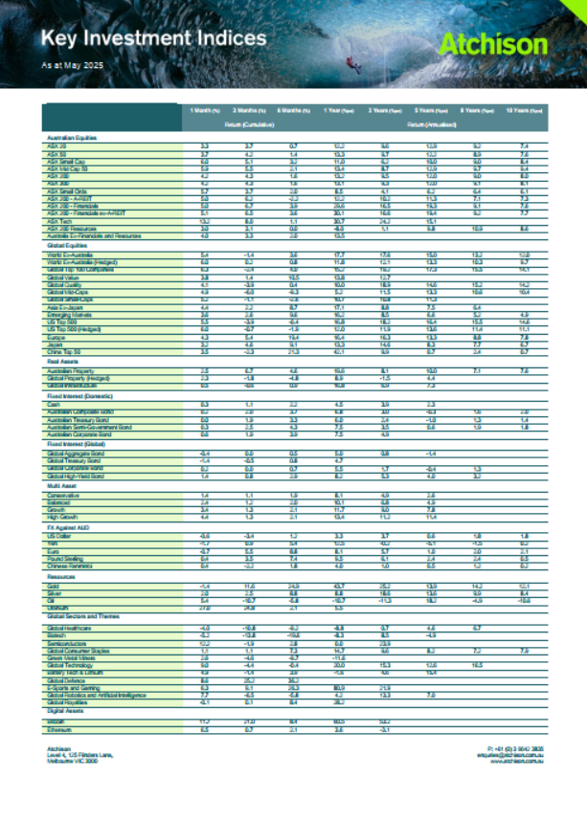
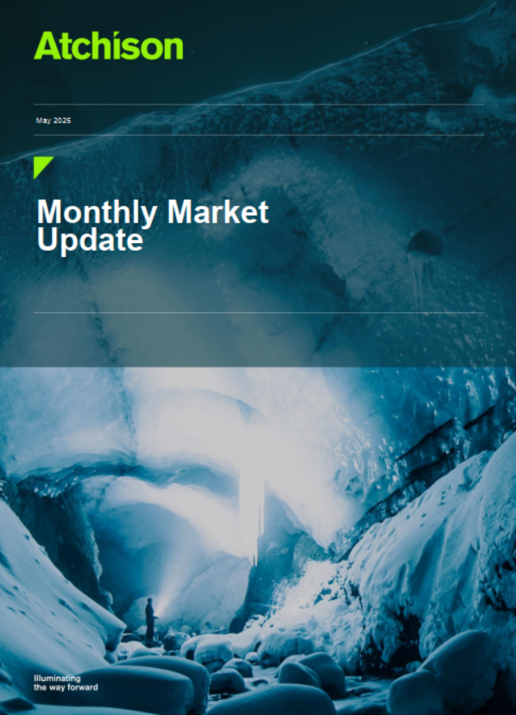
Monthly Indices & Market Update

Slide 34
Semi-Liquid Strategy
Quarterly – Annual liquidity. May include private equity, venture capital, real assets, hedge funds.

Slide 35
Atchison - Adviser Materials

