Slide 1

Atchison & Edwards Marshall Financial Solutions
Presenters:
Kev Toohey – Partner
Jamie Nemtsas - Director
Mishan Dahia – Research & Investment Analyst
Atchison - Edwards Marshall Portal

Slide 2
1. Firm Overview

Slide 3
Company Background:
Founded in Melbourne in 2001, with satellite offices in Perth and Sydney.
Serving superannuation funds, wealth management groups, family offices, charities, foundations and endowment funds.
Specialising in Separately Managed Accounts, Consulting, Governance
Ownership: 100% owned by management

Slide 4
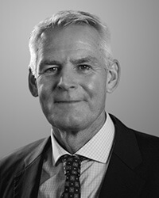
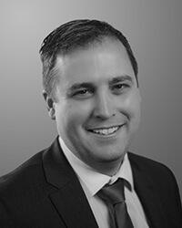
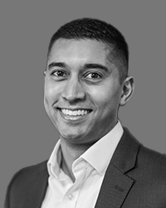
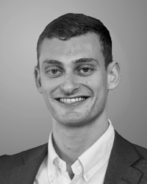
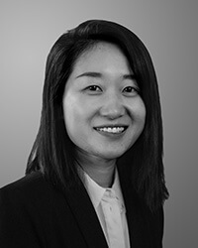
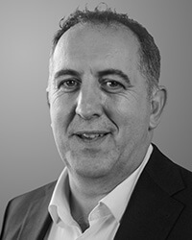
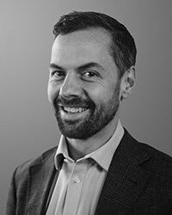
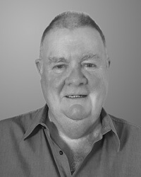
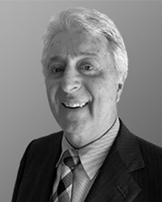
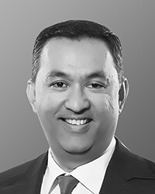
Key Personnel
Our linear structure ensures all members of Atchison can be effectively involved in contributing to maximising investment outcomes for our clients. All team members provide high quality research, advice, and both customised solutions and model portfolios.
Jake Jodlowski Principal
Kev Toohey Principal
Mishan Dahia Research & Investment Analyst
Nick Hatzis Investment Analyst
Ye Peng Developer & Data Analyst
Jamie Nemtsas Director
Drew Meredith Director
Terry Toohey Senior Consultant
Peter Williamson Principal (Perth)
Rohan Shan Senior Consultant

Slide 5
Key Differentiation
Availability: Travelling to Adelaide monthly to service existing clients
Operational efficiency: Atchison SMA’s and Individual Asset Class Sleeves
Support & education: Atchison workshops, explaining SMA’s and merging with your philosophy to ensure alignment and adoption.
Backend onboarding: SOA, ROA wording + best practice implementation
Full investment suite: Available on CFS
Performance and fees: Q1 Performance (end of August 2025), and low fees.
Transparency & centralisation: Simple web-based link
Ownership: 100% staff owned, do not have a corporate entity

Slide 6
2. Current Portfolio Review

Slide 7
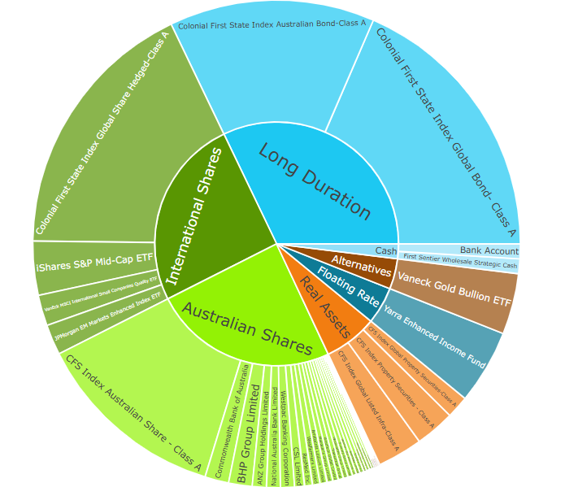
Structural Concerns – Total Portfolio
EMFS:
Too much Long Duration exposure = heightened interest rate sensitivity
Floating rate exposure too low and too concentrated to one name.
Concentrated gold exposure. Opportunity for differentiated return drivers through greater diversification in Alternatives.
75+% Equities and Duration exposure.

Slide 8
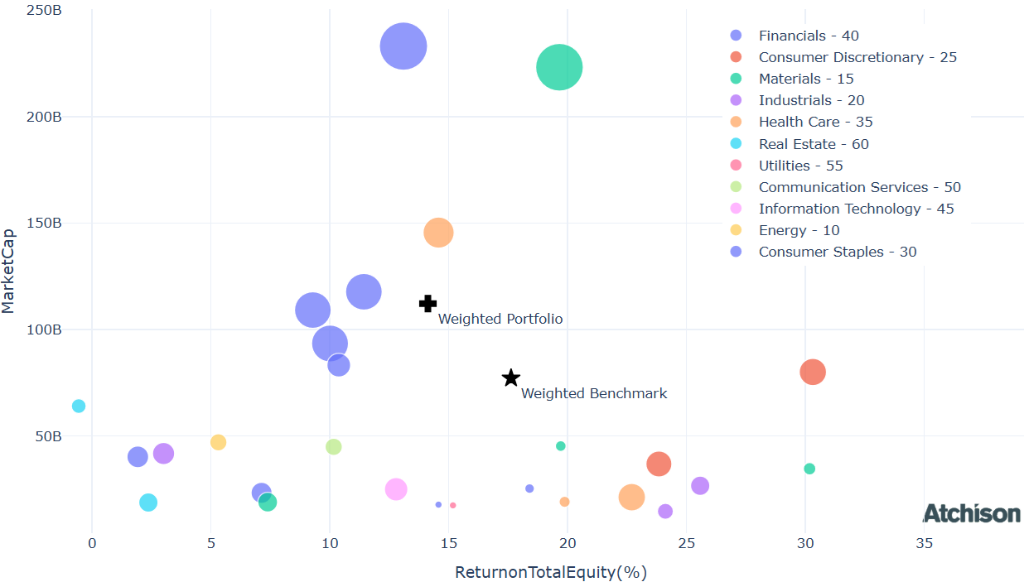
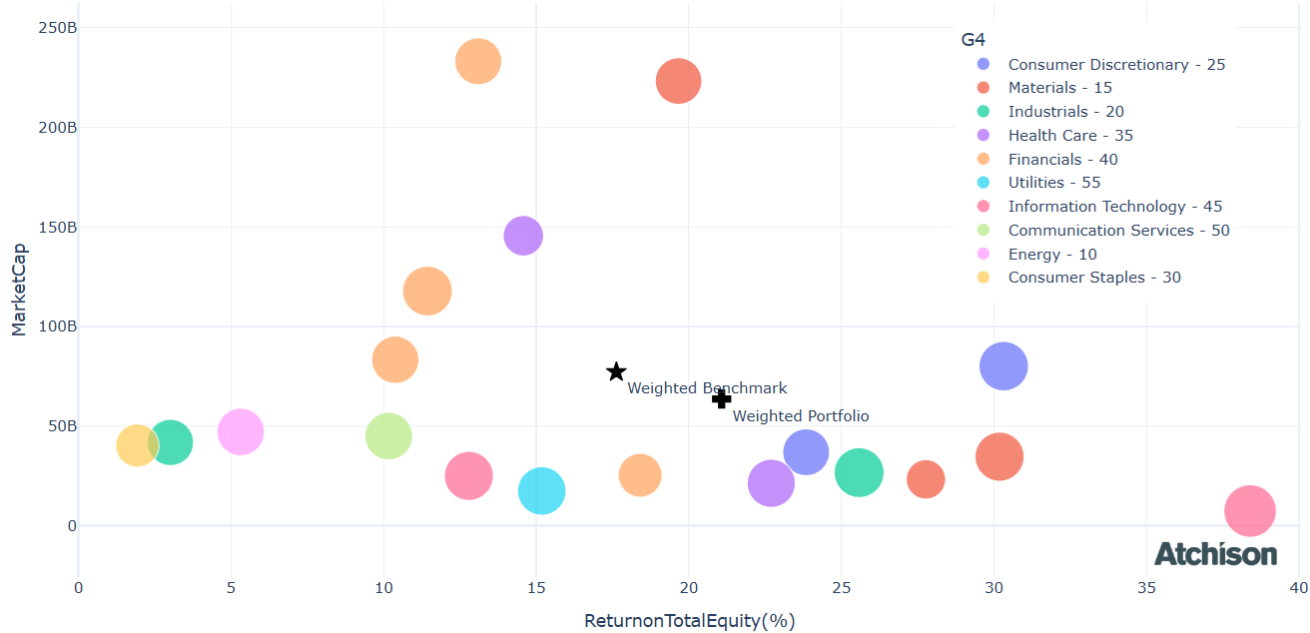
Structural Concerns
EMFS:
Cochlea (COH), Fortescue (FMG), Insurance Australian Group (IAG), Origin Energy (ORG), QBE Insurance Group (QBE), Rio Tinto Ltd (RIO) each holding is < 0.1% weight in the total portfolio.
Each of these positions holds a value between $314 - $882 in a total $1M portfolio.
These positions add little to no value in the total portfolio
Atchison:
Greater diversification and alpha generation potential through, sector, sub-sector, weighting
EMFS Australian Equities
Atchison 20 Equal Weighted Direct Equities

Slide 9
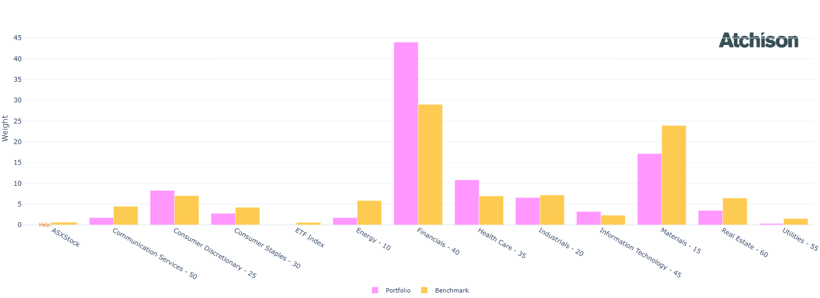
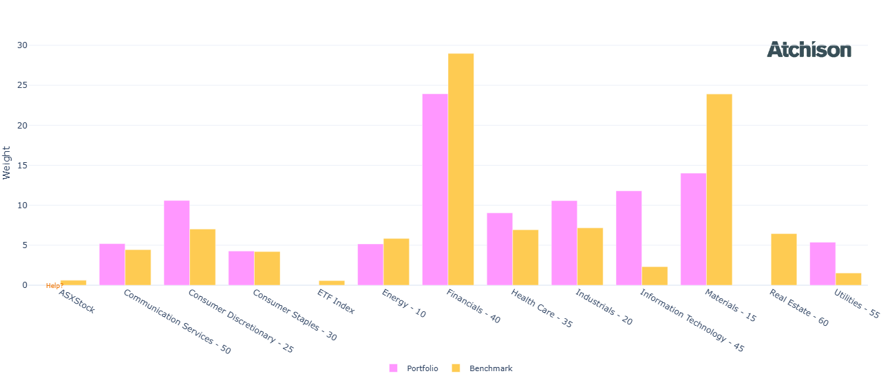
Structural Concerns – Australian Equities
EMFS:
O/W financials
Atchison:
U/W financials
U/W materials
Greater exposure to all sectors

Slide 10
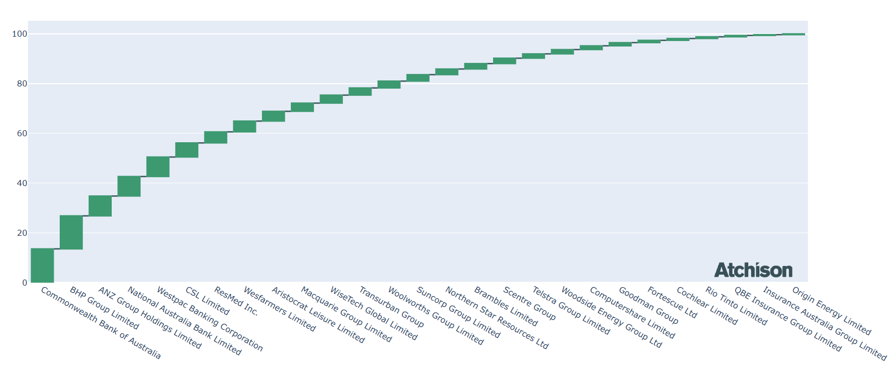
Structural Concerns – Australian Equities
Edwards Marshall – Australian Equities
Return on Equity:
14.03 EMFS, 21.01 Atchison
Yield
5% EMFS, 5.9% Atchison
Concentration:
EMFS - O/W Financials, particularly big four banks 7 names make up 60% of the portfolio, 4 of these names are major banks
Atchison – Split sectors into subcategories. Financials: Banks (CBA), Financial services (GQG), Insurance (QBE)

Slide 11
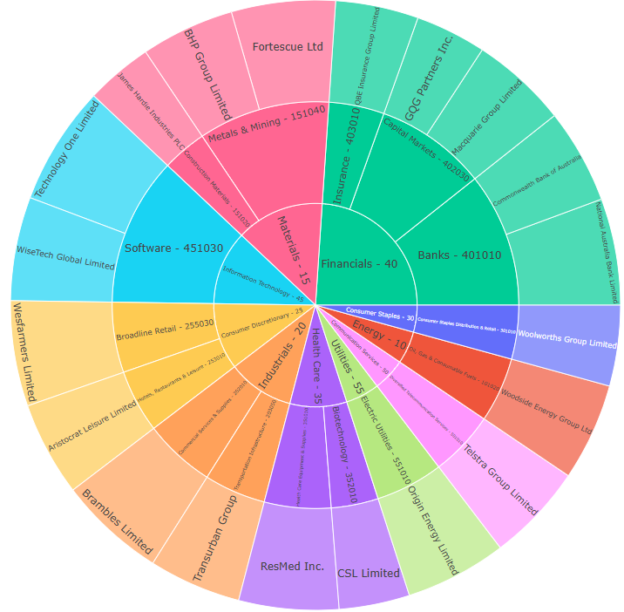
Atchison Direct Australian Equities
Exposure to all sectors and subsectors.
Low-cost, systematic, equal weighted portfolio consisting of 20 names, rebalanced quarterly.
Objective: Produce a total return (capital growth + dividend) greater than the ASX200, over +7 years.
Outperformed ASX20 and ASX200 over last 12 months and since inception.
Performance as of 31st August 2025 | 1 Year | 2 Years
Atchison Direct Australian Equities | 13.3 | 19.2
ASX20 | 12.5 | 15.2
ASX200 | 14.7 | 15
Peer Group | 11.3 | 11.4
Inflation | 1.9 | 2.3

Slide 12
Additional Questions
Investment suitability? Asset allocation? Changes?
Broadly suitable – pending your investment philosophy and client objectives
Greater concentrated diversification per holding in long duration, floating rate, and alternative sleeves would be beneficial relative to current portfolio.
Active fixed income managers provide alpha net of fees against index matching strategies on average. However, this current portfolio does not take advantage of this.
Floating rate exposure should be much higher, and long duration lower.
Alternatives exposure is way too concentrated in just gold.
Only active management is the Yarra Enhanced Income Fund
Direct Australian equities too concentrated in financials (banking)

Slide 13
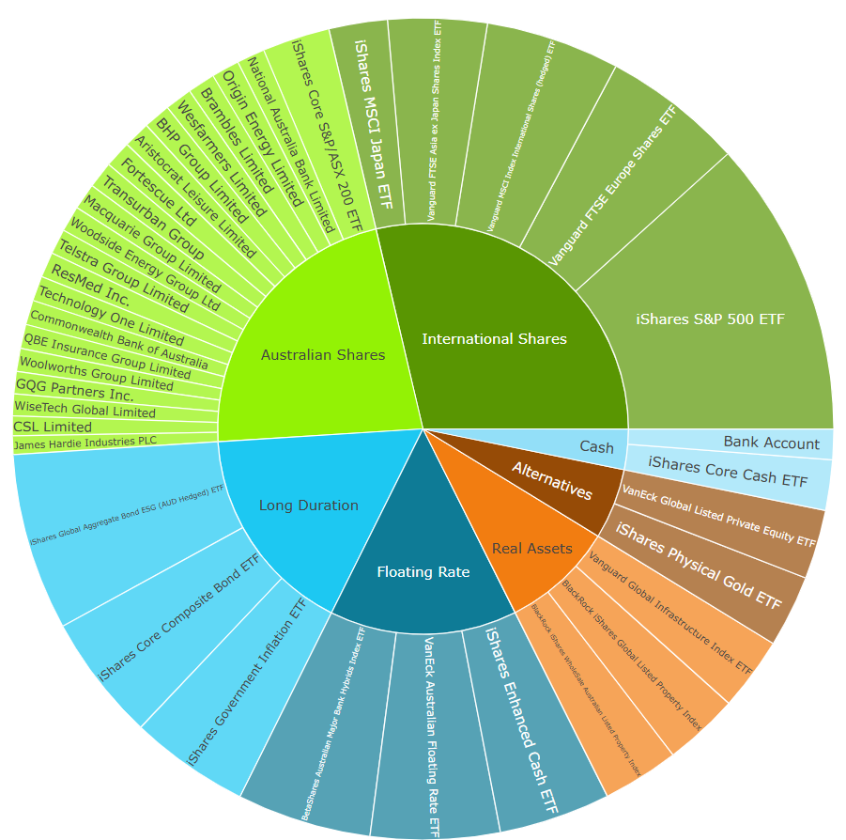
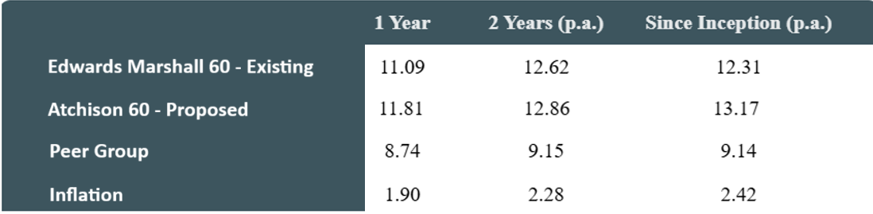
Additional Questions
Recommended portfolio?
Atchison Dynamic SMA with Australian Direct Equities
Atchison Dynamic 60 Portfolio
How does Atchison keep fees to a minimum?
Implement low-cost ETFs and assess other options available in the market.

Slide 14
3. Communication and Support

Slide 15
Ongoing Communication with clients
Quarterly check-ins, quarterly market updates, constant portfolio reviews.
Atchison Booklet: Bridging document highlighting Atchison as your investment arm.
Atchison Investment Suite: Clearly articulates what solutions are available for you and your team.
ROA / SOA wording and support: Streamlining onboarding process of Atchison SMA’s into your business.
Centralised Portal: Product Profiles, Monthly Performance Reports, Interactive Reports, SAA, TAA, Monthly Market Update, Monthly Indices, Portfolio Updates, Atchison Philosophy, APL, Regime Analysis, Portfolio Construction Framework.
HNW / UHNW client conversions Interactive portfolio assessment of existing vs Atchison portfolios

Slide 16
Investment Philosophy
Do you assist clients in developing a clear investment philosophy?
Yes, Atchison maintain our own Investment Philosophy and help develop / guide your firms investment philosophy.
This is achieved through understanding your businesses goals, values, client base, and risk tolerances.
How do you help clients communicate that investment philosophy to their end clients in a consistent and compelling way?
One page investment philosophy, designed and created by Atchison for EMFS.
Atchison SMA’s or Individual Asset Class Sleeves embody this philosophy.
Atchison portal – empowers your team with up-to-date data on any changes that occur within the portfolio.

Slide 17
Portfolio changes / adoption
How do you communicate portfolio changes to clients Email, portal updates, quarterly updates, phone calls. …explaining rationale One page investment philosophy, 2-page portfolio updates
…supporting client adoption and retention during transition?
Atchison booklet, comparative portfolio for HNW/UHNW, product profile, 2-page performance report, interactive in-depth reporting.

Slide 18
4. Additional Services

Slide 19
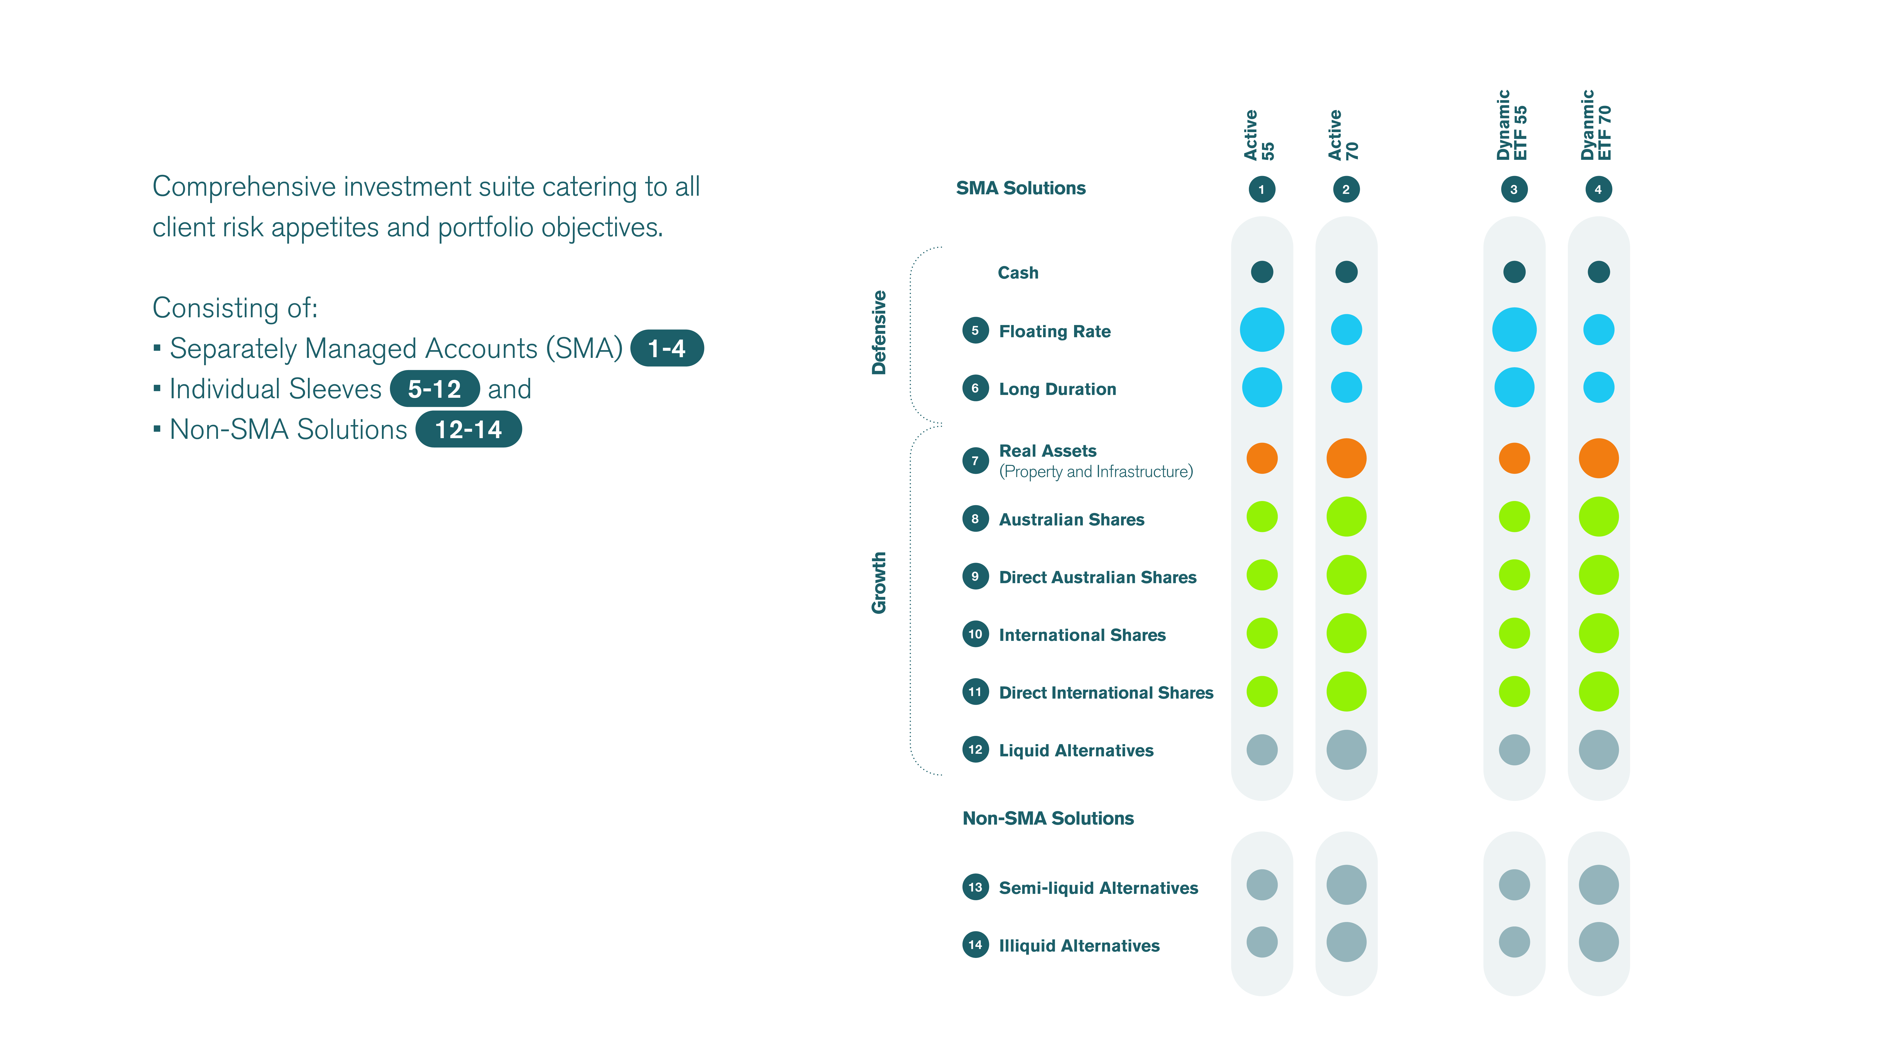
Atchison Investment Suite

Slide 20
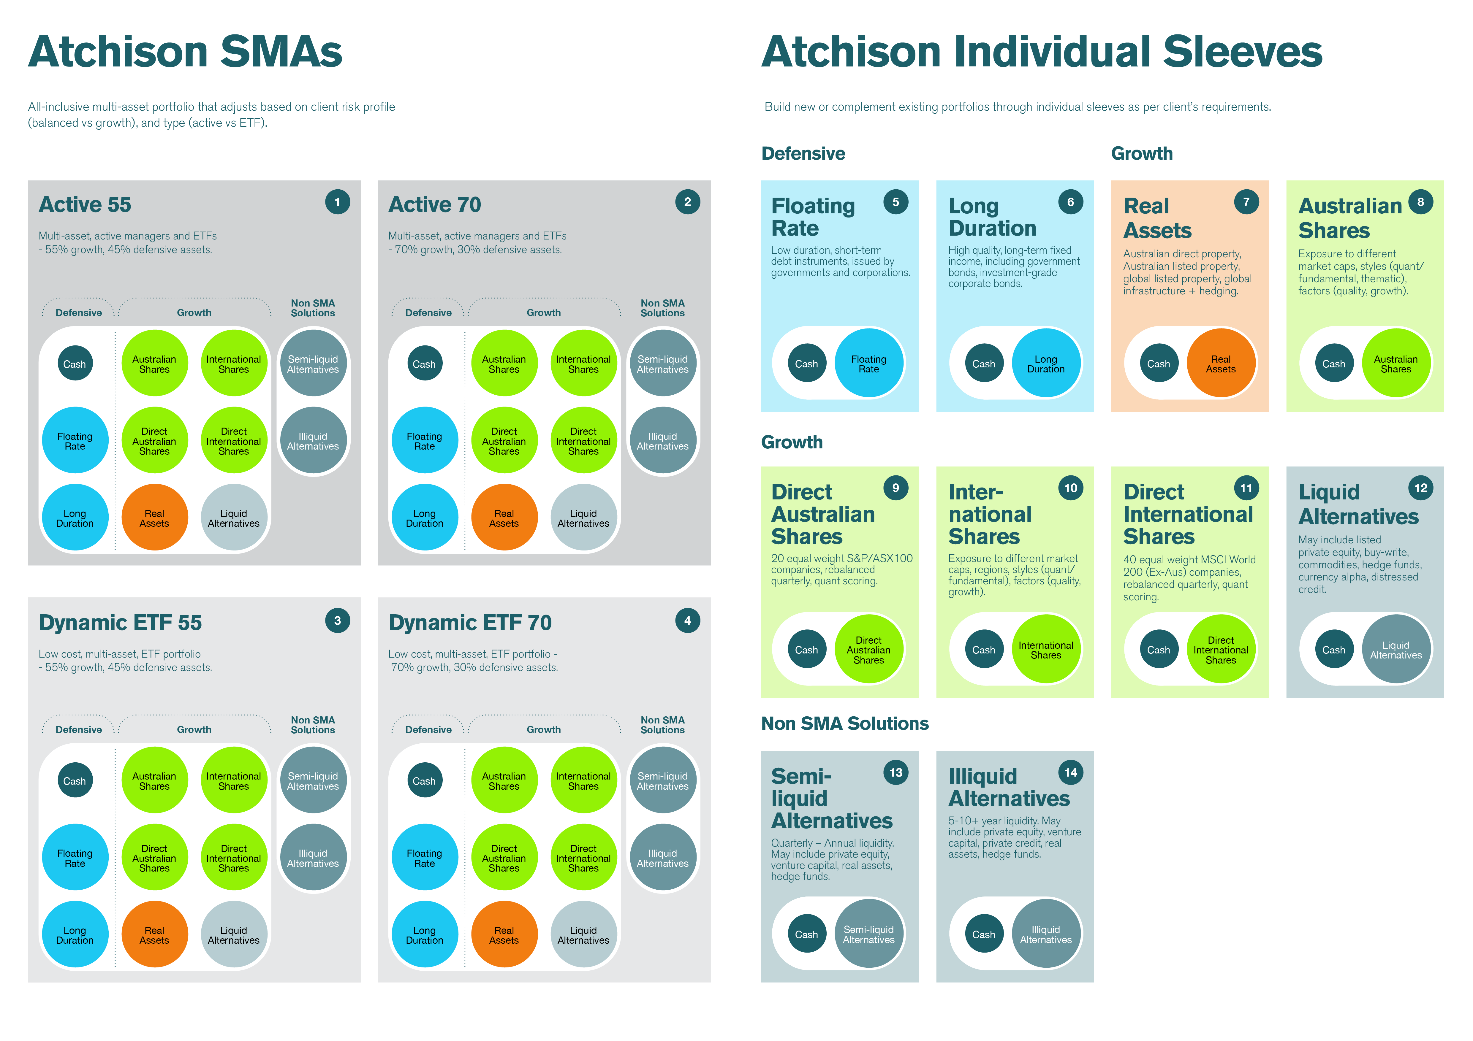
Active & Dynamic ETF SMAs

Slide 21
Individual Asset Class Sleeves

Slide 22
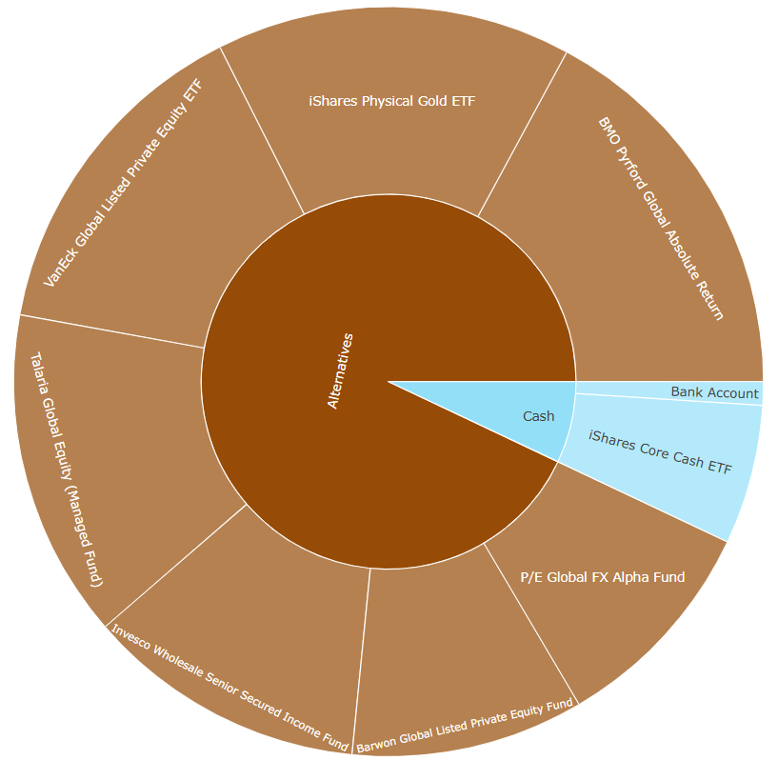
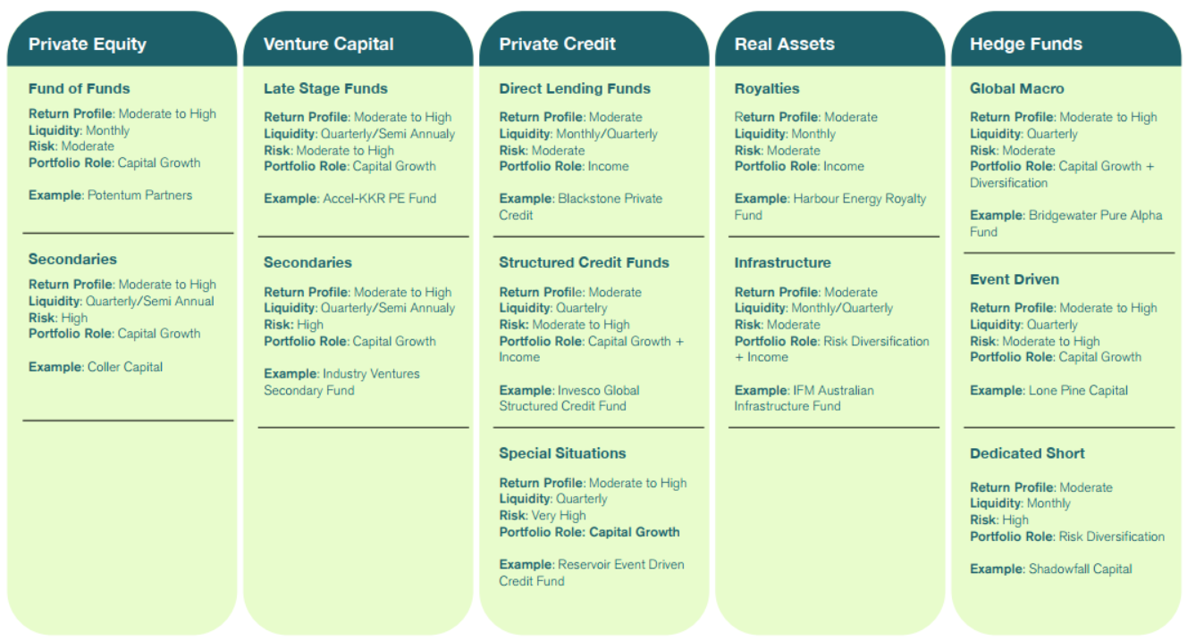
Atchison Alternatives
Atchison Liquid Alternatives
Atchison Semi-Liquid Alternatives

Slide 23
Additional Services
Atchison Approved Product List updates Review, maintain, update APL quarterly with any additions/removals
Portfolio reviews for HNW/UNHN clients Ad-hoc work to assist the transition of existing or new clients in the SMAs
Semi-liquid Alternative paper portfolio List of preferred semi-liquid alternative managers that have been approved / removed – eligible for use by EMFS.
Access to Inside Networks Global Study Tours 2025: USA Study Tour (Bostan, NY, LA), New Zealand Leaders Forum, Singapore INAsia Leaders, Brilliant Investment Committee Quarterly 2026: Alternatives, Equities and Growth, Income and Defensive, Tasmania ESG, New Zealand Leaders, USA or Europe Study Tour * flights and accommodation not included

Slide 24
5. Commercial Terms

Slide 25
Fee Structure
<$1B: 16bps >$1B: 15bps >$2B: 14bps >$3B: 13bps >$4B: 12bps >$5B: 11bps
$50,000 minimum fee per annum takes effect if the total FUM invested is less than $33,333,333 at the end of 12 months across all invested products.
Fees above do not include expenses and fees charged by Platforms. Specifically, any shelf-space fees charged by Platforms for SMAs created outside the existing Atchison Investment Suite will be chargeable.
Utilising the proposed solution will result in no implementation charge.

Slide 26
6. Proposed Solution

Slide 27
Proposed Solution
Atchison Dynamic Plus Suite
Atchison Dynamic SMA with Australian Direct Equities
This will cover different risk spectrums, i.e., balanced, growth, aggressive.
Access to Atchison Individual Asset Class Sleeves
At a later stage, potential to incorporate Systematic International Equities Portfolio
Why this solution?
Aligns with Edwards Marshall existing solutions and philosophy
Low fees, better performance
Maintain exposure to Australian direct equities
Access to Atchison Individual Asset Class Sleeves

Slide 28
STATEMENT OF ANALYST INTEREST AND CERTIFICATION, WARNING AND DISCLOSURE
Analyst Interest and Certification:
The Analyst(s) may hold an investment in any products discussed in this presentation. Atchison Consultants does not consider such holdings to be sufficiently material to compromise the information presented. The Analyst(s) certifies that with respect to content covered: (1) all of the views expressed accurately reflect his or her personal views; and (2) no part of his or her compensation was, is, or will be, directly or indirectly, related to the specific recommendations or views expressed by that research analyst in this presentation.
Warning (General Advice Only):
This presentation contains recommendations and advice of a general nature and does not have regard to the particular circumstances or needs of any specific person who may read it. Investors should assess either personally or with the assistance of a licensed financial adviser whether the Atchison Consultants recommendation or advice is appropriate to their situation before making an investment decision. The information contained in the report is believed to be reliable, but its completeness and accuracy is not guaranteed. Opinions expressed may change without notice. Atchison Consultants does not accept any liability, whether direct or indirect arising from the use of information contained in this report. No part of this presentation is to be construed as a solicitation to buy or sell any investment. Atchison Consultants does not accept any responsibility to inform you of any matter that subsequently comes to its notice, which may affect any of the information contained in this presentation. The performance of any investment in this presentation is not a representation as to future performance or likely return.
Disclosure (Commissioned Research):
Atchison Consultants may or may not have received a fixed fee and/or travel expenses for the presentation and or presentation material. Atchison Consultants has no direct or indirect interest in the success or otherwise of any investments referred to in this presentation.
ATCHISON CONSULTANTS
Atchison Consultants was established in 2001 by Ken Atchison and consists of a team of investment professionals with extensive experience in all aspects of financial markets. The principal focus of the business is the provision of advice and analysis across all components of managing investment portfolios by financial institutions, superannuation and insurance funds and investment managers. Primarily this involves property, or real estate, investments and related mortgage investments. Atchison Consultants’ services and capabilities cover two distinct areas being asset consulting and investment management consulting, with a focus on the property asset class.
Licence
TAG Asset Consulting Group Pty Ltd (ABN 58 097 703 047), trading as Atchison Consultants, is the holder of Australian Financial Services Licence Number 230846.
Contact Details
Atchison Consultants
Level 4, 125 Flinders Lane, Melbourne, Victoria 3000
Phone: +61 3 9642 3835
Fax: +61 3 9642 8886
Email: enquires@atchison.com.au
Website: www.atchison.com.au

