Slide 1

Atchison & Edwards Marshall Financial Solutions
Presenters:
Kev Toohey – Partner
Jake Jodlowski - Principal
Mishan Dahia – Research & Investment Analyst
9 October 2025
Atchison - Edwards Marshall Portal

Slide 2
1. Firm Overview

Slide 3
Company Background:
Founded in Melbourne in 2001, with satellite offices in Perth and Sydney.
Ownership: 100% owned by management – totally independent.
Specialize in the construction and management of Separately Managed Accounts.
Asset Consulting services (research, investment and governance solutions) to superannuation funds, wealth management groups, charities, foundations, endowment funds, platforms and trustees.
Assets under advice and management in excess of A$31 billion.

Slide 4
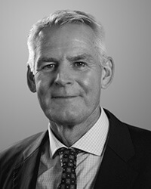

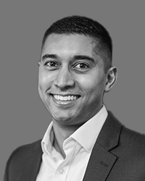
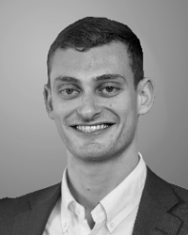

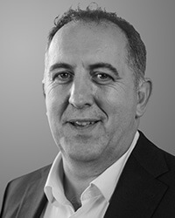
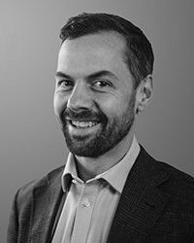
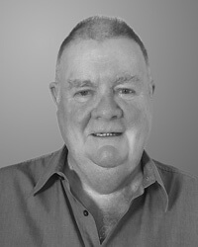
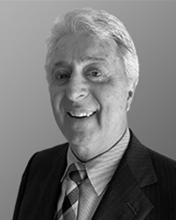
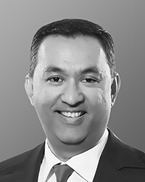
Key Personnel
Our linear structure ensures all members of Atchison can be effectively involved in contributing to maximising investment outcomes for our clients. All team members provide high quality research, advice, and both customised solutions and model portfolios.
Jake Jodlowski Principal
Kev Toohey Principal
Mishan Dahia Research & Investment Analyst
Nick Hatzis Investment Analyst
Ye Peng Developer & Data Analyst
Jamie Nemtsas Director
Drew Meredith Director
Terry Toohey Senior Consultant
Peter Williamson Principal (Perth)
Rohan Shan Senior Consultant

Slide 5
Atchison – Value-add
Our value proposition has not changed since 2001, nor is it a static statement but evolves with each client relationship and requirement - a testament of Atchison’s plus 24 years of providing economic value to clients.
Our focus is on assisting our clients to increase return on investment made within acceptable risk parameters, across defined timeframe. We understand that clients seek outcomes, not just services.
Atchison’s methodology is to assess each client’s objectives and work alongside to achieve corporate and investment objectives.

Slide 6
Key Differentiation
Institutional grade service: research, portfolio construction, fee negotiation, investment performance.
Strong on Governance, Risk and Compliance: APRA/ASIC.
Investment Committee support: best practice, charter, roles, responsibilities.
Support, research & education: 24/7 access to Atchison Team, outside of SMA.
Face-to face: In Adelaide monthly to service existing client (institutional).
Total SMA transparency: Web-linked link portal to portfolios (training provided).
Backend onboarding support: SOA, ROA wording + best practice implementation.
Full SMA investment suite: On CFS (multi-asset & single asset classes).
Additional support: Inside Network (PR), Capital Outcomes (Events)

Slide 7
2. Additional Questions – Grant Edwards

Slide 8
1. Does Atchison outperform Peers / Benchmarks?
Data as of 30th September 2025

Slide 9
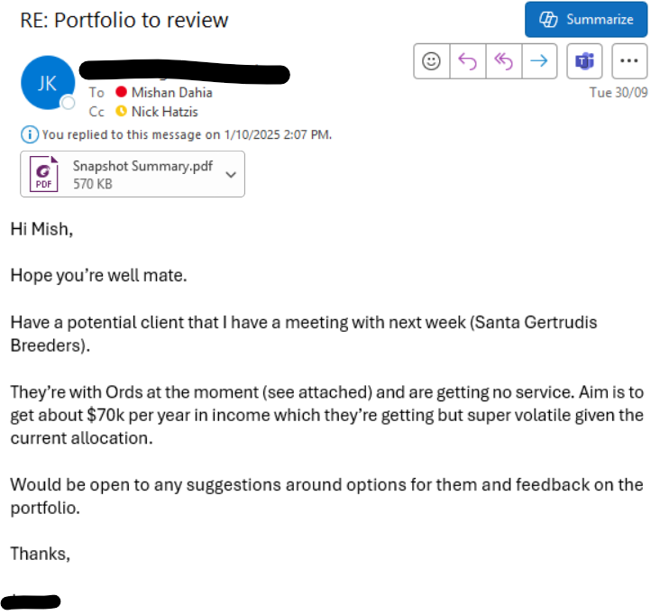
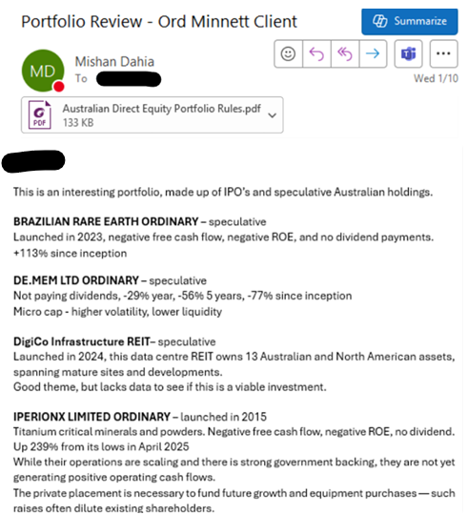


2. How does Atchison help Edwards Marshall outside of managed accounts?
We stress test / provide commentary on client’s portfolios.
We factor in your client’s risk profile and objectives when suggesting preferred portfolios.

Slide 10
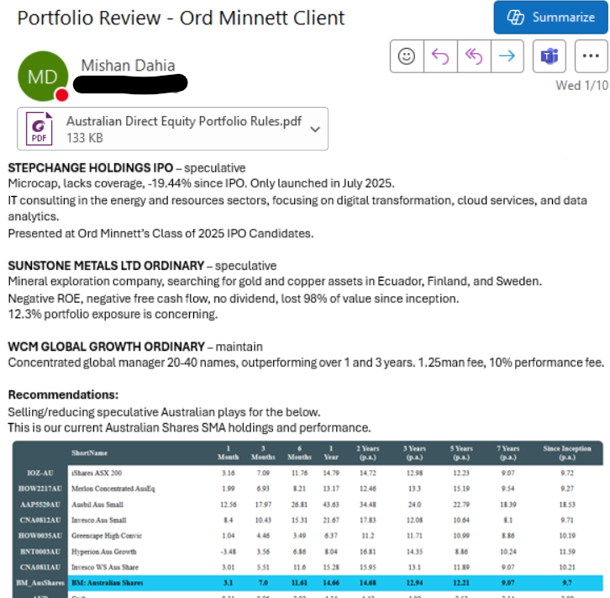
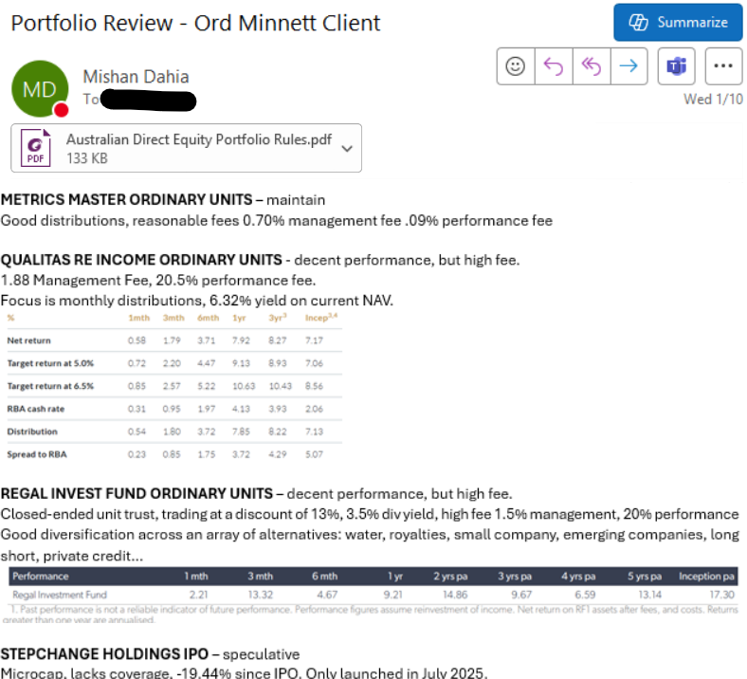
2. How does Atchison help Edwards Mashall outside of managed accounts?

Slide 11
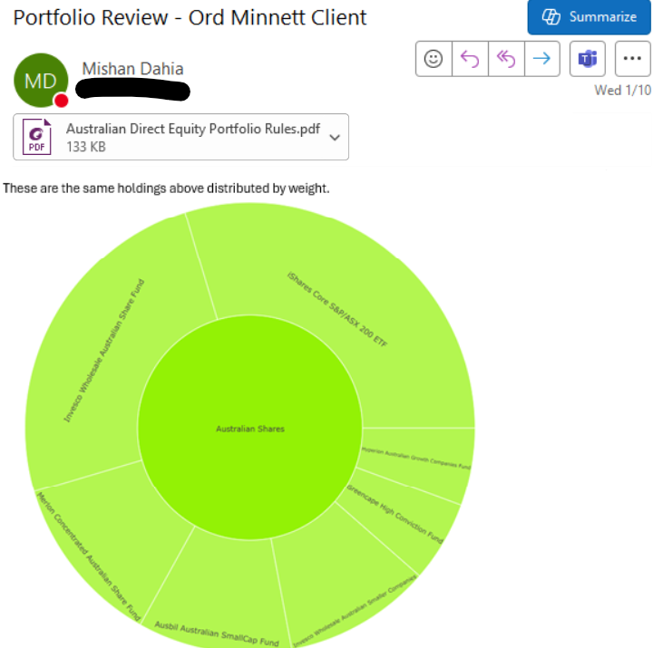
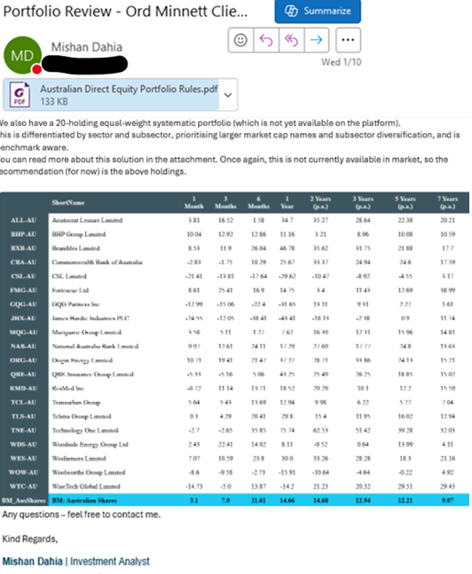
2. How does Atchison help Edwards Mashall outside of managed accounts?

Slide 12
3. Edwards Marshall is looking for an outsourced CIO, is that what Atchison is?
Yes. We provide outsourced-CIO functions to multiple partners. We appreciate that your client solution and offering needs to be broader than the core SMA solutions.
4. How will you help build out and articulate our investment philosophy?
Philosophical Alignment: Atchison seek to understand your values, goals, investment beliefs, client base, target market, 20-year objectives, what’s working / what’s not.
Investment Framework Development: Outlining core principles including, asset allocation, diversification, risk management, active vs passive vs direct equities vs illiquid alternatives.
Communication and Integration: We help translate the investment philosophy into consistent messaging across client documents, presentations, onboarding materials, and advice processes.

Slide 13
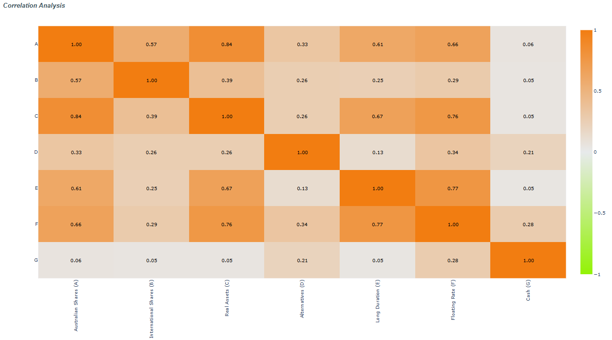
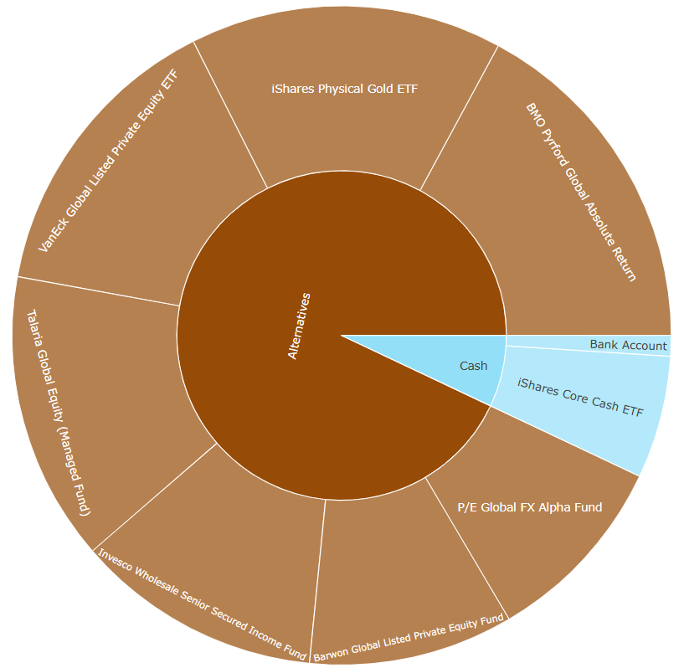
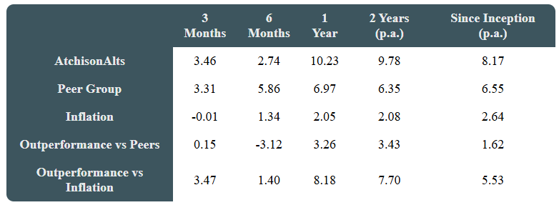
5. How does Atchison help with HNW clients seeking alternative assets / private market solutions that are not in the managed accounts?
One solution is the already available Atchison Liquid Alternatives Sleeve to complement existing managed accounts.

Slide 14
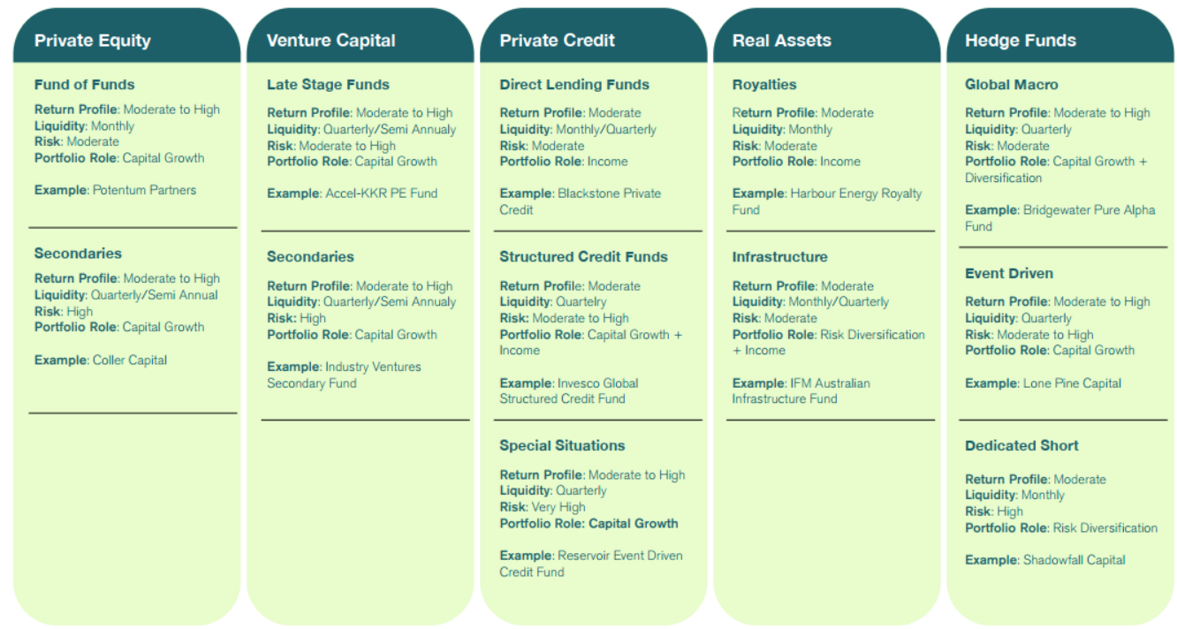
5. How does Atchison help with HNW clients seeking alternative assets / private market solutions that are not in the managed accounts?
Additionally, Atchison offers Semi-Liquid Alternatives as a paper portfolio. We seek asset class differentiation and sub asset class exposures for true drivers of uncorrelated returns within portfolios.

Slide 15
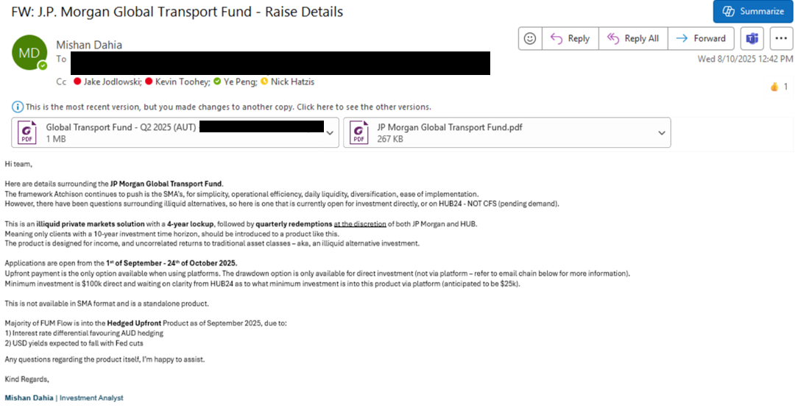
5. How does Atchison help with HNW clients seeking alternative assets / private market solutions that are not in the managed accounts?

Slide 16
3. Establishing an Investment Philosophy

Slide 17
Investment Philosophy
Do you assist clients in developing a clear investment philosophy?
Yes, Atchison maintain our own Investment Philosophy and help develop / guide your firms investment philosophy.
This is achieved through understanding your businesses goals, values, client base, and risk tolerances.
How do you help clients communicate that investment philosophy to their end clients in a consistent and compelling way?
One page investment philosophy, designed and created by Atchison for EMFS.
Atchison SMA’s or Individual Asset Class Sleeves embody this philosophy.
Atchison portal – empowers your team with up-to-date data on any changes that occur within the portfolio.

Slide 18
Atchison’s Philosophy - Guiding Lights
Start and end with risk: Focus on compensated risk only; avoid hidden or style-based risks that don’t add value.
Asset allocation is the key return driver: Strategic and dynamic allocation decisions drive ~90% of long-term performance.
Active management has a role: Select true active managers (with high active share) who can improve returns and reduce volatility.
Automated rebalancing matters: Rebalancing should be systematic and rules-based to enforce discipline (buy low, sell high) and minimize behavioural risk.
Liquidity adds value: Liquidity enables rebalancing, adaptability, and resilience — especially in higher rate environments.
Trust in mean reversion: Markets revert to long-term trends over time — portfolios should not overreact to short-term themes or extrapolated narratives.
Costs and turnover matter: Long-term returns are impacted by excessive trading, fees, and tax drag — avoid unnecessary churn.
Always have an exit strategy: Every investment decision must have a clear exit framework — avoid emotion-driven decisions.

Slide 19
4. Atchison’s Investment Process

Slide 20
Atchison’s Investment Process
Short and long-term views of the market through SAA and TAA.
Set Return, Vol/Risk and Horizon targets.
In-house python models testing thousands of different portfolio scenarios and outcomes.
Select specialist managers or ETFs for each asset class.
Each asset is measured and combined using our stress testing framework, assessing risk/return and correlation metrics.
Final positions are overlayed to best meet whole of portfolio top-down and bottom-up constraints.
We track performance daily and alert you of any important changes.
1. Market Outlook
2. Portfolio Objectives
3. Stress Test and Optimise
4. Build Sector Portfolios
5. Bottom-up risk analysis
7. Monitor
6. Refine

Slide 21
5. Example Investment Committee
LINK HERE: Atchison - Edwards Marshall IC Agenda & Materials

Slide 22
6. Communication:
Supporting EMFS & Client Journey

Slide 23
Communication: Adviser & Client Journey
Daily Market Updates
Monthly Indices
Tactical Asset Allocation
Strategic Asset Allocation
Daily emails that keep advisers informed on overnight market moves to support timely client conversations.
Tracks benchmark performance across regions and asset classes.
Quarterly portfolio positioning based on a 12–18 month forward-looking asset class view.
10-year forecast of markets, using proprietary mean variance optimisation and stress testing model.
Monthly Market Updates
Digestible summary of key market themes to inform adviser commentary and strategy.
Provides additional thematic insights into gaming, Bitcoin, and healthcare.

Slide 24
Communication: Adviser & Client Journey
Approved Product List
Adviser & Client Relationship (meeting one)
Adviser & Client Relationship (meeting two)
A list of investment products available to advisers for client use outside of the SMA framework.
Atchison Booklet: Take home booklet outlining RP’s Investment Arm.
Product 2 Pager: Overview of the product.
Interactive Adviser Portal
A centralised web portal, giving advisers access to all relevant investment resources in one place.
Performance Reports: Overview of performance of relevant solution.

Slide 25
7. Onboarding Framework

Slide 26
Example - Onboarding Framework
Define investment philosophy: Align on beliefs, goals, values, mandate, and pricing.
Approve product list: Governance-led APL and conduct integration.
Set strategic asset allocation: Model and test long-term SAA.
Construct portfolios: Design and validate portfolio structures.
Integrate tactical allocation: Apply flexible TAA where required.
Transition and communicate: Manage client transition and messaging.
Implement and support: Ongoing execution and adviser support.

Slide 27
STATEMENT OF ANALYST INTEREST AND CERTIFICATION, WARNING AND DISCLOSURE
Analyst Interest and Certification:
The Analyst(s) may hold an investment in any products discussed in this presentation. Atchison Consultants does not consider such holdings to be sufficiently material to compromise the information presented. The Analyst(s) certifies that with respect to content covered: (1) all of the views expressed accurately reflect his or her personal views; and (2) no part of his or her compensation was, is, or will be, directly or indirectly, related to the specific recommendations or views expressed by that research analyst in this presentation.
Warning (General Advice Only):
This presentation contains recommendations and advice of a general nature and does not have regard to the particular circumstances or needs of any specific person who may read it. Investors should assess either personally or with the assistance of a licensed financial adviser whether the Atchison Consultants recommendation or advice is appropriate to their situation before making an investment decision. The information contained in the report is believed to be reliable, but its completeness and accuracy is not guaranteed. Opinions expressed may change without notice. Atchison Consultants does not accept any liability, whether direct or indirect arising from the use of information contained in this report. No part of this presentation is to be construed as a solicitation to buy or sell any investment. Atchison Consultants does not accept any responsibility to inform you of any matter that subsequently comes to its notice, which may affect any of the information contained in this presentation. The performance of any investment in this presentation is not a representation as to future performance or likely return.
Disclosure (Commissioned Research):
Atchison Consultants may or may not have received a fixed fee and/or travel expenses for the presentation and or presentation material. Atchison Consultants has no direct or indirect interest in the success or otherwise of any investments referred to in this presentation.
ATCHISON CONSULTANTS
Atchison Consultants was established in 2001 by Ken Atchison and consists of a team of investment professionals with extensive experience in all aspects of financial markets. The principal focus of the business is the provision of advice and analysis across all components of managing investment portfolios by financial institutions, superannuation and insurance funds and investment managers. Primarily this involves property, or real estate, investments and related mortgage investments. Atchison Consultants’ services and capabilities cover two distinct areas being asset consulting and investment management consulting, with a focus on the property asset class.
Licence
TAG Asset Consulting Group Pty Ltd (ABN 58 097 703 047), trading as Atchison Consultants, is the holder of Australian Financial Services Licence Number 230846.
Contact Details
Atchison Consultants
Level 4, 125 Flinders Lane, Melbourne, Victoria 3000
Phone: +61 3 9642 3835
Fax: +61 3 9642 8886
Email: enquires@atchison.com.au
Website: www.atchison.com.au

Slide 28
8. Current Portfolio Review

Slide 29
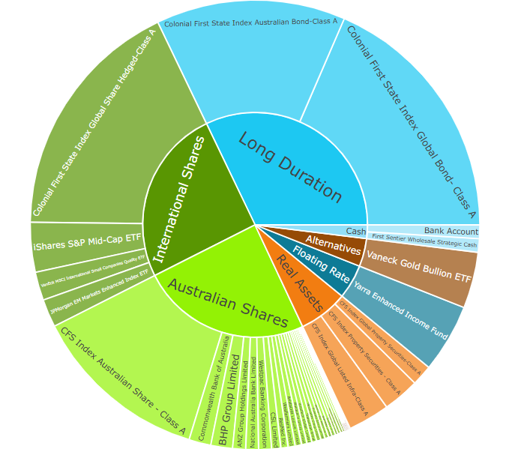
Structural Concerns – Total Portfolio
EMFS:
Too much Long Duration exposure = heightened interest rate sensitivity.
Floating rate exposure too low and too concentrated to one name.
Concentrated gold exposure. Opportunity for differentiated return drivers through greater diversification in Alternatives.
75+% Equities and Duration exposure.

Slide 30
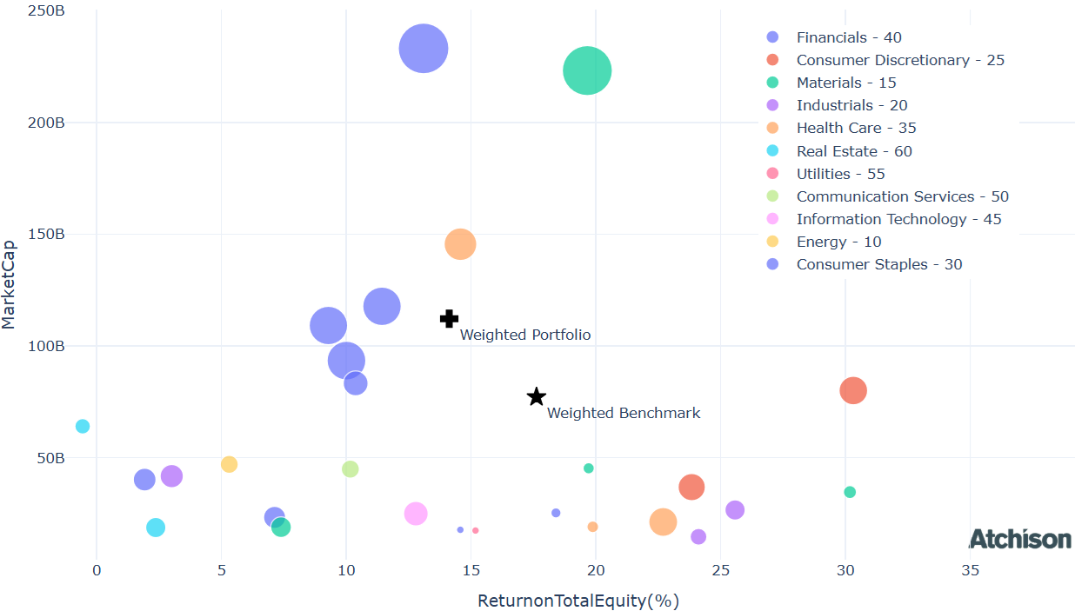
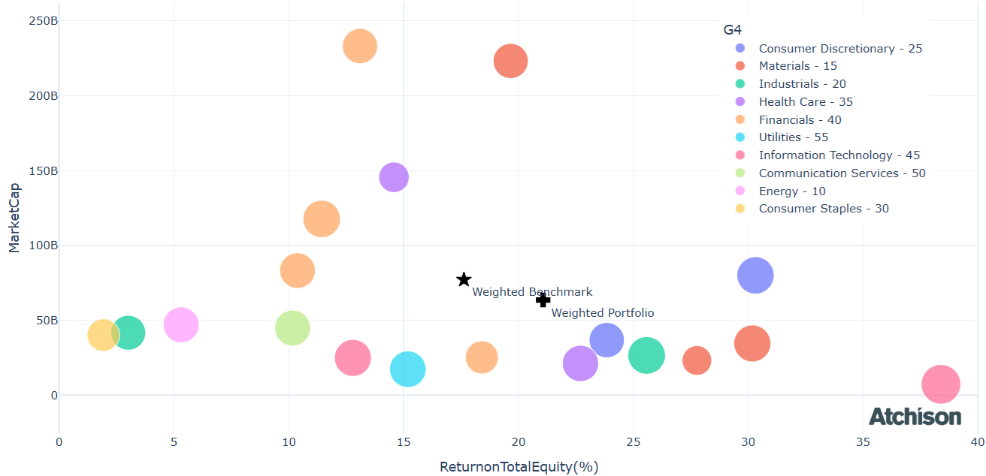
Structural Concerns
EMFS:
Cochlea (COH), Fortescue (FMG), Insurance Australian Group (IAG), Origin Energy (ORG), QBE Insurance Group (QBE), Rio Tinto Ltd (RIO) each holding is < 0.1% weight in the total portfolio.
Each of these positions holds a value between $314 - $882 in a total $1M portfolio.
These positions add little to no value in the total portfolio
Atchison:
Greater diversification and alpha generation potential through, sector, sub-sector, weighting
EMFS Australian Equities
Atchison 20 Equal Weighted Direct Equities

Slide 31
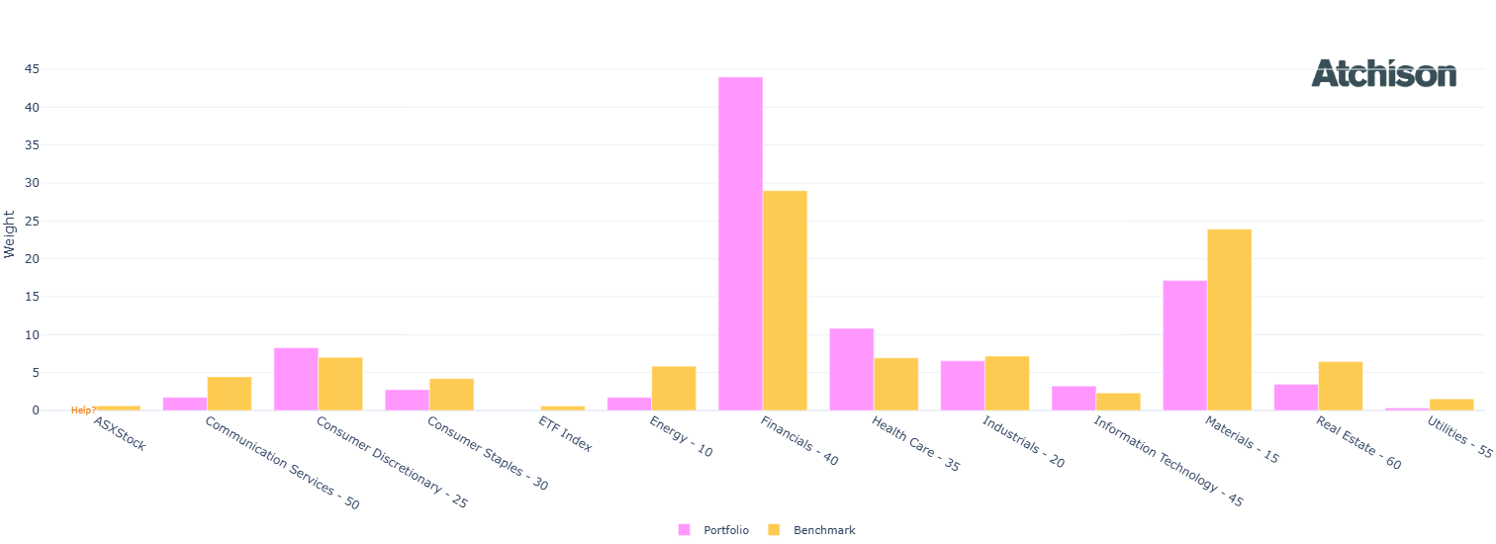
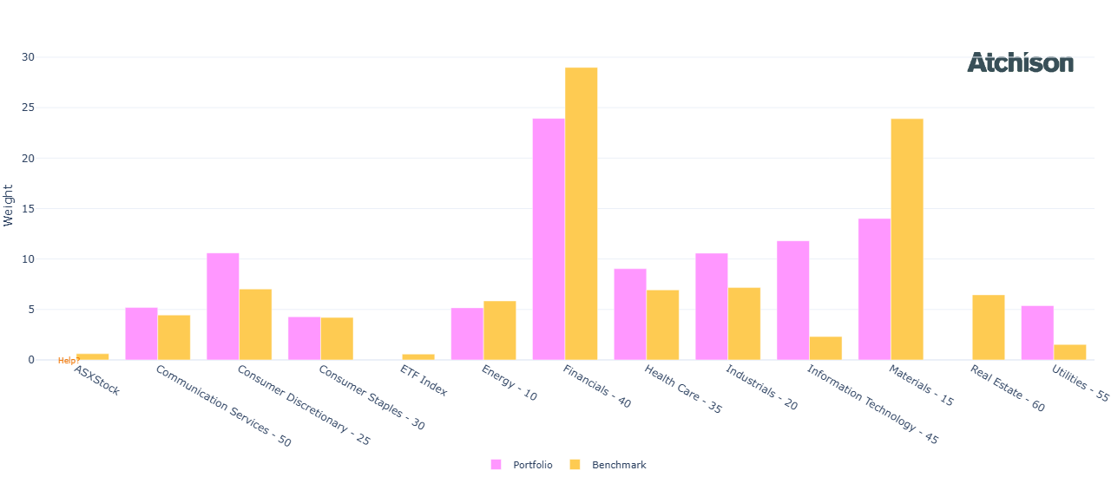
Structural Concerns – Australian Equities
EMFS:
O/W financials
Atchison:
U/W financials
U/W materials
Greater exposure to all sectors

Slide 32
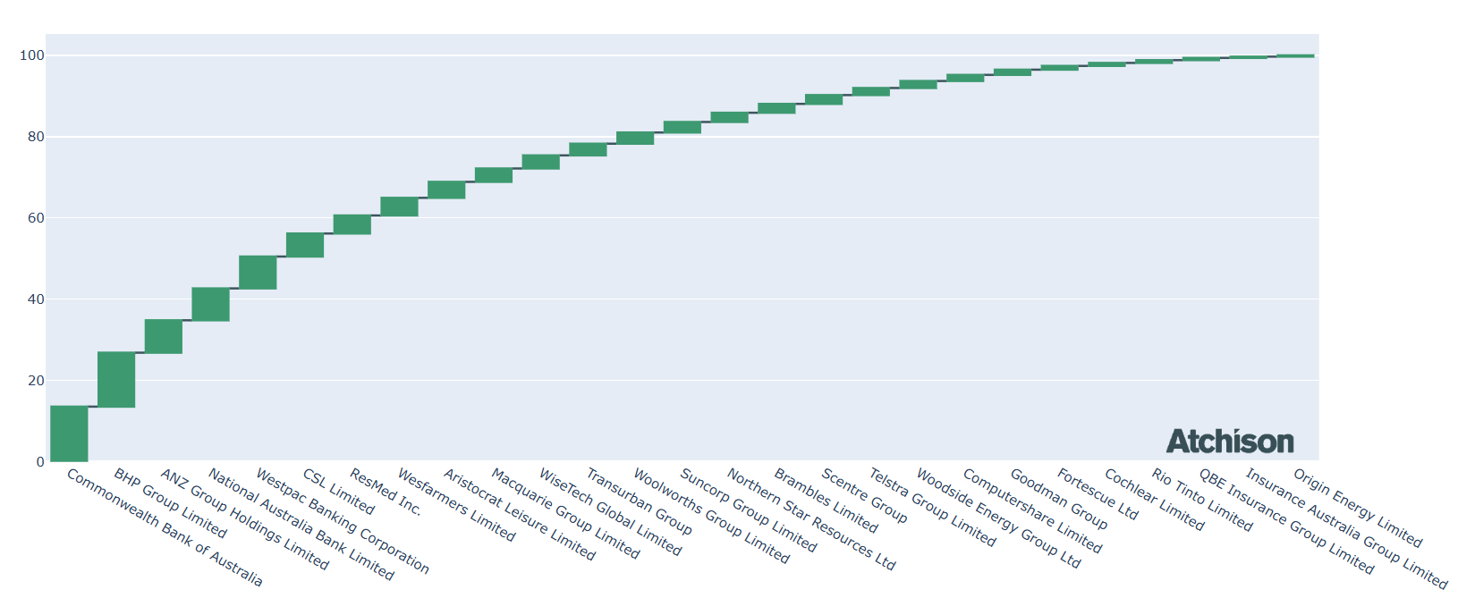
Structural Concerns – Australian Equities
Edwards Marshall – Australian Equities
Return on Equity:
14.03 EMFS, 21.01 Atchison
Yield
5% EMFS, 5.9% Atchison
Concentration:
EMFS - O/W Financials, particularly big four banks 7 names make up 60% of the portfolio, 4 of these names are major banks
Atchison – Split sectors into subcategories. Financials: Banks (CBA), Financial services (GQG), Insurance (QBE)

Slide 33
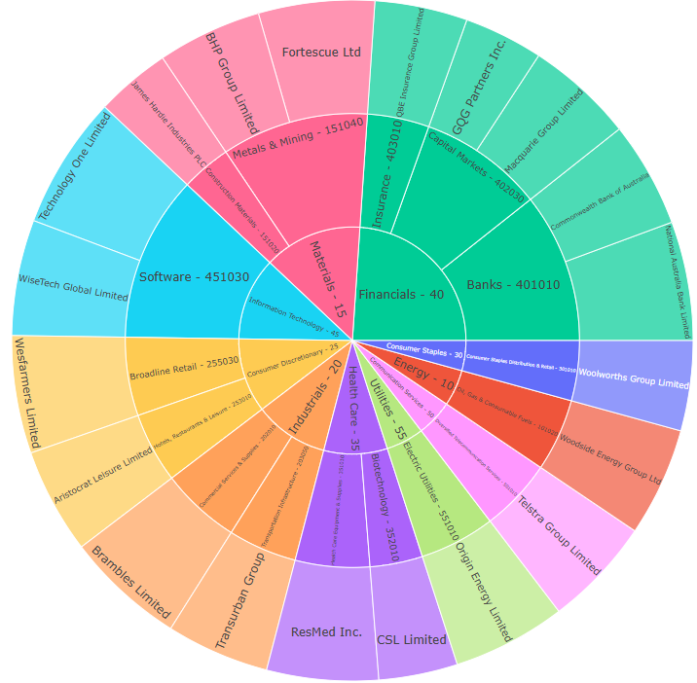
Atchison Direct Australian Equities
Exposure to all sectors and subsectors.
Low-cost, systematic, equal weighted portfolio consisting of 20 names, rebalanced quarterly.
Objective: Produce a total return (capital growth + dividend) greater than the ASX200, over +7 years.
Outperformed ASX20 and ASX200 over last 12 months and since inception.
Performance as of 31st August 2025 | 1 Year | 2 Years
Atchison Direct Australian Equities | 13.3 | 19.2
ASX20 | 12.5 | 15.2
ASX200 | 14.7 | 15
Peer Group | 11.3 | 11.4
Inflation | 1.9 | 2.3

Slide 34
Additional Questions
Investment suitability? Asset allocation? Changes?
Broadly suitable – pending your investment philosophy and client objectives
Greater concentrated diversification per holding in long duration, floating rate, and alternative sleeves would be beneficial relative to current portfolio.
Active fixed income managers provide alpha net of fees against index matching strategies on average. However, this current portfolio does not take advantage of this.
Floating rate exposure should be much higher, and long duration lower.
Alternatives exposure is way too concentrated in just gold.
Only active management is the Yarra Enhanced Income Fund
Direct Australian equities too concentrated in financials (banking)

Slide 35
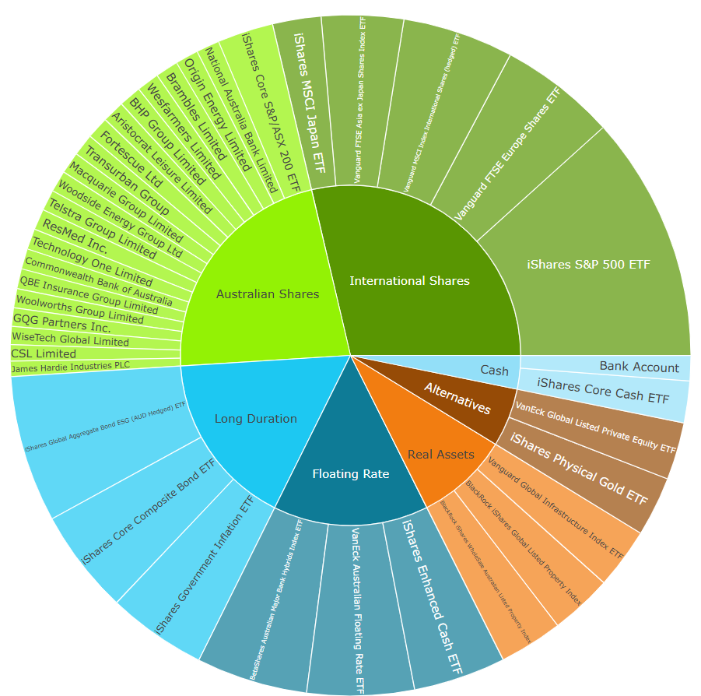
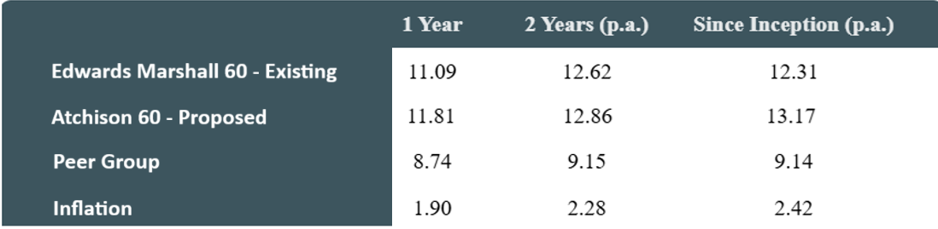
Additional Questions
Recommended portfolio?
Atchison Dynamic SMA with Australian Direct Equities
Atchison Dynamic 60 Portfolio
How does Atchison keep fees to a minimum?
Implement low-cost ETFs and assess other options available in the market.

Slide 36
9. Additional Services

Slide 37
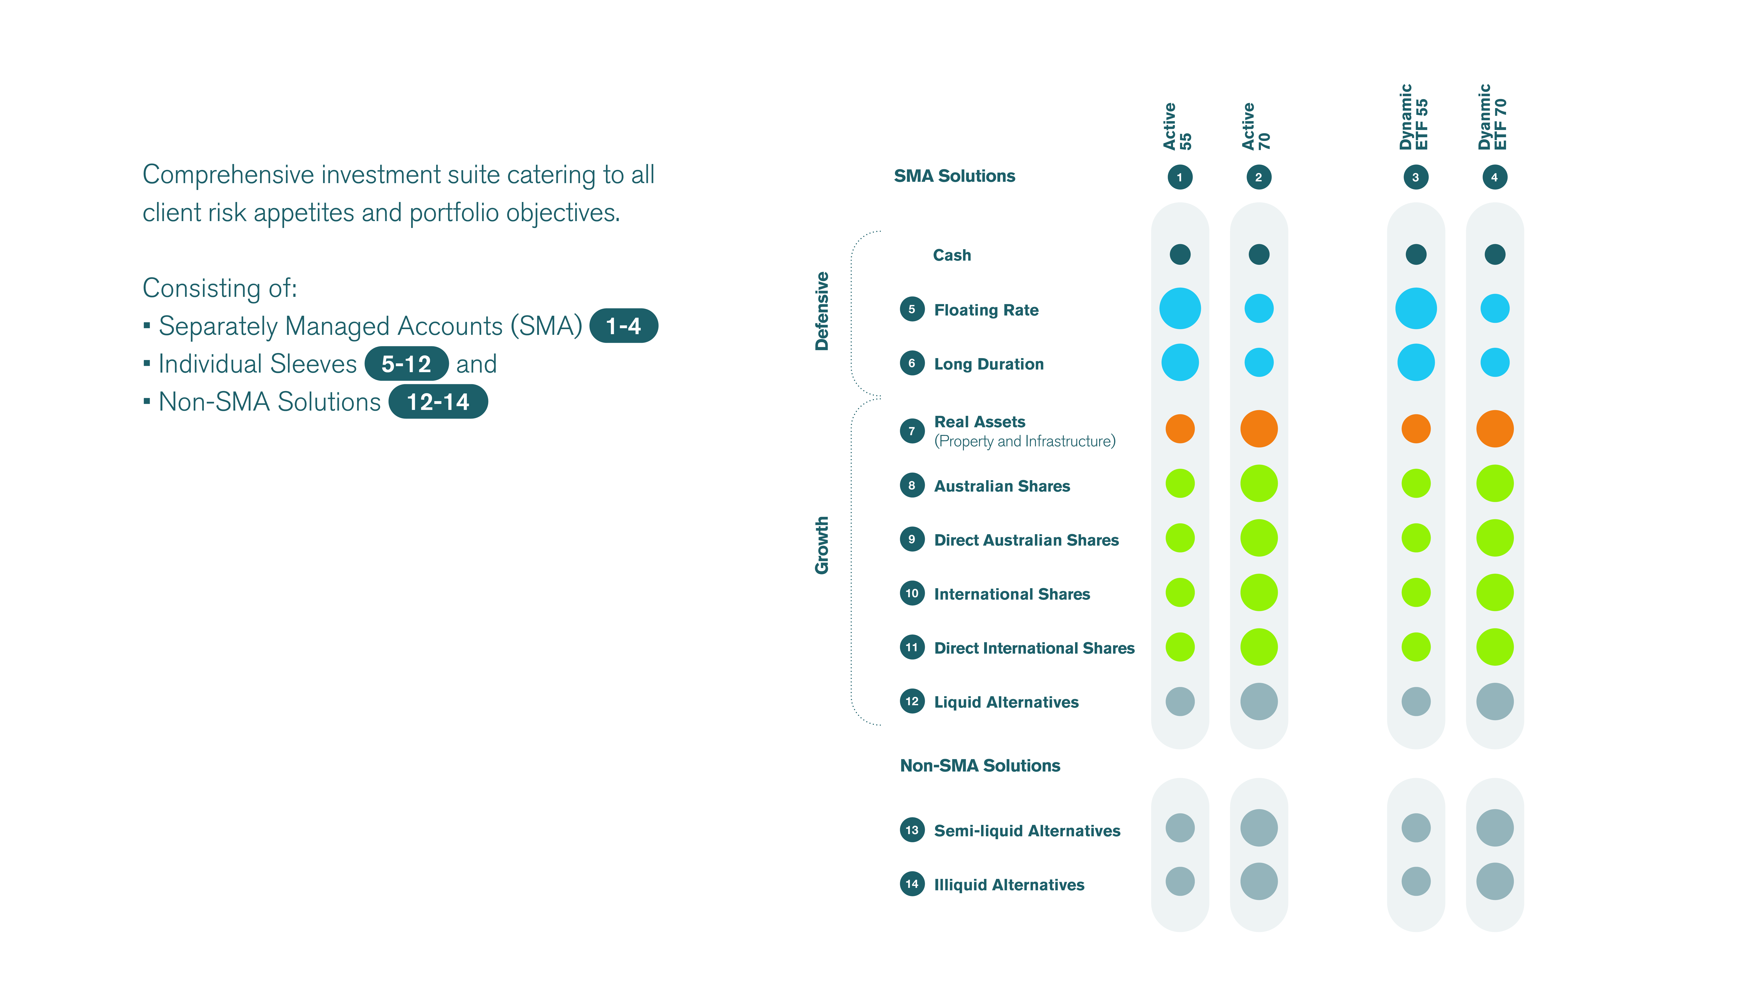
Atchison Investment Suite

Slide 38
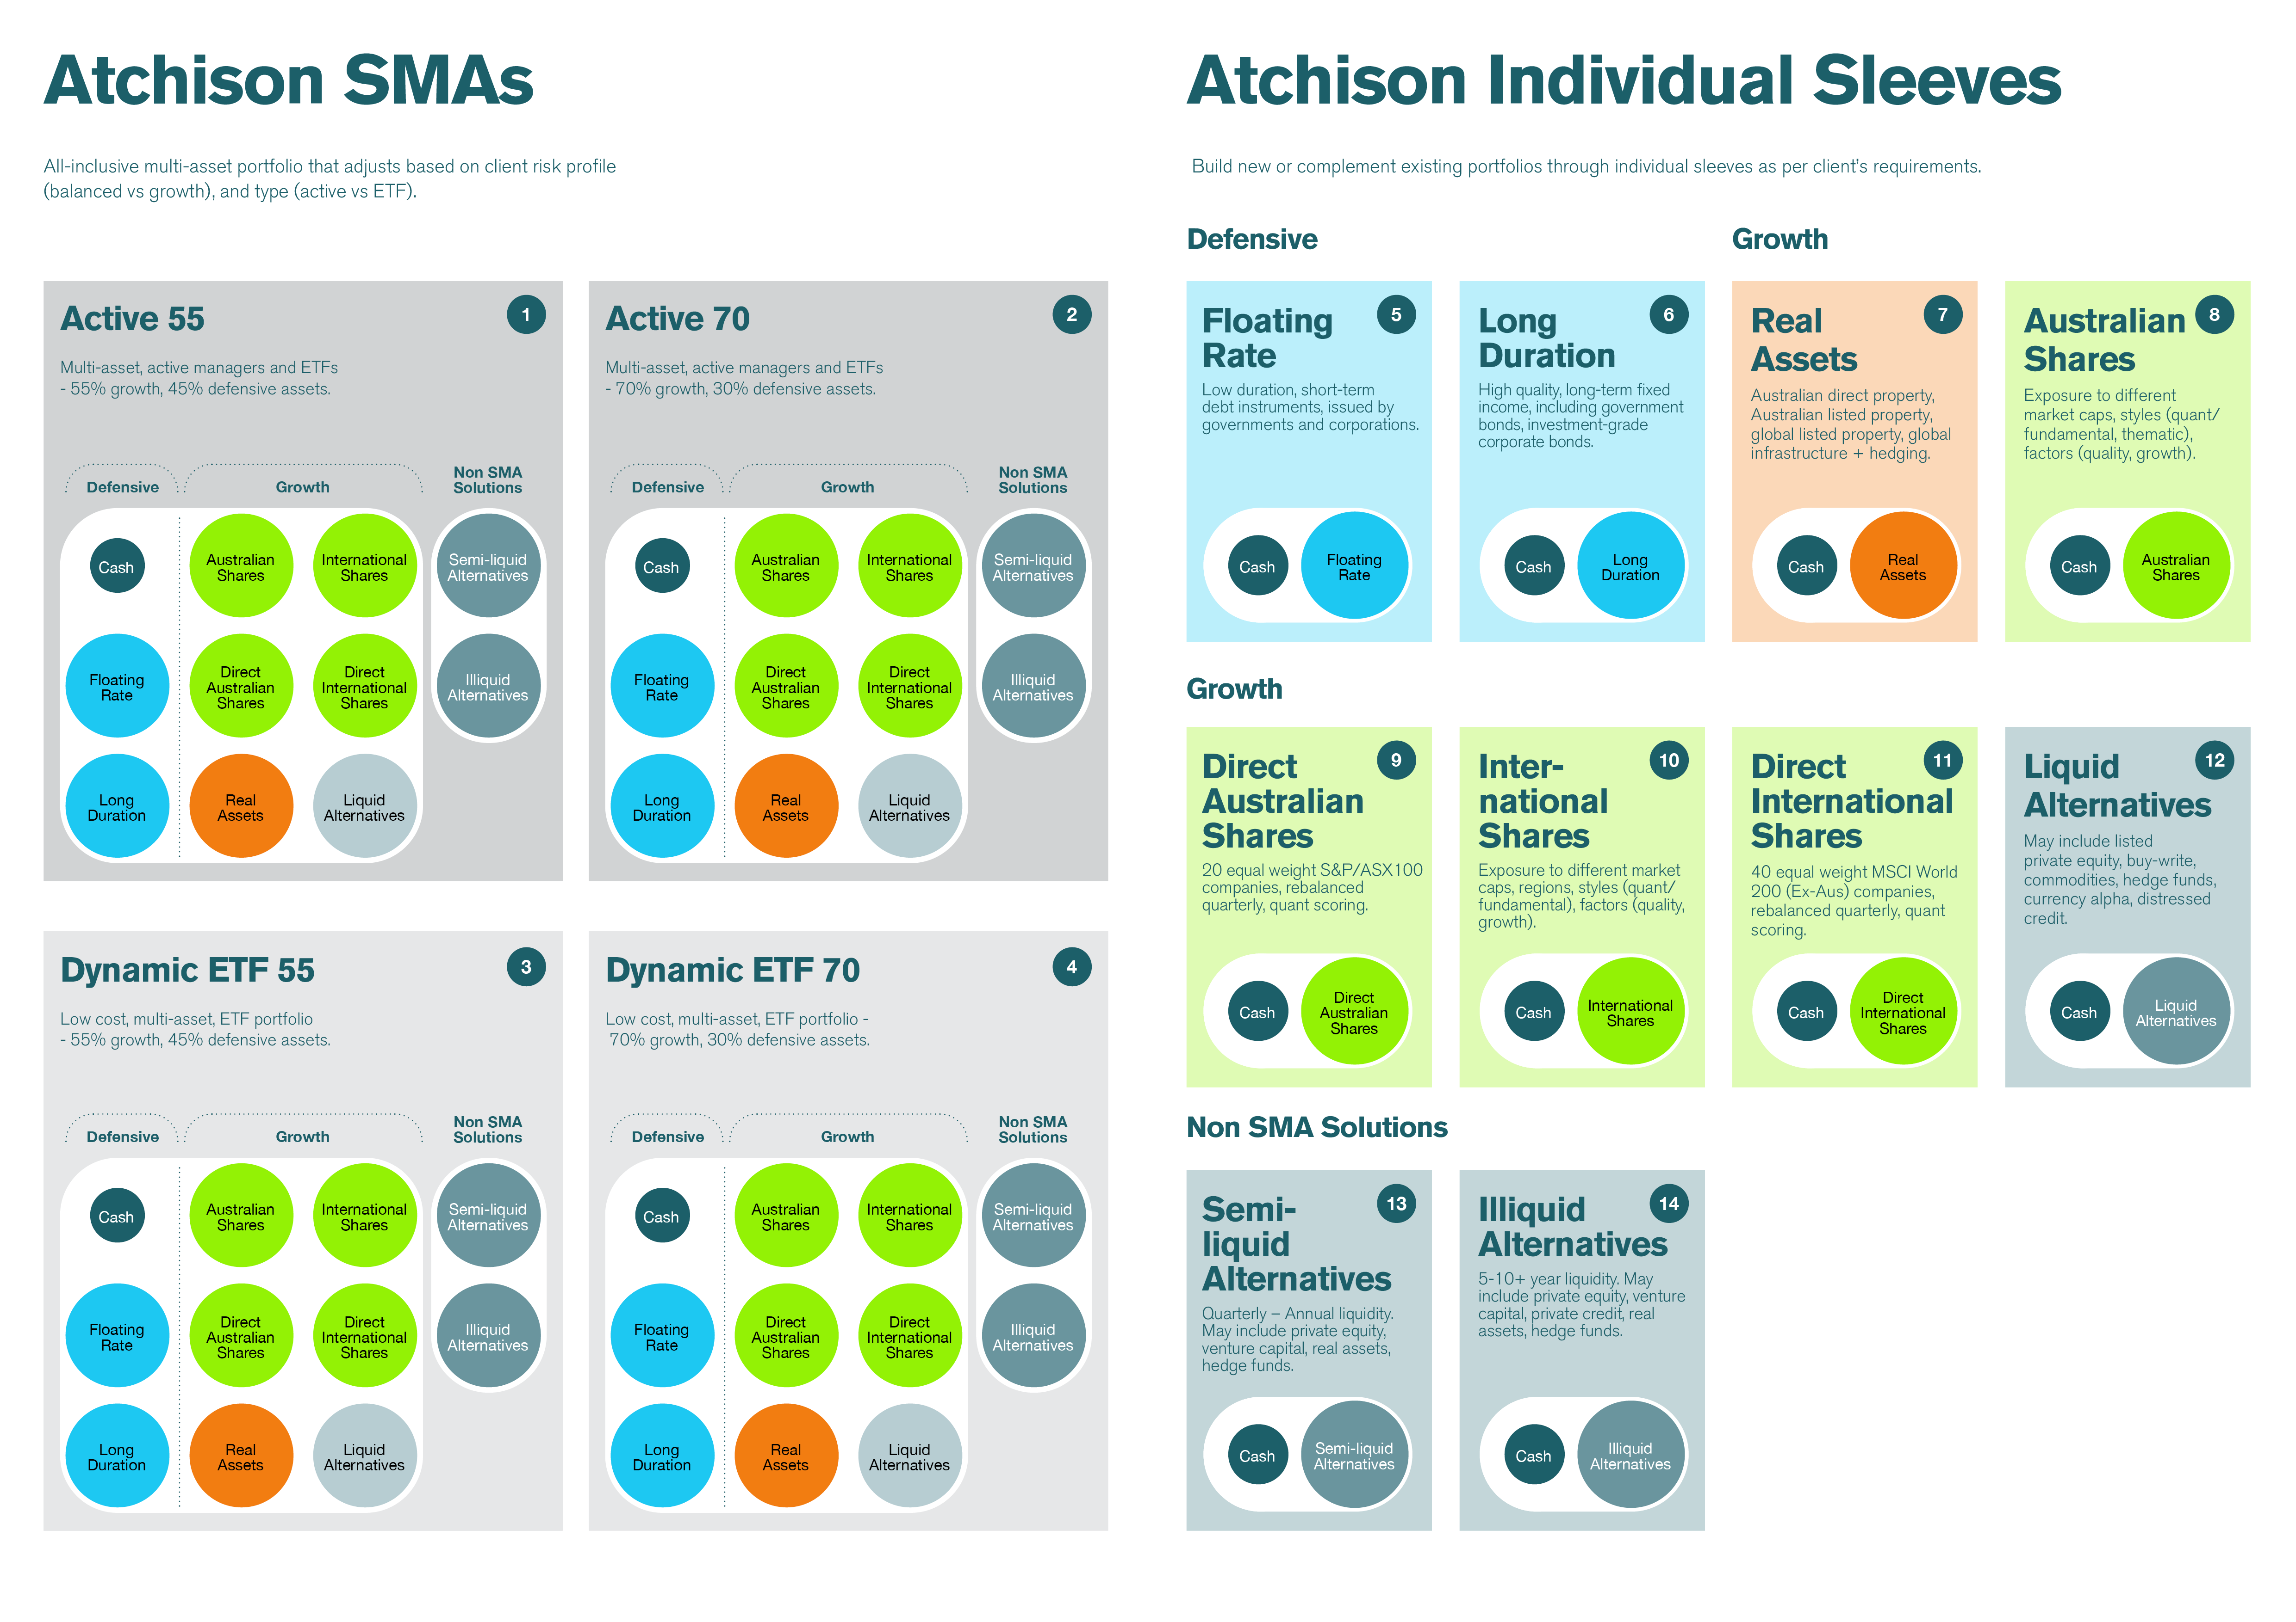
Active & Dynamic ETF SMAs

Slide 39
Individual Asset Class Sleeves

Slide 40
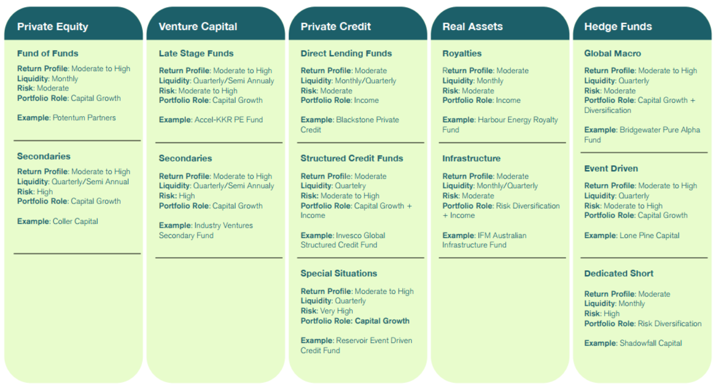
Atchison Alternatives
Atchison Liquid Alternatives
Atchison Semi-Liquid Alternatives

Slide 41
Additional Services
Atchison Approved Product List updates Review, maintain, update APL quarterly with any additions/removals
Portfolio reviews for HNW/UNHN clients Ad-hoc work to assist the transition of existing or new clients in the SMAs
Semi-liquid Alternative paper portfolio List of preferred semi-liquid alternative managers that have been approved / removed – eligible for use by EMFS.
Access to Inside Networks Global Study Tours 2025: USA Study Tour (Bostan, NY, LA), New Zealand Leaders Forum, Singapore INAsia Leaders, Brilliant Investment Committee Quarterly 2026: Alternatives, Equities and Growth, Income and Defensive, Tasmania ESG, New Zealand Leaders, USA or Europe Study Tour * flights and accommodation not included

Slide 42
10. Commercial Terms

Slide 43
Atchison Fee Structure
<$1B: 16bps >$1B: 15bps >$2B: 14bps >$3B: 13bps >$4B: 12bps >$5B: 11bps
Utilising the proposed solution will result in no implementation charge.
Underlying proposed portfolio management fees – estimated @ 11bps
Estimated investment fee <$1B: 16bps + 11bps = 27 bps
Fees above do not include expenses and fees charged by Platforms. Specifically, any shelf-space fees charged by Platforms for SMAs created outside the existing Atchison Investment Suite will be chargeable.

Slide 44
11. Proposed Solution

Slide 45
Proposed Solution
Atchison Dynamic Plus Suite
Atchison Dynamic SMA with Australian Direct Equities
This will cover different risk spectrums, i.e., balanced, growth, aggressive.
Access to Atchison Individual Asset Class Sleeves
At a later stage, potential to incorporate Systematic International Equities Portfolio
Why this solution?
Aligns with Edwards Marshall existing solutions and philosophy
Low fees, better performance
Maintain exposure to Australian direct equities
Access to Atchison Individual Asset Class Sleeves

Slide 46
STATEMENT OF ANALYST INTEREST AND CERTIFICATION, WARNING AND DISCLOSURE
Analyst Interest and Certification:
The Analyst(s) may hold an investment in any products discussed in this presentation. Atchison Consultants does not consider such holdings to be sufficiently material to compromise the information presented. The Analyst(s) certifies that with respect to content covered: (1) all of the views expressed accurately reflect his or her personal views; and (2) no part of his or her compensation was, is, or will be, directly or indirectly, related to the specific recommendations or views expressed by that research analyst in this presentation.
Warning (General Advice Only):
This presentation contains recommendations and advice of a general nature and does not have regard to the particular circumstances or needs of any specific person who may read it. Investors should assess either personally or with the assistance of a licensed financial adviser whether the Atchison Consultants recommendation or advice is appropriate to their situation before making an investment decision. The information contained in the report is believed to be reliable, but its completeness and accuracy is not guaranteed. Opinions expressed may change without notice. Atchison Consultants does not accept any liability, whether direct or indirect arising from the use of information contained in this report. No part of this presentation is to be construed as a solicitation to buy or sell any investment. Atchison Consultants does not accept any responsibility to inform you of any matter that subsequently comes to its notice, which may affect any of the information contained in this presentation. The performance of any investment in this presentation is not a representation as to future performance or likely return.
Disclosure (Commissioned Research):
Atchison Consultants may or may not have received a fixed fee and/or travel expenses for the presentation and or presentation material. Atchison Consultants has no direct or indirect interest in the success or otherwise of any investments referred to in this presentation.
ATCHISON CONSULTANTS
Atchison Consultants was established in 2001 by Ken Atchison and consists of a team of investment professionals with extensive experience in all aspects of financial markets. The principal focus of the business is the provision of advice and analysis across all components of managing investment portfolios by financial institutions, superannuation and insurance funds and investment managers. Primarily this involves property, or real estate, investments and related mortgage investments. Atchison Consultants’ services and capabilities cover two distinct areas being asset consulting and investment management consulting, with a focus on the property asset class.
Licence
TAG Asset Consulting Group Pty Ltd (ABN 58 097 703 047), trading as Atchison Consultants, is the holder of Australian Financial Services Licence Number 230846.
Contact Details
Atchison Consultants
Level 4, 125 Flinders Lane, Melbourne, Victoria 3000
Phone: +61 3 9642 3835
Fax: +61 3 9642 8886
Email: enquires@atchison.com.au
Website: www.atchison.com.au

