Slide 1




Chicago CTA Tweets
Group Members: Joseph Wantroba, Amy Cleveland, Garima Chauhan, Gabriela Hernandez, Kelly Lao

Slide 2

Table of Contents
Purpose/Rational
Datasets: Training & Testing Data
Data Cleaning Steps
Building Models
Bayesian
Bernoulli
Complement
Multinomial
Decision Tree
Random Forest
SVM
Neural Network
Model vs Score
CTA Tweets Prediction
Tweets per Day
Best Fit Model – CTA Tweets
Sentiment Analysis
Word Cloud

Slide 3
Purpose/Rational
CTA has made a number of improvements over the past decade. We wanted to track sentiment as the improvements are made.

Slide 4
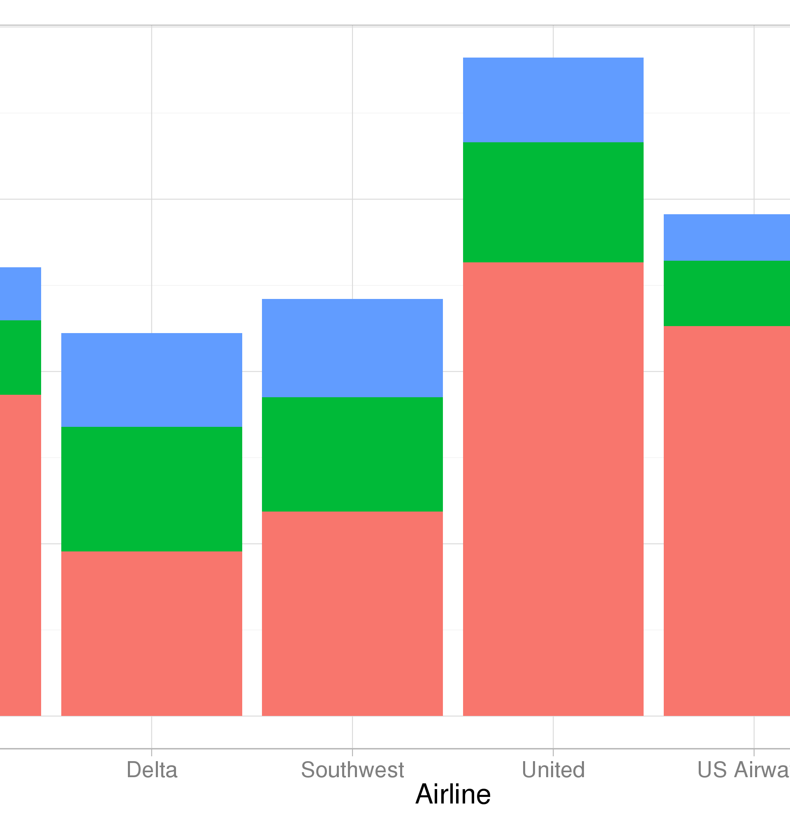
Data Sets: Training & Testing
Twitter API to obtain the CTA tweets for the past 10 days.
Airline Twitter sentiment (CSV) - The Twitter data were classified into positive, negative, and neutral tweets, followed by categorizing negative reasons.

Slide 5

Data Cleaning Steps
Obtaining the CSV
Cleaning data by removing all the tags, special characters, urls, etc
Using Label encoding to convert sentiments to numbers

Slide 6

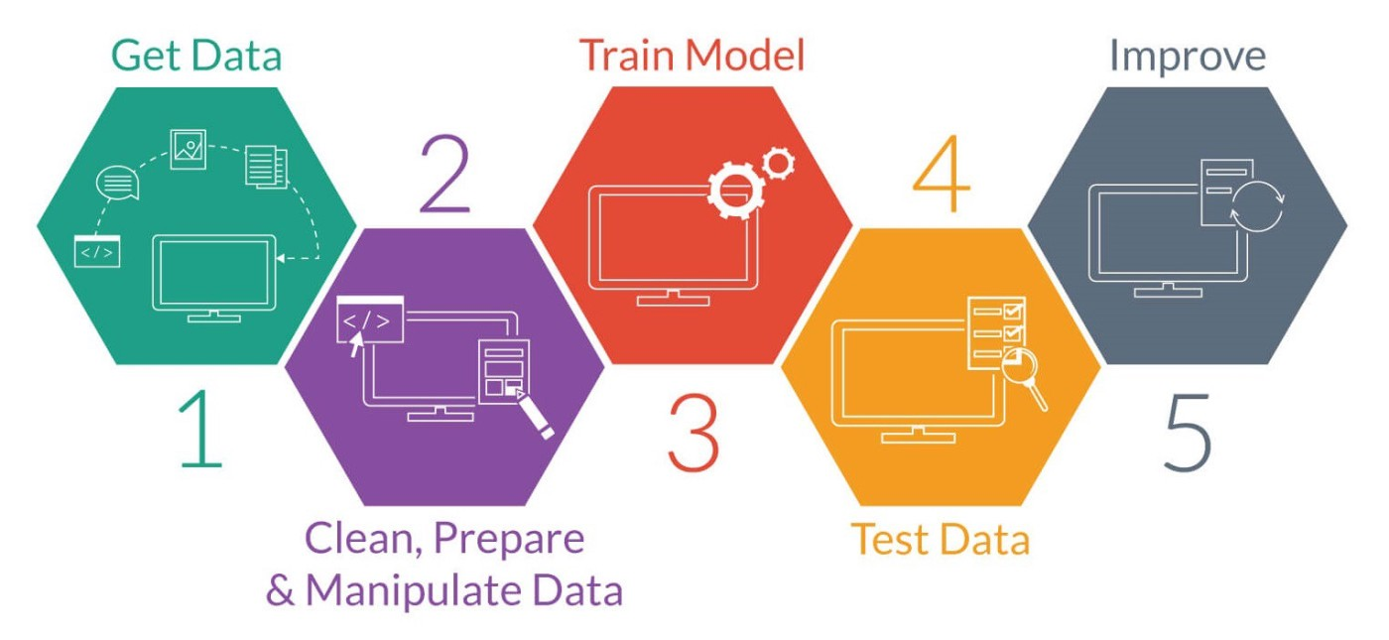
Building Models
Bayesian
Bernoulli
Complement
Multinomial
Decision Tree
Random Forest
SVM
Neural Network

Slide 7
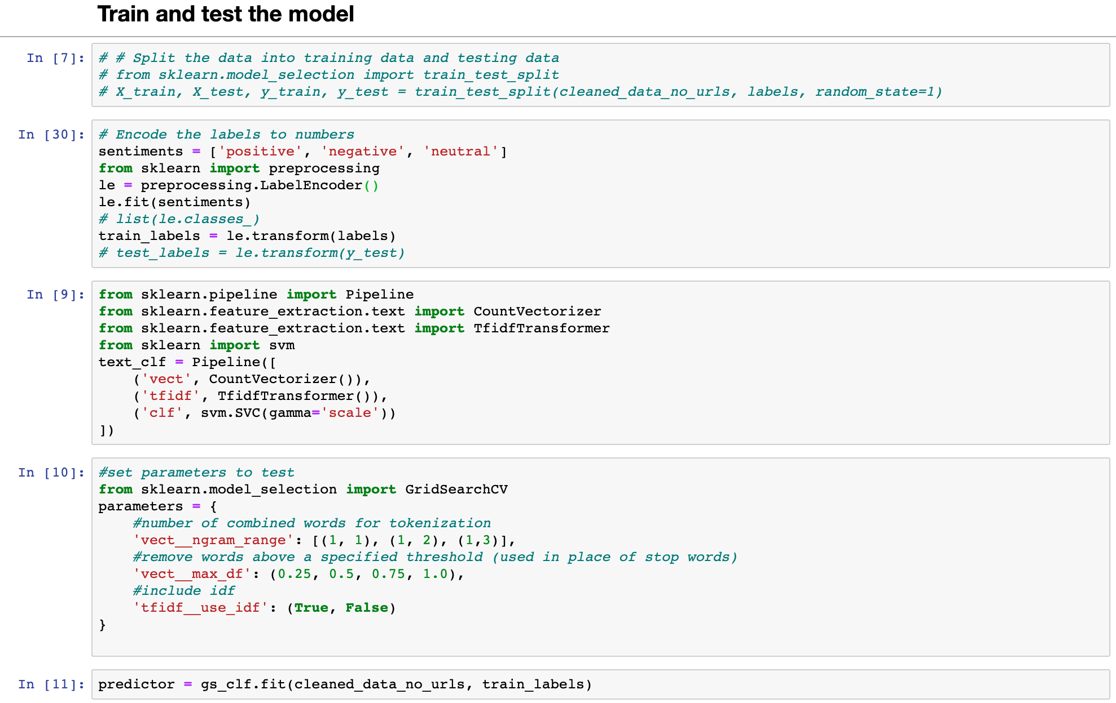

Slide 8
Model Vs. Score

Slide 9
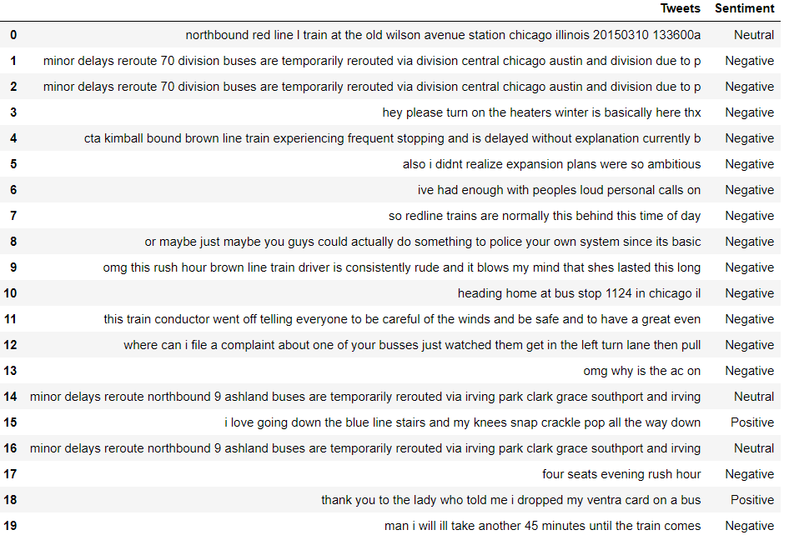
CTA Tweets Prediction

Slide 10
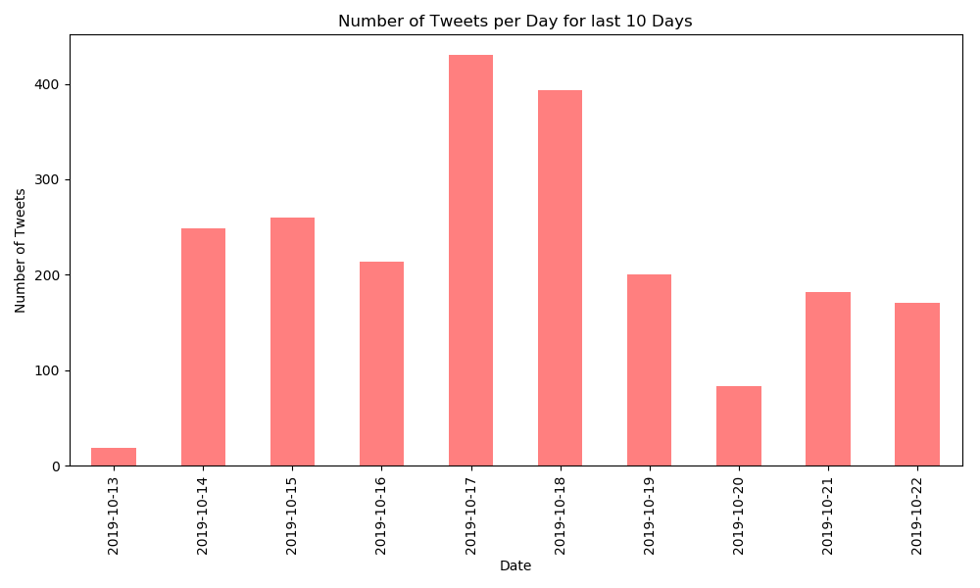
Number of Tweets per day

Slide 11
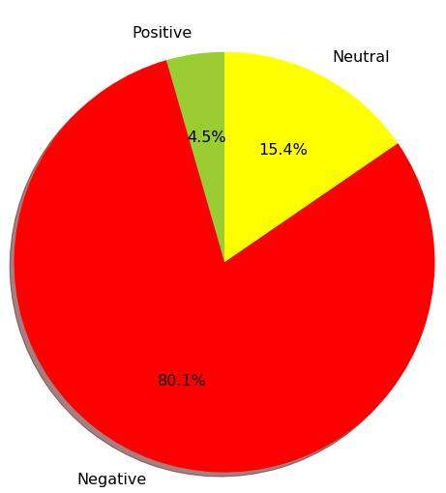
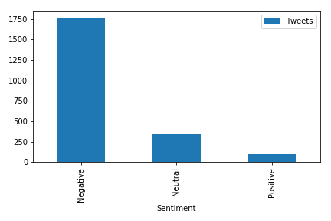
Best Fit Model – SVM on CTA Tweets

Slide 12
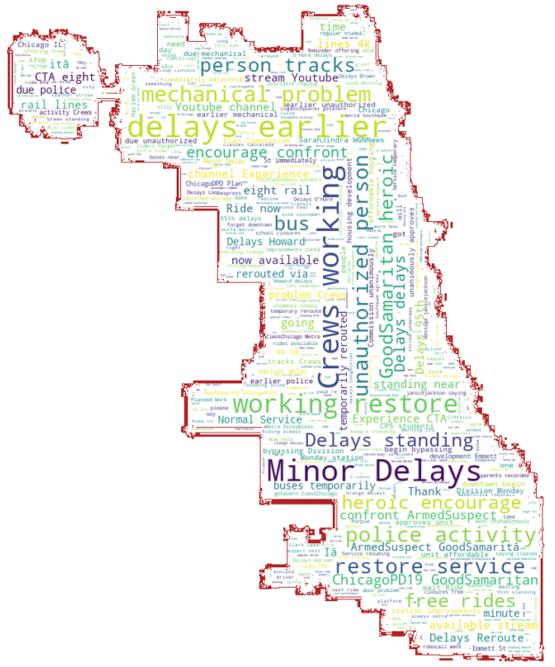
Word Cloud – CTA Tweets

Slide 13


Thank you!

