Slide 1




Chicago CTA Tweets
Group Members: Joseph Wantroba, Amy Cleveland, Garima Chauhan, Gabriela Hernandez, Kelly Lao
Notes:
KL

Slide 2

Table of Contents
Purpose/Rational
Datasets: Training & Testing Data
Data Cleaning Steps
Building Models
Bayesian
Bernoulli
Complement
Multinomial
Decision Tree
Random Forest
SVM
Neural Network
Model vs Score
CTA Tweets Prediction
Tweets per Day
Best Fit Model – CTA Tweets
Sentiment Analysis
Word Cloud
Notes:
KL

Slide 3
Purpose/Rational
CTA has made a number of improvements over the past decade. We wanted to track sentiment as the improvements are made.
Notes:
KL

Slide 4
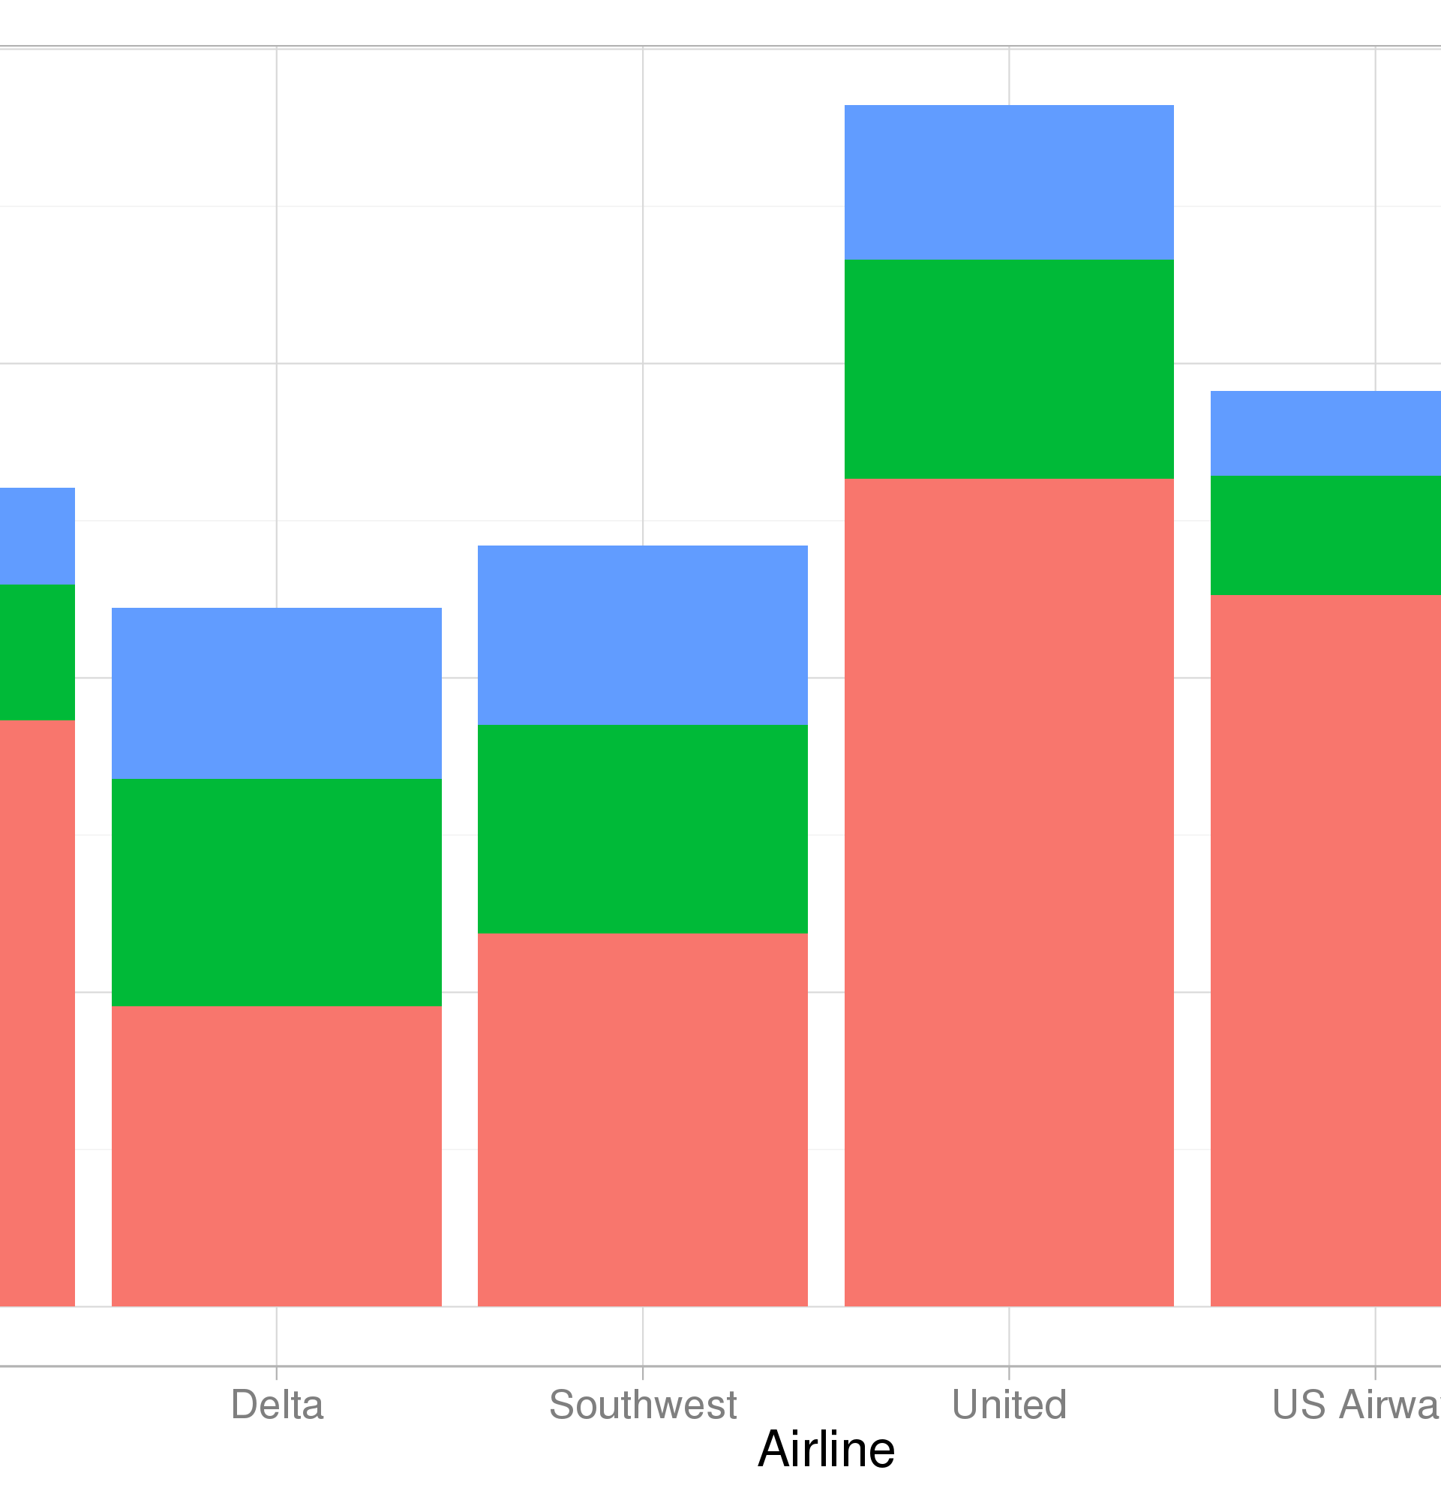
Data Sets: Training & Testing
Twitter API to obtain the CTA tweets for the past 10 days.
Airline Twitter sentiment (CSV) - The Twitter data were classified into positive, negative, and neutral tweets, followed by categorizing negative reasons.
Notes:
Gaby

Slide 5

Data Cleaning Steps
Obtaining the CSV from Kaggle
Cleaning data by removing all the tags, special characters, urls, etc
Using Label encoding to convert sentiments to numbers
Notes:
Amy

Slide 6

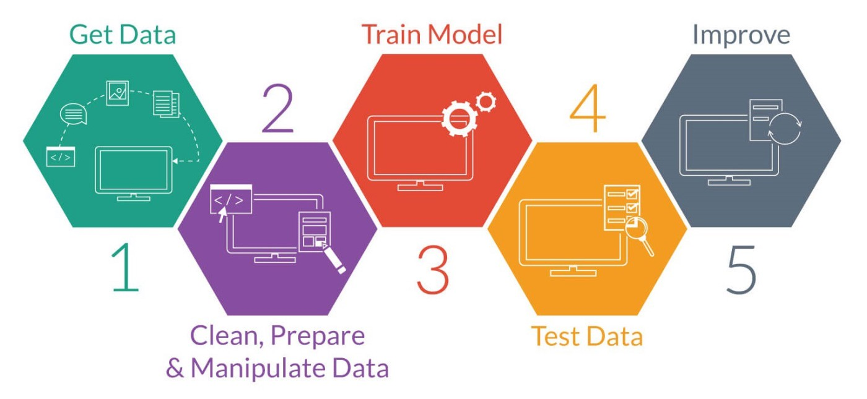
Building Models
Bayesian
Bernoulli
Complement
Multinomial
Decision Tree
Random Forest
SVM
Neural Network
Notes:
Amy

Slide 7
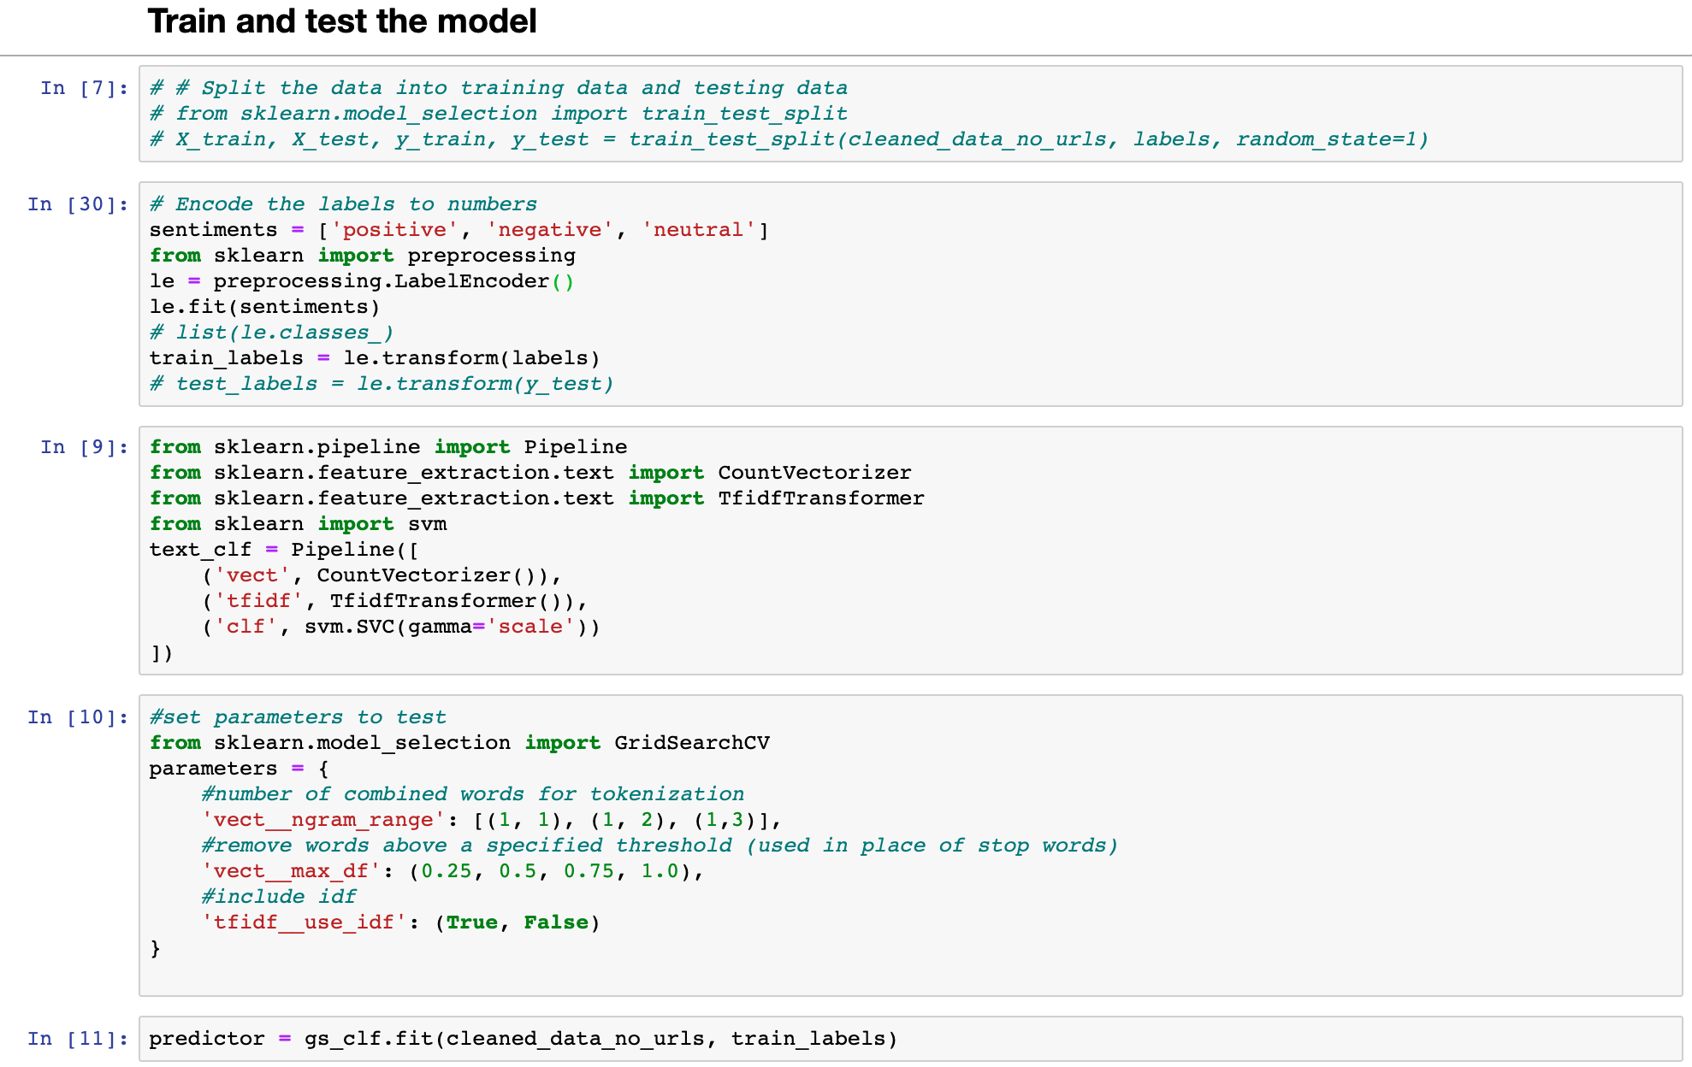
Notes:
Joe

Slide 8
Model Vs. Score
Notes:
Amy

Slide 9
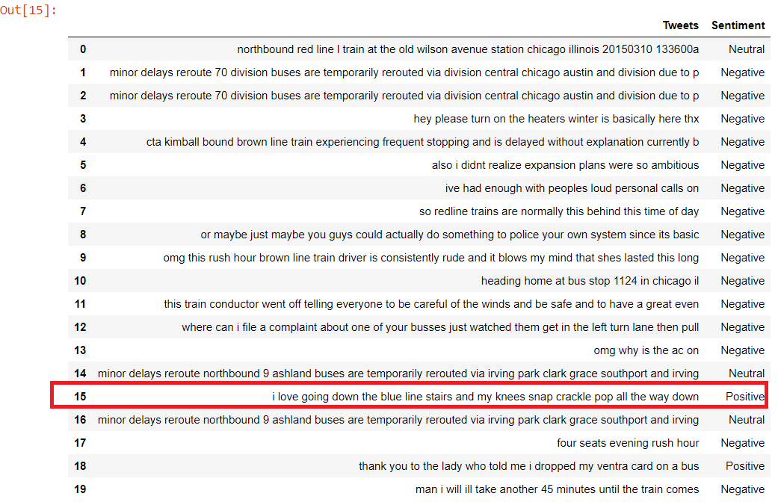
CTA Tweets Prediction
Notes:
Gaby

Slide 10
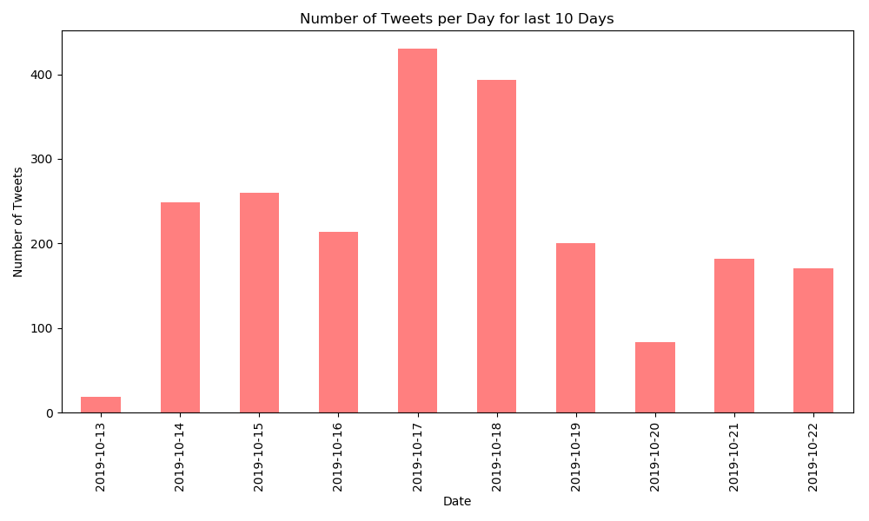
Number of Tweets per day
Notes:
Amy
- on 17th, red line delay due to man jumping onto the track

Slide 11
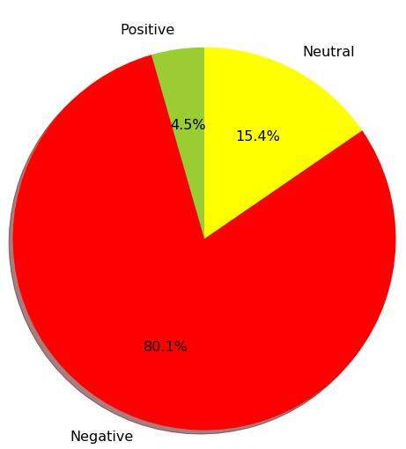
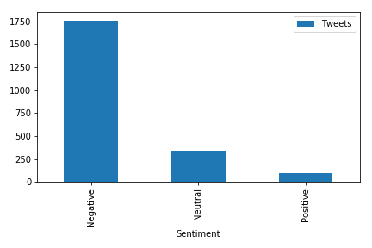
Best Fit Model – SVM on CTA Tweets
Notes:
Garima – people tend to only post negative feedbacks, and a way to track negative things, for future improvement

Slide 12
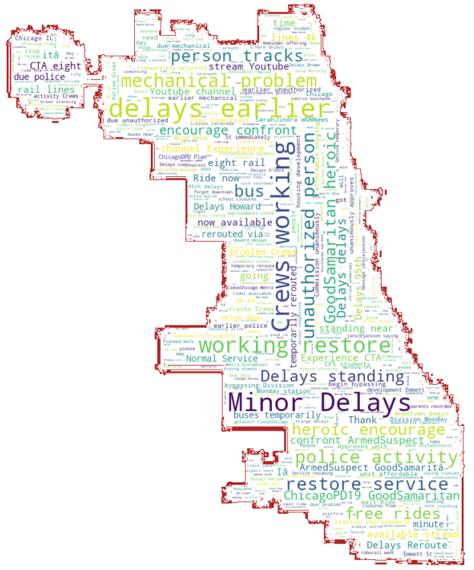
Word Cloud – CTA Tweets
Notes:
Garima

Slide 13


Thank you!

