Slide 1







Future Programming Language Trends
KEERTHI KATHULA
13 APRIL 2024

Slide 2



OUTLINE
Executive Summary
Introduction
Methodology
Results
Visualization – Charts
Dashboard
Discussion
Findings & Implications
Conclusion
Appendix

Slide 3

EXECUTIVE SUMMARY
Collecting demand of jobs open from various technology and locations
Analyzing the data and identifying insights and trends
Top programming languages
Top databases skills
Popular IDEs
Bringing information together with a dashboard showing current skills, future trend skills, and demographics

Slide 4

INTRODUCTION
To match the current technology programming in order to ensure that it is align with the current expertise in its specific fields ( IT solutions and consultants)
Focus problems:
What are the programming/database skills in the present?
What are the programming/database skills in the future?

Slide 5

METHODOLOGY
Data Collection
Data Wrangling
Exploring Data Analysis
Data Visualization
Dashboard Creation
Presenting of Findings
Data source: Job postings (https://cf-coursesdata.s3.us.cloud-object-storage.appdomain.cloud/IBMDA0321EN-SkillsNetwork/LargeData/m1_survey_data.csv)

Slide 6
RESULTS
In the following sections we will see graphical data from survey respondents regarding their age, gender, programming language/database preference and use, education level and sex

Slide 7
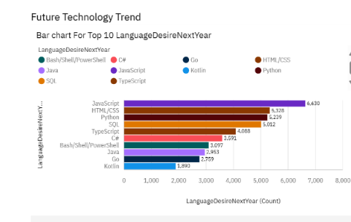
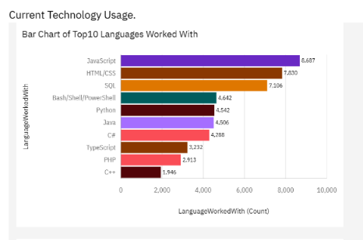
PROGRAMMING LANGUAGE TRENDS
Current Year
Next Year

Slide 8
PROGRAMMING LANGUAGE TRENDS - FINDINGS & IMPLICATIONS
Findings
Based on both findings, it is obvious that JavaScript is the highest number of people working, followed by HTML and CSS.
The third most used language SQL has been replaced by Phyton on the future trend
C++, which is the lowest number of users will be replaced with Koitlin language based on the future trends.
Implications
There are no changes for the JavaScript and HTML and CSS trends.
Phyton has been increasingly used as compared to Bash/Shell/PowerShell
Though SQL has dropped in number, it still remains usable.

Slide 9
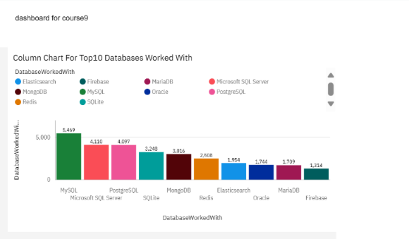
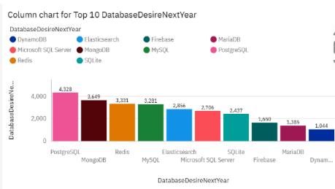
DATABASE TRENDS
Current Year
Next Year

Slide 10
DATABASE TRENDS - FINDINGS & IMPLICATIONS
Findings
Based on both findings, it is obvious that MySQL, which is the highest number of database people use, will be replaced by PostgreSQL in the future.
The MongoDB, the fifth highest in the current trend has increased to the second place in the future trend.
The least used database, Firebase, had a slight increased to the seventh place in the future trend.
Implications
SQL will still be the common database used in the future.
MongoDB will be more popular in the future trends
Firebase stays relevant in the database system.

Slide 11

DASHBOARD
keerthirepo/IBMCognosDashboard _for_course9.pdf at main · keerthikathula/keerthirepo (github.com)

Slide 12
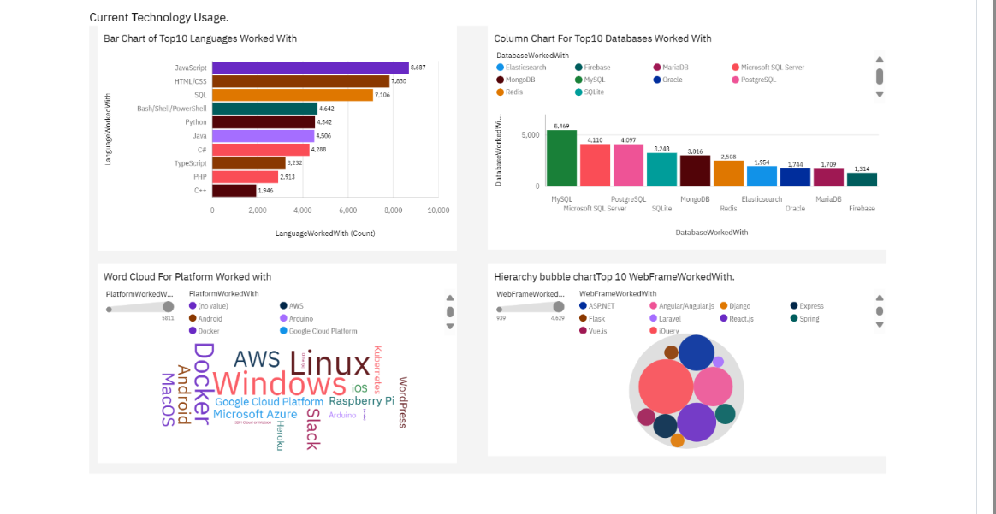
DASHBOARD TAB 1
Screenshot of dashboard tab 1 goes here

Slide 13
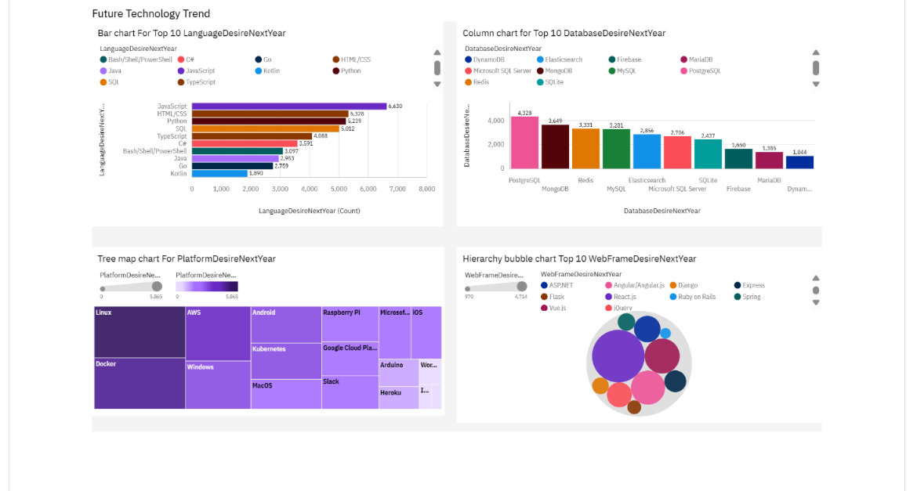
DASHBOARD TAB 2
Screenshot of dashboard tab 2 goes here

Slide 14
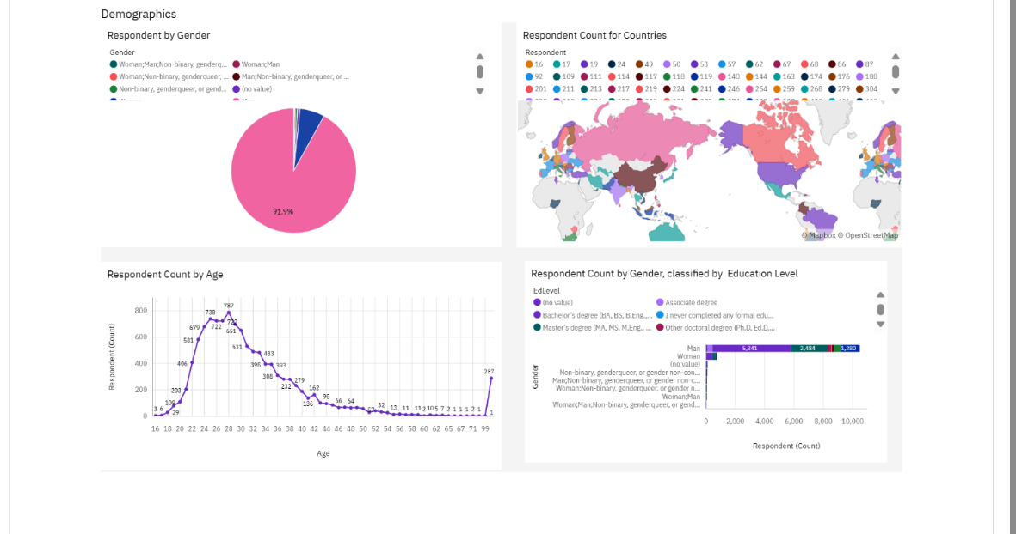
DASHBOARD TAB 3
Screenshot of dashboard tab 3 goes here

Slide 15
DISCUSSION
Low number woman in tech.
What is the key value of HTML/CSS to still be required?
Why SQL still remain relevant throughout the trend?

Slide 16
OVERALL FINDINGS & IMPLICATIONS
Findings
By gender, men have shown more participation in tech with the highest number of them having a bachelor’s degree
In the future, JavaScript and HTML/CSS will remain at the top of the list.
PostgreSQL is presented to be in the first place instead of MySQL, compared to the disappearance of Microsoft SQL Server and SQLite
Implications
Large number of men with bachelor’s Degree tend to participate
JavaScript/ and HTML/CSS will continue to thrive along with time
SQL servers will be required but the most popular database is expected to be PostgreSQL

Slide 17

CONCLUSION
HTML/CSS language is estimated to be popular as time goes by
PostgreSQL database will also be popular among the databases
Men are more interested in IT skills more than women

Slide 18
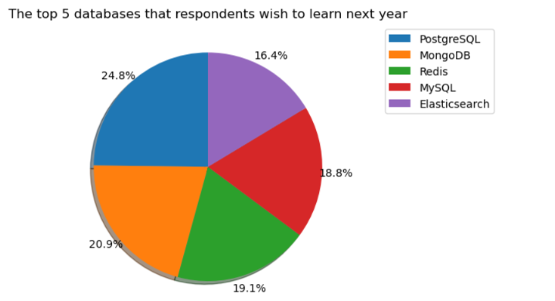
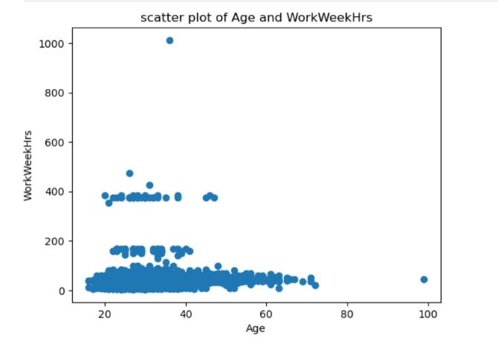
APPENDIX

Slide 19
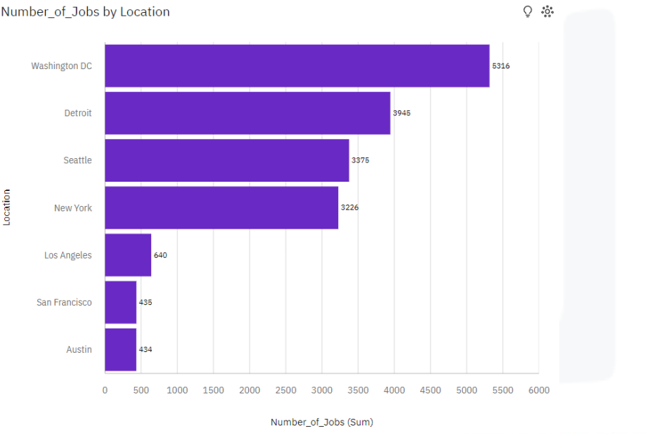
JOB POSTINGS
In Module 1 you have collected the job posting data using Job API in a file named “job-postings.xlsx”. Present that data using a bar chart here. Order the bar chart in the descending order of the number of job postings.

Slide 20
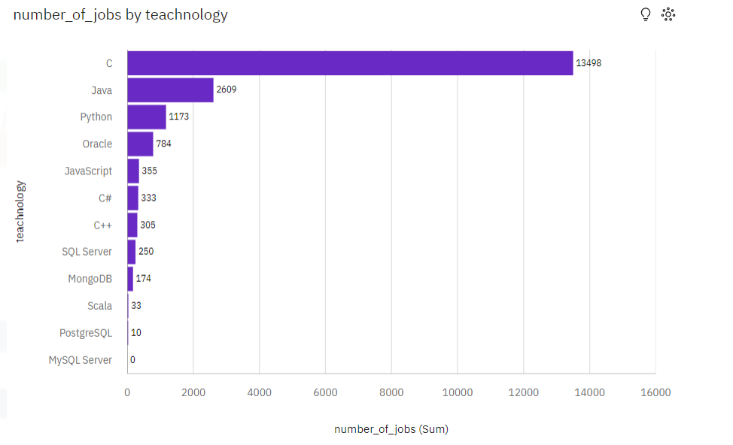
POPULAR LANGUAGES
In Module 1 you have collected the job postings data using web scraping in a file named “popular-languages.csv”. Present that data using a bar chart here. Order the bar chart in the descending order of salary.

