Slide 1

Hotel Reservation Management System
Student’s | ID
Atekah Aljafar | 222427138
Norah Almarri | 222411213
Fatimah Albesher | 222411640
Fatimah Alabdellah | 222412119
Zainab Alhadhari | 222405495

Slide 2
Introduction
This project develops a Hotel Reservation Management System (HRMS) for small to mid-sized hotels, providing real-time availability, secure online booking, accurate inventory management, and synchronization with external booking channels. The system enables guests to search, compare, book, and manage reservations instantly, while helping hotels reduce double-booking, minimize manual work, and improve overall service quality.

Slide 3
Methodology Description
Methodology Overview
Requirement gathering and analysis
System design and architecture
Technology selection and implementation
Web-based desktop application development

Slide 4
Requirement Gathering and System Design
Users: guests, staff, administrators
Issues addressed:
Third-party booking dependency
Commission-based profit loss
No unified system
Layered architecture

Slide 5
Technology Selection
Secure and scalable stack
Multi-role support
Real-time updates
Core features:
Reservations
Payments
Housekeeping

Slide 6
System Implementation
Front-End: HTML, CSS, JavaScript
Back-End: PHP
Database: MySQL

Slide 7
Security and Application Development
Security measures:
HTTPS encryption
Password hashing
Role-Based Access Control (RBAC)
Developed as a web-based desktop application

Slide 8
Requirements
The system supports guest booking and payment, staff and admin management functions, and secure role-based operations, while ensuring reliability, usability, performance, and proper system resources for continuous operation.

Slide 9
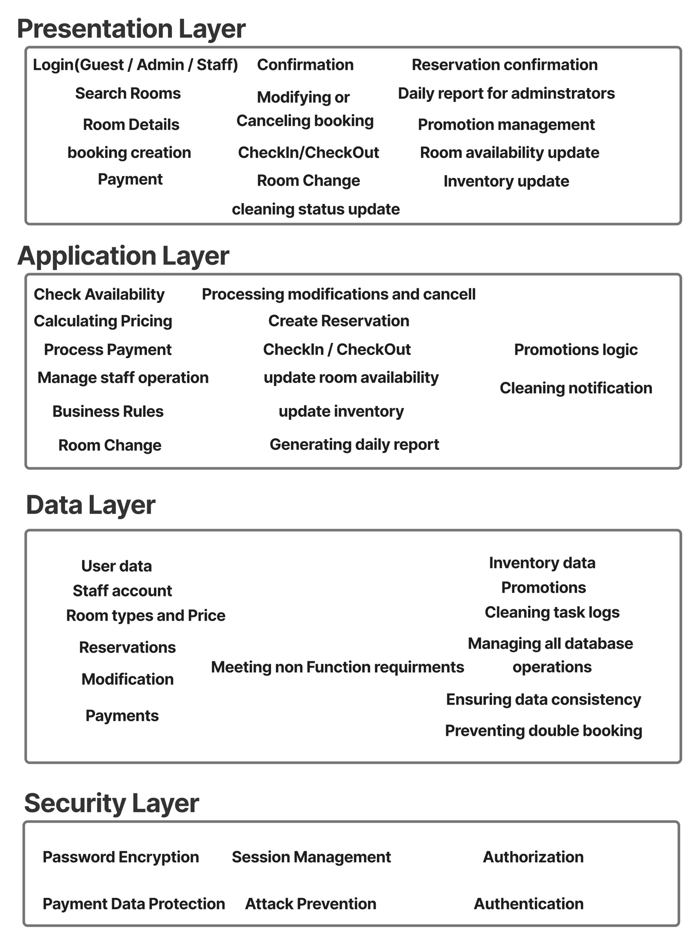
Architecture Design
The Hotel Reservation Management System uses a layered architecture. This design separates the system into Presentation, Application, Data, and Security layers to improve maintainability, security, and scalability.

Slide 10
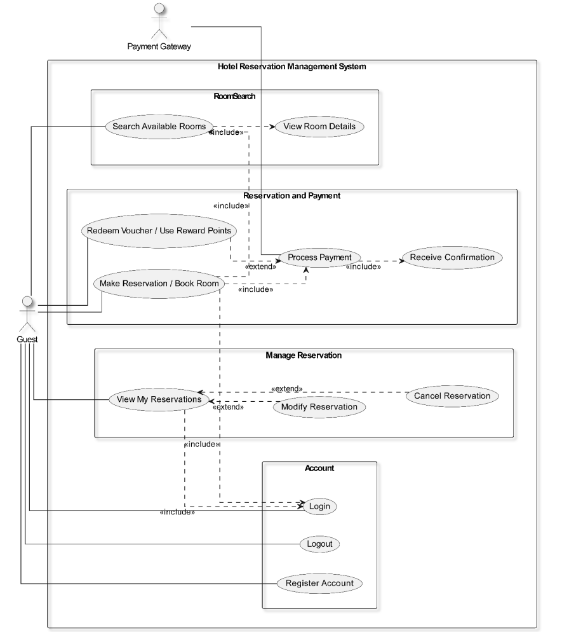
Models
1. Use Case Diagrams
These diagrams provide a high-level view of HRMS functionality by showing how each actor interacts with the system. They illustrate the main use cases for Guest & Payment Gateway, Administrator, Front Desk Staff, Staff, and Cleaning Staff.
Guest and Payment Gateway – Use Cases

Slide 11
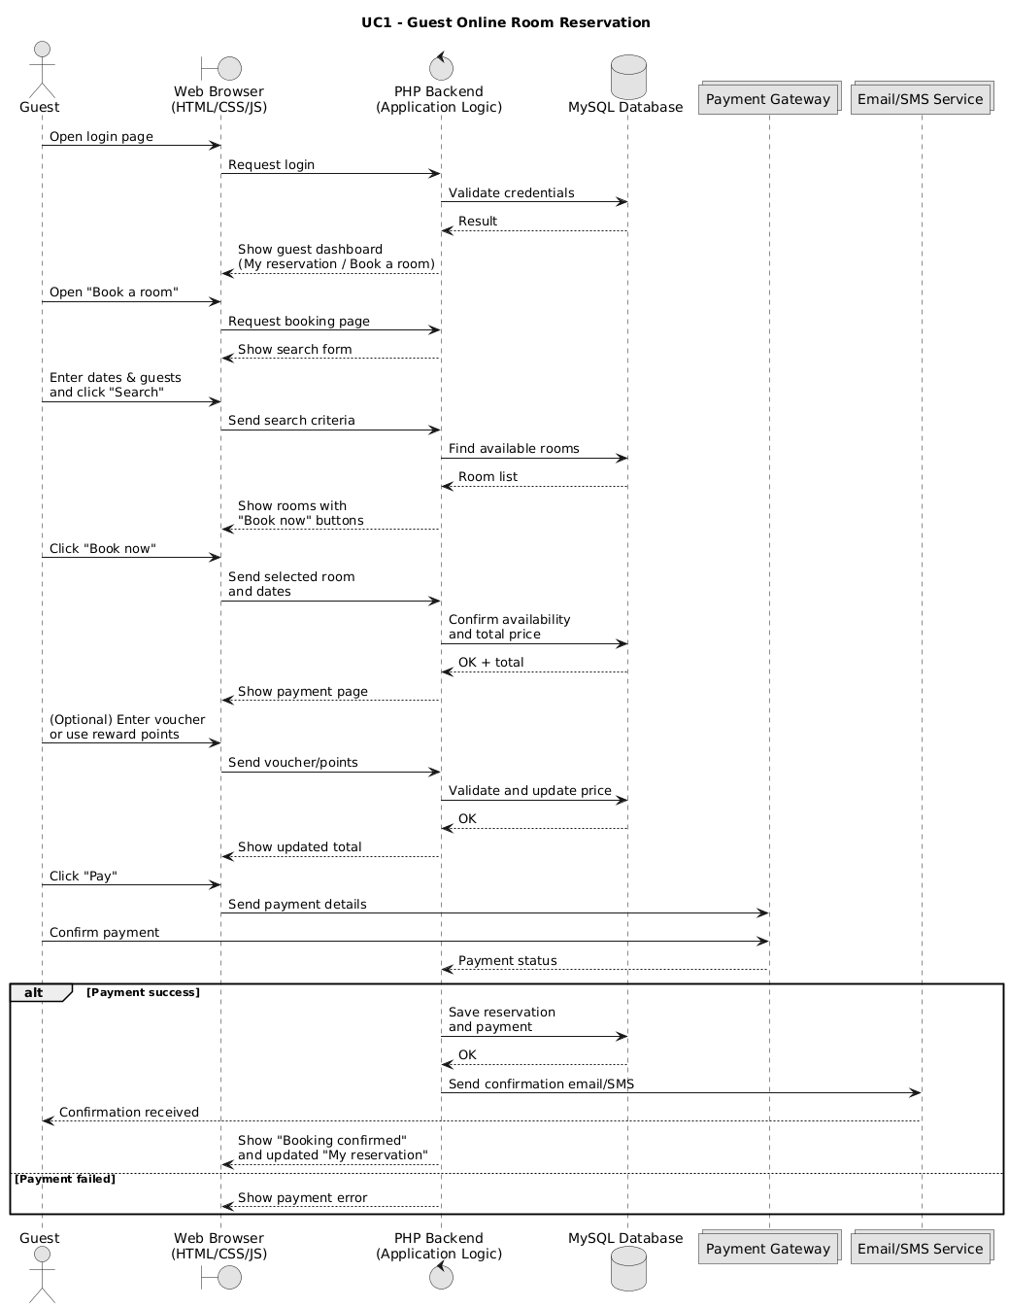
Models
2. Guest Sequence Diagram
)Make Reservation & Payment(
Guest selects a room and enters booking details
System validates availability and processes payment
Reservation is confirmed and notification is sent

Slide 12
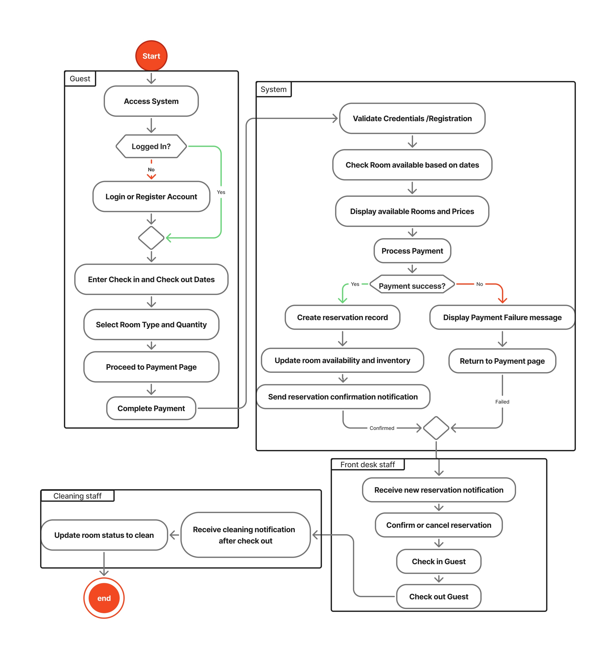
Models
3. Activity Diagram
This diagram explains how the reservation process flows step by step, starting from the guest accesses the system and ending with room cleaning and staff updates.

Slide 13
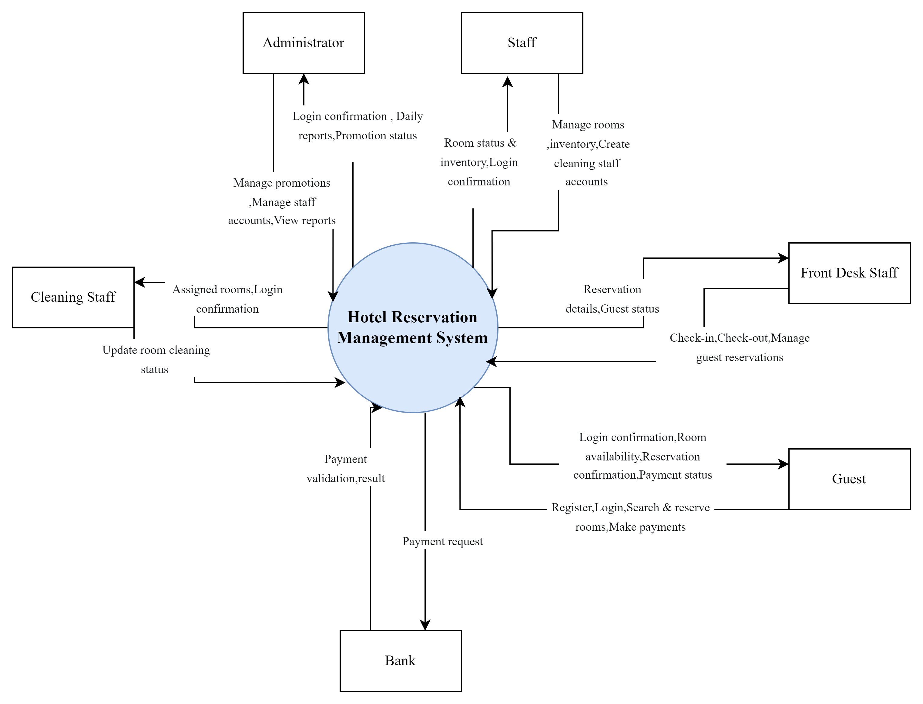
Models
4. Context Diagram
The diagram provides a high-level view of data flow between the system and its actors, demonstrating how information is exchanged to support hotel reservation processes.

Slide 14
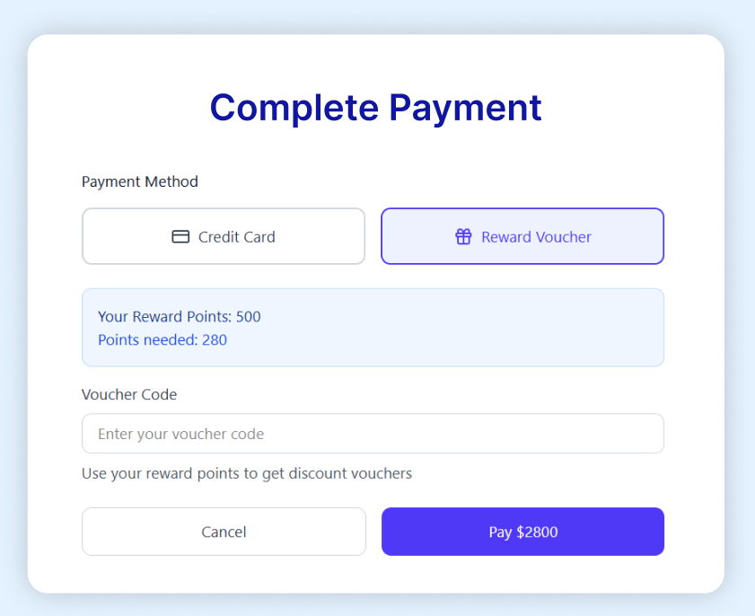
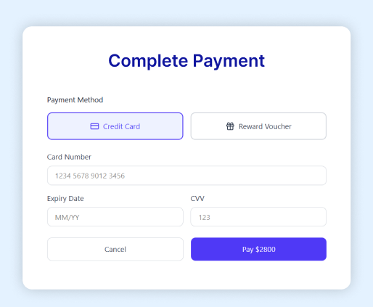
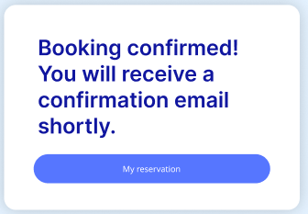
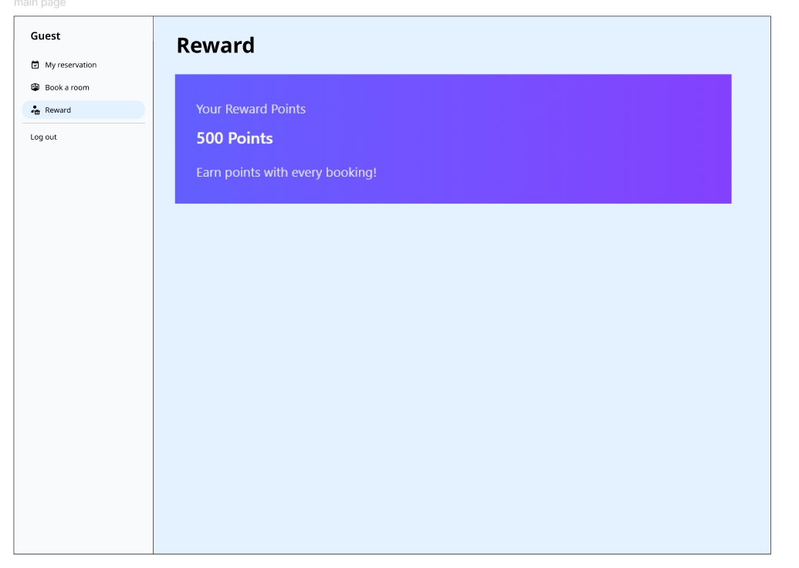
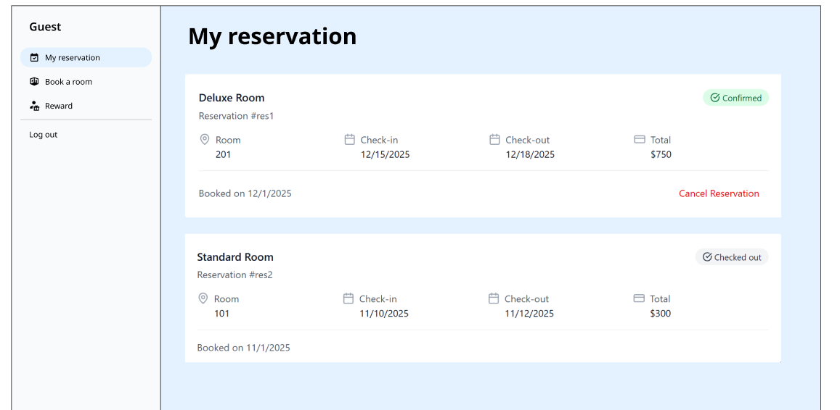
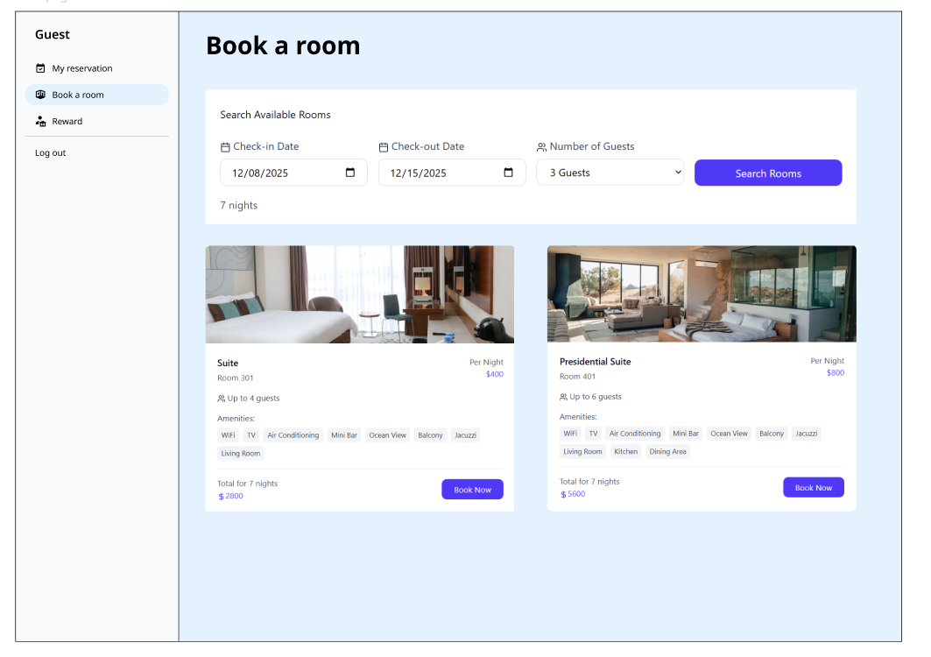
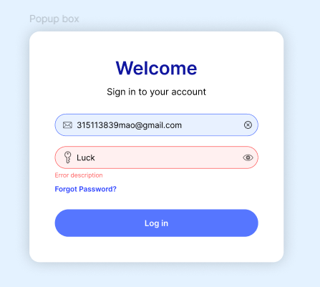
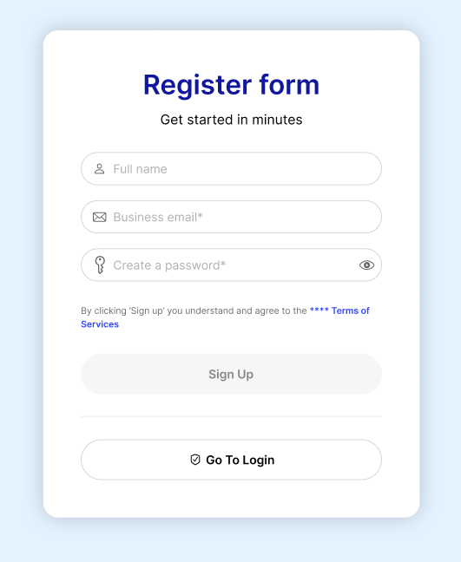
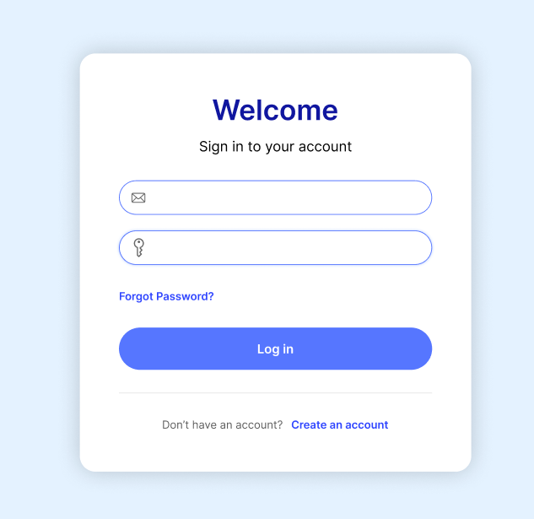
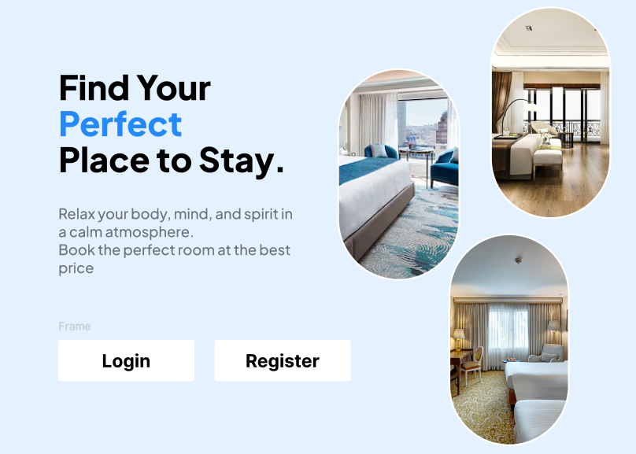
Prototype

Slide 15
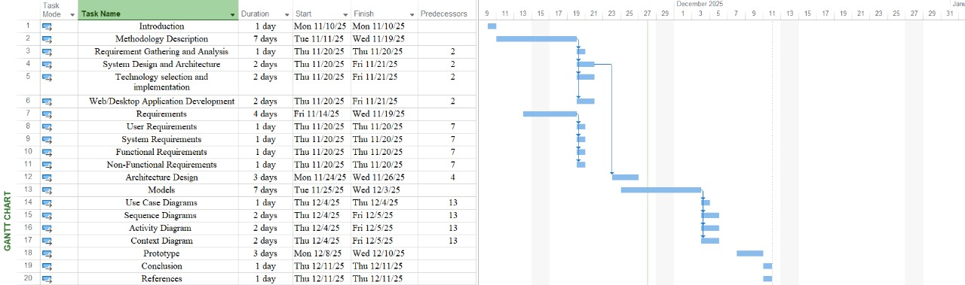
Gantt Chart

Slide 16
Conclusion
This project focused on designing a Hotel Reservation Management System to improve hotel booking and operational efficiency. The system supports key functions such as room availability management, reservations, secure payments, and staff operations.
Through requirements analysis, UML diagrams, and a functional prototype, the system design was clearly defined and aligned with real-world hotel needs. The layered architecture and security measures ensure reliability, scalability, and safe data handling.
Overall, this project demonstrates the effective use of software engineering principles to design a user-friendly and scalable hotel reservation system with potential for future enhancements.

