Slide 1
Homework week 2
Pere-Pau Vázquez
Dept. Computer Science – UPC

Slide 2
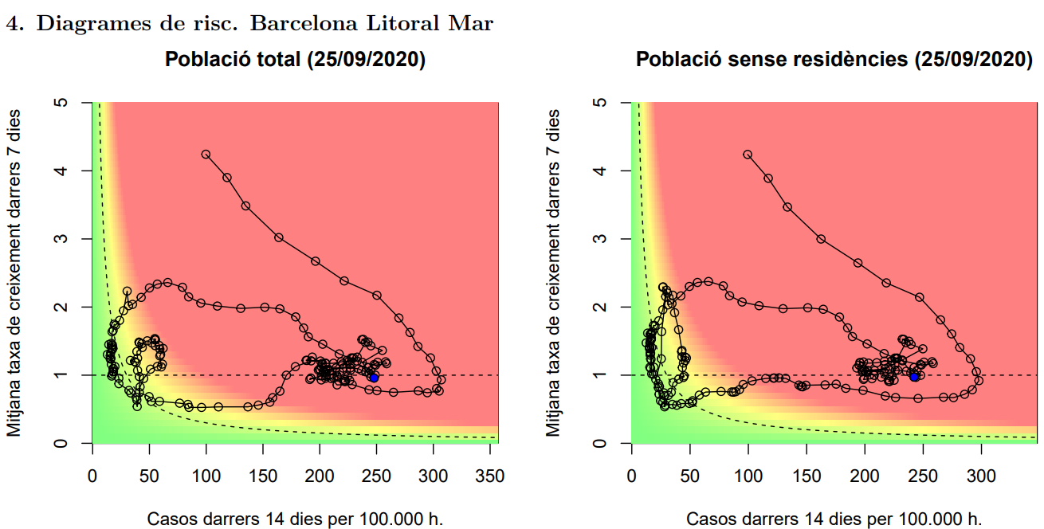
Check this chart

Slide 3
Think on it for 5 minutes
What do you understand?
What do you miss?

Slide 4
Now check the explanation
Page 3 of https://dlscitizens.blob.core.windows.net/rtreports/last/AGA/InformeCasosRt_AGA_71.pdf
What do you understand now?
Is it enough?
What would you change?

Slide 5
Discussion
Next Thursday

