Slide 1
DETECTING AI-GENERATED TEXT
TF-IDF vs. DistilBERT SEA 820 NLP Final Project
July 20, 2026
Team Members
Atem Ako Eyong Atem
Nahaeli Brunder

Slide 2
PROBLEM & OBJECTIVE
WHY THIS MATTERS
PROJECT GOAL
AI-generated writing is now common in education and online content.
Classify text as human-written or AI-generated.
MAIN RISK
EVALUATION
False positives can wrongly accuse human authors.
Compare accuracy, precision, recall, F1 and real errors.

Slide 3




PROJECT WORKFLOW
DATA
BASELINE
TRANSFORMER
ANALYSIS
40,000 balanced texts
TF-IDF + Logistic Regression
Fine-tuned DistilBERT
Metrics, errors and ethics

Slide 4



DATASET OVERVIEW
BALANCED
CLEAN
20,000 human 20,000 AI
No missing values No duplicates
SPLIT
LENGTH
32k train 4k validation 4k test
Human avg: 422 words AI avg: 344 words

Slide 5
MODELS & EXPERIMENTS
CLASSIC BASELINE
DISTILBERT
TUNING
50,000 TF-IDF unigram/bigram features Logistic Regression
Contextual Transformer encoder Maximum length: 256 tokens
2 learning rates 2 batch-size settings Validation F1 selection

Slide 6
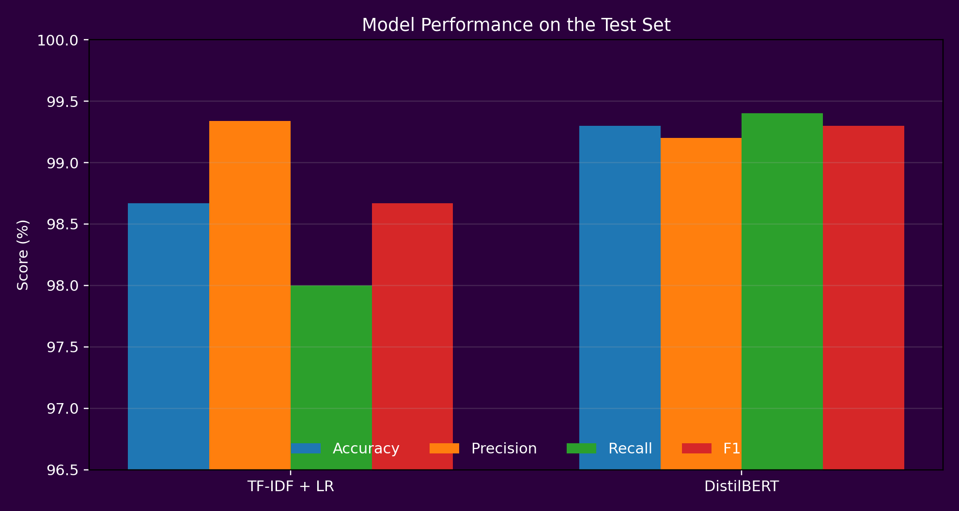
TEST RESULTS

Slide 7
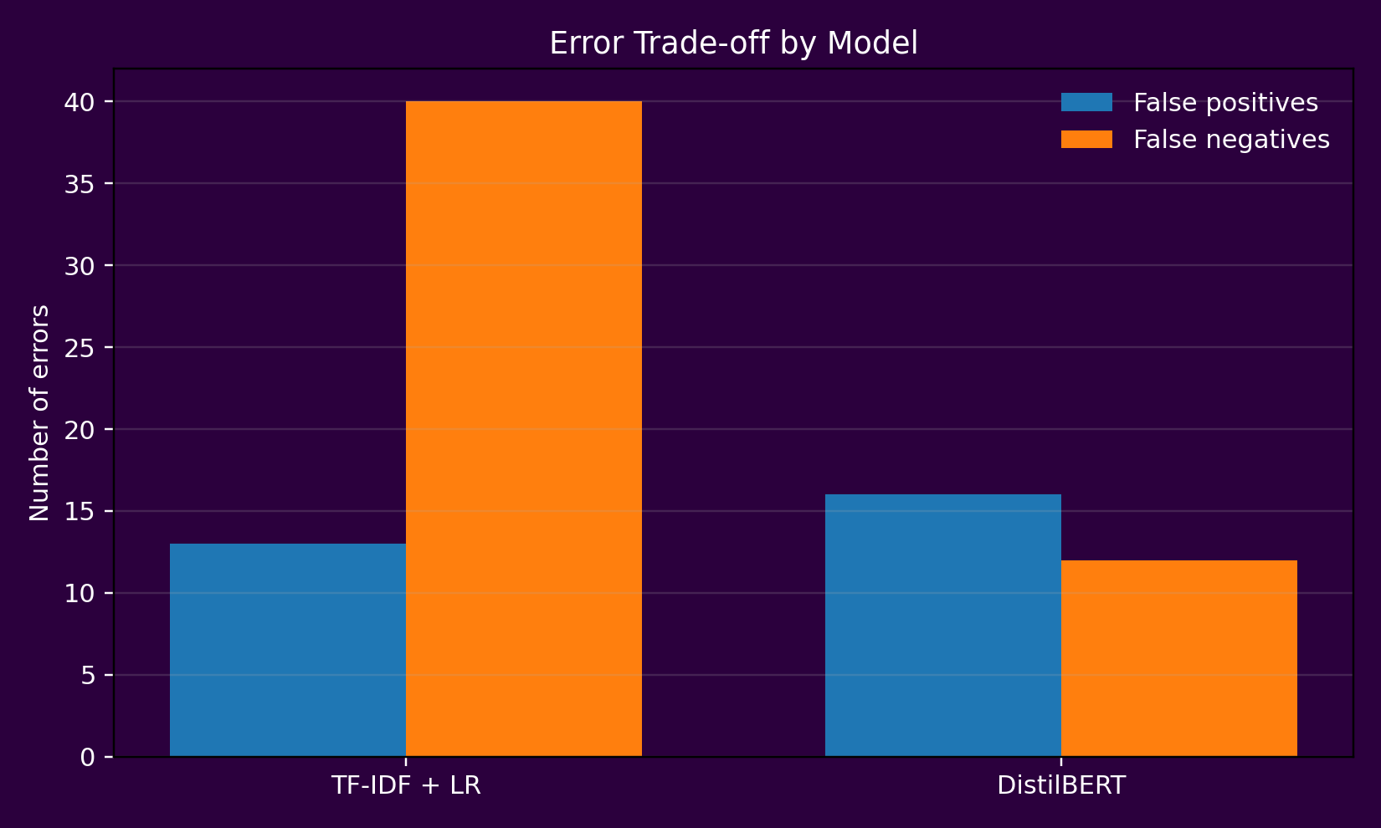
ERROR TRADE-OFF

Slide 8
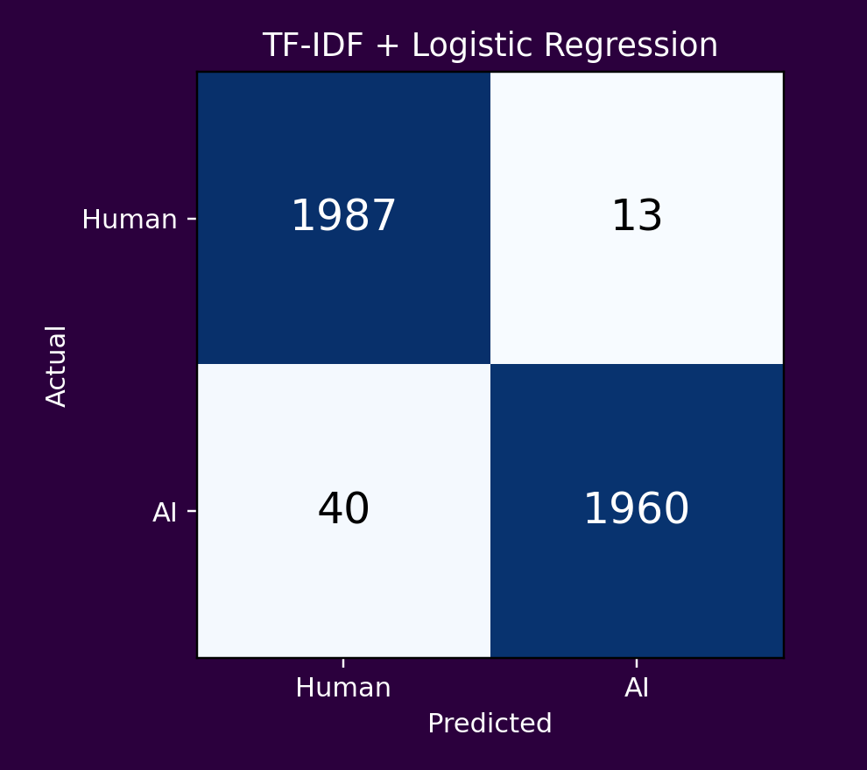
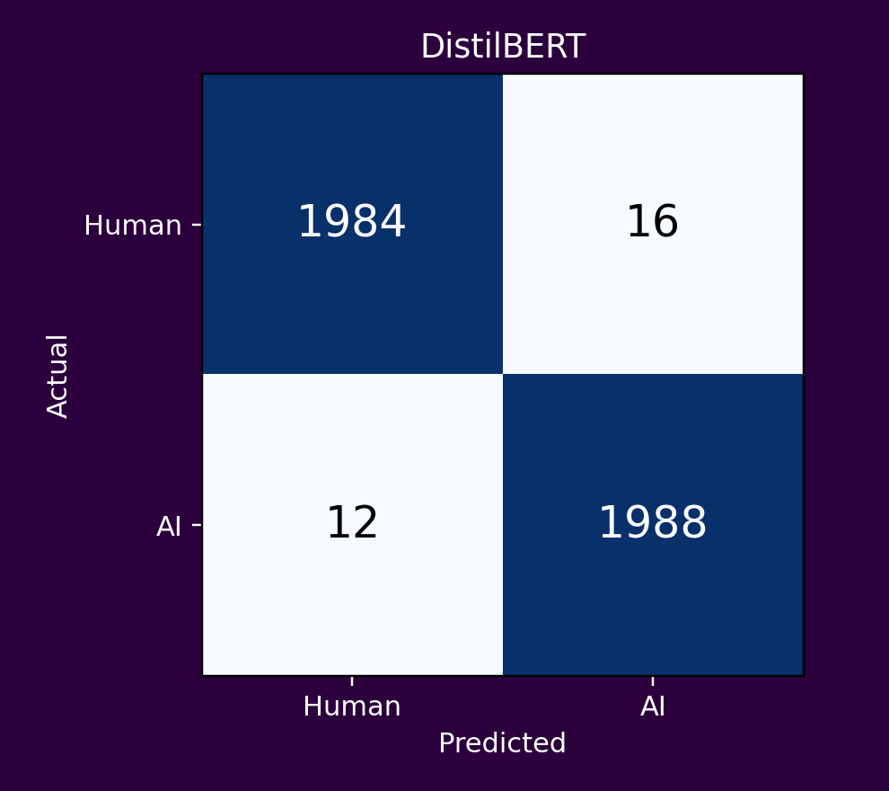
CONFUSION MATRICES
Actual test-set counts
Baseline
Revenue by year

Slide 9
KEY FINDINGS & ETHICS
DistilBERT achieved the best F1 score: 99.30% It reduced false negatives from 40 to 12, but false positives increased from 13 to 16. Human essays with formal structure were sometimes flagged as AI. Generated texts with deliberate errors sometimes appeared human. Recommendation: use the detector only as a screening tool with human review.

Slide 10
THANK YOU
Questions? GitHub: https://github.com/Atem2222/SEA-820-NLP-Final-Project-Detecting-AI-Generated-Text
Dataset: Kaggle AI vs. Human Text
https://www.kaggle.com/datasets/arjunverma2004/ai-vs-human-text-balanced-180k-records?resource=download

