Slide 1
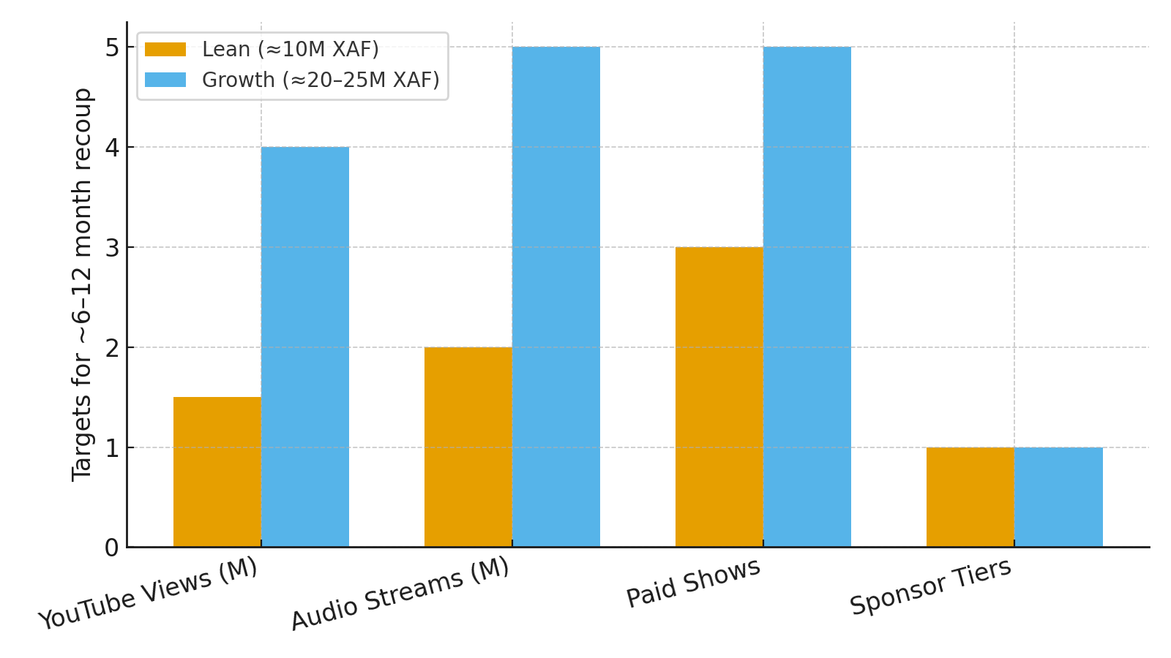
Cameroon Music Investment — 1‑Page Case
Budget ladders, KPI targets, and an ROI path for breakout-ready Cameroonian artists
Thesis
Fund a repeatable system: content cadence → measurable ads → creator engine → live → rights admin.
Budget ladders (XAF)
Lean ≈ 10M: 2 singles, 1 flagship video, focused ads, micro‑influencers, showcase.
Growth ≈ 20–25M: 3 singles, 2 videos, TikTok creator wave, PR/radio, mid‑cap live + sponsor.
KPI targets & ROI window
Lean: ~1.5M YT views, ~2M streams, 2–3 paid shows, 1 sponsor → recoup in ~6–12 months.
Growth: ~4M YT views, ~5M streams, 4–6 shows, 1 sponsor → recoup in ~6–12 months.
Strategy stack
Pick artists by traction (charts/Shazam), lock fair 24–36m master splits.
Two‑video cadence per single + 12–20 short‑form edits.
Creator seeding across Cameroon + FR/BE/CH diaspora; weekly prompts.
RBT + radio plugger + measurable codes; own one signature live moment.
Rights hygiene: SONACAM, neighboring rights, YouTube CID, clean metadata.
Hidden gems & next steps
RBT still cashy when bundled with radio/street; under‑administered rights = found money.
Own recurring event IP (mid‑cap) rather than one‑offs; capture high‑quality live content.

