Slide 1

Breast Cancer Wisconsin (Diagnostic) Dataset to Predict Cancer Diagnosis Based on Cell Features
Project Progress
Atena Rashidi

Slide 2
Agenda
Introduction
Methodology
Results
Summary
Content
I. Introduction
1. Project Description
2. Dataset
II. Methodology
1. Data Preparation
1.1. Correlation Chart for Means and Standard Error
1.2. Splitting the dataset into the training sample and the testing sample
1.3. Coefficients and p-values
2. Breast Cancer Data with Fitting Several Models
2.1. Fitting a model using Generalize Linear Model/Logistic Regression function
2.2. Fitting a model using LDA and QDA
2.3. Fitting a model using Gradient Boosting
2.4. Fitting a model using KNN
2.5. Fitting a model using Decision Tree
2.6. Fitting a model using MLP
2.7. Fitting a model using Random Forest
2.8. Fitting a model using SVM
III. Conclusion
IV. References

Slide 3
Project Description
Introduction
Methodology
Results
Summary
Cancer occurs as a result of :
Mutations
Abnormal changes
in the genes, responsible for regulating the growth of cells and keeping them healthy
A tumor can be:
Benign (not dangerous to health)
Malignant (has the potential to be dangerous).
Breast cancer is: an uncontrolled growth of breast cells, referring to a malignant tumor that has developed from cells in the breast.
This project aims: to detect breast cancer by predicting whether a tumor is benign or malignant.

Slide 4
Dataset
Introduction
Methodology
Results
Summary
Breast Cancer Wisconsin (Diagnostic) Dataset:
Created by Dr. William H. Wolberg from General Surgery Department
W. Nick Street and Olvi L. Mangasarian from Computer Sciences Department in University of Wisconsin
Features are computed from a digitized image of a fine needle aspirate (FNA) of a breast mass.
They describe characteristics of the cell nuclei present in the image.
id | diagnosis | radius_mean | … | radius_se | area_worst | concavity_worst
842302 | M | 17.99 | … | 1.095 | 2019 | 0.7119
842517 | M | 20.57 | … | 0.5435 | 1956 | 0.2416
84300903 | M | 19.69 | … | 0.7456 | 1709 | 0.4504
84358402 | M | 20.29 | … | 0.7572 | 1575 | 0.4
843786 | M | 12.45 | … | 0.3345 | 741.6 | 0.5355
… | … | … | … | … | … | …

Slide 5
Dataset
Introduction
Methodology
Results
Summary
Attribute Information:
1) ID number
2) Diagnosis (M = malignant, B = benign)
3-32)
Ten real-valued features are computed for each cell nucleus:
a) radius (mean of distances from center to points on the perimeter)
b) texture (standard deviation of gray-scale values)
c) perimeter
d) area
e) smoothness (local variation in radius lengths)
f) compactness (perimeter² / area - 1.0)
g) concavity (severity of concave portions of the contour)
h) concave points (number of concave portions of the contour)
i) symmetry
j) fractal dimension ("coastline approximation" - 1)
These features are selected for model fitting: CT, UCSize, UCShape, MA, SECS, BC, NN, and M.

Slide 6
Data Preparation
Introduction
Results
Summary
Methodology
First, necessary libraries will be loaded
The dataset will be read from the URL Breast Cancer data from Wisconsin.
Then the dataset will be cleaned of the id column and column with “?” values.
Then the data type will be checked.
All the data type is integer but diagnosis.
So, the target, which is diagnosis of Benign or Malignant should change to a dummy variable, named outcome.
Notes:
Our custom dataset consists of extracted frames of these videos which have been manually annotated using the Image Annotation Tool – LabelImg which is a free and open source tool software

Slide 7
Data Preparation
Introduction
Results
Summary
Methodology
- Correlation Chart for Means and Standard Error
Correlation for mean
Correlation for standard error

Slide 8
Model Fitting
Introduction
Results
Summary
Methodology
Fitting a model using Generalize Linear Model/Logistic Regression function
The area under the ROC curve is called as AUC -Area Under Curve. AUC ranges between 0 and 1 and is used for successful classification of the logistics model.
 | Training Sample | Testing Sample | AUC for Testing Samples | AUC for Testing Samples
Model Accuracy | 0.957 | 0.934 | 0.983 | 0.934
y.test logit.pred | 0: Real-Benign | 1: Real-Malignant
Predicted-Benign | 218 | 7
Predicted-Malignant | 9 | 116
logit.test.error | 0.04571429
train | test

Slide 9
Model Fitting
Introduction
Results
Summary
Methodology
Fitting a model using LDA and QDA
LDA-Confusion Matrix
QDA-Confusion Matrix
y.test logit.pred | 0: Real-Benign | 1: Real-Malignant
Predicted-Benign | 222 | 13
Predicted-Malignant | 5 | 110
lda.test.error | 0.05142857
y.test logit.pred | 0: Real-Benign | 1: Real-Malignant
Predicted-Benign | 216 | 3
Predicted-Malignant | 11 | 120
qda.test.error | 0.04
K-fold=5
K-fold=5
Mean of lda.test.error | 0.04722508
Mean of qda.test.error | 0.05434738

Slide 10
Model Fitting
Introduction
Results
Summary
Methodology
3. Fitting a model using Gradient Boosting
The gradient boosting is done for 10000 trees in every 100 trees. The results are as follows:
Mean squared test error for each of the 100 trees averaged:
100 | 200 | 300 | 400 | 500 | 600
0.05962488 | 0.03113548 | 0.02437623 | 0.02175681 | 0.02042129 | 0.01921702

Slide 11
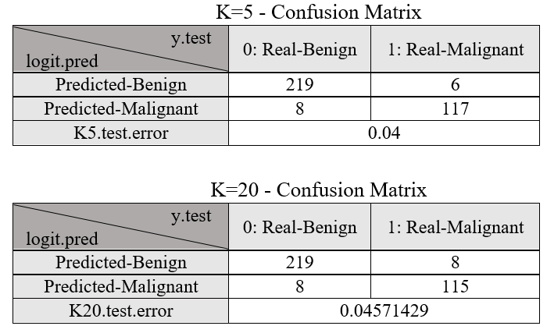
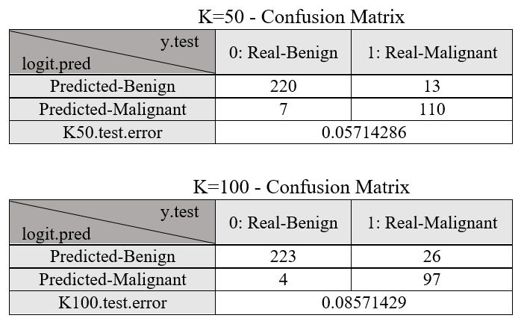
Model Fitting
Introduction
Results
Summary
Methodology
4. Fitting a model using KNN
KNN method is applied for k = 5, 20, 50, and 100.

Slide 12
Model Fitting
Introduction
Results
Summary
Methodology
5. Fitting a model using Decision Tree
In this step, a decision tree model is fitted and because M and B should be classified, it is a classification tree problem.
Classification tree:
tree(formula = outcome ~ UCSize + UCShape +
MA + SECS + BC + NN + M, data = training)
Variables actually used in tree construction:
[1] "UCSize" "BC" "UCShape" "SECS" "M"
Number of terminal nodes: 8
Residual mean deviance: 0.2197 = 74.93 / 341
Misclassification error rate: 0.04011 = 14 / 349

Slide 13
Model Fitting
Introduction
Results
Summary
Methodology
To show the importance of the components, PCA is calculated.
Importance of components: CT, UCSize, UCShape
PC1 PC2 PC3 PC4 PC5 PC6 PC7 PC8
Standard deviation 2.2975 0.86438 0.73405 0.63905 0.61290 0.54618 0.51251 0.3007
Proportion of Variance 0.6598 0.09339 0.06735 0.05105 0.04696 0.03729 0.03283 0.0113
Cumulative Proportion 0.6598 0.75322 0.82057 0.87162 0.91858 0.95586 0.98870 1.0000

Slide 14
Model Fitting
Introduction
Results
Summary
Methodology
To show the importance of the components, PCA is calculated.
In this step, the tree is prune to avoid over fitting. Seems like a tree of size 3 might be best
.

Slide 15
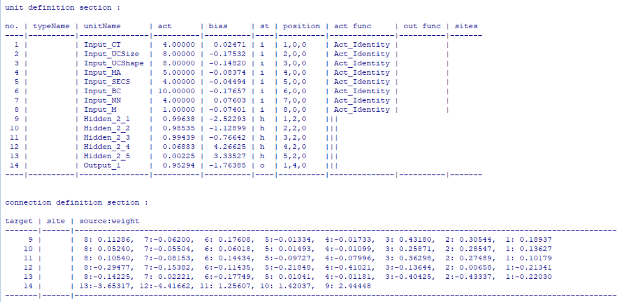
Model Fitting
Introduction
Results
Summary
Methodology
6. Fitting a model using MLP

Slide 16
Model Fitting
Introduction
Methodology
Results
Summary

Slide 17
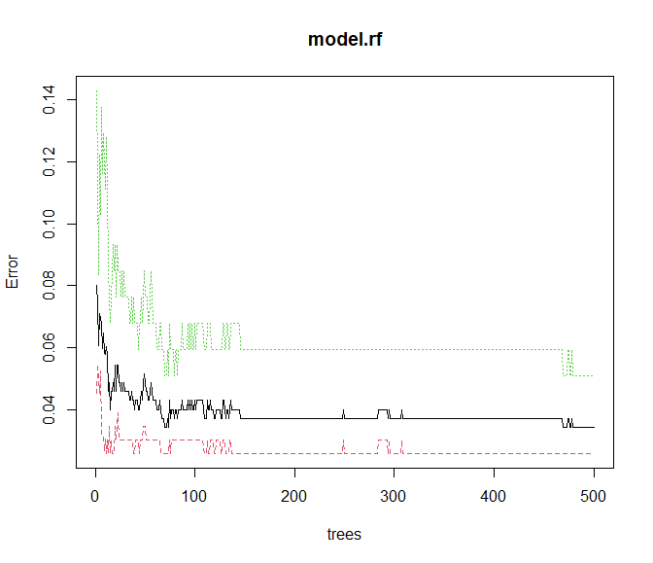
Model Fitting
Introduction
Methodology
Results
Summary
7.Fitting a model using Random Forest
7.Fitting a model using Random Forest
Type of random forest: classification
Number of trees: 500
OOB estimate of error rate: 3.72%
Confusion Matrix
y.test logit.pred | 0: Real-Benign | 1: Real-Malignant
Predicted-Benign | 223 | 8
Predicted-Malignant | 4 | 115
rf.class.error → 0 | 0.02597403
rf.class.error → 1 | 0.05084746
error | 0.0429

Slide 18
Model Fitting
Introduction
Methodology
Results
Summary
8. Fitting a model using SVM
Based on the principle component analysis (PCA), and important features in ransom forest the important components:
CT
UCSize
Therefore, the support vector classifier and support vector machine are fitted to the dataset based on these two features.
Fit Support Vector Classifier using a linear kernel
Fit Support Vector Classifier using a linear radial

Slide 19
Model Fitting
Introduction
Results
Summary
Methodology
Fit Support Vector Classifier using a linear kernel
Parameter tuning of ‘svm’: - sampling method: 10-fold cross validation - best parameters: cost = 10 - best performance: 0.04882353 - Detailed performance results: cost error dispersion 1 1e-03 0.33781513 0.08510982 2 1e-02 0.08042017 0.03335581 3 1e-01 0.06025210 0.02143562 4 1e+00 0.05739496 0.02368248 5 5e+00 0.05168067 0.02984278 6 1e+01 0.04882353 0.03061933 7 1e+02 0.04882353 0.03061933

Slide 20
Introduction
Results
Summary
Methodology
Fit Support Vector Classifier using a linear radial
cost = 0.1 gamma = 4
Parameter tuning of ‘svm’:
- sampling method: 10-fold cross validation
- best parameters: cost = 0.1 gamma = 4
- best performance: 0.04008403
- Detailed performance results:
cost = 1000 gamma = 1
Error: 0.06016807
Error: 0.04008403

Slide 21
Results
Introduction
Results
Summary
Methodology
To find out the best methodology, the accuracy of different approaches after data preparation is calculated. - - Among all these methods:
First, gradient boosting with 0.01921702 error
Second, SVM → linear had the lowest error with the best cost of 10 and the best error performance of 0.04882353.

Slide 22
Summary
Introduction
Results
Summary
Methodology
- To predict whether the cancer is Benign or Malignant a classification problem should be solved.
- After data preparation, several models applied to the dataset such as:
Generalize Linear Model
Logistic Regression
Gradient Boosting Classifier
Random Forest Classifier
Decision Tree Classifier
K Neighbors Classifier
Support Vector Machine classifier
MLP Classifier
- Gradient boosting with 0.01921702 error

Slide 23

Thank you for your attention!

