Slide 1
Digital Democracy
by Anna Terebus

Slide 2
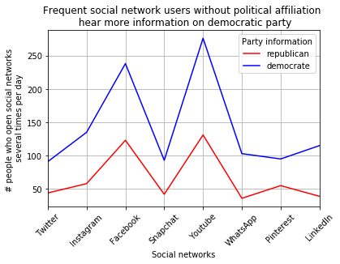
Inspiration
Data:
Survey of people's attitude towards the Internet
https://www.pewinternet.org/dataset/jan-3-10-2018-core-trends-survey/
Is it true that there are so much more tweets from Democrats?

Slide 3
Goal
Create evaluation tool for number of political supporters of political candidates in the countries where there are binary political preferences.
Public opinion monitoring: which group expresses more explicit reaction to current political and social events: elections, new laws, new policies etc.
Future applications: study the effect of social networks to political decision making in elections, find if social network activity affects election results.

Slide 4
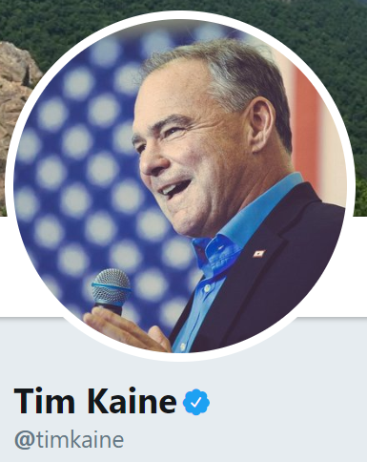
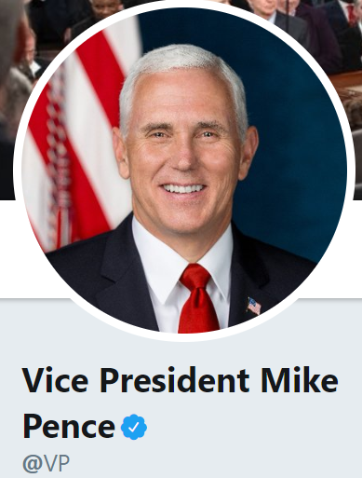
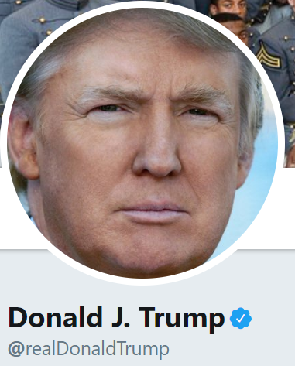
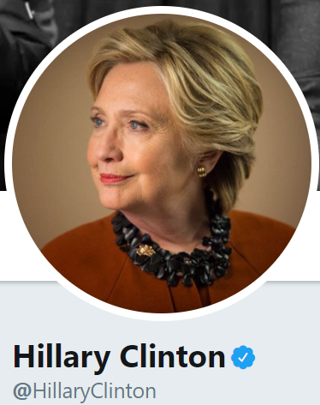
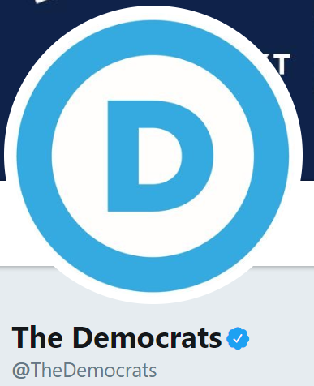

Training DATA: 17,298 tweets
Tweets from
Democrats
Tweets from
Republicans

Slide 5
Model
Text processing: cleaned up the raw tweet text using the nltk package.
Eliminate the rare words.
Feature construction: constructed bag-of-words feature vectors and training labels from the processed text of tweets.
Classification:
Support Vector Machine

Slide 6
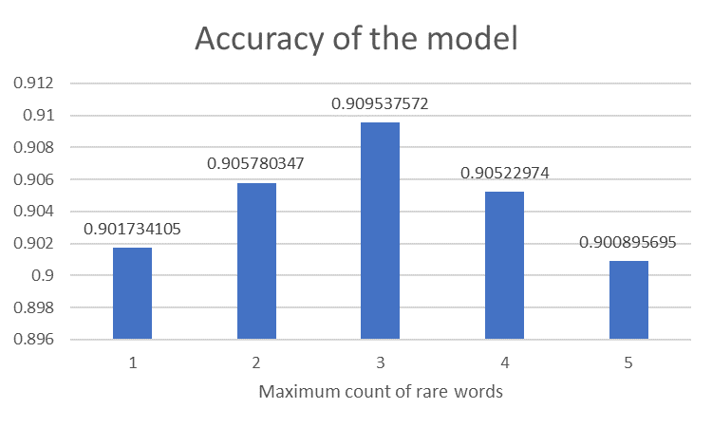
Model accuracy Improvement with eliminating rare words
The best accuracy is
achieved when
we eliminated words that
occurred three and
less times

Slide 7
Prediction of political affiliations of people who tweeted in the past two weeks
#Trump
1,355 Democrats,
593 Republicans.
#abortion
2,089 Democrats,
665 Republicans.
#GameOfThrones
192 Democrats,
63 Republicans.
#Coffee
19 Democrats,
35 Republicans.

