Slide 1
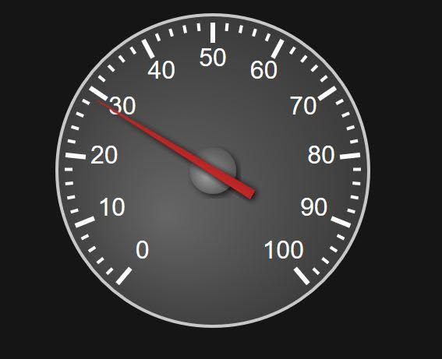
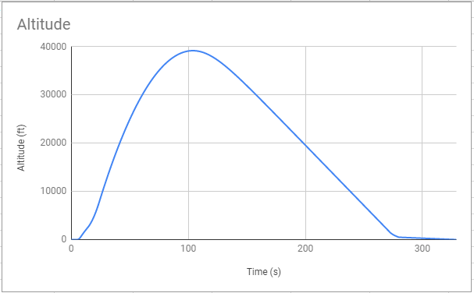
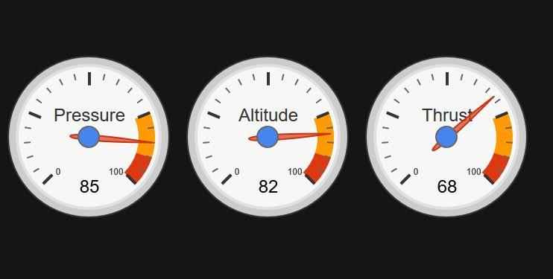
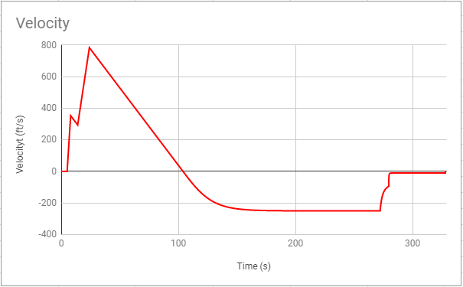
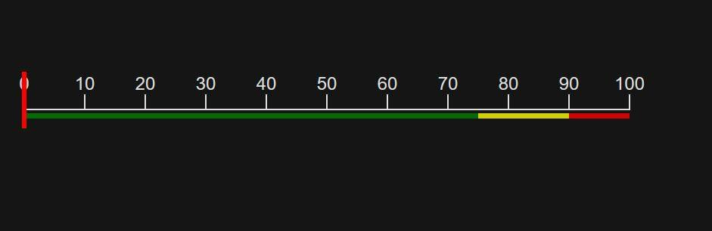
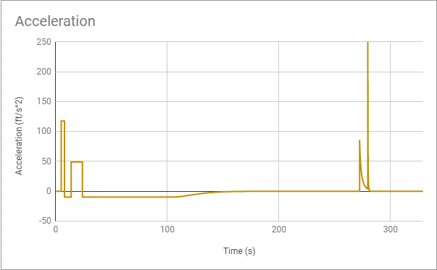
11
HART CS Groundstation
Data Storage and Access
Applying a Kalman Filter live telemetry from a two-stage solid propellant Student Researched and Developed rocket motors, and visualizing the flight path with WebGL.
Kalman Filter
Describe the server configuration
Describe data reception and storage techniques
Hardware details
If necessary, pad with miscellaneous info
What a Kalman Filter is
How we implemented it
Technical details
Challenges encountered?
(Webclient GUI screenshots)
(Split left/right: 2d/3d elements?)
(Kalman Filter Input/Output graphs)
2-dimensional Visualization
3-dimensional Visualization
Describe the design and development of dials, guages, and other 2-dimensional elements used to display singular variables
Describe the design and development of the 3-dimensional trajectory visualization

